Slide 1
Quillen ETSU Physicians
Allscripts Touchworks - The Basics
Clinical Staff and Provider Training Module
Quillen EHR Team
Phone: (423) 282-6122, Option 1
May 2021

Slide 2
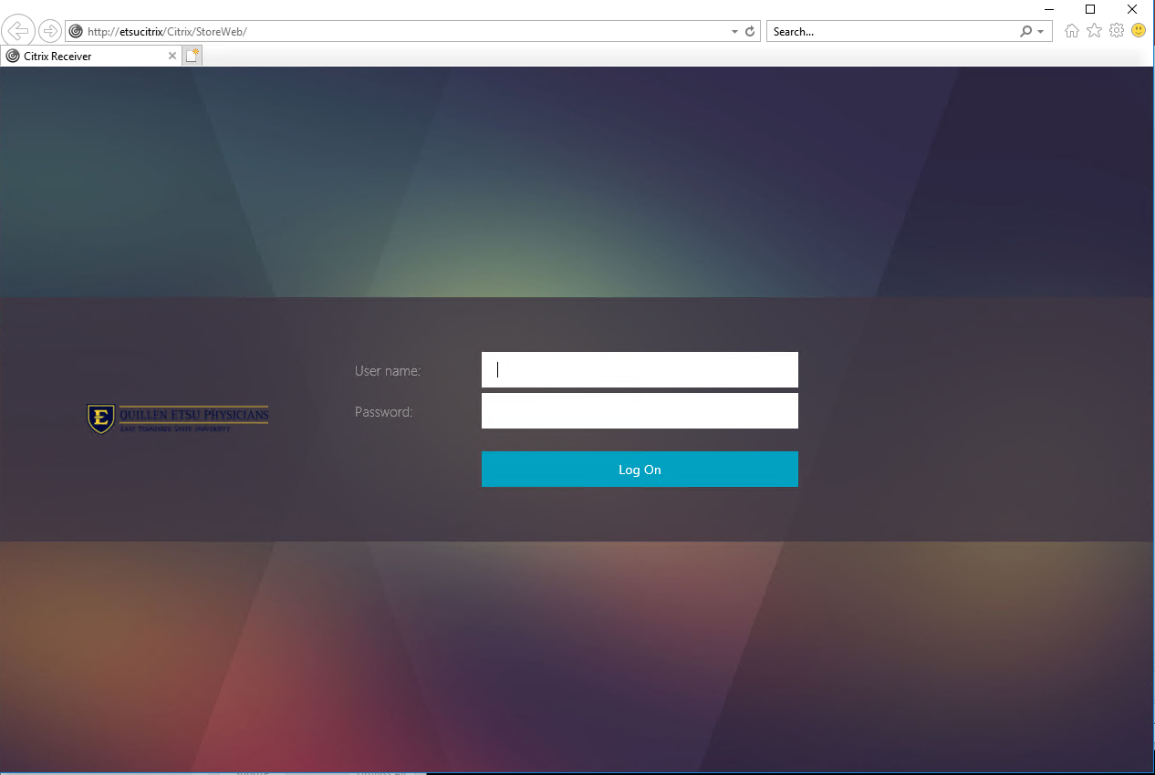
Logging In
If you are an on-boarding provider that needs EPCS-enrollment for controlled substances, a member of the EHR team will help you enroll, set up your security account, and log in.
Logging into Allscripts is a two-step process, first into the server (Citrix), and then into Allscripts.
Each clinic computer should have a shortcut set up for logging into Citrix. Double click on the icon to access the Citrix login screen.

Slide 3
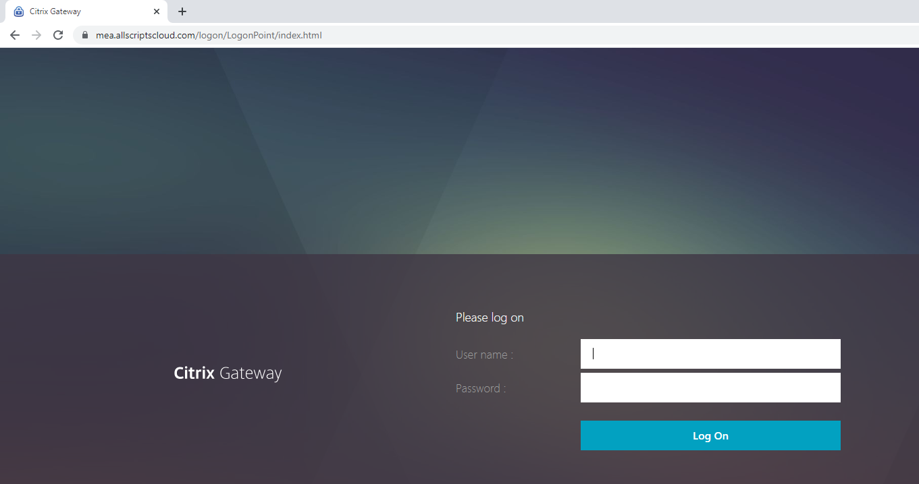
Logging In from Home
If on a personal device, download Citrix Workspace from
https://www.citrix.com/downloads/workspace-app/
Once downloaded, go to https://mea.allscriptscloud.com on Chrome or Safari and log into Citrix

Slide 4
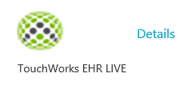
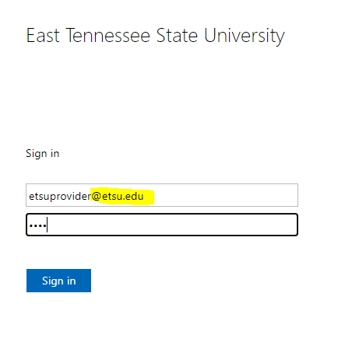
Logging In
Click the TouchWorks EHR LIVE icon.
This is called the federation page. Log into ETSU domain again using your full email address and password.

Slide 5
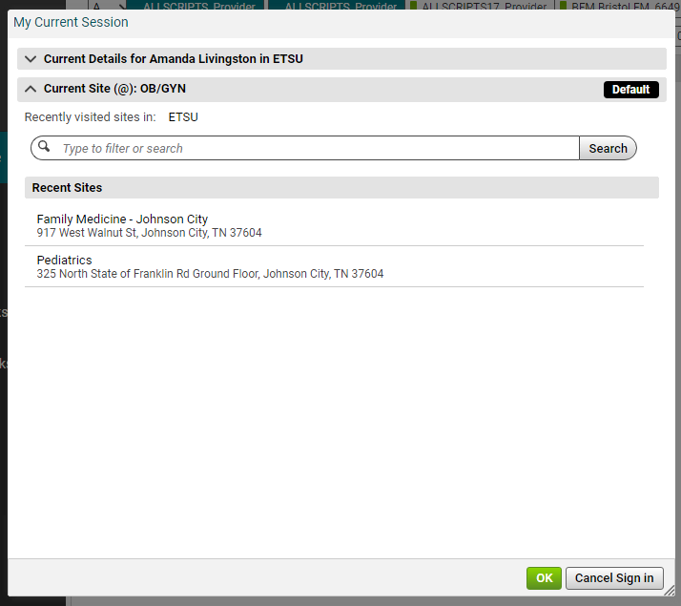
My Current Session
Always log into the correct site or location.
You MUST select the correct location.
Current Site shows site currently selected.
You can make a site your Default.
Use your Search box to look for a new site or location.

Slide 6
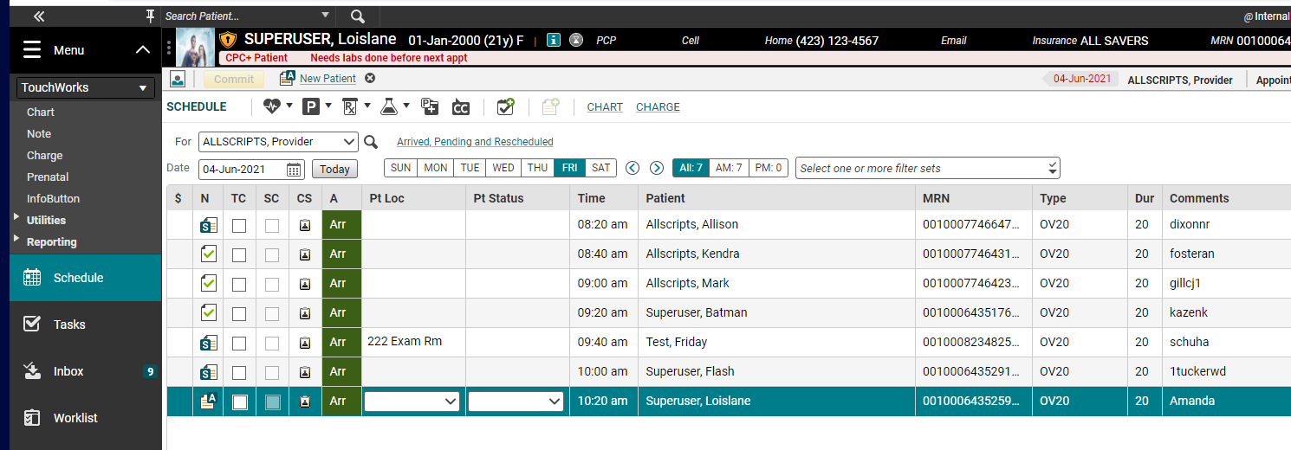
Schedule
The magnifying glass allows you to pull up another provider’s schedule
Jumps forward/backward a week at a time
Click on days of the week or the calendar icon to navigate to another date
When you first log in, you will land on the Schedule. You can pull in other providers’ schedules by clicking on magnifying glass and searching by last name. The schedule defaults to the current date, but you can navigate to other dates by clicking on the days of the week, the calendar icon, or using the arrows to jump forward/backward a week at a time.

Slide 7
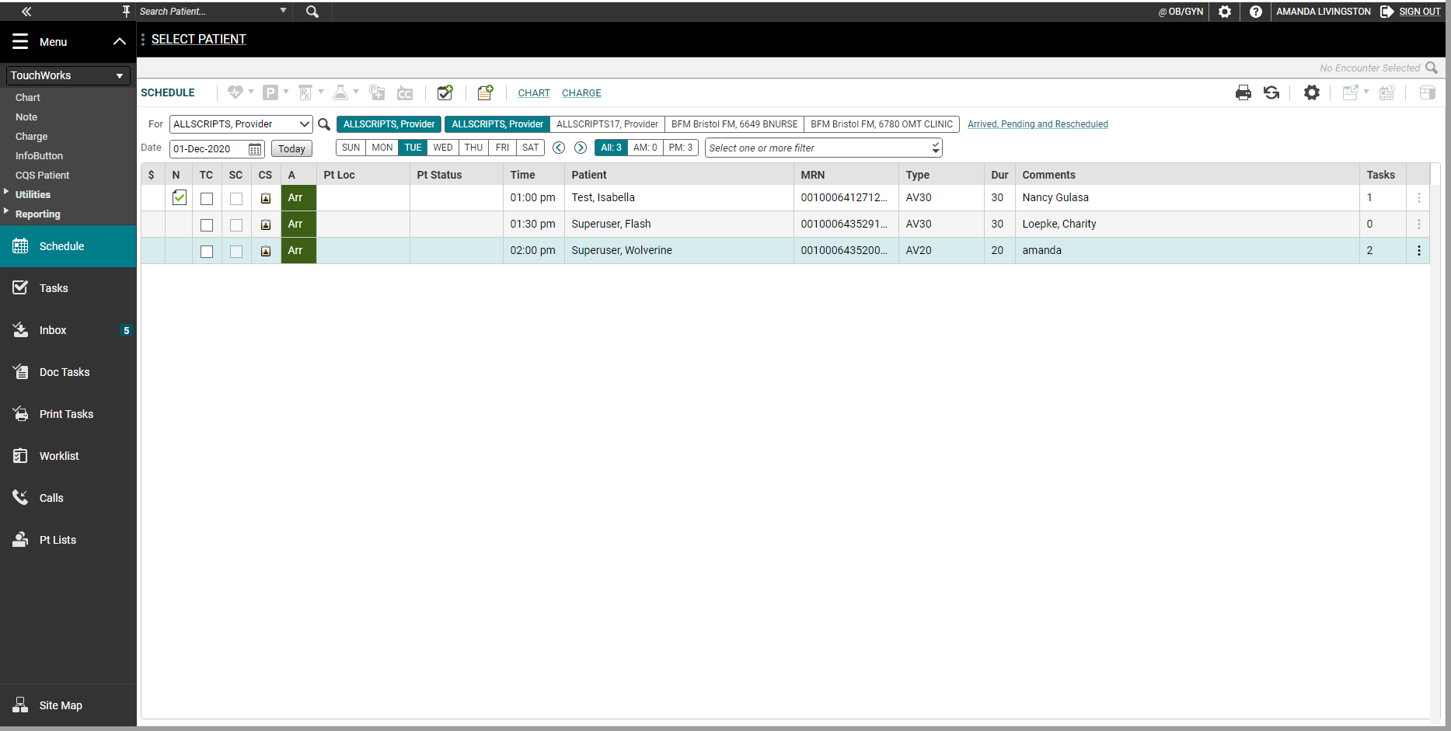
Action Bar
The action bar is a menu-based navigational tool you use to access workspaces in Allscripts TouchWorks® EHR that are available to you. It is located on the left.
You can minimize or maximize .
The push pin icon will “pin” a menu into place throughout Touchworks.
You can access all pages in the Site Map.

Slide 8
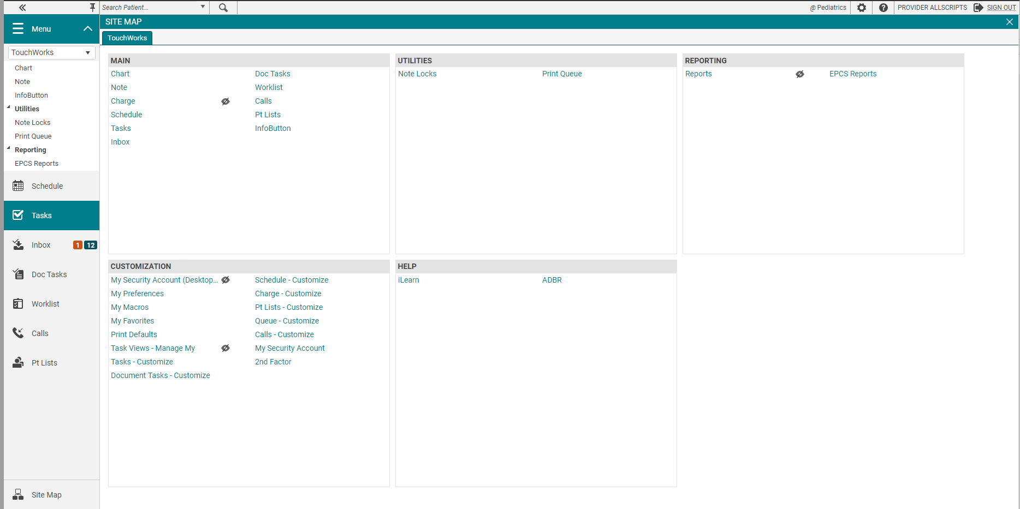
Site Map
The Site Map shows you the pages you have available. We recommend only showing the workspaces you use daily. You can also navigate to your pages from here.
External links like CSMD, EHR website, Opioid Documents will be located in the HELP section on the Site Map.

Slide 9
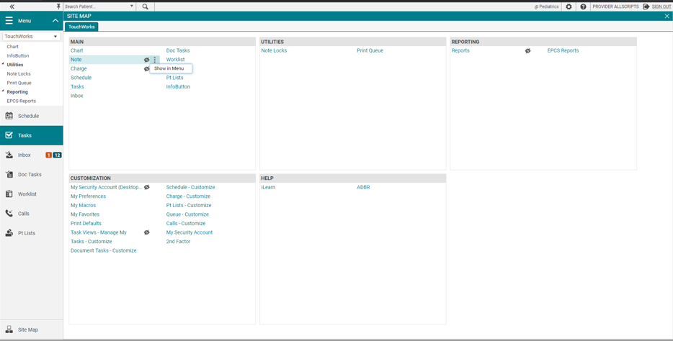
Hiding and Showing Pages
The hidden from menu icon is displayed next to hidden pages. These pages aren’t shown in the Action Bar.
To show a page in the Action Bar, Click the options icon and select Show in Menu.
You can hide pages too.

Slide 10
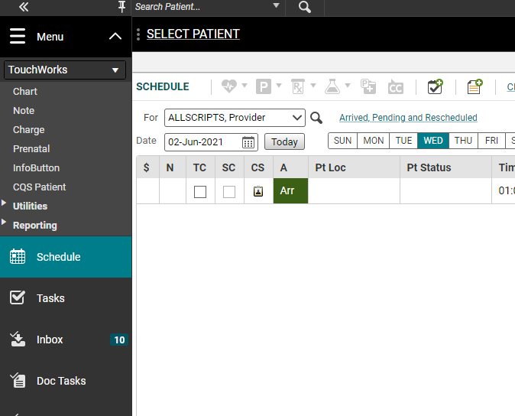
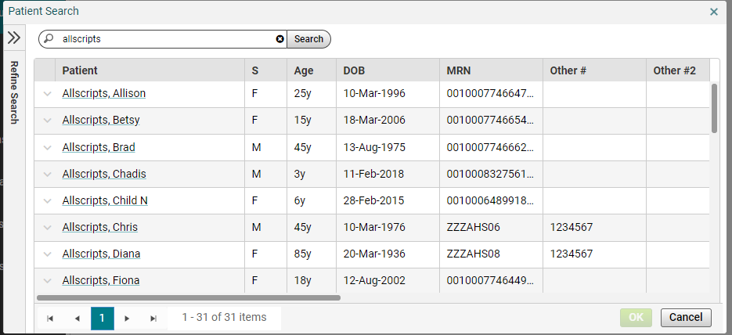
Search for a Patient
If searching for a patient not on a schedule, click the magnifying glass.
Search by last name or date of birth. Select the correct patient and click OK.

Slide 11
Schedule
Patient Banner
A single click on the patient’s name pulls them into context and displays their name/demographic info in the Patient Banner.
A double click on the patient’s name takes you to their chart.

Slide 12
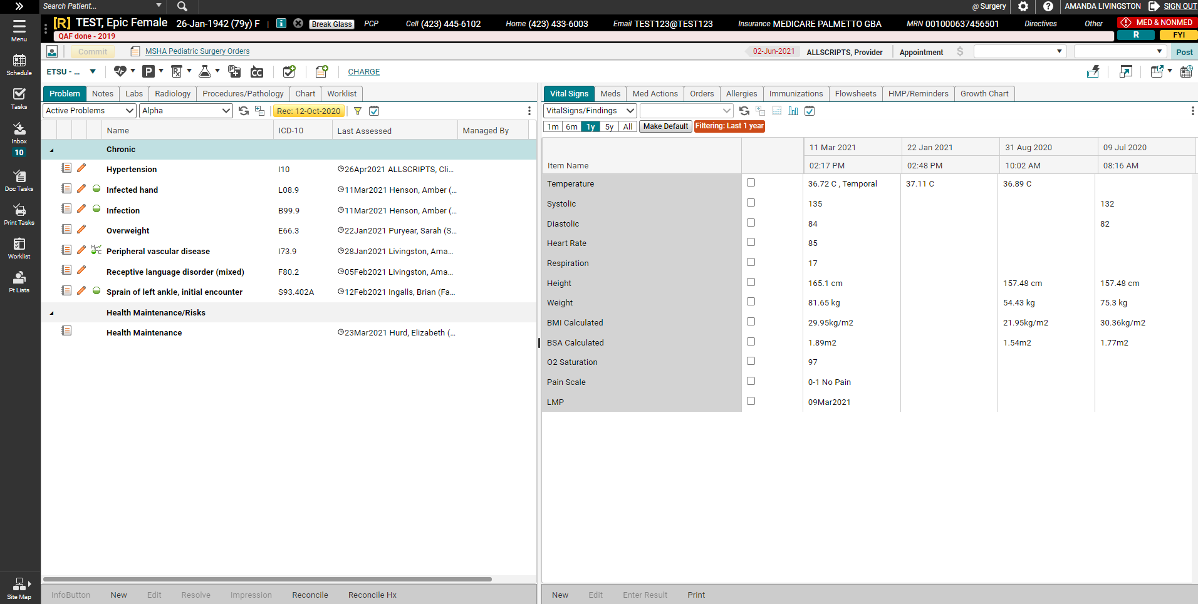
Chart
“Clinical Toolbar”
This is where you add information to the chart
“Patient’s Chart”
This is where you view information in the chart
Click on the icons underneath the Patient Banner to ADD information to the patient’s chart.
The two panels underneath the Clinical Toolbar is where you can view the information that is already in the patient’s chart.
Notes:
Click on the icons underneath the Patient Banner to ADD information to the patient’s chart.
The two panels underneath the Clinical Toolbar is where you can view the information that is already in the patient’s chart.

Slide 13
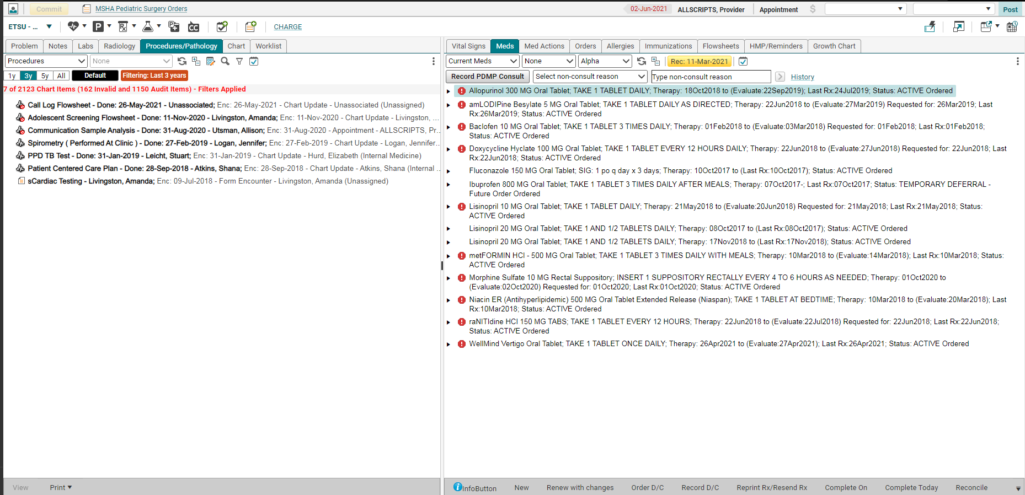
Viewing the Chart
Click on the various tabs to view the patient’s problem list, notes, labs, procedures, and radiology.
This side of the chart contains the vitals, medications, orders, allergies, immunizations, and growth chart.
The toolbar gives you options to resolve problems, print/fax notes, and view/print drug education, etc.
Click on the tabs at the top of each section to view various parts of the chart: the Problem List, Notes, Labs, Procedures, Radiology, and the entire Chart, including administrative paperwork. The second panel has the Vital Signs, Medications, Orders, Allergies, and Immunizations.
Notes:
Click on the tabs at the top of each section to view various parts of the chart: the Problem List, Notes, Labs, Procedures, Radiology, and the entire Chart, including administrative paperwork. The second panel has the Vital Signs, Medications, Orders, Allergies, and Immunizations.

Slide 14
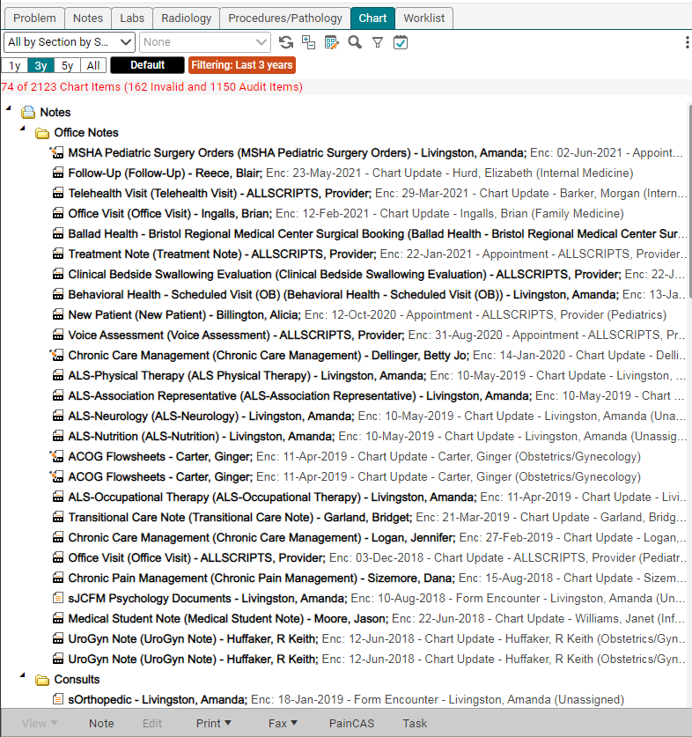
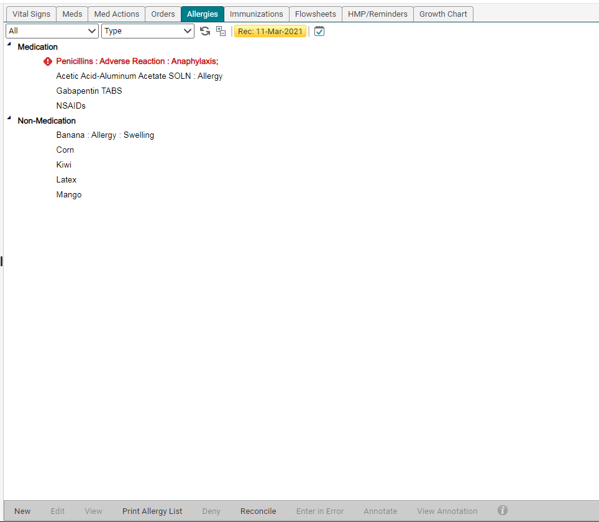
Viewing the Chart
Sorts/Filters: Most of the tabs also have a variety of sort options and filters from which you can choose, in order to find items more quickly. The sort options are underneath the main tab.
Generally, double clicking on an item allows you to view it. Single clicking (highlighting) an item activates the toolbar, which gives you options for printing, faxing, etc.
Each tab contains different items. Most of the tabs have a variety of sort options and filters from which you can choose in order to find items more quickly. Right clicking on an item opens a menu that expands the options available. This includes resolving problems, editing notes, annotating, and reviewing audit reports.
Notes:
Each tab contains different items. Most of the tabs also have a variety of sort options and filters from which you can choose in order to find items more quickly. Generally, double clicking on an item allows you to view it. Single clicking (highlighting) an item activates the toolbar, which gives you options for printing, faxing, viewing drug education, etc.

Slide 15
Charting
Entering information into the patient’s chart is done through the Clinical Toolbar.
Active Problems, History items (Past Medical, Family, Social Hx)
Medications, Medication Administration
Labs, Radiology, Procedures, Follow ups, Referrals, Education

Slide 16
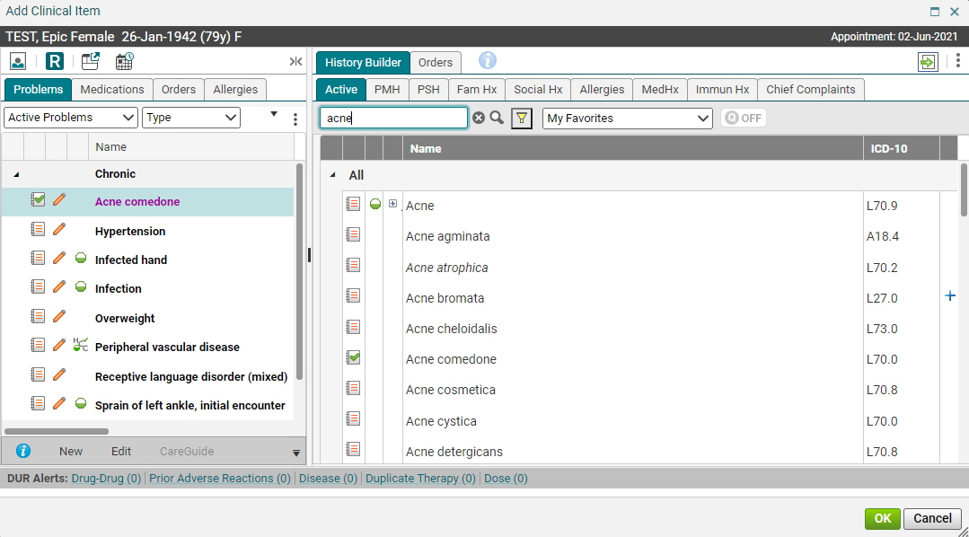
The ACI
Clicking the on the Clinical Toolbar opens the ACI (Add Clinical Item screen). The Active tab is where you will enter the patient’s new and current diagnoses.
This panel shows items that are already in the patient’s chart

Slide 17
Adding Active Problems
Search for an item
To add it to the patient’s chart, click on the name. This pulls it into the panel on the left. It will remain a pink color until the item is committed.

Slide 18
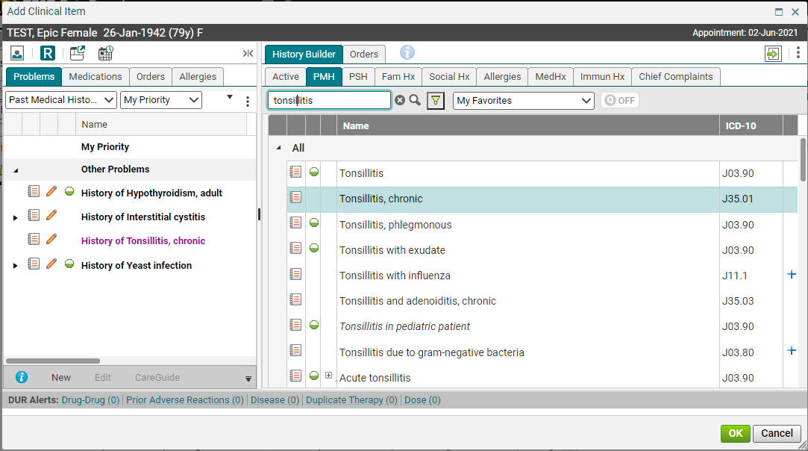
Adding History Items
Search field
Adding history items is just like adding active problems. Click on the appropriate tab and then type in the search field and click the binoculars (or hit “enter”). Find the item, and click to add to the chart.
PMH – Past Medical History
PSH – Past Surgical History
Med Hx – Medication History (Meds the patient states they are currently on, but which are not being prescribed by you or another ETSU Health provider.)
Immun Hx – Immunization History (Immunizations the patient has received in the past.)

Slide 19
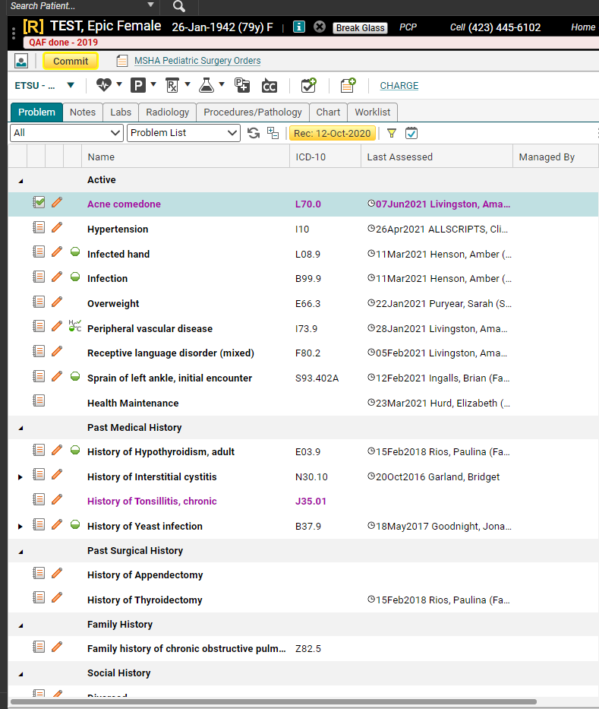
Saving (Committing)
Once you’ve added items to the patient’s chart, and have clicked OK to close the ACI screen, you need to Commit the items to save them.
Pink = Unsaved information
Black = Saved information
Commit often to avoid losing information!

Slide 20
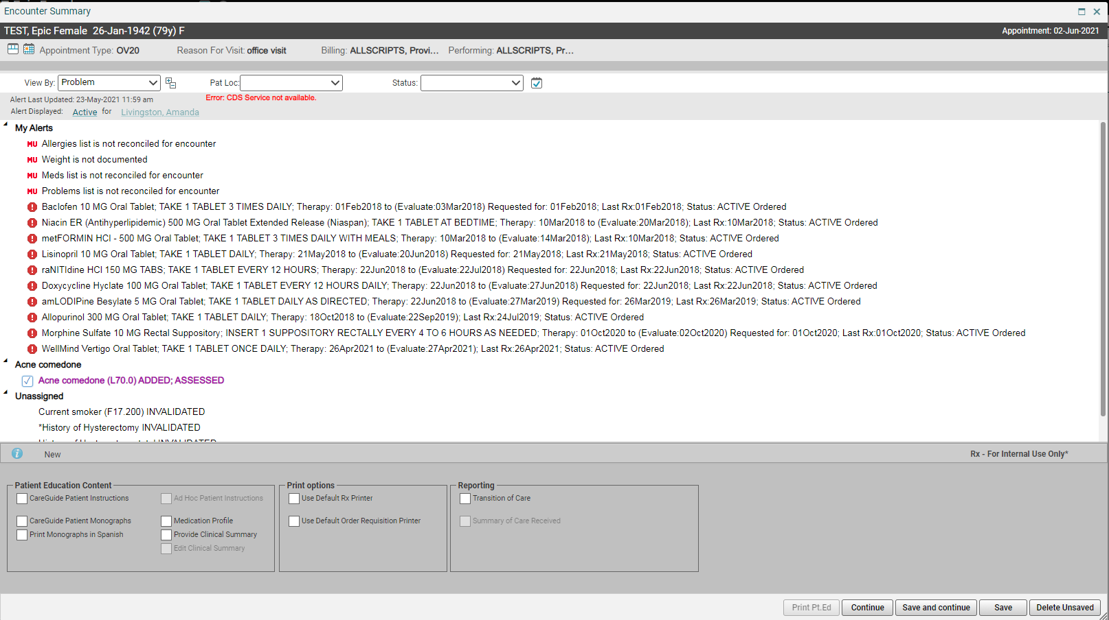
Saving (Committing)
The yellow Commit button prompts the Encounter Summary and enables the user to
Permanently save an item to the chart, but it also will allow a user to
Review new items, and
Delete items entered incorrectly.
Review new items
Providers (except for residents and FM) will not have the Encounter Summary automatically pop up.

Slide 21
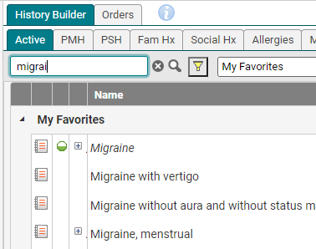
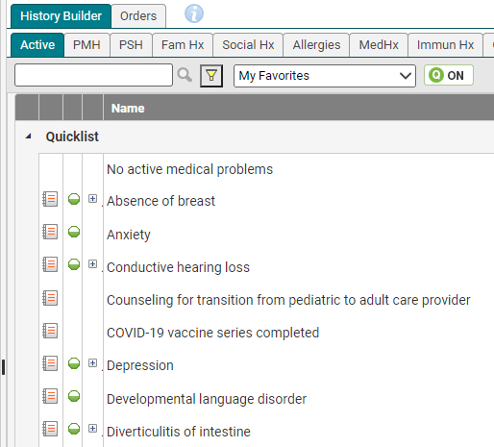
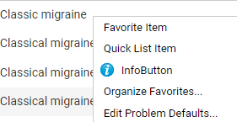
Favorites and Quick lists
You can create favorites and quick lists for items that you use often.
Favorites – as you type in the search field, items that you have saved as a favorite pull up.
If you still don’t see what you are looking for, hit “enter” or click the binoculars icon to pull up the Master list
The Quick list will populate as soon as you click on the tab. These are items that you use every day. It is recommended that you keep this list as short as possible, so you can find these items quickly.
Note: Your Quick list button must be “on” in order to see these items
To add an item as either a favorite or a quick list, right click on it and choose Favorite Item or Quick list Item

Slide 22
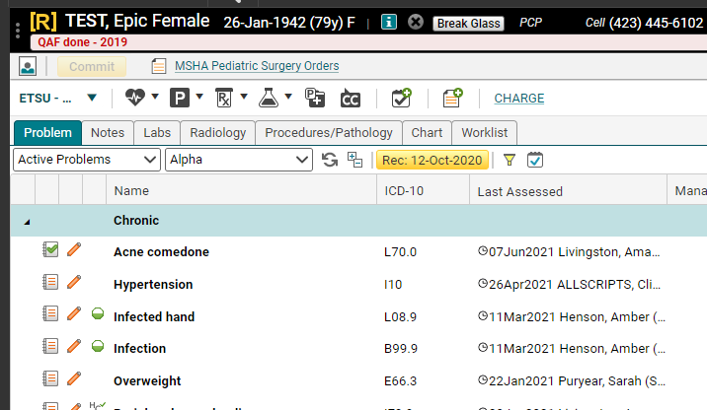
Starting A Note
To start a note, ALWAYS double click on the patient’s name from the Schedule tab.
This links the note with the appointment date. (If you do not double click from the schedule, your vitals (and possibly other items) will not pull into your note)
Double clicking the patient’s name takes you to the Chart.
Click on the paper with the plus to start a note.

Slide 23
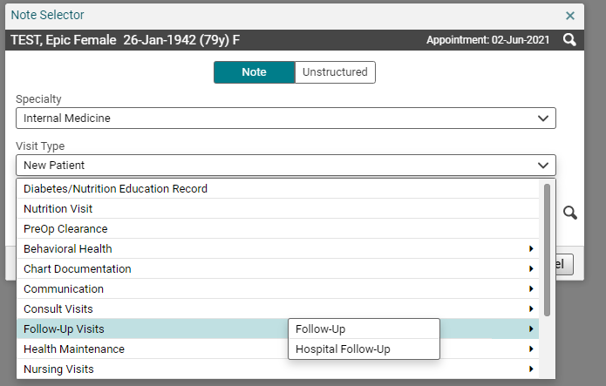
Starting A Note
In the Note Selector box, make sure your specialty is correct, and that your name is in the Owner field. Click the drop-down arrow next to the Visit Type field to choose the note type. (The note types will vary depending on your specialty). Click OK.

Slide 24
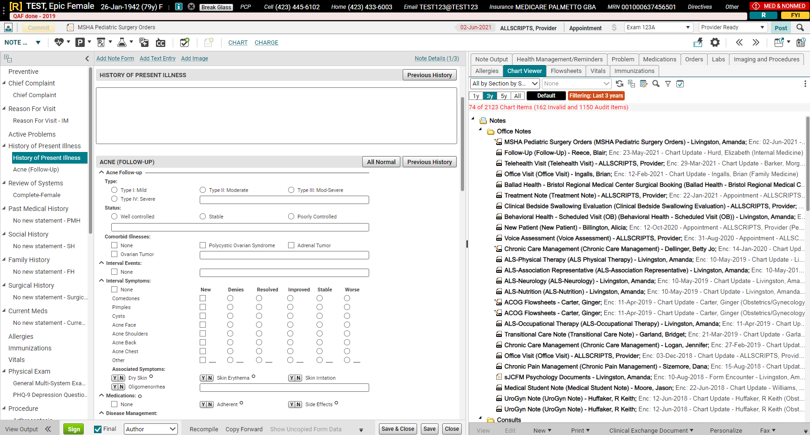
Notes
Table of Contents
Info from Chart
Note Input (Forms)
Table of Contents – Navigate through the note by clicking on the headings and forms in this panel (the forms are indented underneath the section headers).
Clhart– Patient’s chart – contains the same tabs as on the Chart page. Allows you to view items in the patient’s chart while in the note.
Note Input – As you click on section headings/forms in the Table of Contents, that section will open here, so you can document.
Notes:
Table of Contents – Navigate through your note by clicking on the headings and forms in this panel (the forms are indented underneath the section headers)
Clinical Desktop – Patient’s chart – contains the same tabs as on the Clinical Desktop tab. Allows you to view items in the patient’s chart while in the note
Note Input – As you click on section headings/forms in the Table of Contents, that section will open here, so you can document.
Note Accumulator Workspace (NAW) – As you click on forms/type in the boxes above, the text will display in this section.

Slide 25
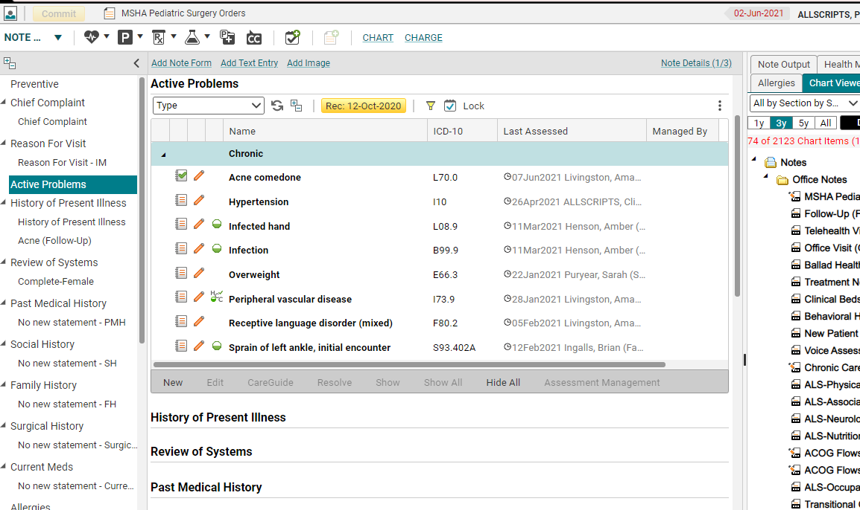
Notes - Autopopulation
Allscripts notes are set to auto populate certain sections from the patient’s chart. You can choose to hide/show specific items in these sections.
Sections which auto populate:
Active Problems
Past Medical History
Social History
Family History
Surgical History
Current Meds
Allergies
Immunizations
Vitals
Results/Data (Labs)
Assessment
Notes:
Allscripts notes are set to autopopulate certain sections within the note: the Active Problems (diagnoses), Past Medical Hx, Social Hx, Family Hx, Past Surgical Hx, Current Meds, Allergies, Immunizations, Vitals, Labs, and the Assessment, which pulls in active problems that have been assessed for the current visit. All of these sections will pull information from the chart into each note. You can choose to hide/show specific items in these sections.

Slide 26
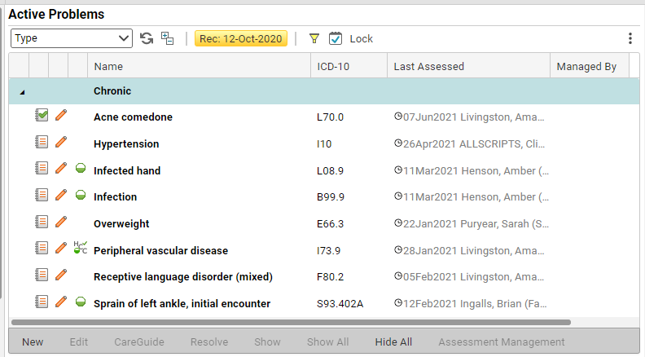
Notes – Hiding Autopopulated Items
If you do not wish these items to appear in your note, you CAN hide them. On the toolbar below each section, you can choose to Hide All/Show All, or Hide/Show individual items.
Notes:
If you do not wish these items to appear in your note, you CAN hide them. On the toolbar below each section, you can choose to Hide All/Show All, or Hide/Show individual items. Ctrl and click will highlight individual items which can be hidden/shown by clicking “Show or Hide.”

Slide 27
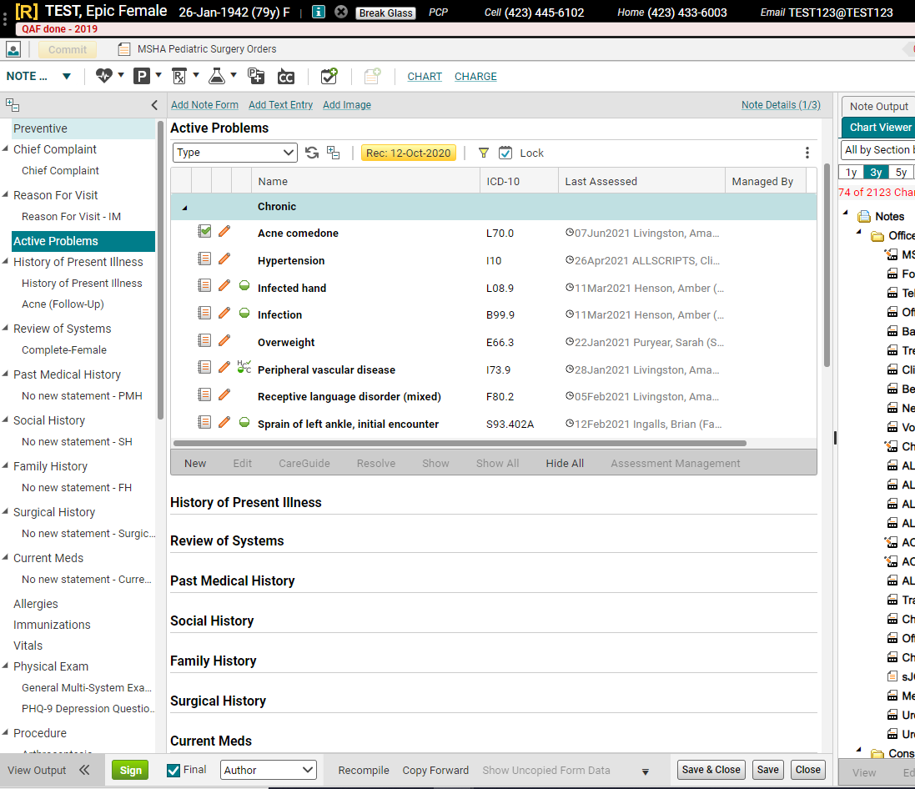
Notes - Signing
To sign your note, click the “Sign” button.

Slide 28
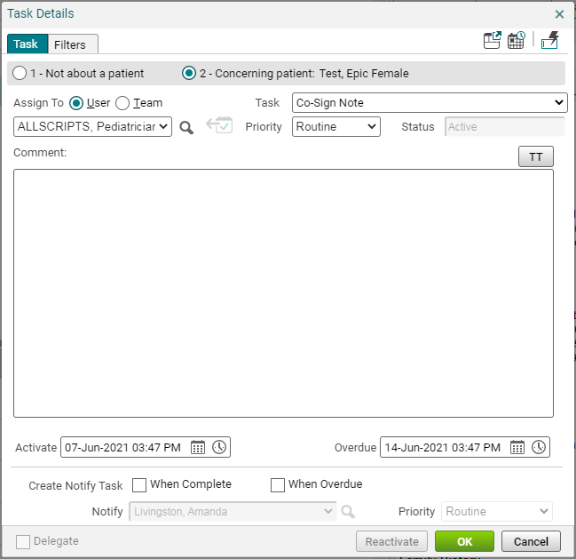
Notes – Co-Sign Note Task
If you are a resident or clinical staff, once you click OK, you will get a Co-Sign Note task box which prompts you to send the note to the co-signer for a final signature.

Slide 29
Notes – Co-Sign Note Task
Switch the radio button from Team to User, and if your co-signer is not in the drop-down list, click the magnifying glass button and search by their last name. Once you have pulled their name in, just click OK to send the task. You do not have to type anything in the Comment field.

Slide 30
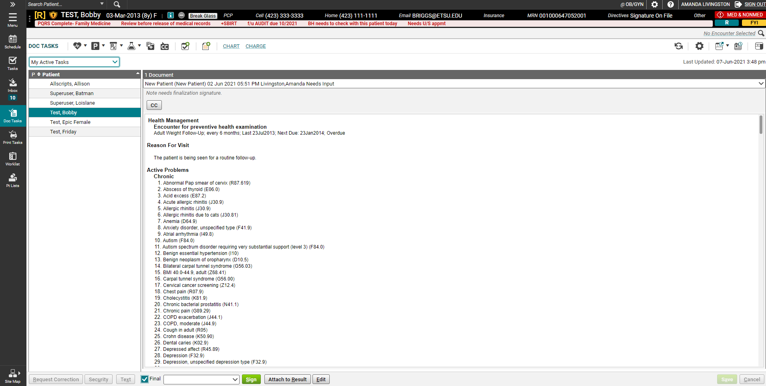
Doc Sign
The Doc Sign tab allows you to quickly sign off on your notes, review documents sent by other providers, and sign scanned results.

Slide 31
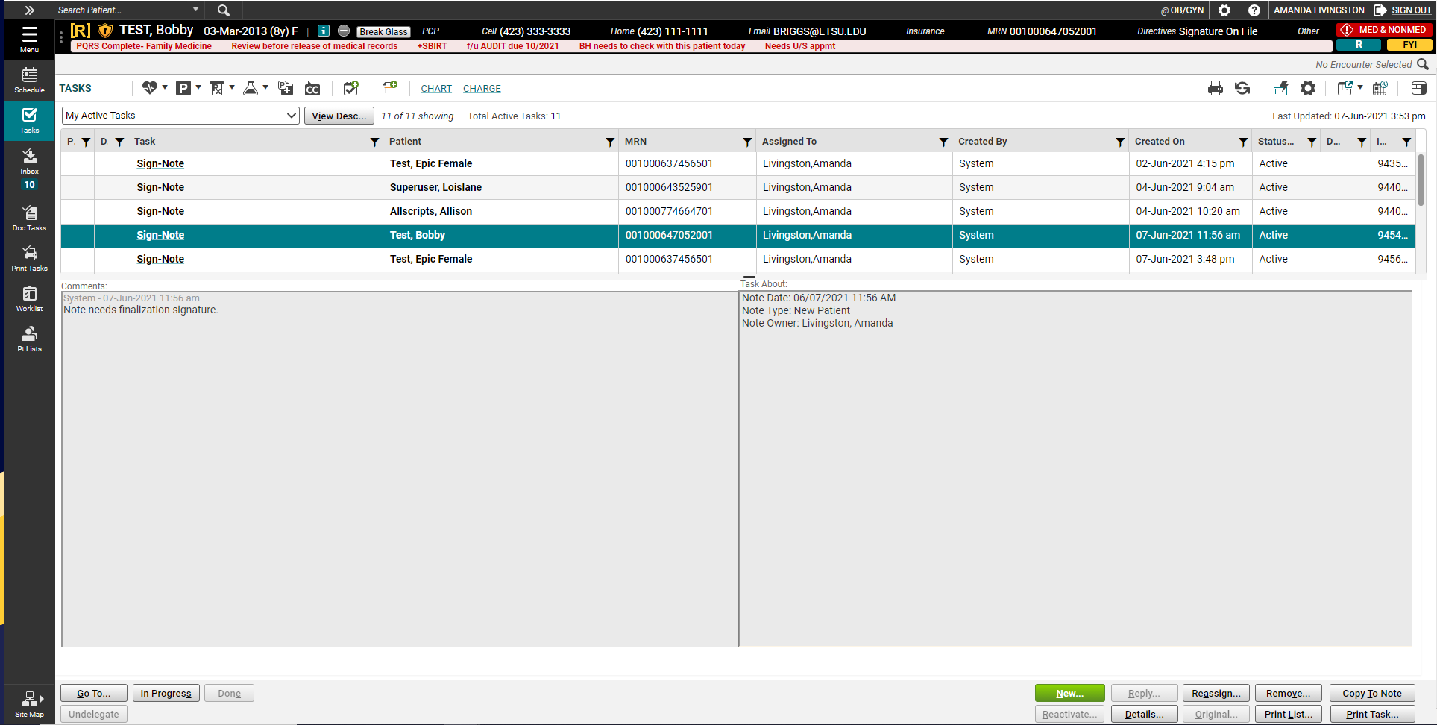
Tasks
Ask about your clinic’s policy regarding checking tasks on non-clinic days.
Tasks are how we communicate with each other about patient care. Tasks can be generated by the system, by a colleague, or by a patient.
Make sure to check your tasks every time you log into the system. Ideally, it should be checked when you first log in and again before you log out, to make sure that all issues have been handled before leaving the clinic.
Notes:
Ask about your clinic’s policy regarding checking tasks on non-clinic days.

Slide 32
Tasking
FMH Tasks
Manually Created
System Generated
System-generated tasks: These tasks pop in when workflows require completion; signing a note, renewing a medication, etc.
Manually created tasks: These tasks are sent by other employees in the office and are usually related to patient care – inquiries regarding test results, requests to return phone calls, etc.
FMH (Follow My Health) tasks: These are tasks sent by your patients via the Patient Portal (Follow My Health™). You need to respond to all FMH tasks within 48 hours at the latest. This is an organizational policy.

Slide 33
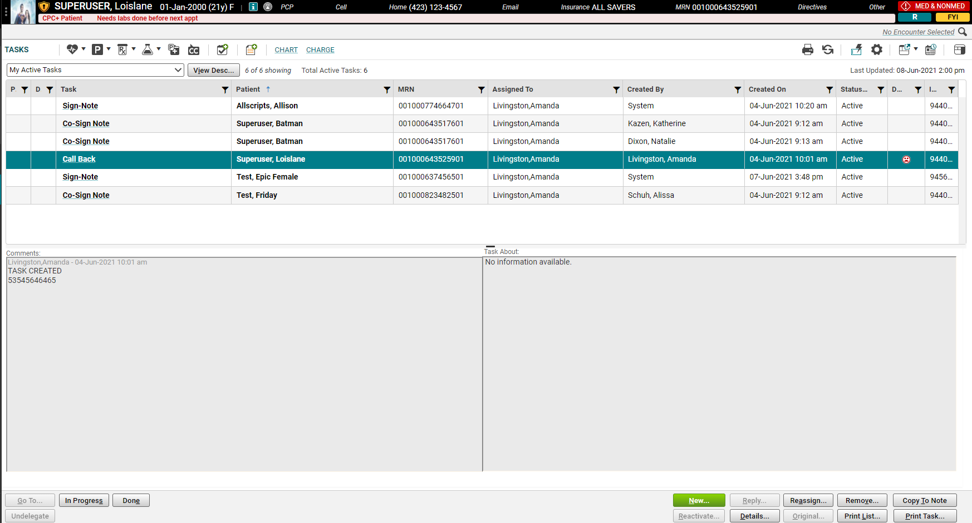
Tasking
Single click on a task to read the comments.
Double click to take you to the area where the task needs to be performed.

Slide 34
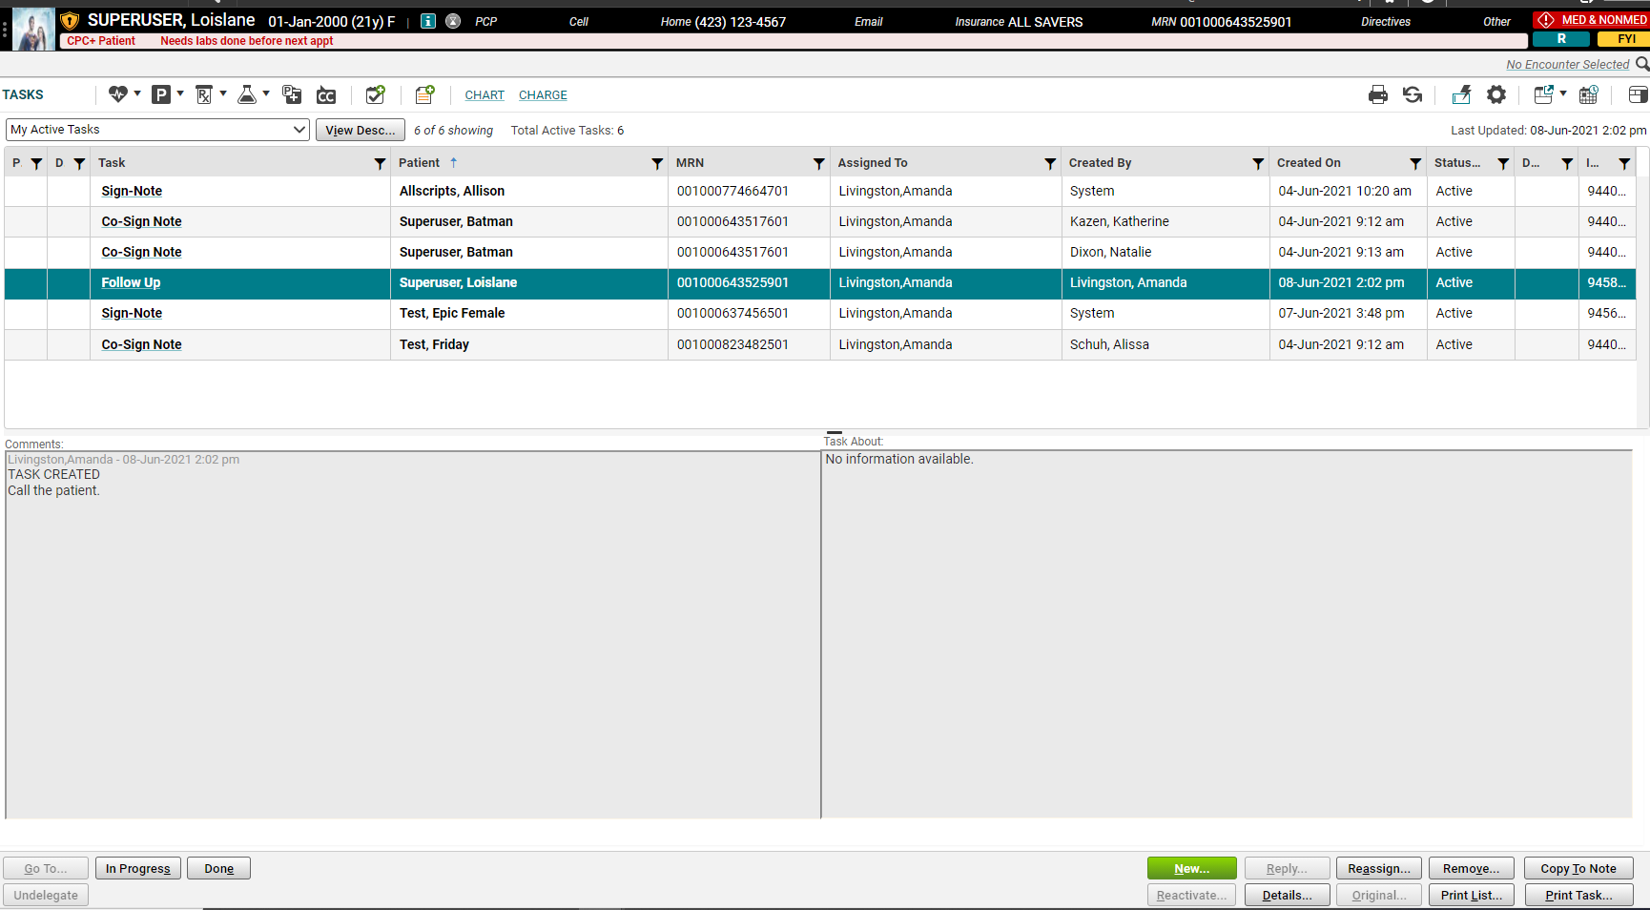
Tasking
If you need to reply to a task, or reassign it to another person, highlight the task by single clicking on it, and then click the appropriate button.

Slide 35
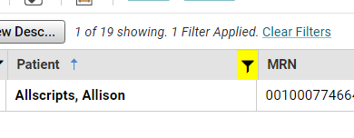
Tasks Filters
On the Tasks window, you can now sort and filter.
Selecting the funnel icon allows for filtering.
Clicking on the header sorts the column.
When a filter is applied, it turns yellow and says “Filter Applied.”
Click Clear Filters to remove filter.

Slide 36
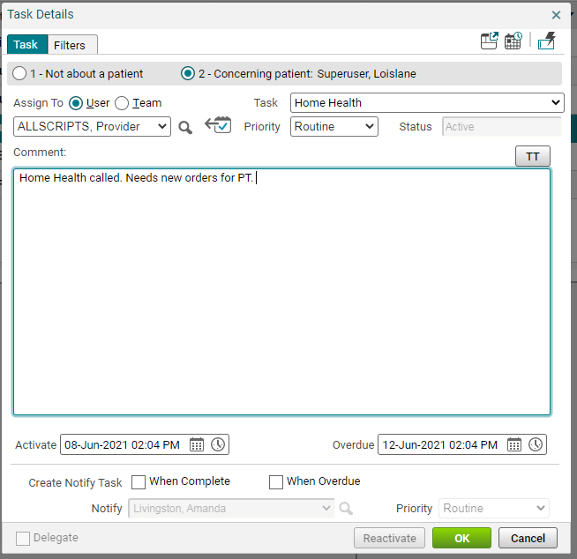
Creating a New Task
In the Task type box, choose the appropriate option, then type your comment in the Comment field. Click OK. It will go to the user in the Assign to: field.
On the Tasks page, click “New.”
The Task Detail box will open. Change the radio button to User or Team, as appropriate. Pull in the name of the recipient by searching the drop down, or, if not there, clicking the magnifying glass to search by last name..

Slide 37
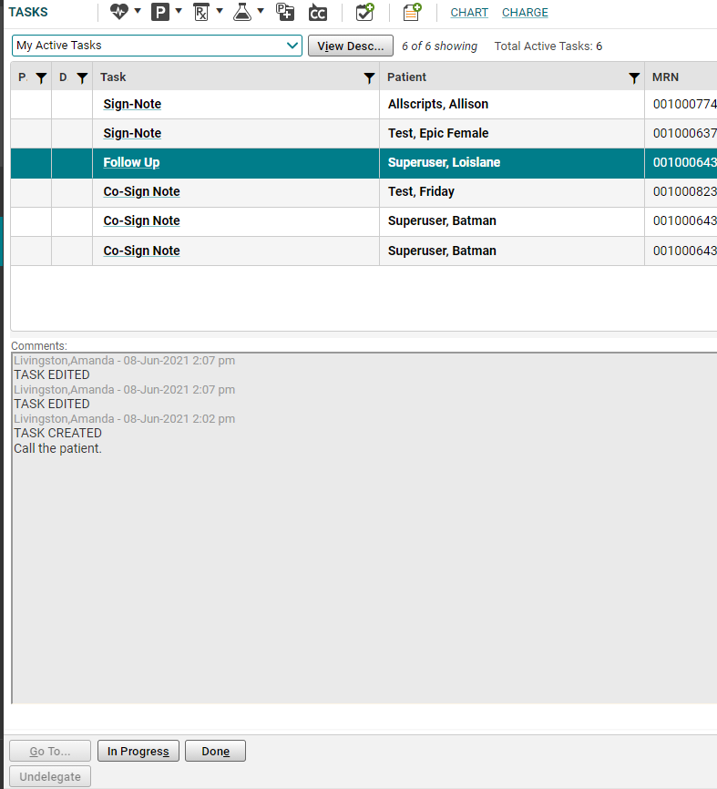
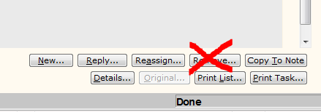
Completing Tasks
Note: This applies to manually created tasks. System-generated tasks will drop off your list automatically once you have completed the action (signed the note, renewed the medications, etc.) Never, never REMOVE a task.
When you have finished a task, click the “Done” button.

Slide 38
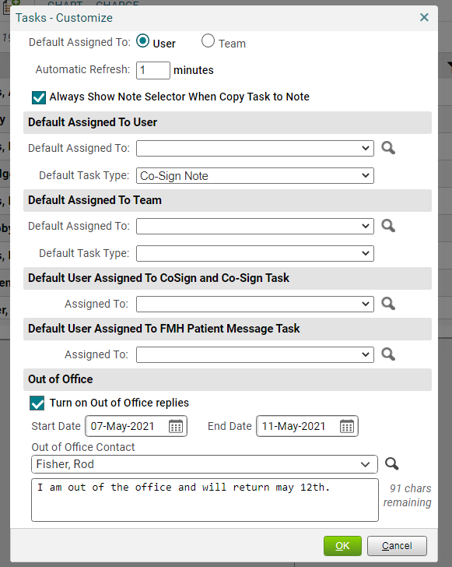
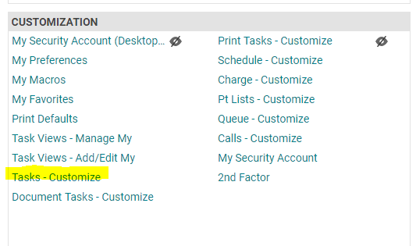
Task – Out of Office
Tasks now have an Out of Office option.
Accessible from the Tasks page, at the top right, click the gear box.
Out of Office is also accessible from the Site Map, under the Customization header, choose Tasks – Customize.
To open, click the gear box on the upper right side on the task window.

Slide 39
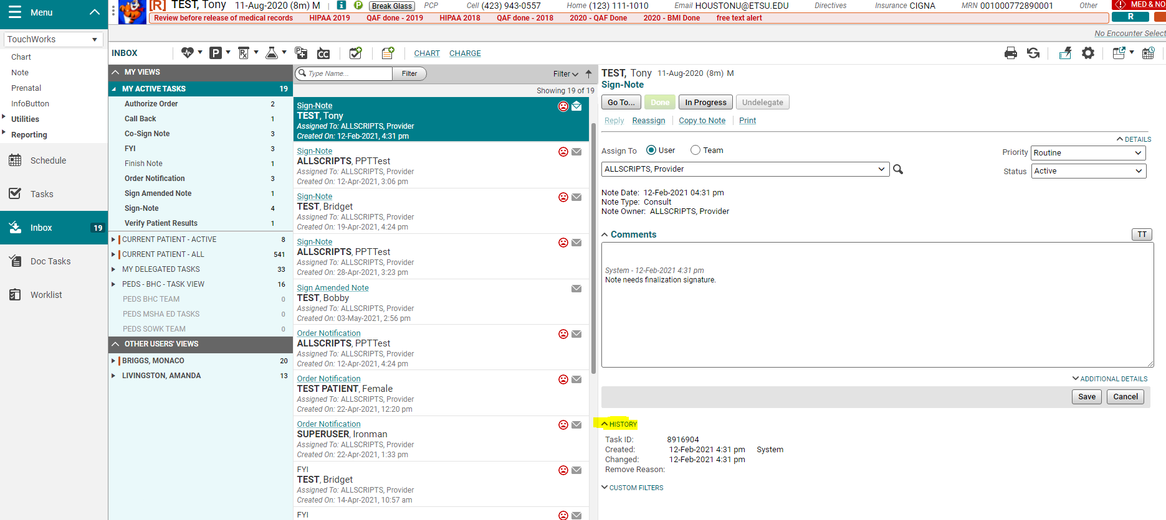
Inbox
The functionality remains the same as tasks: Go To…, Done, In Progress, Undelegate, Assign To.
It has a more “email-like” look.
You can see the History of the task.

Slide 40
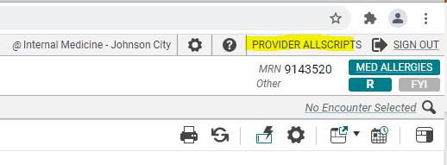
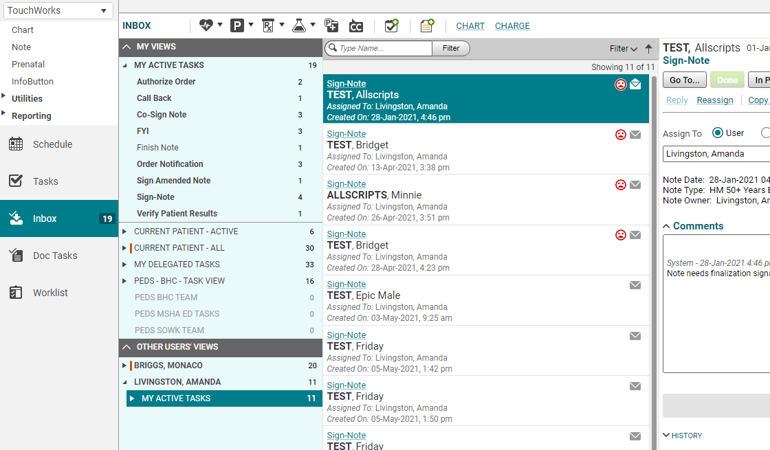
Other Users’ Views
Ability to see other user’s “My Active Tasks.”
You can set up a view of your nurse’s tasks, your out-of-town colleagues, or your residents.
In the example on the right, Dr. Provider Allscripts can also see and work the “My Active Tasks” of Monaco Briggs, and Amanda Livingston.
These are only visible on the Inbox page.
Logged in as Provider Allscripts.

Slide 41
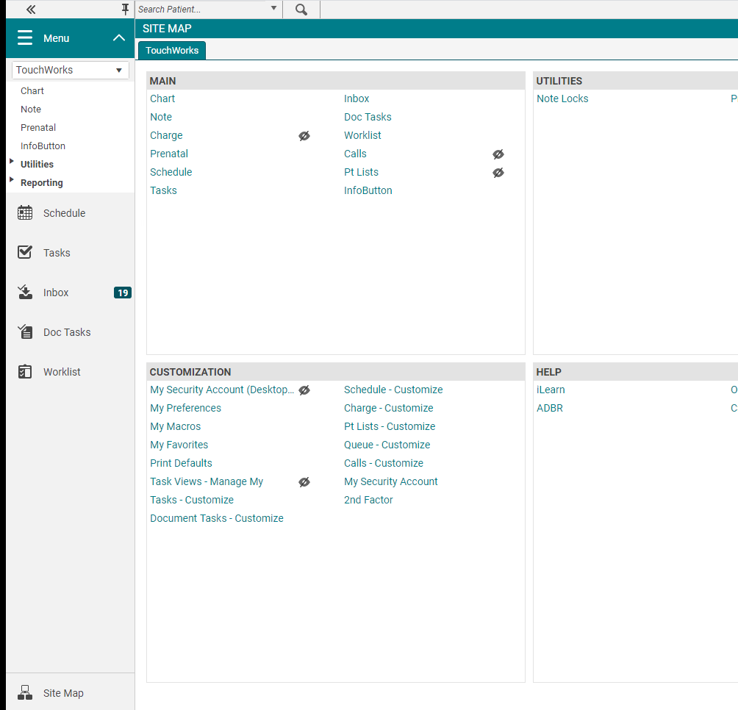
Setting up Other Users’ Views
From the Site Map under Customization, you will choose Tasks Views-Manage My.

Slide 42
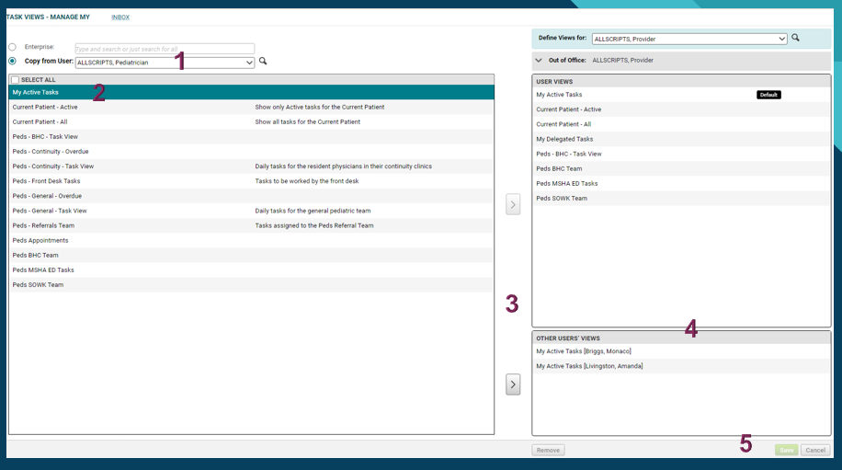
Tasks Views – Manage My
Select the user you want to copy from. (Remember to search using magnifying glass.)
Select which box you want to Copy.
Select the > arrow to add to your view.
Teams go on the top section and “My Active Tasks” are assigned on the bottom section.
Save

Slide 43
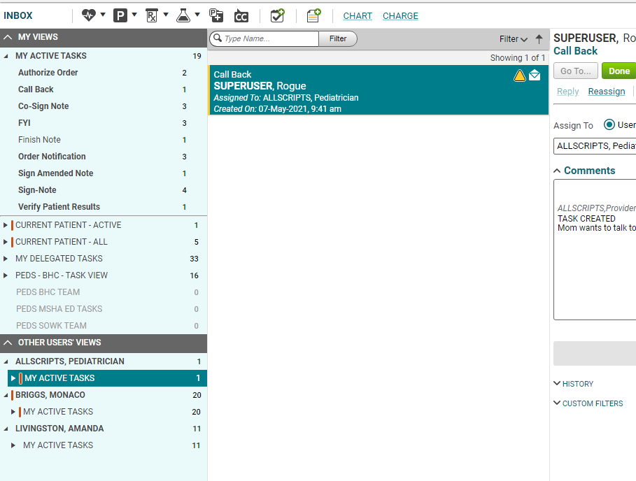
Inbox updated
From my example, Dr. Provider Allscripts can now see the “My Active Tasks” of Dr. Pediatrician Allscripts.
Use the checkmark-plus sign icon to start a new task from the Inbox page.
Start new task

Slide 44
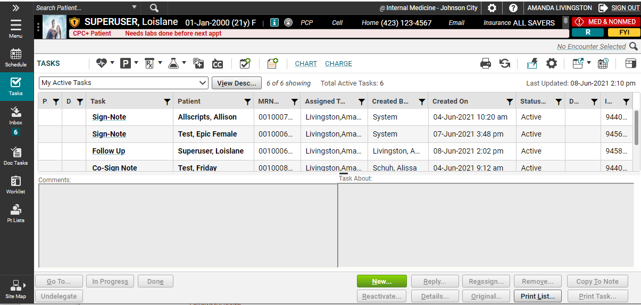
Appointments
To see a patient’s appointments, click the appointments (looks like a calendar) icon and see past and future appointments that are scheduled with any provider in the MEAC/Family Medicine system.

Slide 45
Quality Measures
As part of the Affordable Care Act, Medicare has developed the Shared Savings Program, which is a new approach to the delivery of healthcare. Congress created the SSP to facilitate coordination among providers to improve the quality of care and reduce unnecessary costs. ETSU participates in the SSP through AnewCare, our Accountable Care Organization (ACO).
Currently, this targets Medicare patients, and thus, predominantly affects our primary care offices; however, some elements also affect our specialists. Through our participation in this program, our primary care residents will be required to document certain items in the EHR in order to remain compliant.
A few examples of the quality measures include:
Tobacco screening and cessation education/medication
Reconciling medications and allergies at each visit
Performing fall screening
Flu and pneumonia vaccinations
Appropriate cancer screening
Depression screening and follow up
Careful follow up of chronic conditions, such as diabetes, IVD, CAD and HTN
For more information about the Quality Measures and Population Health, please visit our website: https://www.quillenphysiciansehr.com/populationhealth.html

Slide 46
Takeaways
Drop-down lists are populated by searching for users. If a user is NOT in your drop-down list, click the button next to the search field and search by last name.
Right-clicking on an item will often give you more menu options.
Double click on the patient’s name from the Schedule before starting your note.
Make sure you check your tasks and worklist EVERY time you log into the system and as often as required by your clinic.
Commit, Commit, Commit. Make sure to commit and/or save OFTEN! When saving in a note, save at least after each section.

Slide 47
Remote Access
To log in from anywhere not in clinic or on a personal device:
Download Citrix Workspace (https://www.citrix.com/downloads/workspace-app/)
ETSU Health devices will have Citrix installed.
Open your browser (Chrome, Internet Explorer, Safari) and type in the following: https://mea.allscriptscloud.com
Call the Helpdesk 423-282-6122, Option 1 for assistance.
Troubleshooting tips and instructions for installing Allscripts on your tablet/phone are available on our website at www.quillenphysiciansehr.com

Slide 48
Quillen ETSU Physicians Clinics
Internal Medicine – Johnson City & Kingsport
Infectious Disease
Surgery
OB-GYN – Johnson City & Elizabethton
Pediatrics
Genetics
Cardiology
Endocrinology
Fertility
Rheumatology
Hematology
Psychiatry
Osteoporosis
Sports Medicine at BucSports
Family Medicine – Johnson City, Bristol & Kingsport

Slide 49
ETSU Health Clinics
Speech Language Pathology at the Nave Center
Audiology at the Nave Center
Gary E. Shealy Memorial ALS Clinic
NICU Follow-up Clinic at ETSU Pediatrics

Slide 50
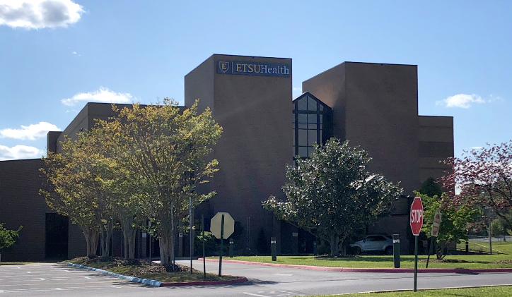
Quillen ETSU Physicians
The Clinical Education Building (CEB) at 325 N. State of Franklin Rd.
Surgery – Third Floor
Internal Medicine and Endocrinology – Second Floor
Lab – Second Floor
OB-GYN – First Floor
Pediatrics and Genetics – Ground Floor

Slide 51
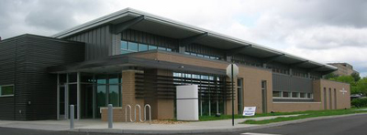
CEB 2
Located behind the main Clinical Education Building (CEB) is CEB2.
This building is home to Cardiology.

Slide 52
Other Specialties and Locations
Psychiatry – Located on the VA campus (Building 52)
Behavioral Health– integrated into Internal Medicine, OB-Gyn, Pediatrics, and Family Medicine
Addiction Care – integrated into Family Medicine and OB-Gyn.
Fertility & Urogynecology -Women’s Services - Located at 1319 Sunset Drive, Suite 103, Johnson City
Elizabethton OB/GYN – 1505 West Elk Avenue, Suite 1, Elizabethton
Osteoporosis Center – Located in the ETSU Innovation Lab – 2109 West Market Street, Room 143, Johnson City
BucSports – Orthopedic and Sports Medicine – ETSU Mini-Dome, John Bell Dr, Johnson City
Infectious Diseases – 615 North State of Franklin, Johnson City
Nave Center– 1000 Jason Witten Way, Elizabethton

Slide 53
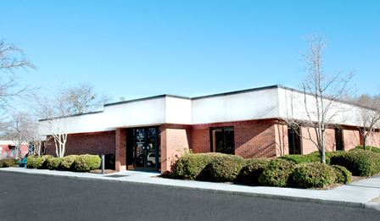
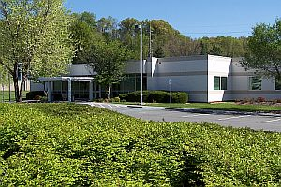
Family Medicine
Johnson City
ETSU Family Medicine has three locations – Johnson City, Bristol, and Kingsport
Bristol
Kingsport

