Slide 1
Quillen ETSU Physicians
Module 1: Daily Schedule & Clinical Desktop
Provider Training Module
Allscripts Touchworks EHR
Quillen EHR Team
Phone: (423) 282-6122, Option 1
May 2021

Slide 2
Module instructions
There are a total of 5 modules that need to be completed prior to the on-site training. It is REQUIRED that you complete all of the modules PRIOR to training.
These modules are intended to serve two purposes: as an introduction to the system, and as a reference. The modules are very detailed. As such, we don’t expect you to retain all of the information in the slides before training; however, we encourage you to print the PDFs, as you will be able to refer back to them as you begin to use the system.
Training will consist mainly of mock practice sessions, so a basic knowledge of the system prior to training is essential. If you have any problems completing these modules, please contact the EHR team. (Contact info is on Slide 1 of each module).

Slide 3
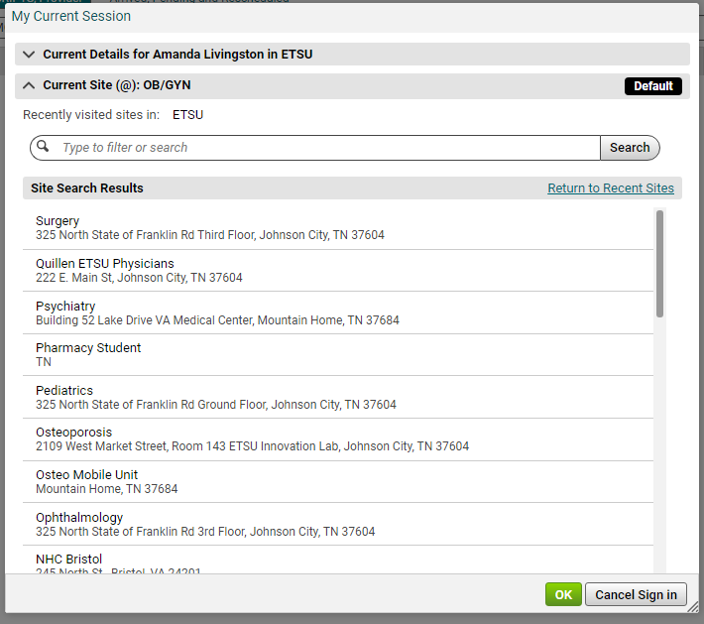
When you first log in, you’ll be presented with a My Current Session window. This is where you would choose your Site or location.
Some staff will rotate through different sites and specialties. Always make sure you are on the correct one.

Slide 4
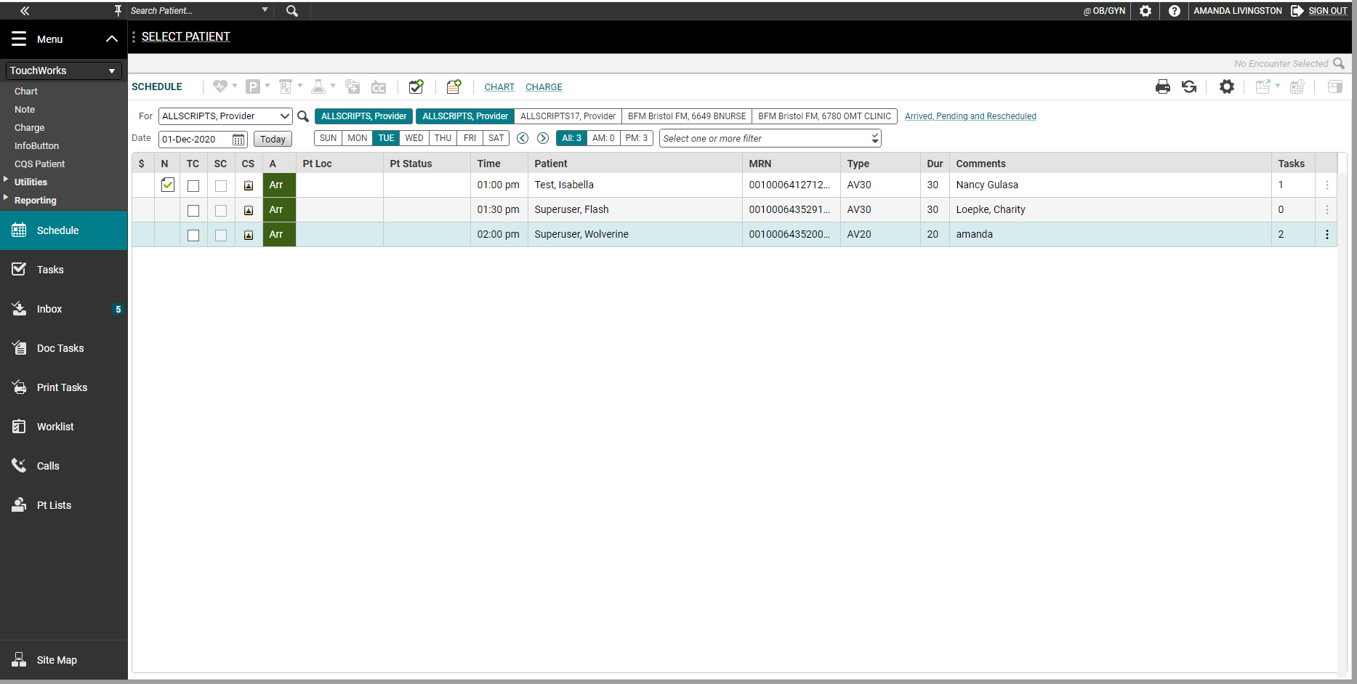
ACTION bar
The action bar is a menu-based navigational tool you use to access workspaces in Allscripts TouchWorks® EHR that are available to you. It is located on the left.
You can minimize or maximize .
The push pin icon will “pin” a menu into place throughout TouchWorks.
You can access all pages in the Site Map.

Slide 5
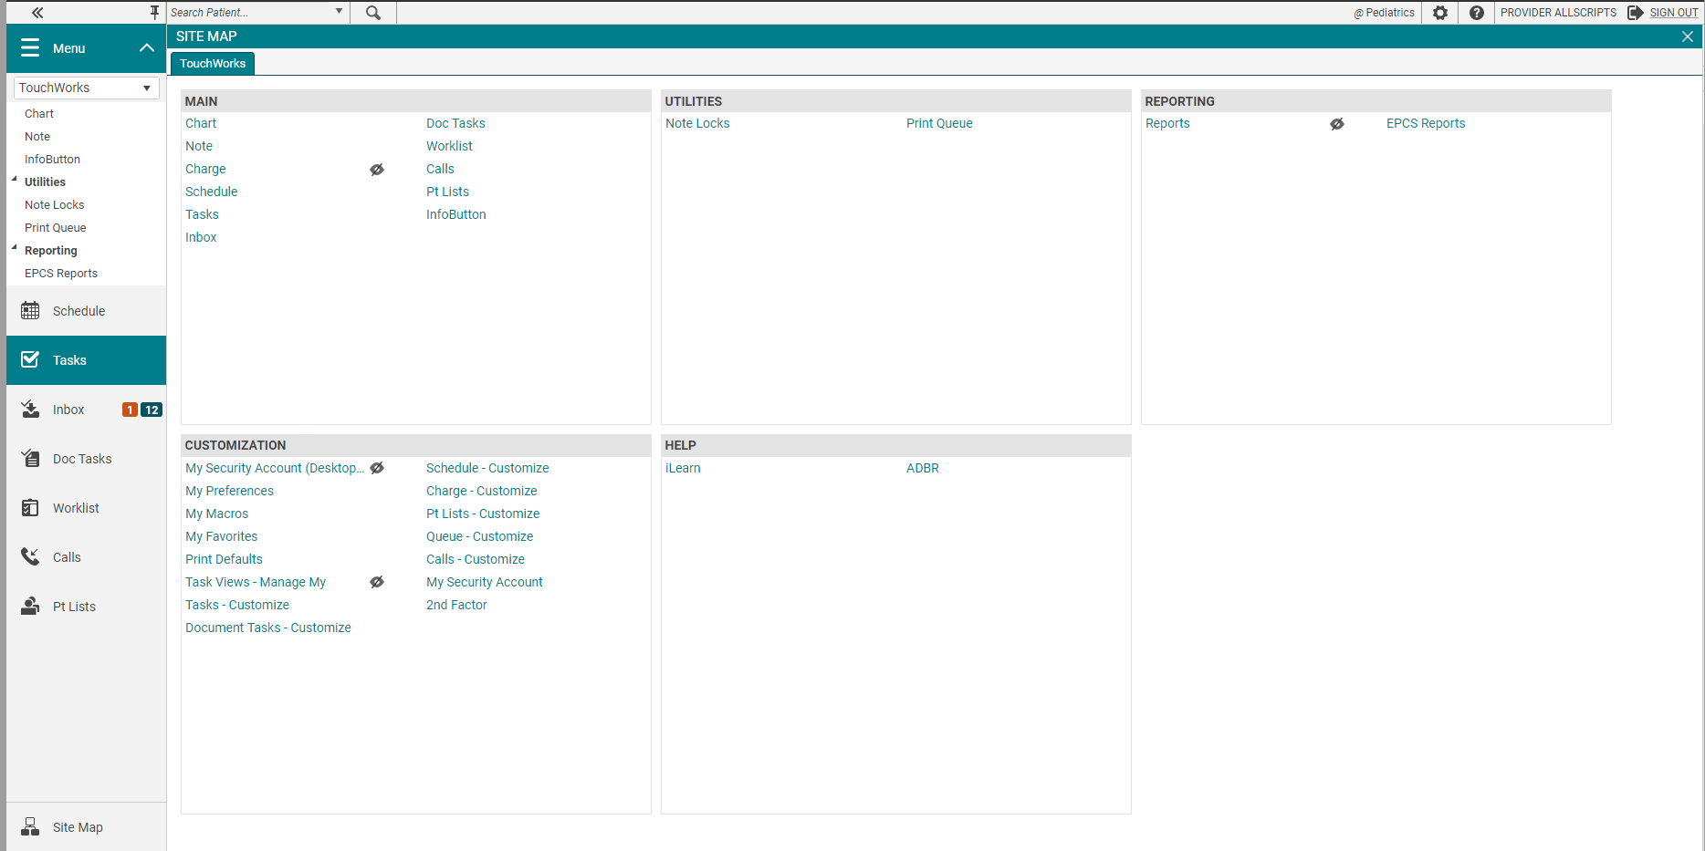
SITE MAP
The Site Map shows you the pages you have available. We recommend only showing the workspaces you use daily. You can also navigate to your pages from here.
External links like CSMD, EHR website, Opioid Documents will be located in the HELP section on the Site Map.
The HELP links can also be located on the

Slide 6
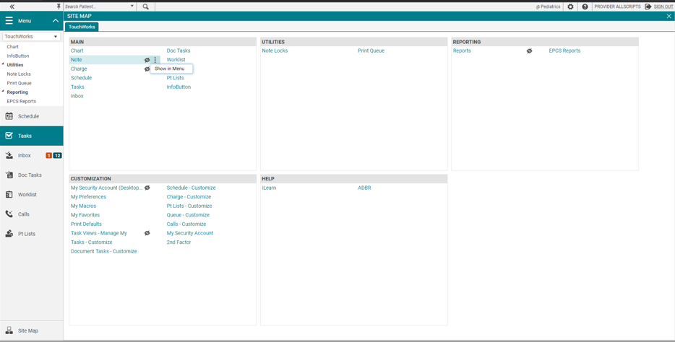
Hiding and showing pages
The hidden from menu icon
is displayed next to hidden pages.
These pages aren’t show in the Action Bar.
To show a page in the Action Bar, Click the options icon and select Show in Menu.

Slide 7
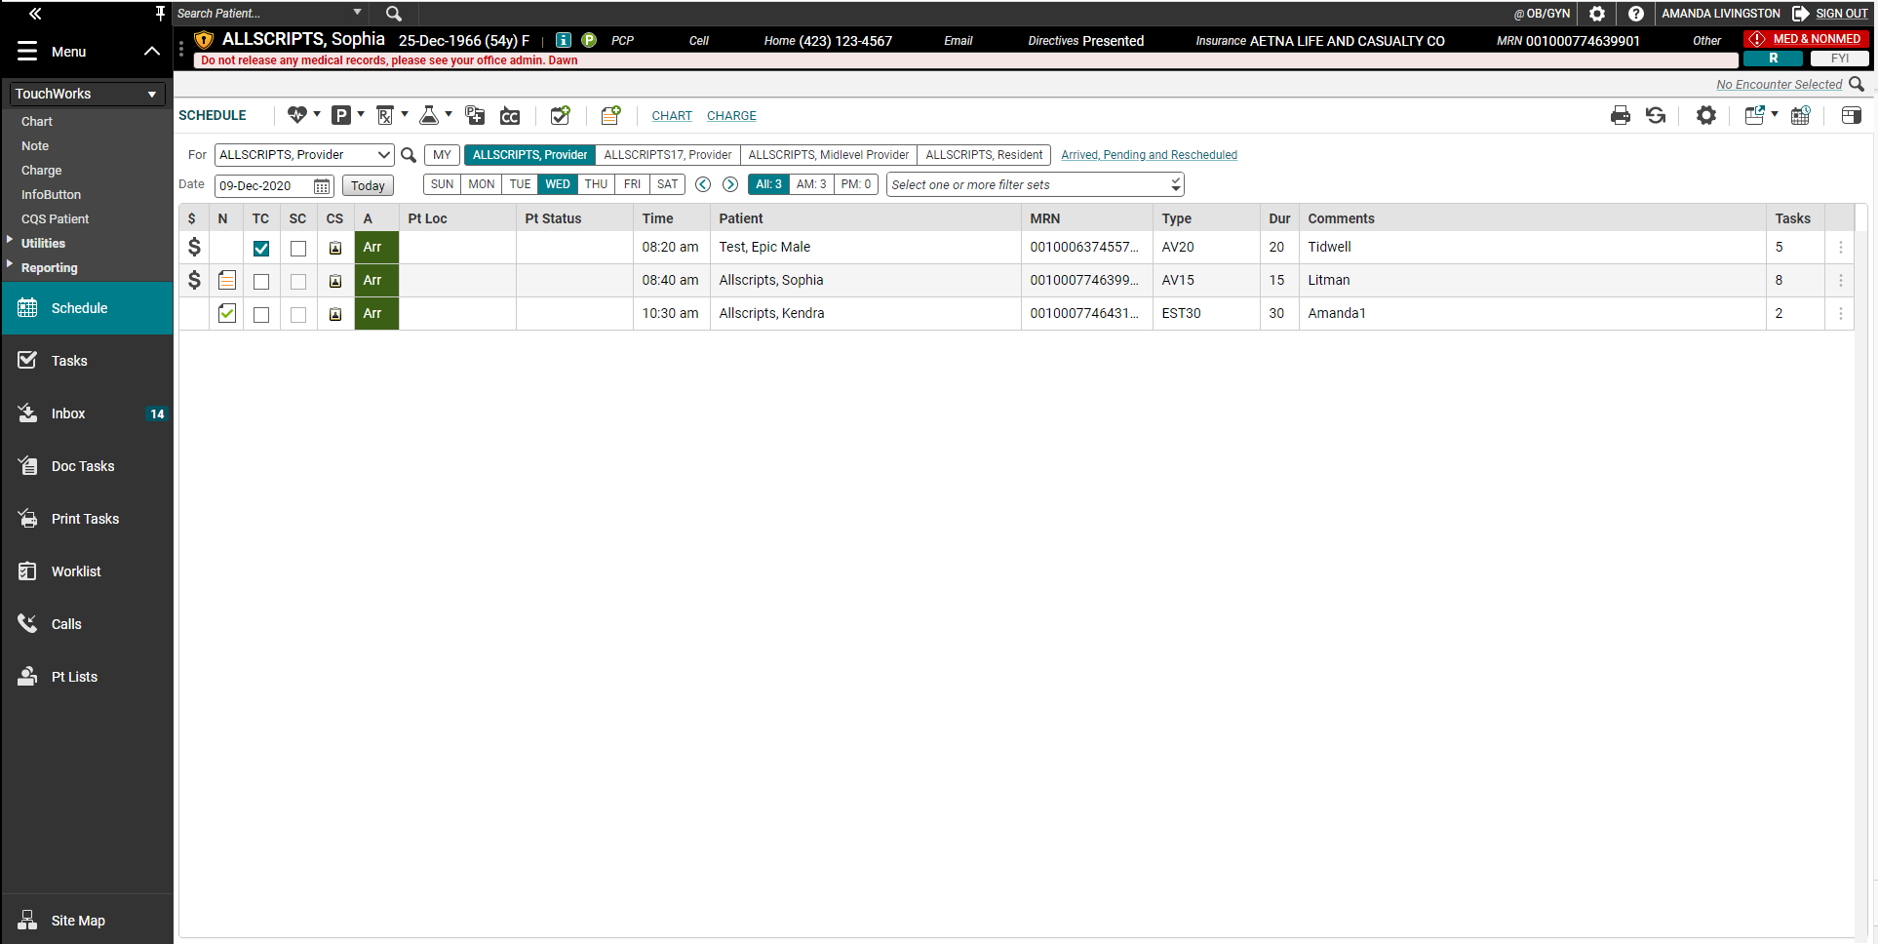
Schedule
When you first log in, you will see your Daily Schedule. To pull in a provider’s schedule, click the drop-down arrow in the Provider field. If their name is not there, click on the icon. A Search Window will pop up.
Tip: Once you’ve searched for a name, it will appear in the drop-down list the next time you perform a search. This functionality works throughout Allscripts.

Slide 8
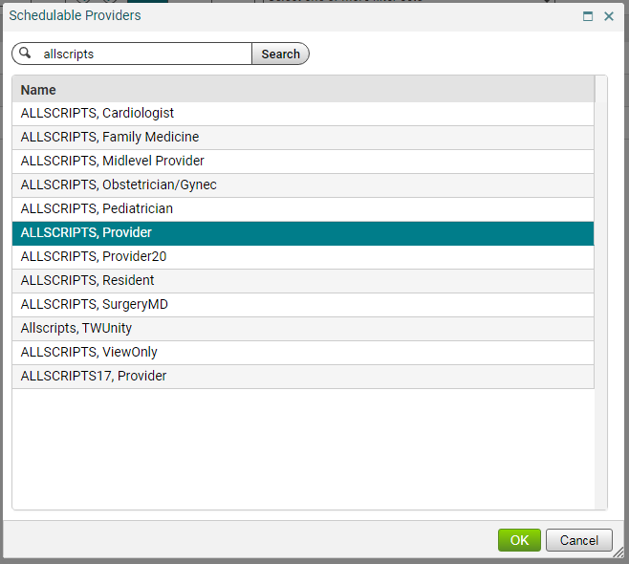
In the “Search” field, type the provider’s last name and click Search. Highlight the desired provider and click OK.
Schedule

Slide 9
Schedule
There are several ways to change the date of the schedule:
Click on the day of the week
Click on the calendar icon next to the Date field
Click on the blue arrows to navigate forward or backward a week
To get back to today’s date, click on this icon

Slide 10
Schedule icons
N Column Note icon: This indicates that a note has been started on the patient
N Column Finished Note icon: Note has been finalized by the attending MD
TC Column Transition of Care: Check if patient is transitioning to your care from another setting
CS Column: Indicates whether or not a Clinical Summary has been printed for the patient
A Column Arrival Status: NSH – No Show ARR – Arrived Pen – Pending Can - Cancelled
Pt Loc: Patient Location. This tracks the patient’s location throughout the visit.
Pt Status: This indicates the patient’s status throughout the visit.

Slide 11
Patient Banner
A single click on the patient’s name from the Schedule will pull them into the Patient Banner. If the patient’s name is in the Banner, that indicates that you are documenting on that patient’s electronic chart, so make a habit of checking the banner when charting to ensure you are working on the correct patient.

Slide 12
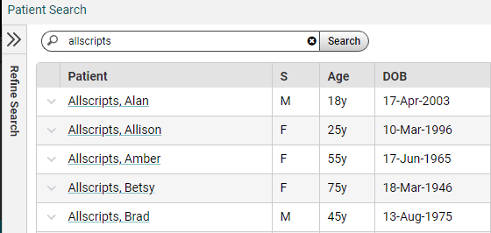
Patient Banner - searching
You can also manually pull a patient into context. In the Patient Banner, click the magnifying glass. In the Search for Patient box, type the patient’s LAST NAME, FIRST NAME or date of birth. Highlight the correct patient’s name, and then click OK.
Tip: When searching, you don’t have to type the entire name. You can type “Super, Gr,” for Superuser, Grover. You can also search by other parameters, such as DOB, phone number, etc.

Slide 13
Patient Banner – fyi icon
All of the patient’s demographic information can be accessed from the Patient Banner. The age, sex, allergies, phone number, etc., are visible whenever the patient’s name is in context.
The FYI box on the patient banner is similar to a “sticky note” on a paper chart. It is used to document information that is not clinically relevant and is typically used by the front desk staff; however, anyone can read the information in the FYI field.
To read an FYI, click on the yellow FYI button on the Patient Banner.
Tip: If the icon on the patient banner is yellow, there is an available FYI. If it is grayed out, the field is empty.

Slide 14
Patient Banner – information icon
Other patient information can be accessed by clicking on the on the banner.
Information icon: Clicking on this opens the Patient Profile Dialog box. Information in this section includes the FYI box, Chart Alerts, demographics, emergency contact info, pharmacy info, and patient care team. Hyperlinks at the top of the page will take you directly to each individual section.

Slide 15
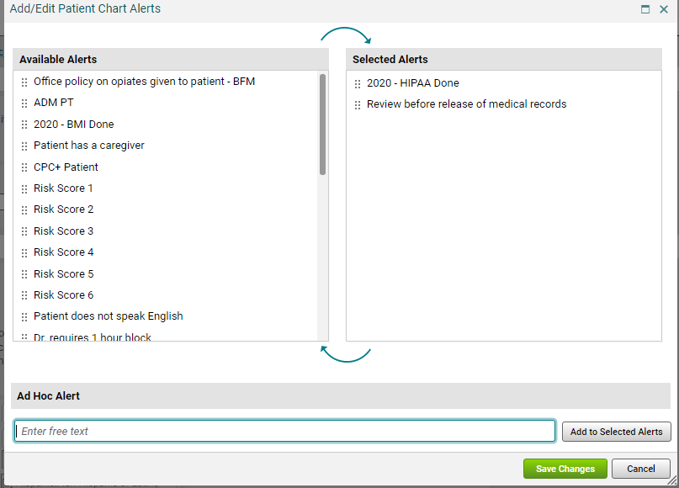
information icon – chart alerts
Chart Alerts are used to document clinically relevant information. You can add alert by clicking on the on the patient banner.
Clicking the Add Alert button opens this window, which allows you to add multiple Chart Alerts. There are some available alerts which can just be checked, or you can free text an alert in the Ad Hoc Alert section.
The Chart Alerts will appear on the Patient Banner.

Slide 16
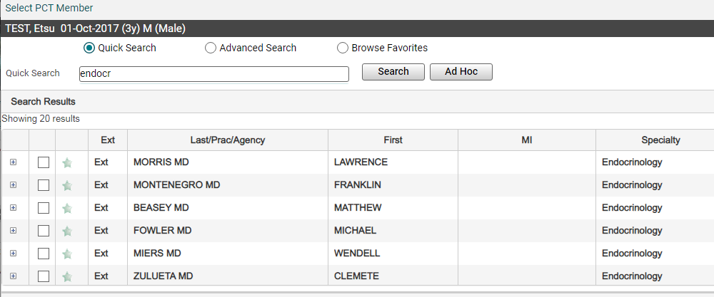
information icon – patient care team
The patient care team, which is also accessed through the Information Icon, allows you to add/delete and view other members of the patient’s care team. You can add providers, healthcare agencies and even family members to the care team.
Click on the Add Provider/Agency button. You can search by last name or specialty. Check the box next to the provider’s name to add it to the patient’s chart.
To add a family member, click on the Add Patient Caregiver/Resource button and free text their name.

Slide 17
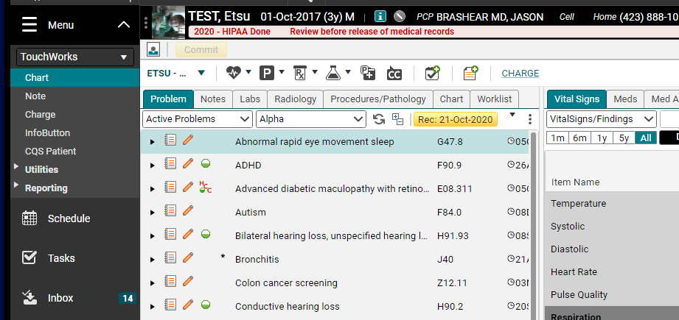
CHART
To look at the patient’s chart, from the Schedule tab, double click their name on your schedule. This will take you to the next tab, the Chart, which is their electronic chart.
Tip: It’s important that you ALWAYS access the patient’s chart by double clicking from the Schedule (if they have an appointment), because this links the appointment date with your chart documentation.

Slide 18
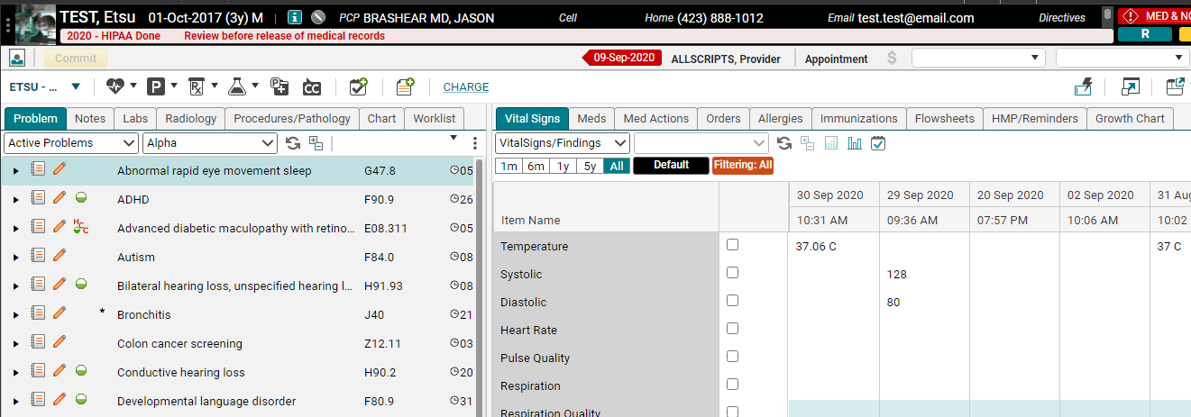
Chart
The chart has two main components. Each component contains different tabs, where you will access the patient’s information.
Clinical Toolbar
Component 1
Component 2

Slide 19
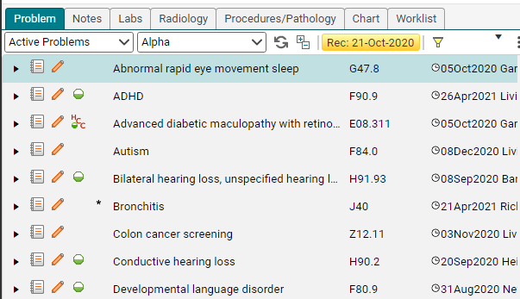
Problem tab
The first tab that you will see when you open the patient’s electronic chart is the Problem tab. This is where all of the patient’s active problems, past medical history, social history, etc. will appear.
Tip: Each tab on the Clinical Desktop has a couple of different sort options which can be used to help you find information quickly.

Slide 20
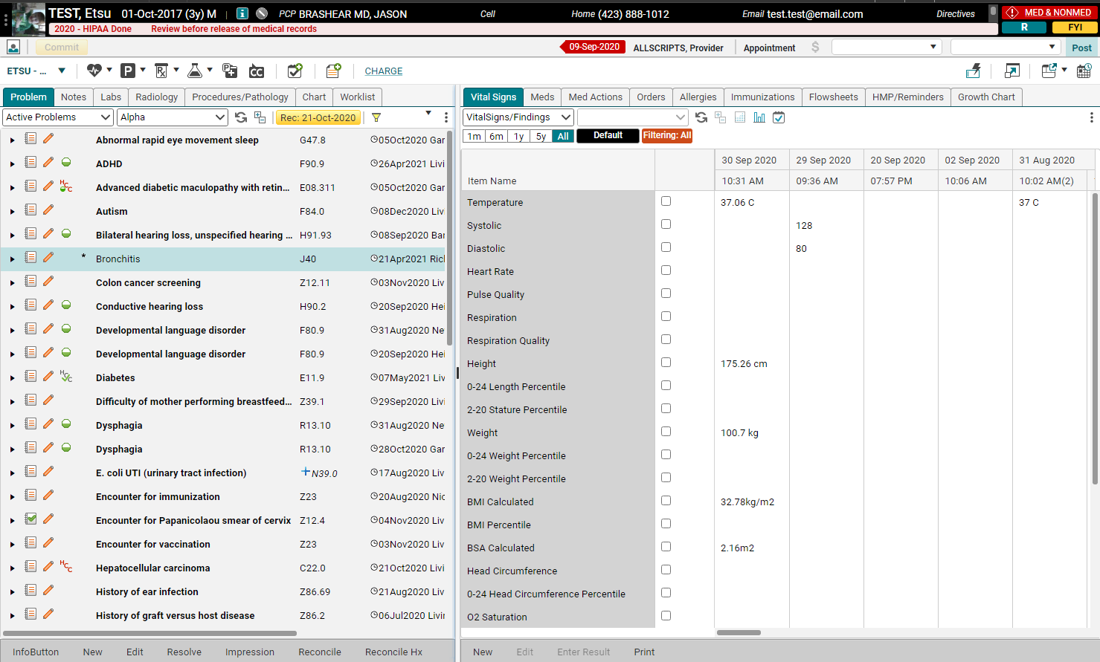
Problem tab
The Problem tab is where you will be able to view all of the patient’s active problems (diagnoses), past medical, social, family and surgical histories.
You can also resolve, edit and refine problems from this tab. Cleaning up the patient’s active problem list is easy – just highlight the problem and choose “Resolve” from the toolbar.
You can also right-click on the problem, which will open up an extensive menu.

Slide 21
Problem tab
Active Problems is the default. Use the dropdown to see PMH, PSH, PFH, and SoxHx.

Slide 22
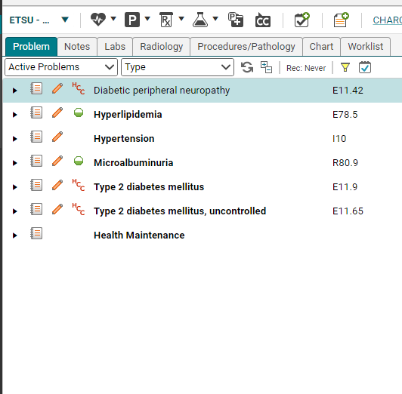
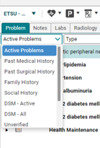
Problem dropdown
Problems tab will now default to only Active Problems.
Use the dropdown arrow to show All Problems or to select a Problem list.

Slide 23
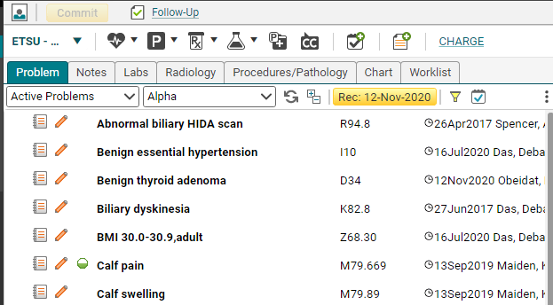
PROBLEM RECONCILATION
In order to ensure that the problem list remains current and up to date, the Reconciliation button will turn yellow at each appointment. Once the list has been verified/updated, click the yellow button to indicate that the list is current. For most clinics, this is a provider task.
Different clinics have different policies regarding resolving problems entered in by other clinics. Please use your clinical discretion.

Slide 24
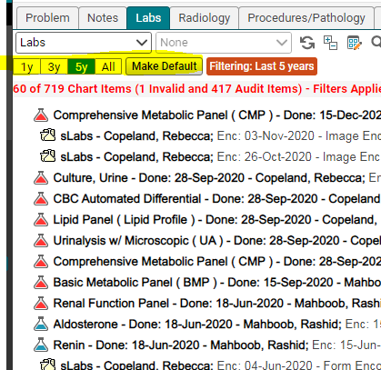
Chart view filtering
Notes, Labs, Radiology, Procedures/Pathology, Chart tabs have the ability to show 1 year, 3 years, 5 years, All.
1 year is system default and allows for fastest loading times.
You can toggle to alternate values and set your own default filter by clicking Make Default.

Slide 25
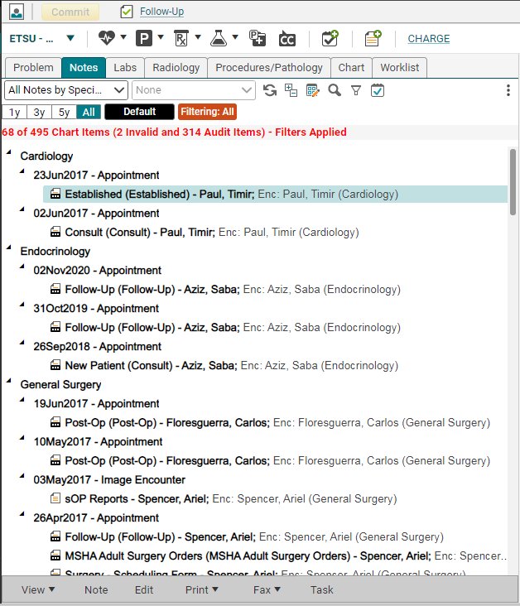
notes tab
The 2nd tab is the Notes tab. This is where all of the patient’s notes reside. To read a note, double click on it. To edit a note, highlight and choose “edit” from the toolbar.
Tip: If your patient is seen by other providers within the organization, their notes will be available on the Clinical desktop too.

Slide 26
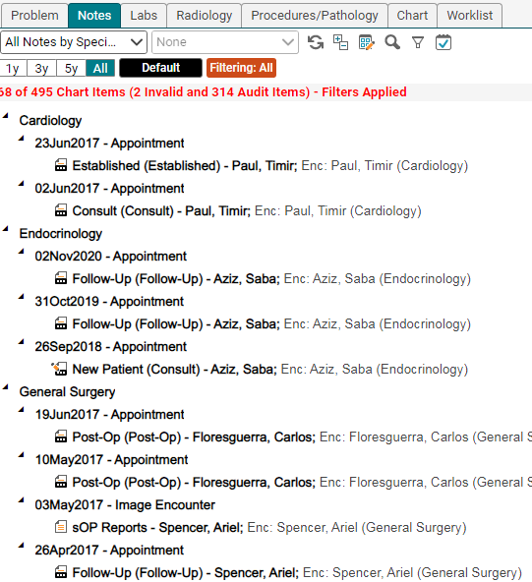
notes tab - icons
Finalized note icon: This note has been signed by the attending physician
Unfinalized note icon: This note still requires a signature
The small “s” indicates that this is a scanned document
sArchive – document was part of the original paper chart

Slide 27
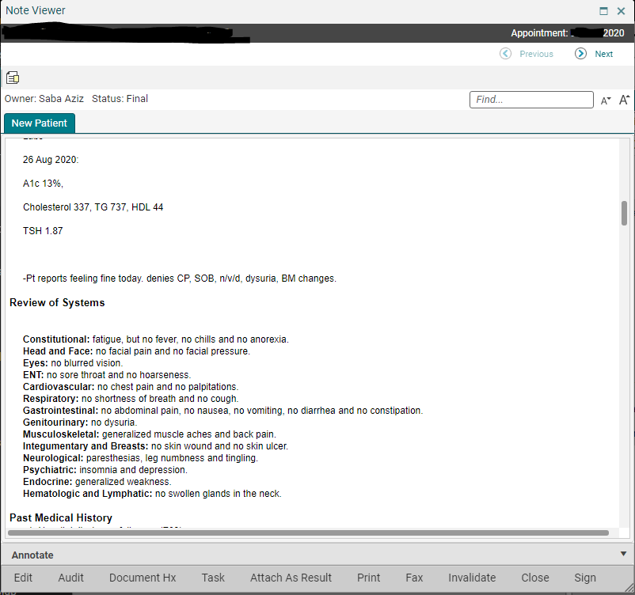
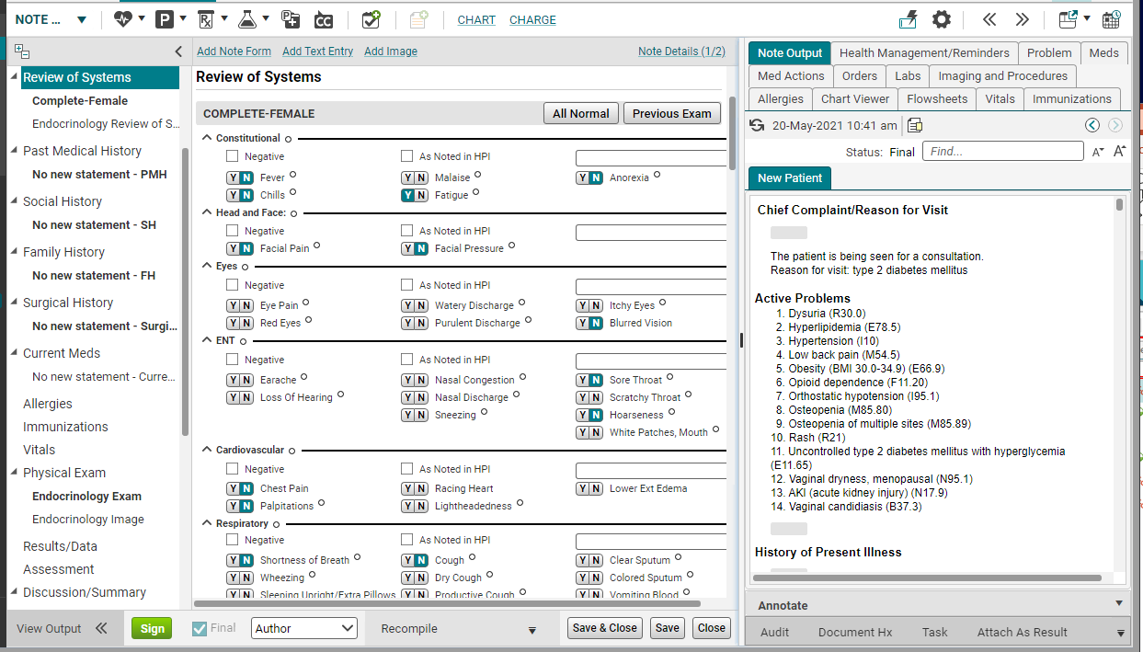
notes – view mode vs. edit mode
View Mode: This is similar to a “read-only” mode. You can’t make any changes on this page. This is how you should always open a note unless you are charting in it.
To open a note in View Mode, double click the note icon on the Clinical Desktop.
Edit Mode: This is what the screen looks when you are actively charting on a patient.
There are two main ways to open a note in Edit mode:
Double click on the note icon on the Daily Schedule.
Highlight the note icon on the Notes tab and choose “edit” on the toolbar.

Slide 28
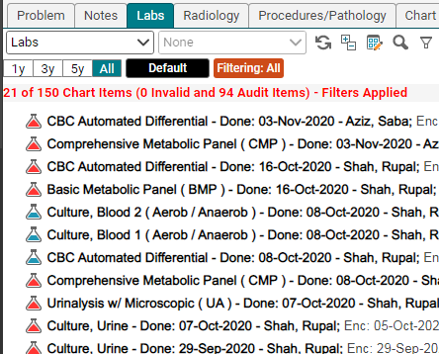
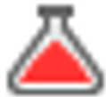
Labs tab
We have an interface with “Orchard” (our own lab), so labs sent to our lab will result back into the system electronically. Labs that are sent to outside vendors will come back on paper and will be scanned in by medical records personnel.
Normal lab that has been verified
Normal lab that has not been verified
Abnormal lab that has been verified
Abnormal lab that has not been verified
Scanned lab
Lab that has been resulted back manually

Slide 29
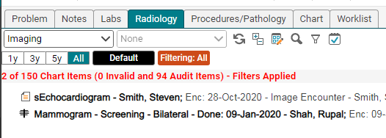
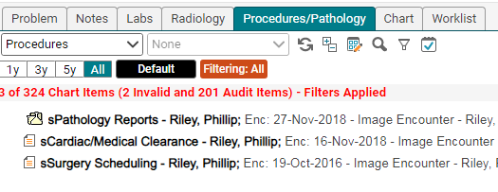
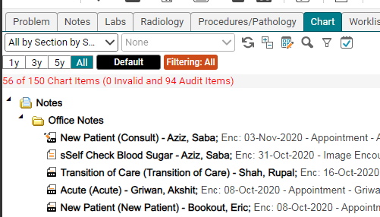
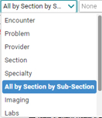
Radiology
Procedures
Chart
The next couple of tabs in the first component are pretty self-explanatory: the Procedures tab contains procedure reports; Imaging has x-rays, CT scans, etc., and the Chart tab contains the entire chart—notes, labs, procedures, imaging and administrative documents.
Each tab has a sort option that will allow you to find items easier.

Slide 30
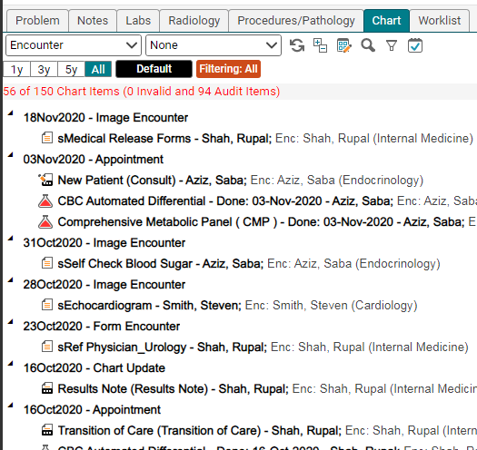
Chart tab- sort by encounter
Changing the dropdown to Encounter, sorts the Chart tab by date with the most recent information on top.

Slide 31
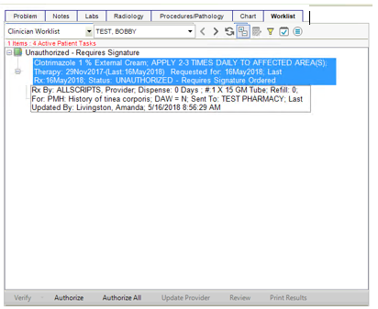
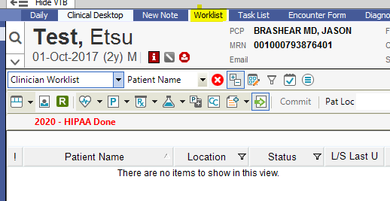
worklist tab
The worklist contains items that need to be verified, such as labs, and medications that need authorization by an attending physician.
Labs will automatically go to the preceptor for signature, but they may be forwarded to the resident for review. It is good practice to check your worklist when you first log in and before you log out for the day.

Slide 32
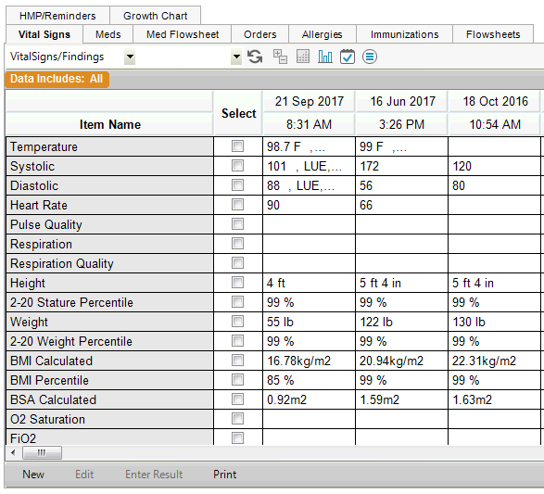
vitals tab
Typically, your nurse will enter the vitals. Once they have been saved, they will appear here.
The vitals can also be viewed in a graph format. Check the boxes next to the items you want to view and then click the graph icon on the toolbar at the top. To return your screen to normal, click the Refresh button.

Slide 33
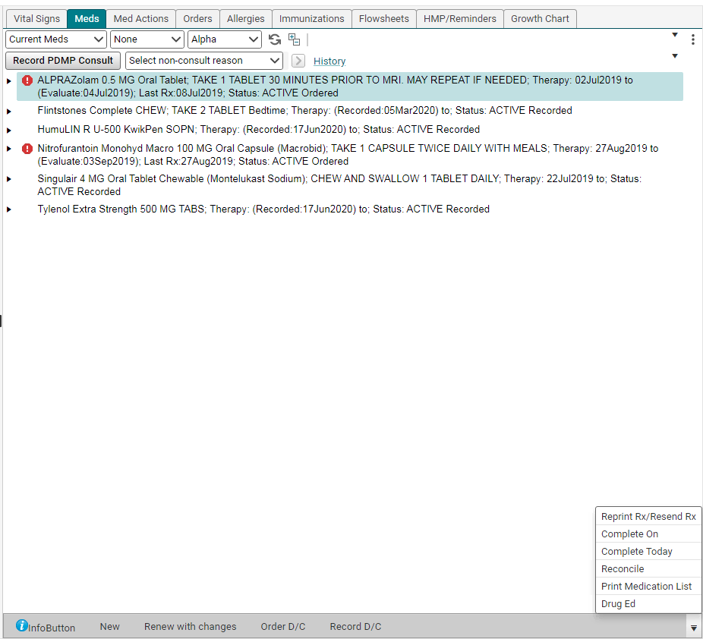
meds tab
The Meds tab allows you to do the following:
View the Current Medications. To view the details, double click the med
View the Past Medications/All Medications. To view discontinued and completed meds, click the drop down and choose Past Medications
Prescribe a new medication (click on the New Rx button on the toolbar)
Renew a medication (click on the Renew w/ Changes button)
Discontinue/Complete a medication
Reprint/Resend a medication
View/print the drug education on a prescription (Drug Ed button)
Print the Medications list. (You may need to use the arrow to see the option.)

Slide 34
Reconciling medications
An important component on the Meds tab is the Reconciliation button. Each time a patient is seen, the medication list will need to be reviewed and updated. Once the list has been verified as being correct, you will need to click the yellow button to verify that the meds list was reconciled at the current visit. The last date that the list was reconciled will be stamped on the button, so the next person to view the meds list will know when it was last updated.

Slide 35
Med actions
Med flowsheet has been updated to Med Actions.
Green check mark indicates patient is taking medication.
Red dash indicates patient is non-compliant, not taking medication.
Red dash does not remove med from Current Meds to Past Meds.
Dropdown box allows a not-taking reason.
R D/C allows to record discontinue from this tab and does move med from Current Meds to Past Meds.
3 dots opens additional menu.
Can also right click for an additional menu.
Changes must be Committed.
This can be used as part of the medication reconciliation.
Please work with medical directors for each specialty to determine best practices for your team.
Right now, this is a physician and nurse practitioner tab, not a nursing tab.

Slide 36
Med actions screenshot

Slide 37
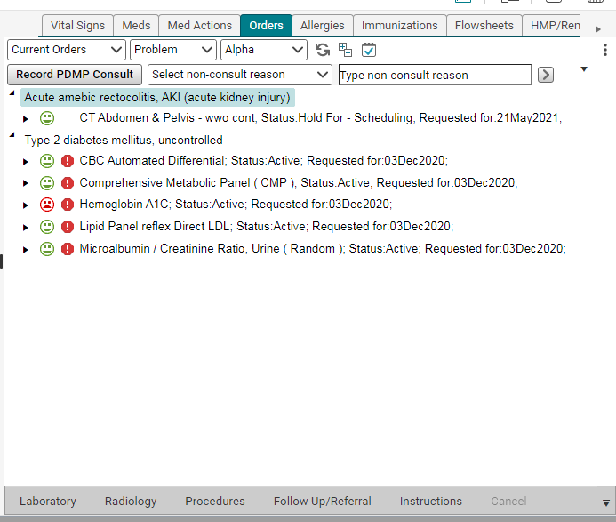
Orders tab
The Orders tab shows all of the Current Orders for the patient. These are items that have been ordered, but not yet resulted/completed. Past orders can be viewed by changing the sort field from Current Orders to Past Orders or All Orders. New items can also be ordered by clicking on the appropriate option on the toolbar.
The faces are tied to the patient’s insurance formulary:
Red face – insurance will not pay for this test
Yellow face – insurance will pay a partial amount
Green face – insurance will pay for test

Slide 38
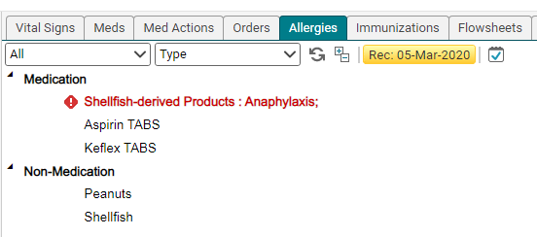
Allergies tab
Just like with the Medications, the Allergies will need to be reconciled at each visit. If the allergies are up-to-date and accurate, click the yellow button to reconcile the allergies.
The Allergies tab shows all of the patient’s allergies. Allergies with serious reactions, such as anaphylaxis, will have a warning icon next to it. Double clicking on an allergy will open the Allergy Viewer screen which will show any additional information documented about the allergy.

Slide 39
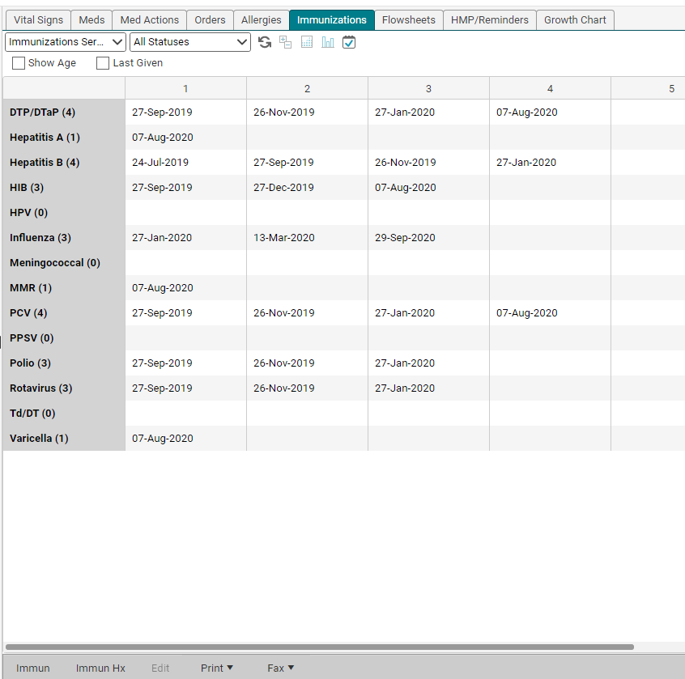
Immunizations tab
As immunizations are ordered, they will automatically flow into this table. The immunization list can be printed by clicking Print on the bottom toolbar.

Slide 40
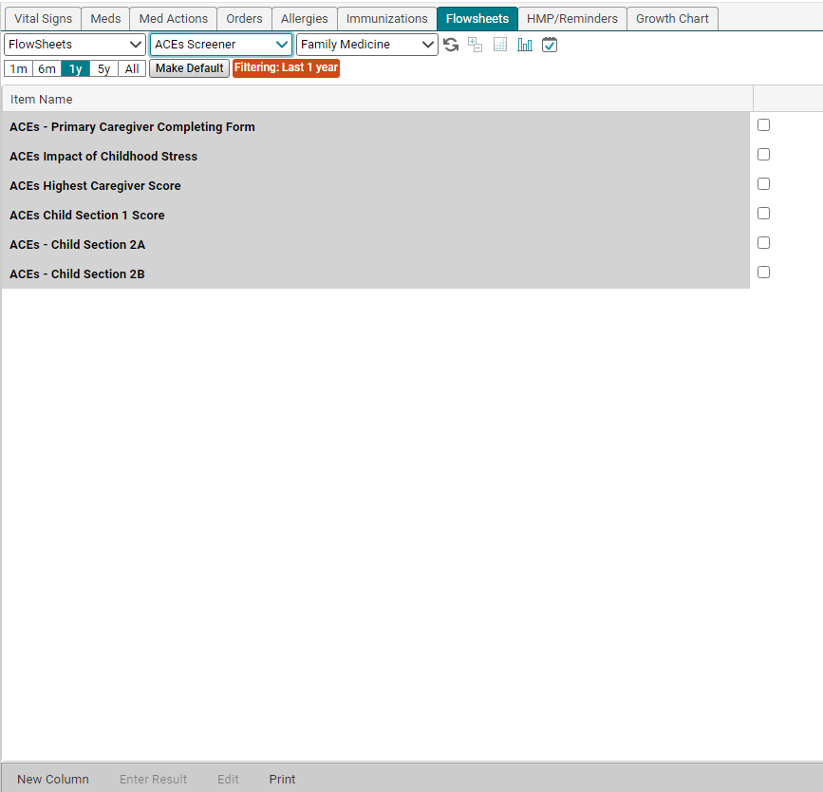
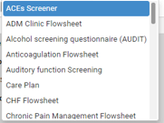
Flowsheets tab
Flowsheets allow you to keep track of various clinical items—usually based upon specific disease processes. Flowsheets are created by the EHR team, depending upon the needs of each clinic.

Slide 41
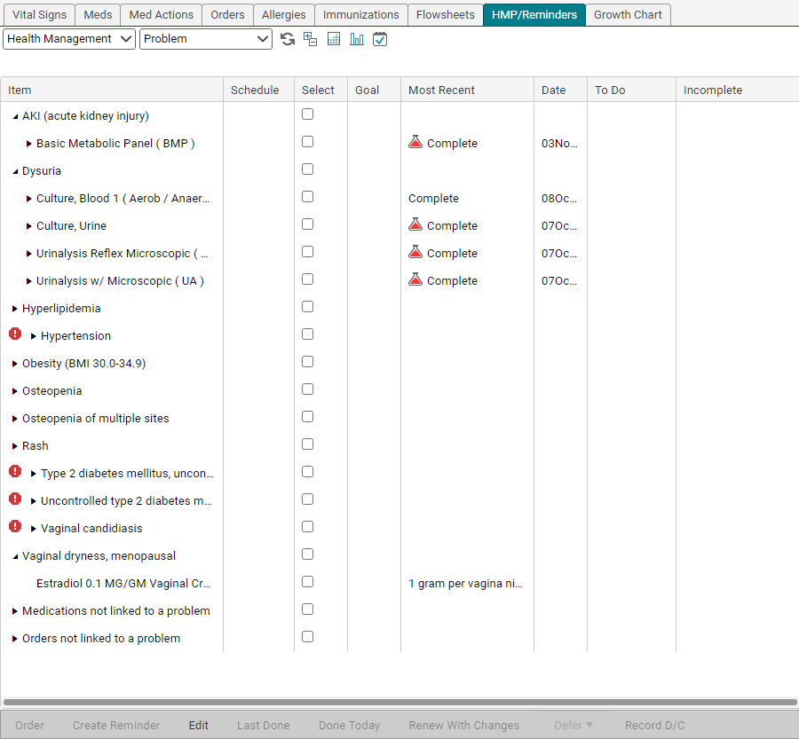
Hmp/reminders tab
HMP—Health Management Profile
This table keeps track of all items that have been ordered with a particular diagnosis. Basically, this is the patient’s Plan in table format. At a quick glance, you can view when an item was ordered, if it is due or near due, and what the value was when last ordered.
You can also set goals for various items, such as weight, BMI, lab items, etc.

Slide 42
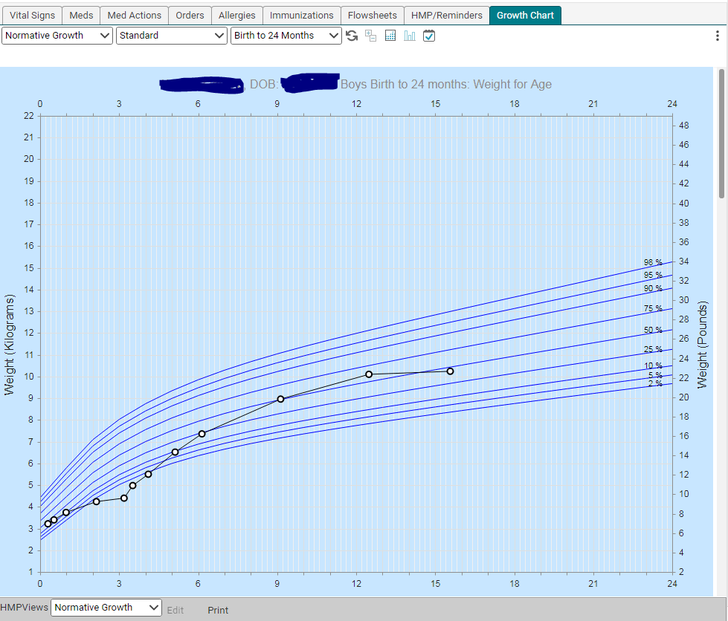
Growth chart tab
Growth chart for Pediatric patients.
The default is the standard view; however, clicking the drop down allows you to choose either Prematurity or Down syndrome. (The patient must have that dx in their Active Problem list before it will generate the chart).

Slide 43
Please proceed to the next module – Documenting history

