Slide 1
Quillen ETSU Physicians
Module 2: Documenting History
Provider Training Module
Allscripts Touchworks EHR
Quillen EHR Team
Phone: (423) 282-6122, Option 1
May 2021

Slide 2
Module instructions
There are a total of 5 modules that need to be completed prior to the on-site training. It is REQUIRED that you complete all of the modules PRIOR to training.
These modules are intended to serve two purposes: as an introduction to the system, and as a reference. The modules are very detailed. As such, we don’t expect you to retain all of the information in the slides before training; however, we encourage you to print the PDFs, as you will be able to refer back to them as you begin to use the system.
Training will consist mainly of mock practice sessions, so a basic knowledge of the system prior to training is essential. If you have any problems completing these modules, please contact the EHR team. (Contact info is on Slide 1 of each module).

Slide 3
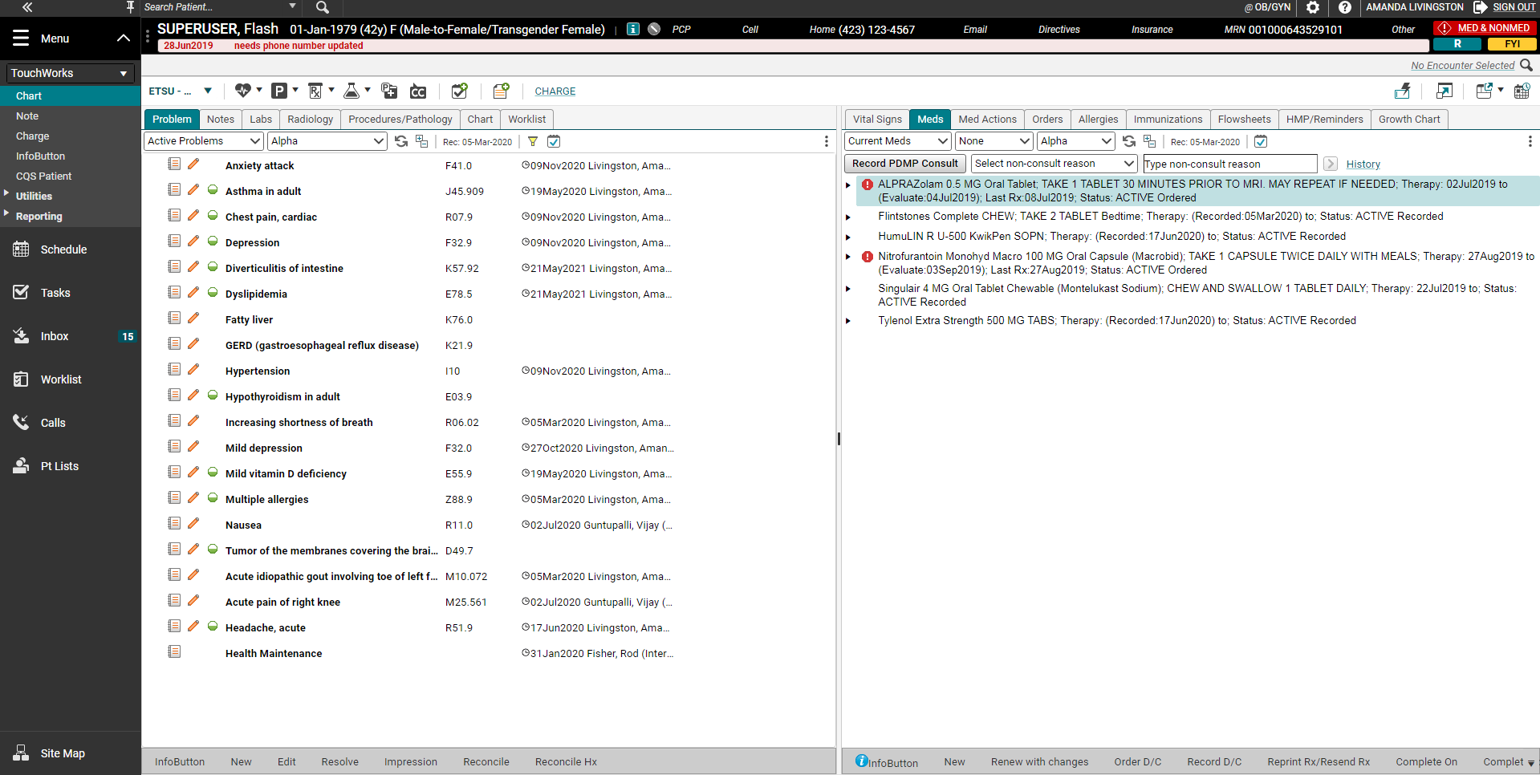
Documenting History
To begin documenting history items on your patient, go to the Chart and click on the “P” on the Clinical Toolbar.

Slide 4
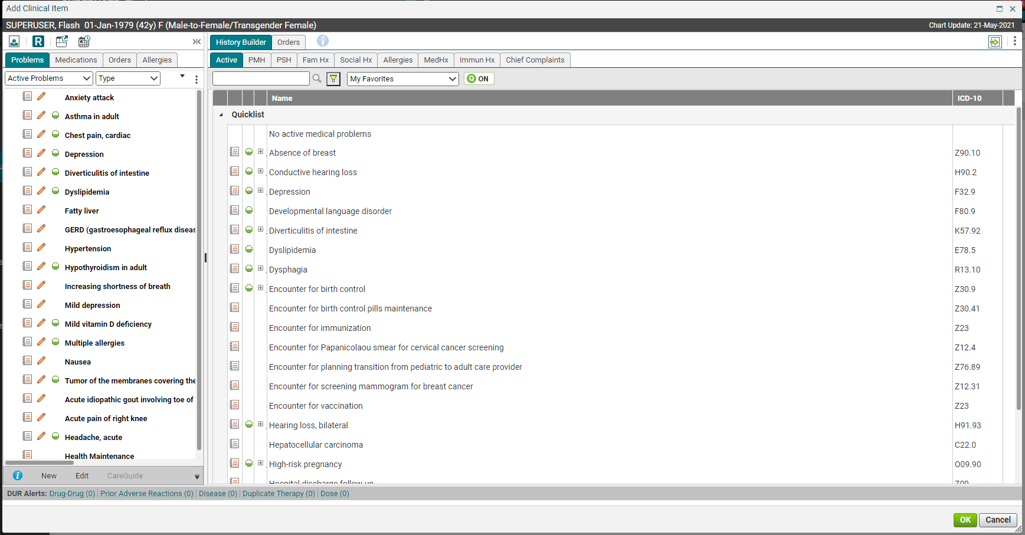
Active Problems
Clicking on the “P” icon opens up the Add Clinical Item screen (ACI), which is where all of the patient’s history and ordering will be completed. The History Builder tab contains the Active Problems (diagnoses); Past Medical History; Past Surgical History; Family History; Social History; Allergies; Medication History; Immunization History, and Chief Complaints.
Viewing Pane
When adding items to the patient’s chart, always check the Viewing Pane to make sure that they don’t already have a particular diagnosis/history item documented in their chart.

Slide 5
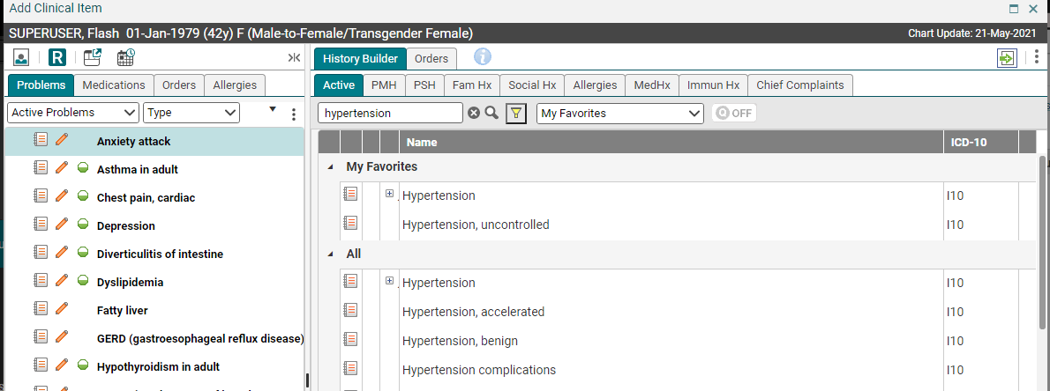
Searching Tips
To add a new diagnosis to a patient’s chart, type the name in the search field. If you click the magnifying glass (or hit “enter”), your search will return results from the entire ICD-10 dictionary. As you can see, that is going to be overwhelming for most diagnoses. So, Allscripts has devised some shortcuts to make searching easier.
Tip: you can also search by the ICD-10 code
Tip: You will need to search by 3 characters minimum.

Slide 6
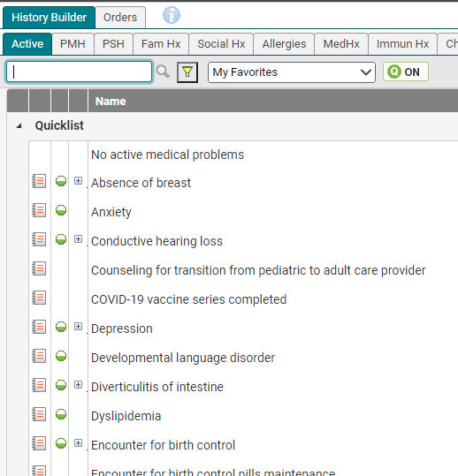
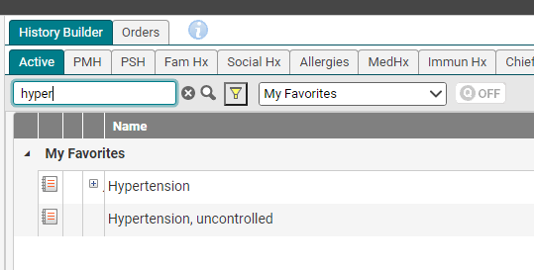
Quick Lists & Favorites
Quick Lists
Quick Lists are lists of items that are “docked” onto a particular tab. For example, every time I click on the Active tab, the following items are available, without searching.
Favorites
Favorites are “autofill” items. As soon as you start typing in the search field, they will pop up. If you have typed the entire word and still haven’t found what you need, you can click the magnifying glass or hit “enter.”
Tip: Saving items to your quick list and favorites lists will save you a LOT of time! It is highly recommended that you take advantage of these time-saving features!

Slide 7
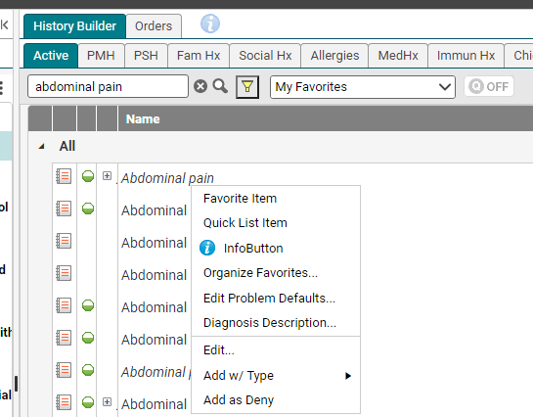
Saving to Quick Lists & Favorites
Saving an item to a Quick List/Favorites list is easy – simply right click on the item and choose either Quick List or Favorite Item. (Note: If you save an item to your Quick List, it will automatically save it as a Favorite item).
Tip: To view your Quick List, make sure that the Quick List icon is turned on.
Tip: The EHR also has the ability to set up folders for frequently ordered items. We will not cover that in these slides; however, if you are interested in using the folders, the instructions for set up and use are available on our website. https://www.quillenphysiciansehr.com/how-tos.html

Slide 8
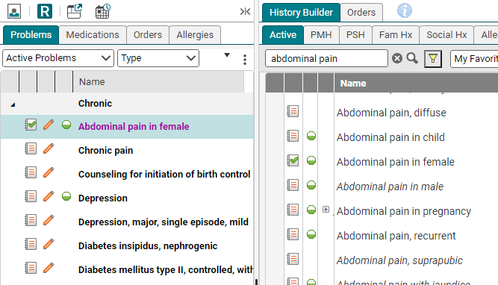
Adding/assessing an active problem
Adding an active problem (diagnosis) to the patient’s chart is simple. From the Active tab, simply click on the paper icon next to the name of the problem. This will add the problem to the patient’s chart and also assess it. It will automatically pull the item into the Assessment section of your note. The item will appear in pink in the Viewing Pane until it has been committed (saved).
Green check on the paper means the diagnosis is assessed/evaluated and will be billed. If you don’t want the dx code assessed/billed, uncheck the paper.
assessed

Slide 9
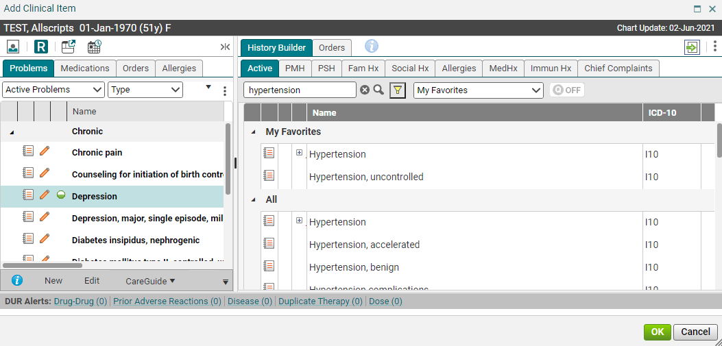
Clinical Qualifier Tool
The plus sign beside of the ICD-10 code indicates the diagnosis code can be more specific.

Slide 10
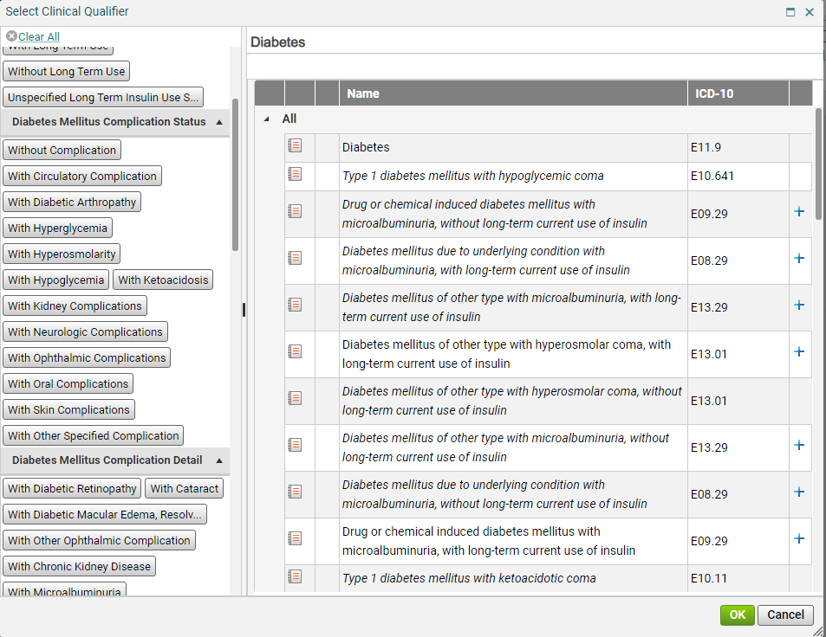
icd-10 selection
Work top to bottom on the left tool bar until out of choices. Required fields must be filled out. Be sure to add the green check box for added/assessed problem.

Slide 11
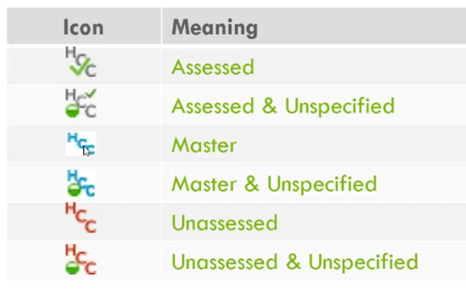
HCC Icons for Dx Codes
HCC-Hierarchical Condition Categories
CMS uses HCCs to reimburse Medicare Advantage plans based on the health of their members. It pays accurately for the predicted cost expenditures of patients by adjusting those payments based on demographic information and patient health status. The risk assessment data used is based on the diagnosis information pulled from claims and medical records which are collected by physician offices, hospital inpatient visits and in outpatient settings.
*Please note-Unassessed=Not assessed for the current calendar year
(from https://www.medirevv.com/blog/what-is-hcc-coding-understanding-todays-risk-adjustment-model)

Slide 12
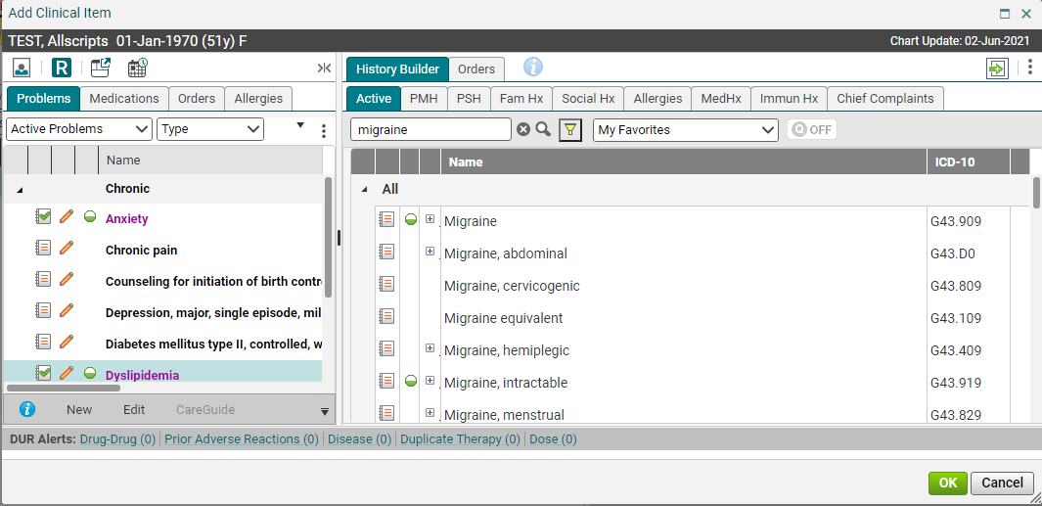
Adding multiple active problems
To add a 2nd active problem, simply clear out the search field by clicking the “x” and type in the new problem. Click the paper icon to add it to the chart.
To save these items, click OK.

Slide 13
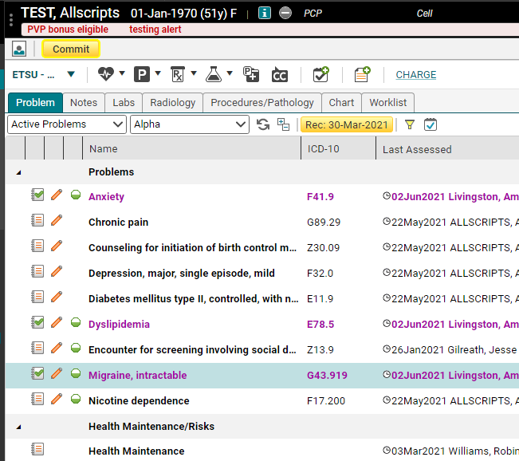
Committing problems
Once you click OK, you will be returned to the Chart Items in pink are unsaved items. To save them, click the yellow Commit button. We recommend that you commit after adding approximately 10 items to the chart.
There is no auto-save feature in Allscripts, so commit often!

Slide 14
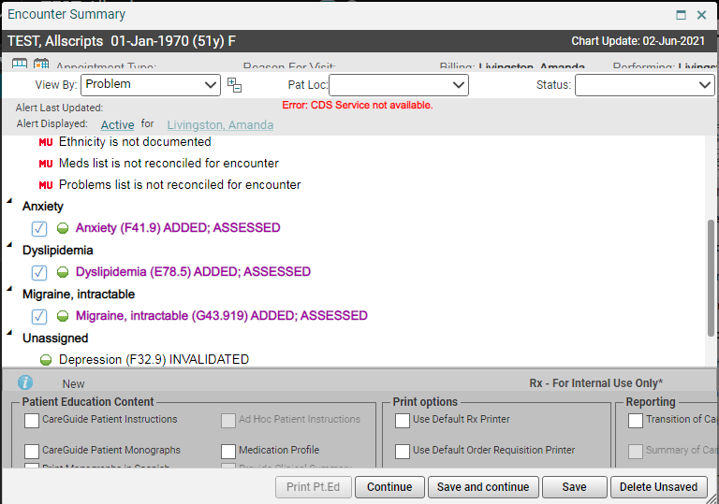
Encounter summary
Clicking on the Commit button will pull up the Encounter Summary. This allows you to review your changes and either Save and Continue or Delete Unsaved. If there is an item that you do NOT want to save, you can uncheck the box, and then click Save and Continue to save the remainder of your items.
Tip: The Encounter Summary also contains reminders of items that need to be taken care of before the patient checks out. The MU Alerts relate to Meaningful Use. The Alerts relate to medical items that need attention. Right clicking on an MU item will give you options for completion.

Slide 15
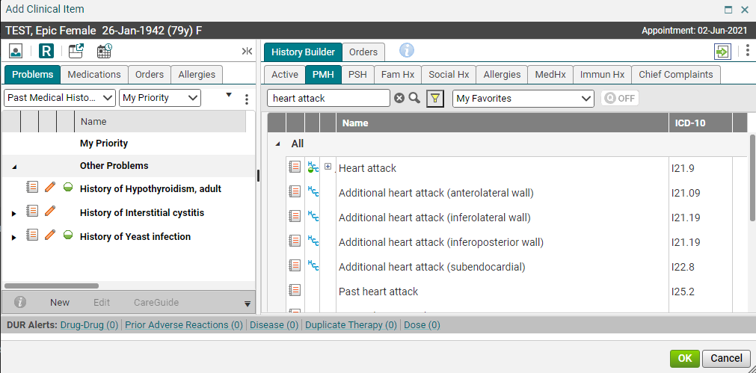
Past medical history
Once you’ve committed your changes, click on the “P” again to get back into the ACI.
The Past Medical History tab is similar to the Active Problems tab in terms of searching. You can set up Quick Lists and Favorites on each of the tabs in the ACI.
To add a PMH item to the patient’s chart, click on the NAME of the item. Don’t click the paper icon unless you are actually ASSESSING that item at the current visit. In other words, if you want the item to show up in the Assessment section of your note, click the paper icon. To just add it to the chart, click the name (to add the check box to the left of the paper).

Slide 16
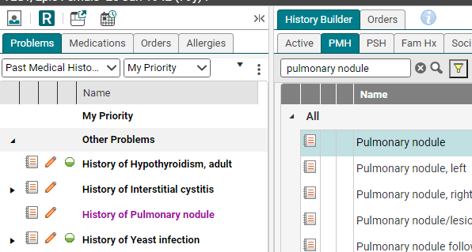
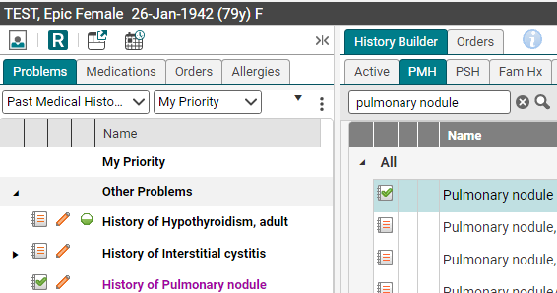
Adding vs assessing problems
If you click on the Name of the item (i.e., Pulmonary nodule), it will only add it to the PMH section in your note. It will NOT show up in the Assessment section.
If you click on the Paper icon, it will add a green checkmark on the paper icon. This indicates that the item is being assessed, and it will show up in the assessment section of the note.
REMEMBER: Check mark on paper is assessment/billing dx code.

Slide 17
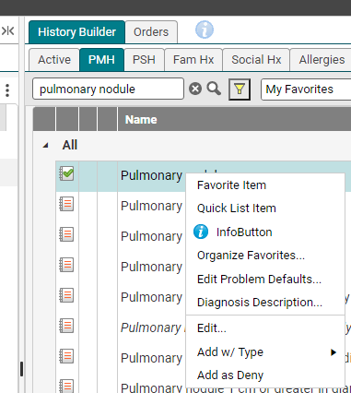
Adding details
You can easily add additional details to any problem by right-clicking on the problem and choosing Edit

Slide 18
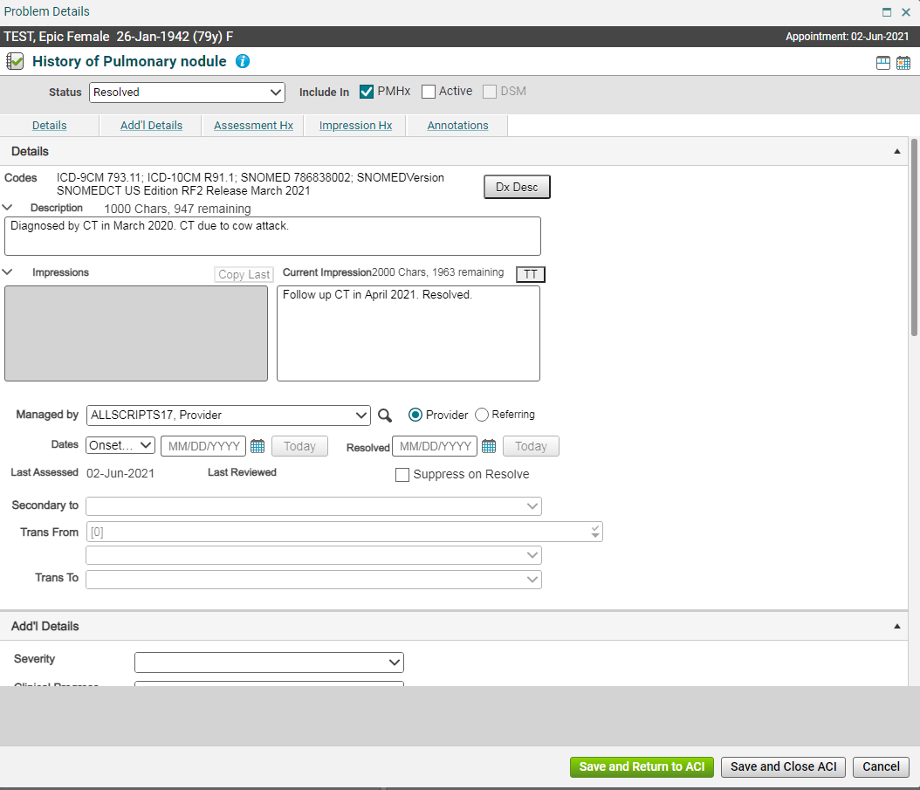
Adding details
Items added to the Description field will show up in the note and on the Chart.
Items added to the Current Impression field will be visible on the Chart.
You can also add an onset date, resolution date, and managing provider, if you like.
Tip: Double clicking on the problem from the Clinical Desktop will open up a window with all the details and impression history.

Slide 19
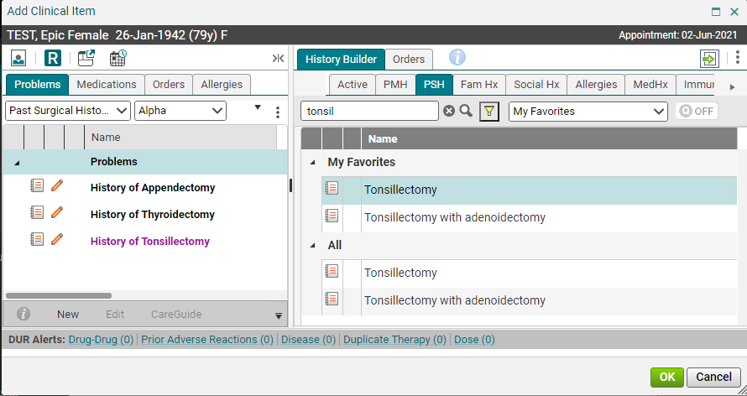
Past surgical history
The Past Surgical History tab works the same way as the PMH tab. Search for your item in the Search field; right click and save it as a Quick List item if you use it frequently, and click on the NAME to add it to the patient’s chart.

Slide 20
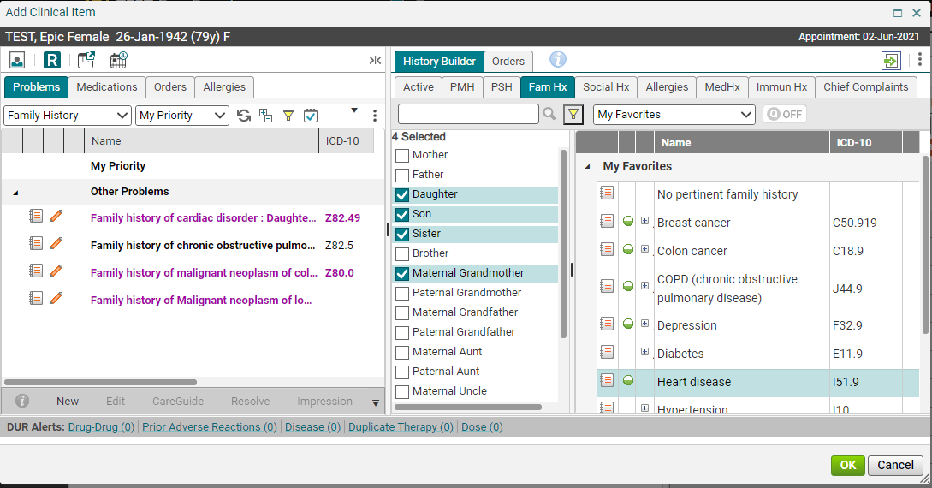
Family history
The Family History tab works a little differently from the other tabs. If you click on the relationship before you choose the family history, it will indicate which family member had the history. You can choose multiple family members for one diagnosis, as well. Family History for first degree relatives needs to be documented.

Slide 21
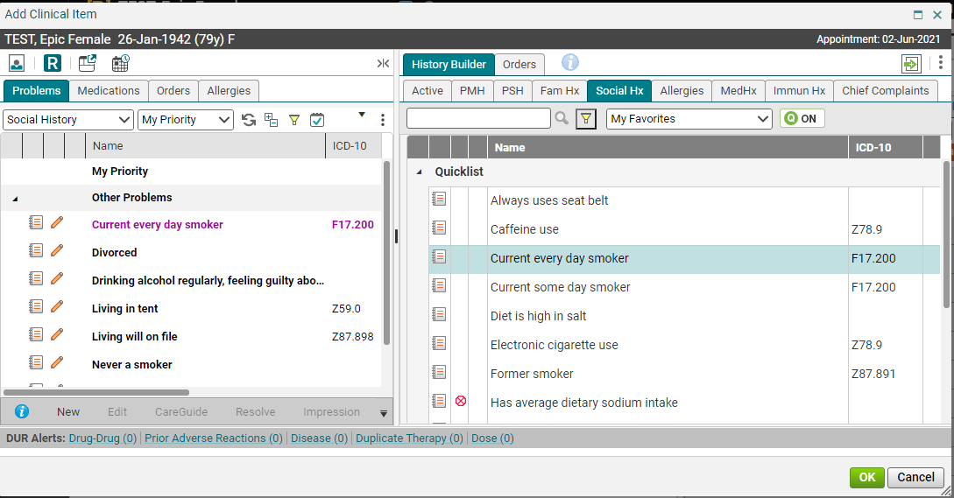
Social history
A smoking status MUST be entered in every patient who is 13 years of age and older. There are numerous smoking statuses available in the Social Hx section, but there are only 8 that will satisfy the Quality Program requirements. Those are listed on Slide #27. Make sure you document a smoking status on all of your eligible patients.

Slide 22
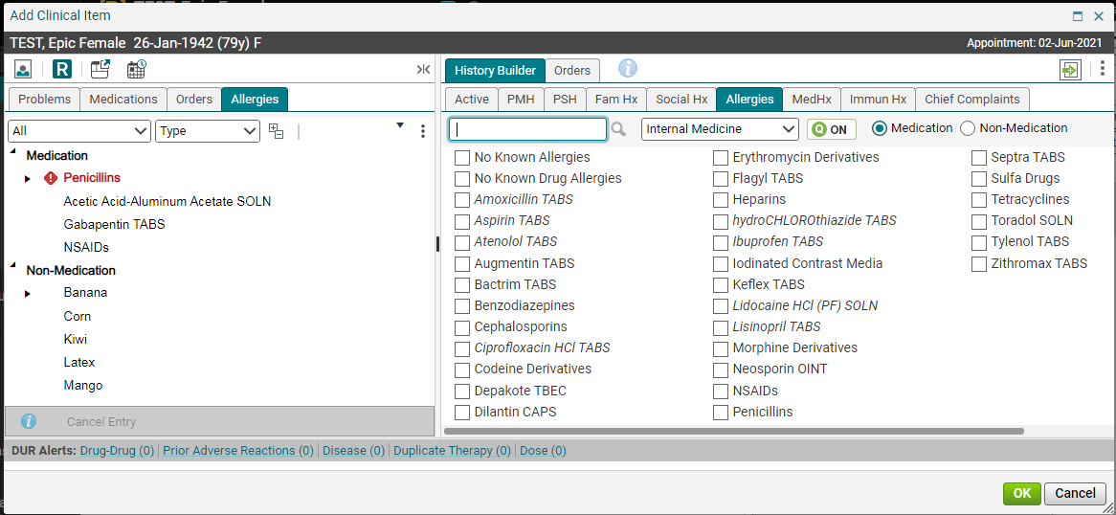
allergies
The only thing that is different on the Allergies tab is that you will need to make sure you have the appropriate radio button clicked – for Medication or Non-Medication allergies. If you search for “strawberry” and the Medication button is checked, you will only get fragrances and flavorings.

Slide 23
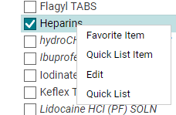
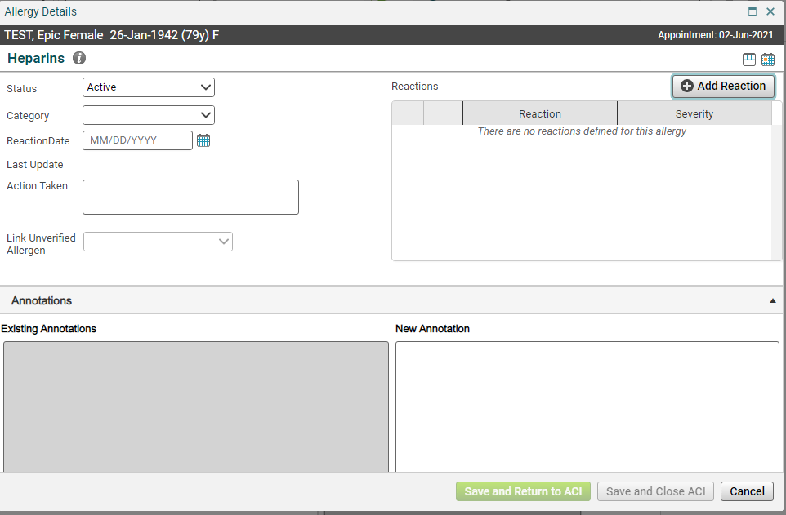
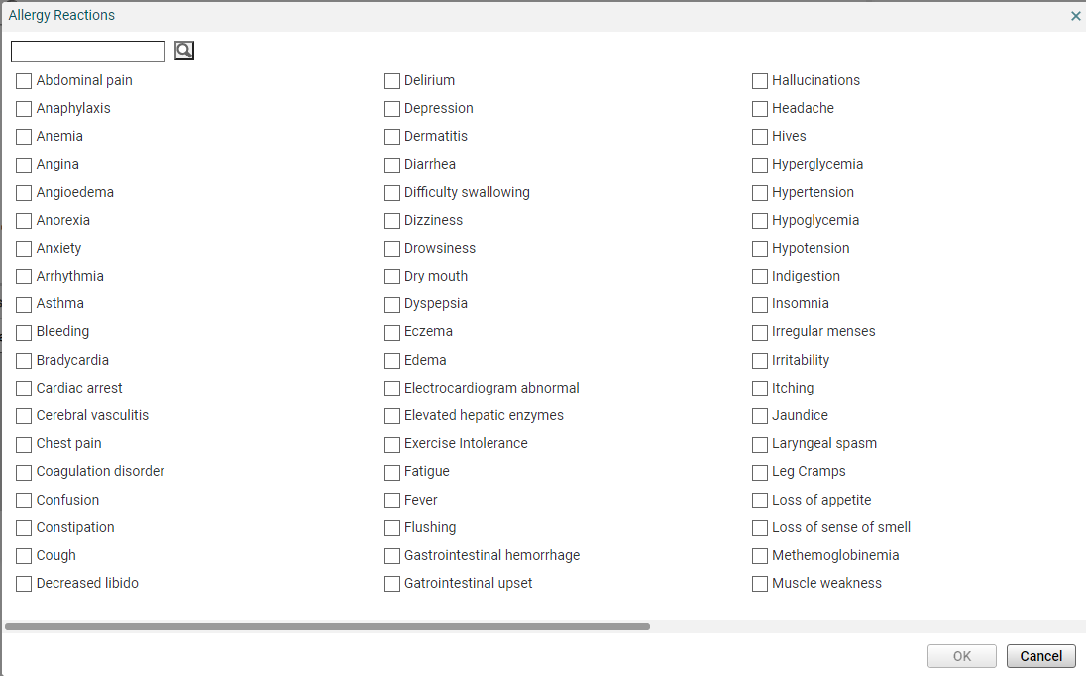
Adding reactions to allergies
To add details to an allergy, right click and edit.
This opens up a details box where you can document the status, category, a reaction date and a reaction type. To document a reaction, click on the + Add Reaction button and check the box next to the appropriate reaction type. If a reaction is severe, it will mark it with an icon

Slide 24
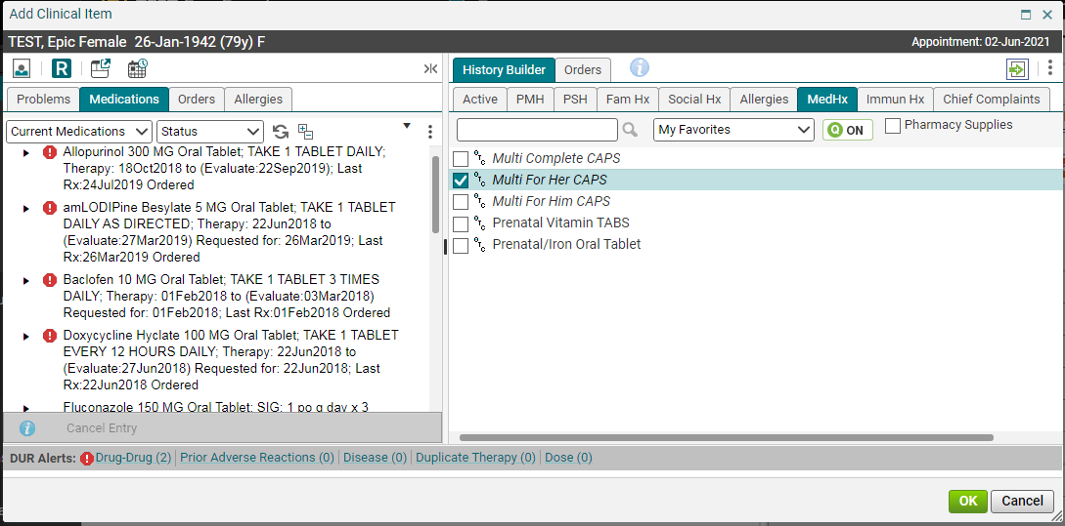
Medication history
Don’t forget to check Pharmacy Supplies when search for pharmacy supplies.
The Med Hx tab is where you will document medications that the patient states they are on (not medications that you are ordering for the patient). If the patient isn’t sure what dosage they are on, there are some generic options that can be used. This includes OTC.
Tip: Before adding any medications, review the medication list – it’s possible that the medication has already been added to the patient’s chart by another provider/nurse.

Slide 25
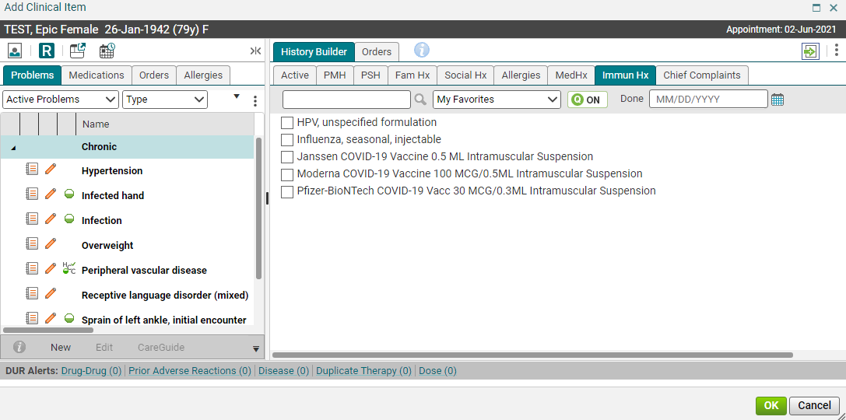
Immunization history
Please note the names of the Covid vaccines in the EHR.
The Immun Hx tab is where you will document immunizations that the patient has had done in the past. Clicking the box will open a details box which will require a date. The date can also be entered in the Done field on the ACI.

Slide 26
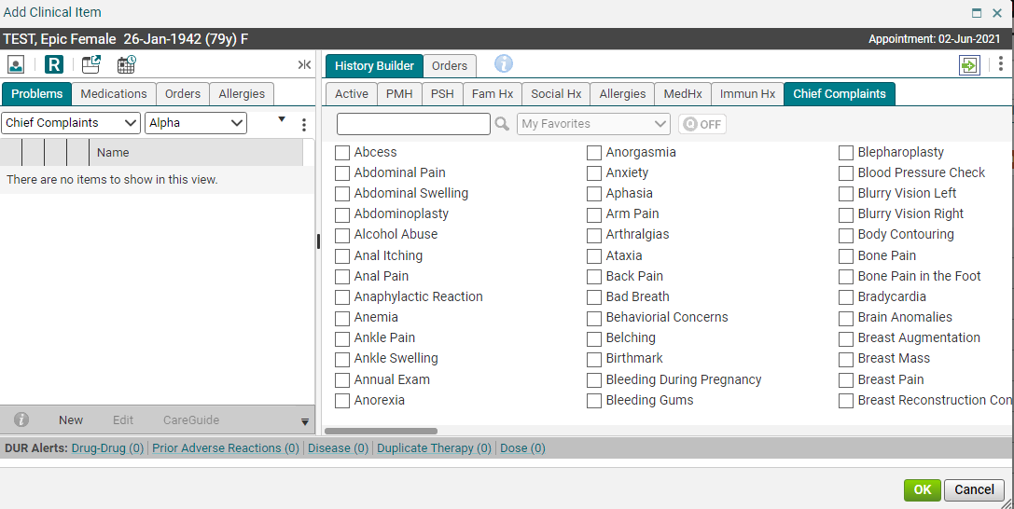
Chief complaints
Tip: The chief complaint is the symptom, not the diagnosis. So, you will find “shortness of breath,” but not “asthma.” Also, once you make the diagnosis of asthma, you will need to add that to the patient’s chart from the Active problems tab.
Typically, the nurse will document the chief complaints when she begins the note. We do have some clinics, however, where the physician starts their own note. In those cases, simply check the box next to the appropriate complaint and then click OK. In other instances, it is typed into the note, and this section isn’t used often.

Slide 27
Items to save to the quick list
It is recommended that you save the following items to your history tabs, so that you can find them easily.
PMH tab
PSH tab
Social Hx tab
Med Hx tab

Slide 28
Please proceed to the next module – ordering and managing rx

