Slide 1
Quillen ETSU Physicians
Module 3: Ordering & Managing Prescriptions
Provider Training Module
Allscripts Touchworks EHR
Quillen EHR Team
Phone: (423) 282-6122, Option 1
June 2021

Slide 2
Module instructions
There are a total of 5 modules that need to be completed prior to the on-site training. It is REQUIRED that you complete all of the modules PRIOR to training.
These modules are intended to serve two purposes: as an introduction to the system, and as a reference. The modules are very detailed. As such, we don’t expect you to retain all of the information in the slides before training; however, we encourage you to print the PDFs, as you will be able to refer back to them as you begin to use the system.
Training will consist mainly of mock practice sessions, so a basic knowledge of the system prior to training is essential. If you have any problems completing these modules, please contact the EHR team. (Contact info is on Slide 1 of each module).

Slide 3
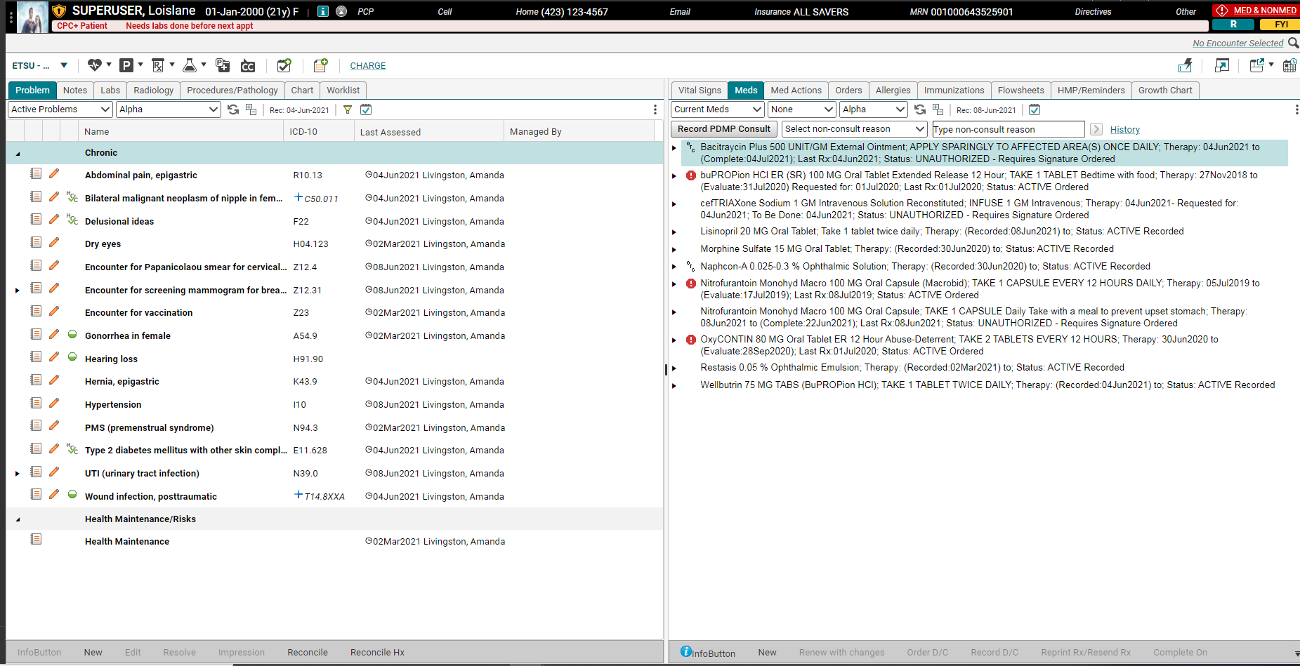
Step 1: Review Current meds
To order an Rx on a patient, first review their current meds by clicking on the Meds tab on the Chart.

Slide 4
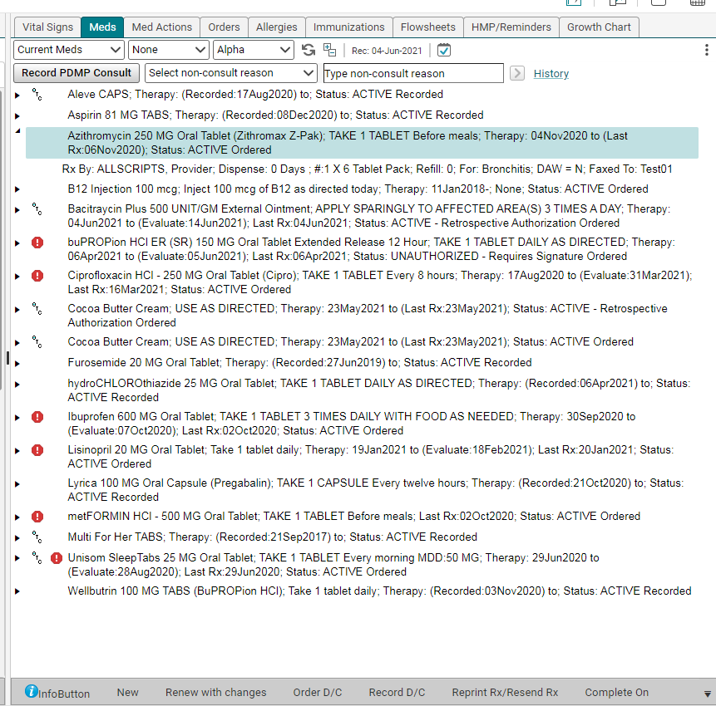
Renewing meds
If the med has already been ordered for the patient, and simply needs to be refilled, highlight the medication by single clicking it, and then click Renew with Changes.

Slide 5
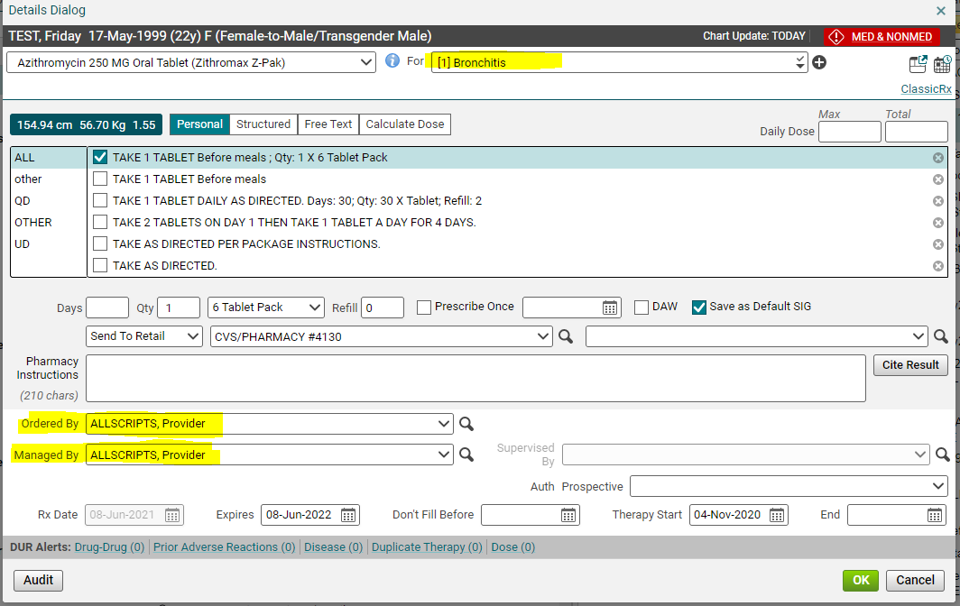
Medication details screen
After you click OK, the Medication Details screen will open up. This is where you will link the medication to a diagnosis, enter the sig information, pharmacy and supervising physician.

Slide 6
Link to Diagnosis
In the For field, select the correct existing diagnosis. To add a new dx, click the plus sign. This will take you to the Active problems tab. You can link to multiple diagnoses.
Tip: Linking your orders to a diagnosis is important for several reasons; the system will remember what you’ve ordered, which will make ordering easier on future patients, and it will also show up in the note and on the clinical summary, which is given to the patient.

Slide 7
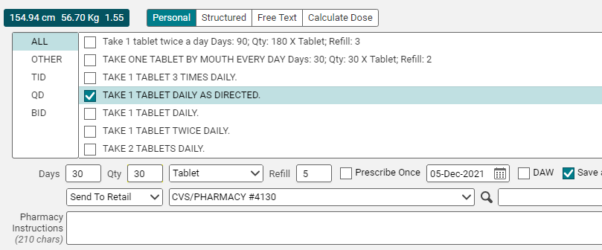
Sig Information
Once you’ve linked the Rx to a diagnosis, fill in the sig information. Most of the time, you’ll be able to just check a box in the Personal sig section, and then fill in the Qty, Days, and number of refills.

Slide 8
New Structured and Free text sigs
However, if a personal sig isn’t available, or if you are prescribing a tapered dosage that requires a free text field, you can click on either the New Structured radio button or the New Free Text radio button in order to create an appropriate sig.
Tip: If you do create a new Structured or Free Text sig, the system will automatically save it to your Personal sigs so it will be available the next time you order that particular medication.

Slide 9
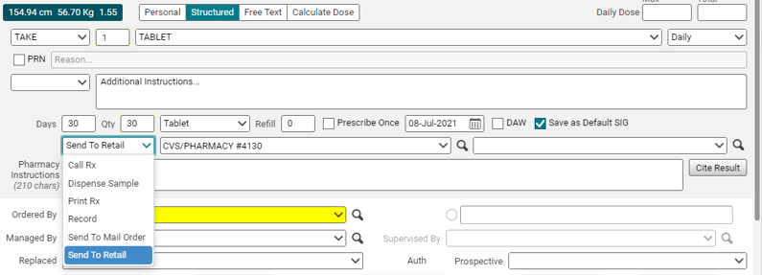
Send to pharmacy
Once you’ve filled out the sig info, choose how you want the sig to be sent to the pharmacy.
Send to Retail – e-scribes it to the pharmacy (default. This is how most scripts will be sent)
Send to Mail Order – e-scribes it to the patient’s mail order pharmacy
Call Rx – sends task to nurse to call in the script
Print Rx – Prints the script on prescription paper
Record – simply records it in the chart. Does not send to pharmacy

Slide 10
Pharmacy field
If the Send to: field is set to Send to Retail/Send to Mail Order, a pharmacy field will pull in. If your nurse has added the patient’s pharmacy to their chart, it will pull in to this field. If the patient has more than one pharmacy, you can choose the correct option by clicking the drop down arrow.
Tip: If the correct pharmacy isn’t available in the drop down, you can do a search by clicking on the binoculars.

Slide 11
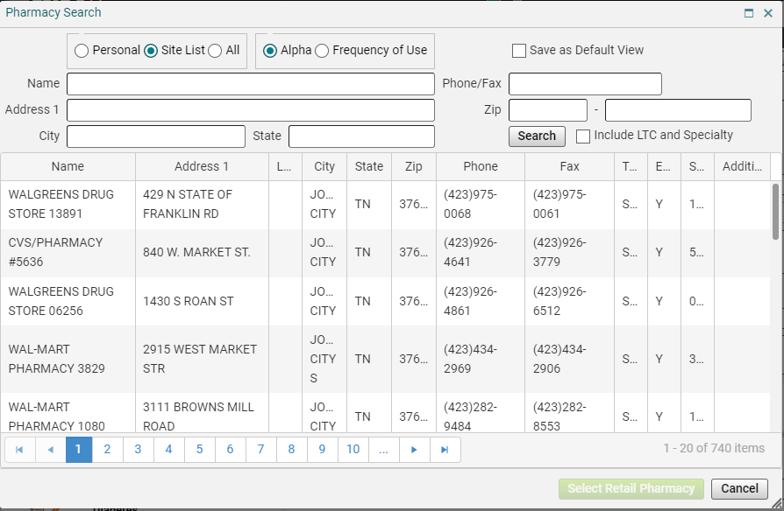
Pharmacy search
Clicking the magnifying glass will pull up the Pharmacy Search screen. To search, first, scroll down through the Site List (this shows every pharmacy that has been used by users in your clinic). If that doesn’t give you what you’re looking for, change the radio button to All, and then search by the pharmacy name and a city or state.

Slide 12
Ordered by/Supervised by
Once you’ve pulled in the pharmacy, pull your preceptor’s name into the Ordered by and Managed by fields. Click OK. If the name is not in your dropdown box, use the magnifying glass to search.

Slide 13
Committing changes
Once you click OK, you will be taken back to the Chart.. Notice that the Commit button is now in yellow, which means there are items that require committing (saving). Additionally, the script has been added to the Meds tab. Note, the system will automatically change from brand name drugs to the generic drugs.
Tip: This script has not yet been sent to the pharmacy, because it hasn’t been committed!

Slide 14
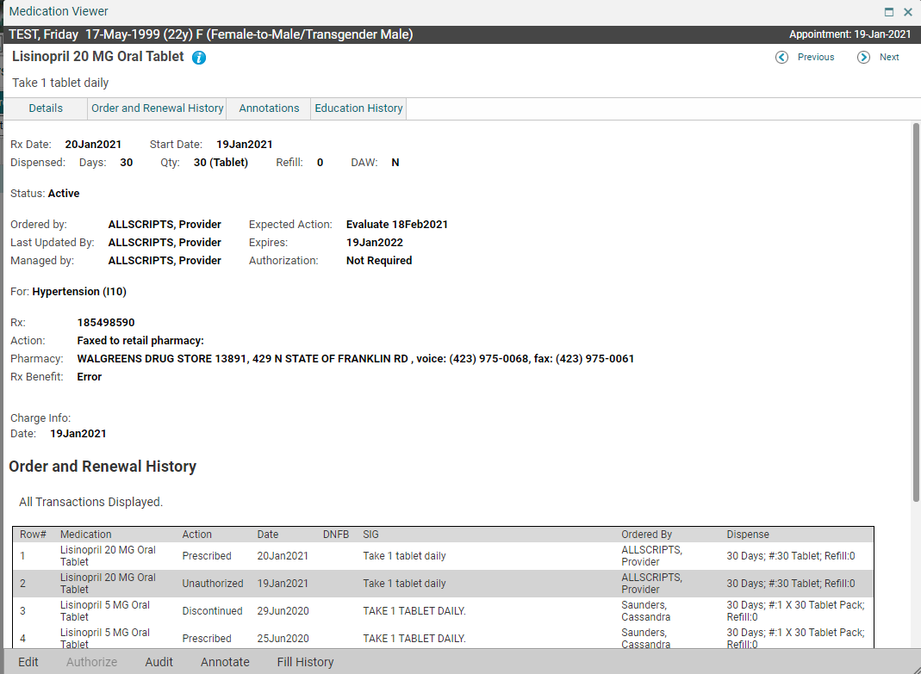
Medication viewer
Once you commit the Rx, it will be sent to the pharmacy. If you ever need to see the order and renewal history on a medication, double click on the medication on the Meds tab.

Slide 15
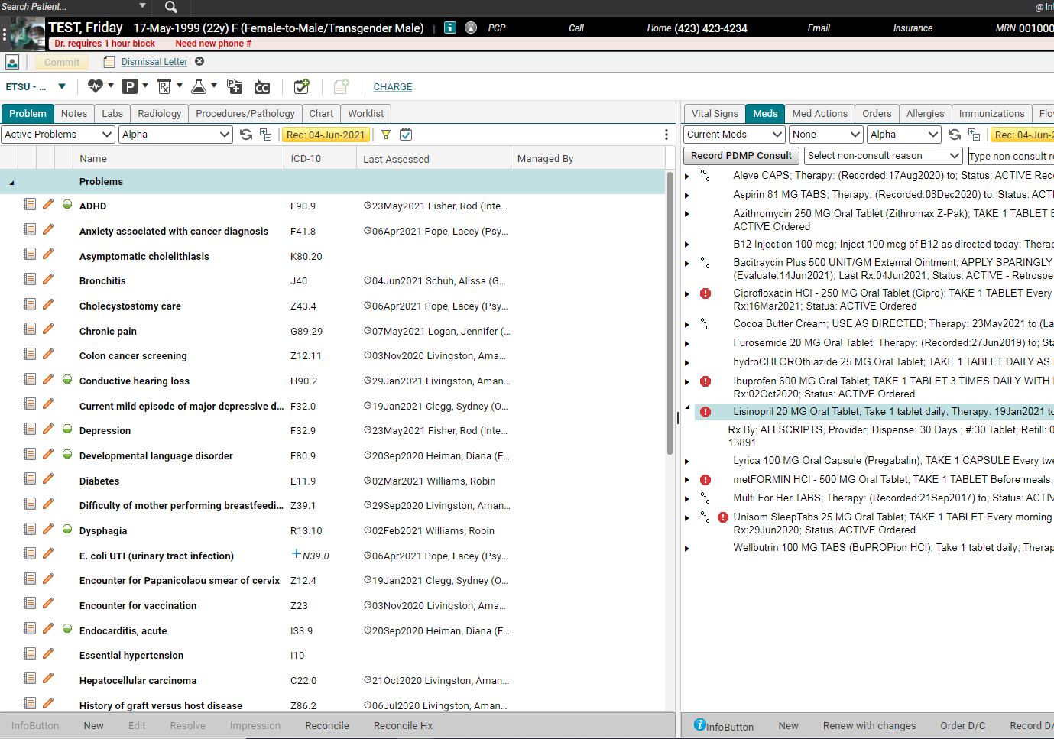
Ordering a new rx
To order a new medication on a patient, from the Clinical Desktop, you can click New Rx from the Meds tab, or you can click on the Rx icon on the Clinical Toolbar.

Slide 16
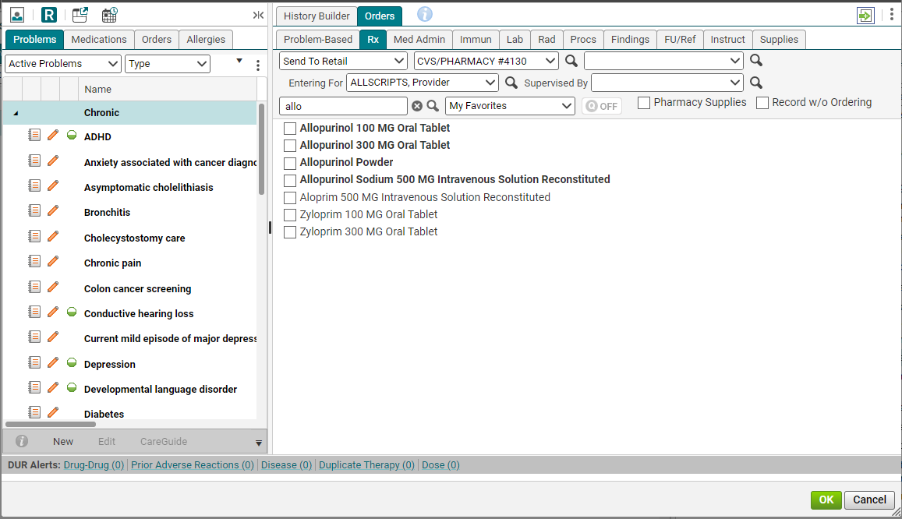
ACI screen
Clicking on the New Rx button will pull up the ACI screen. It is the same screen where you entered the patient’s history items, but now, you are on the Orders tab, instead of the History Builder tab.
Tip: You must search using a minimum of 3 characters in the ACI.

Slide 17
ACI screen
At the top of the Rx tab, you will notice that you can fill in a lot of the necessary information, before you even click on the med. If you fill in the Send to Retail, Pharmacy, and preceptor’s name in the Entering for: field, you will only have to fill out the sig information when you click the medication to order it. Additionally, this information will be saved for subsequent medications.

Slide 18
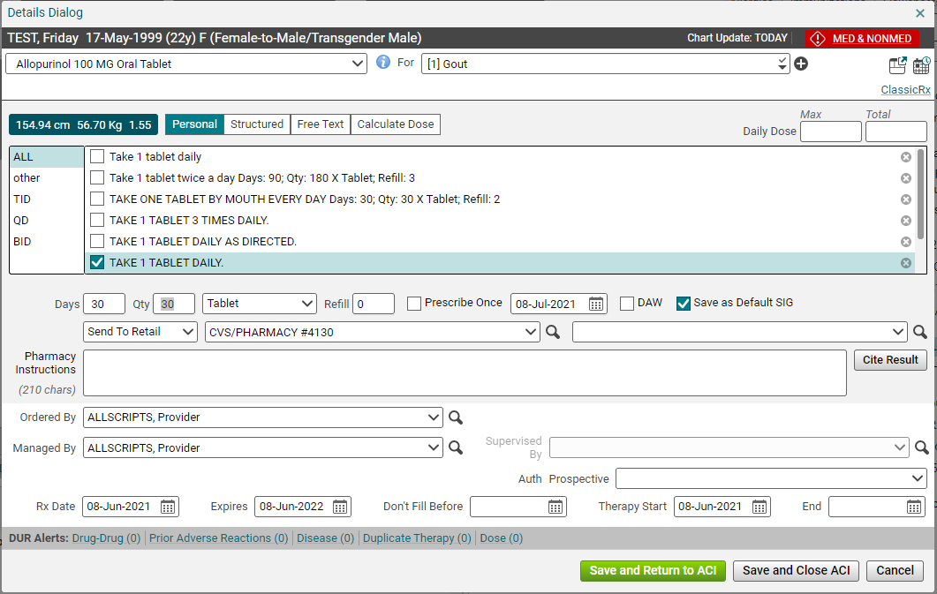
New rx – sig info
Once you check the box next to the medication you want to prescribe, the Medication Details box will pop up. Fill in the For field and the sig information. The Ordered by: and Managed by: fields too.

Slide 19
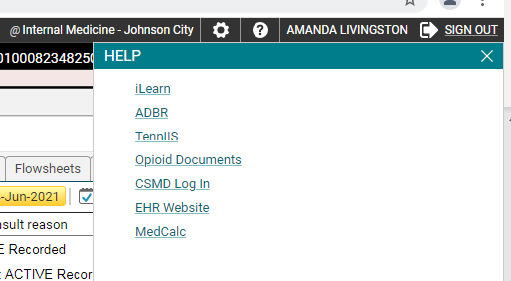
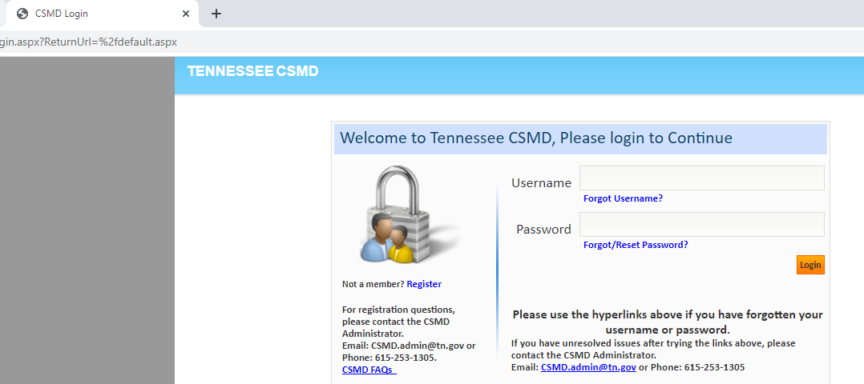
CSMD
To check CSMD, go the ? In the upper right corner for HELP.
Click CSMD Log In.
Log into CSMD.

Slide 20
CSMD
4. After querying the database, return to the patient’s chart in Allscripts. Either from the Meds tab on the Chart, or from within the note Note under Current Medications or in the Plan section, click the Record PDMP Consult button.
5. Preceptors are trained on EPCS when registered.
6. History shows the previous times the PDMP Consult button was clicked.

Slide 21
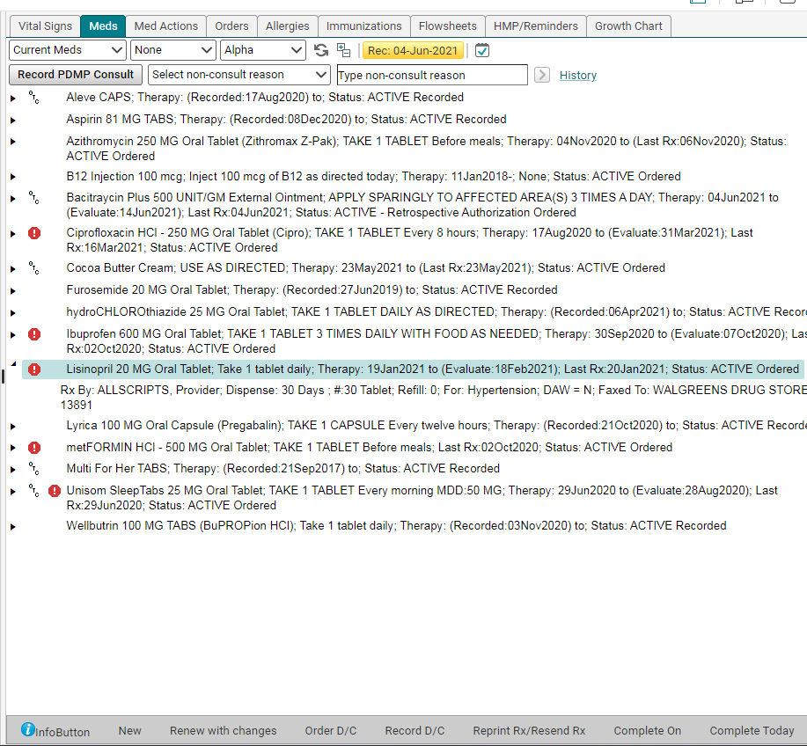
Managing the medication list
It is crucial that the patient’s medication list be kept current and up to date. Fortunately, this is simple. Highlight the med, and then choose either Completed On or Record D/C from the toolbar.

Slide 22
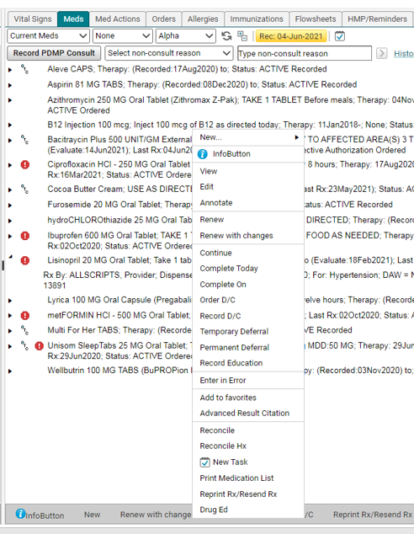
Managing the medication list
The EHR team recommends only using Record D/C at this time.
If neither of those options are appropriate, you can highlight the medication and then right click. A menu will appear which will allow you to choose Completed Today, Completed On, Order D/C (if it’s a medication you originally prescribed), and Enter in Error. This last option should only be used if the patient never took the medication, and it was truly entered into their chart accidentally.

Slide 23
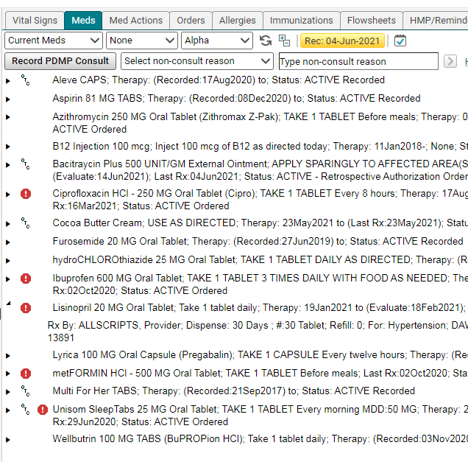
Reconciling the medication list
Once the medication list is up to date, click the yellow “Rec” button. This reconciles the list, and lets the next person to view the chart know the date that the list was last reconciled.

Slide 24
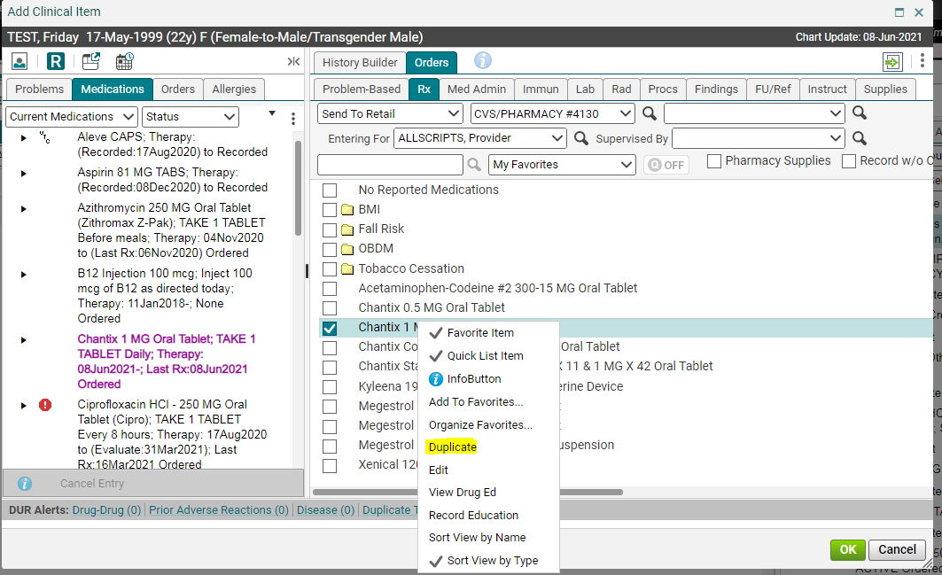
Order 2x/duplicate/split
To order two scripts, duplicate, or split a script, first enter the first script. Before you save, right click on the medication name again. Choose duplicate.

Slide 25
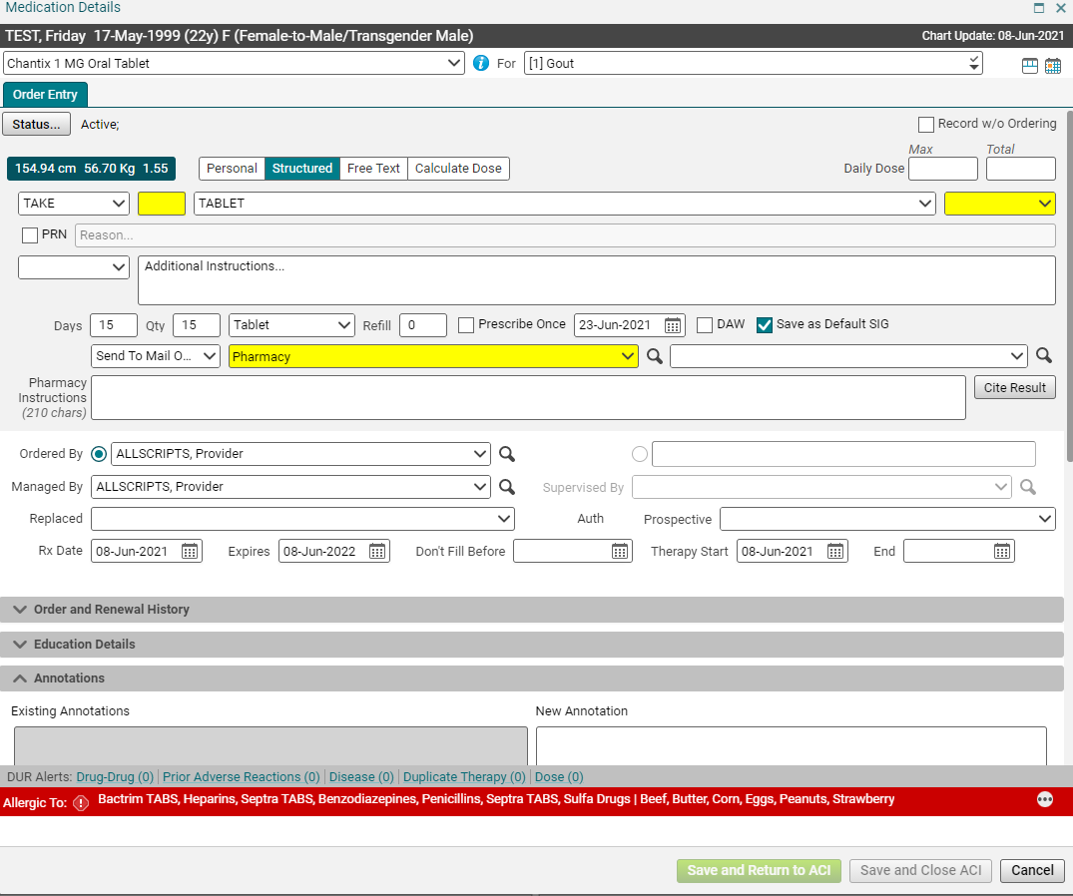
Second Script ordering
Make changes in Medication Details box, such as sending to a different pharmacy like a mail order, quantity, sig, “Bottle for School Nurse” information. Be mindful of federal limits: Schedule II 90 days and Schedule III, IV, V 180 days.

Slide 26
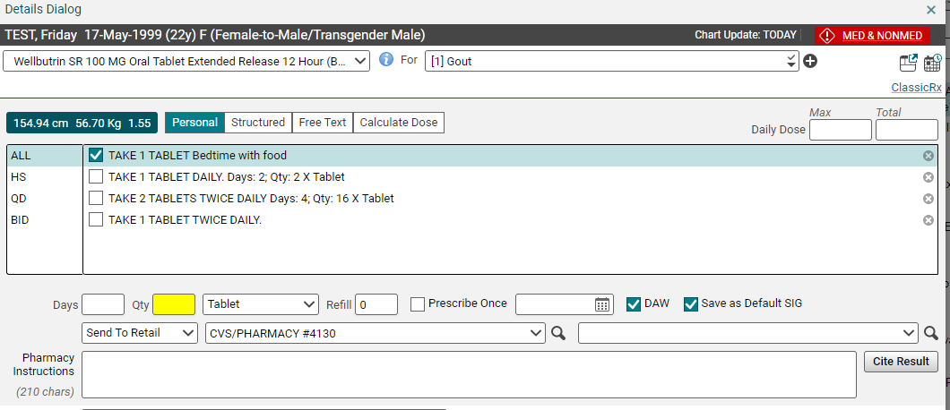
Additional features - daw
The system is designed to automatically send the generic version of a medication to the pharmacy. If you want to prescribe a brand-name drug, you will have to check the DAW box, so the system doesn’t automatically switch it to the generic version.

Slide 27
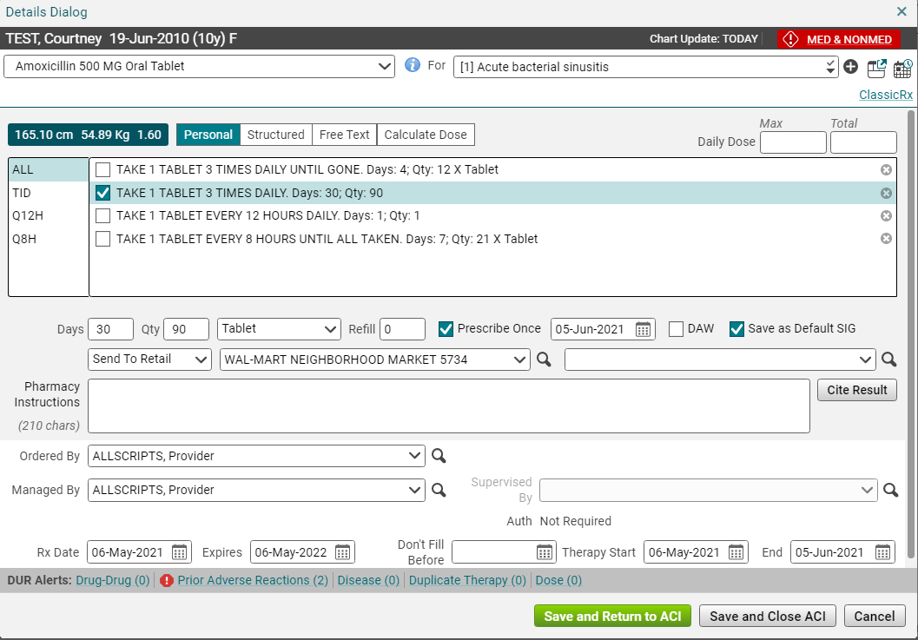
Prescribe once
Prescribe Once completes the med and automatically updates meds list by moving medication from Current Meds list to Past Meds list on date patient should be out of meds.
Prescribe Once can be used for short term meds like antibiotics, steroids.
Not checked is default keeps medication on Current Meds list even when patient is due to be out of medication and possibly needs refill.

Slide 28
Classic Rx vs. Quick Rx
Quick Rx should be fine for most prescription orders.
Automatically opens for non-controlled meds.
To dispense a sample, must use Classic Rx.
Edit and Record w/o ordering is done with Classic Rx.
Some specialty meds, pharmacies, or ePA’s will route to Classic Rx.
If you need to add Education Details, Annotations, or to view Order and Renewal History, use Classic Rx.
Click Classic Rx in blue on the top right to switch.
Some details may need to revalidated when switching to Classic Rx if they are already entered on Quick Rx.

Slide 29
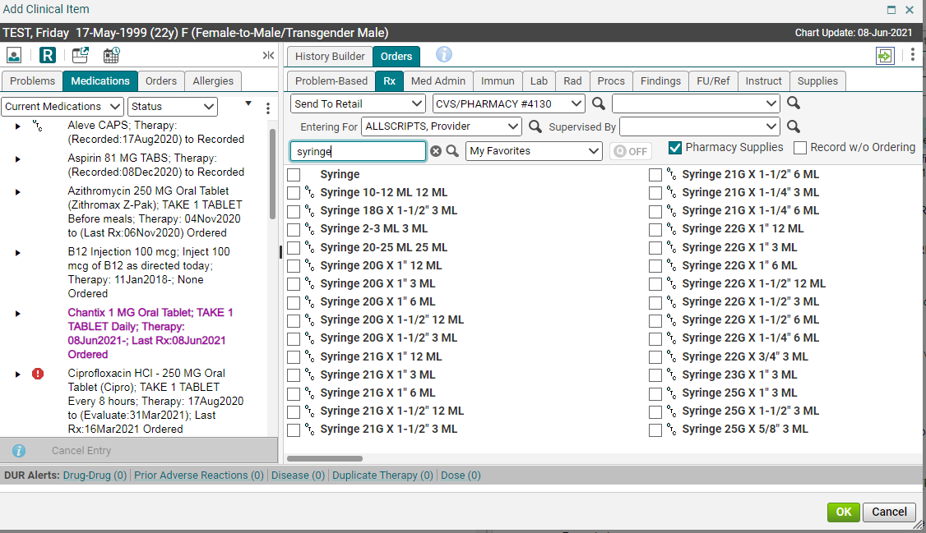
Additional features – pharmacy supplies
If you are trying to prescribe a supply, and can’t find it in the Rx tab, check the Pharmacy Supplies checkbox. This will give you more options for supplies that can be sent to the pharmacy.

Slide 30
Please proceed to the next module – ordering labs

