Slide 1
Quillen ETSU Physicians
Module 4: Ordering Labs
Provider Training Module
Allscripts Touchworks EHR
Quillen EHR Team
Phone: (423) 282-6122, Option 1
June 2021

Slide 2
Module instructions
There are a total of 5 modules that need to be completed prior to the on-site training. It is REQUIRED that you complete all of the modules PRIOR to training.
These modules are intended to serve two purposes: as an introduction to the system, and as a reference. The modules are very detailed. As such, we don’t expect you to retain all of the information in the slides before training; however, we encourage you to print the PDFs, as you will be able to refer back to them as you begin to use the system.
Training will consist mainly of mock practice sessions, so a basic knowledge of the system prior to training is essential. If you have any problems completing these modules, please contact the EHR team. (Contact info is on Slide 1 of each module).

Slide 3
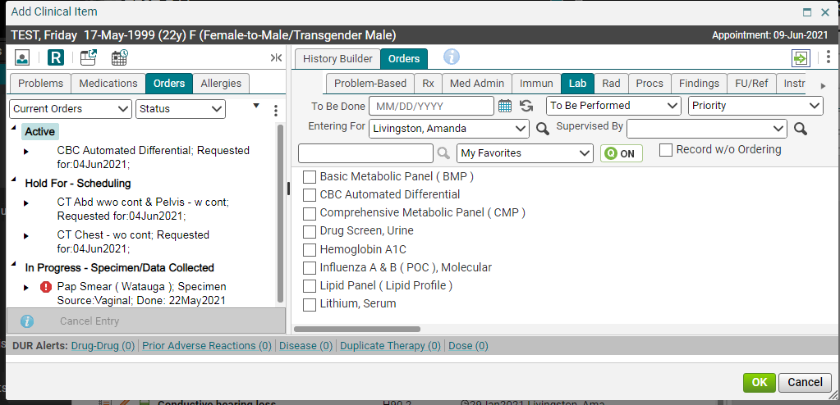
The aci screen – orders tab
From the Chart, click on the “Beaker” icon to pull up the ACI.
Select the order you want to enter using the tabs.
This is the same screen where you ordered your medications. You will order your Med Admin, Immunizations, Labs, Radiology, Procedures, Follow ups, Referrals, and Patient Education from this screen. All of these tabs work the same as the history tabs, i.e., you can create Quick Lists and Favorites Lists, as well as folders.

Slide 4
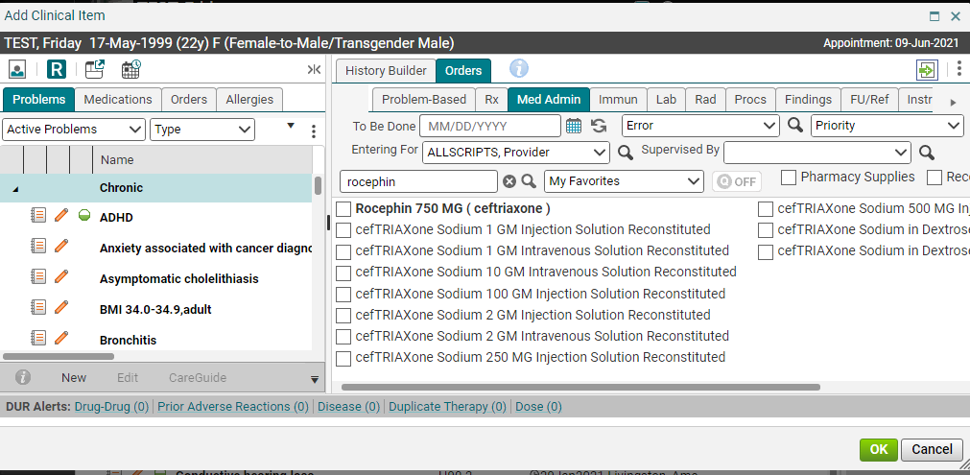
The aci screen – Med Admin
You know what to do here. Search for your medication and check the box to order it!
Notice that you are still on the Orders tab, but you are now on the Med Admin subtab.
The Med Admin tab is where you will order meds that are given in the clinic during the current visit. B12 and testosterone shots are typical examples of items ordered on the Med Admin tab. THIS DOES NOT GO TO THE PHARMACY, but to the nurse to give the medication.
Ordering an item here will generate a task to your nurse, so that he/she can give the med to the patient and document the administration details.

Slide 5
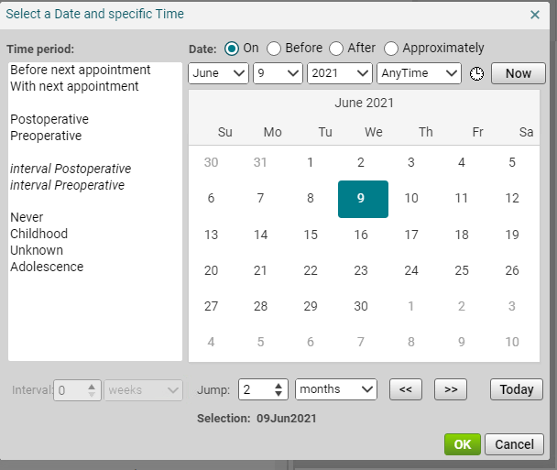
The aci screen – Med Admin
Clicking the calendar icon opens up this screen. You can click the “Now” button to pull in the current date
Ordering a med admin is similar to ordering on the Rx screen. Fill in the To Be Done field (by clicking on the calendar icon and choosing “Now”, then fill in the Entering For provider field. (You can do this on every Orders tab). Check the box next to the med you want to order.

Slide 6
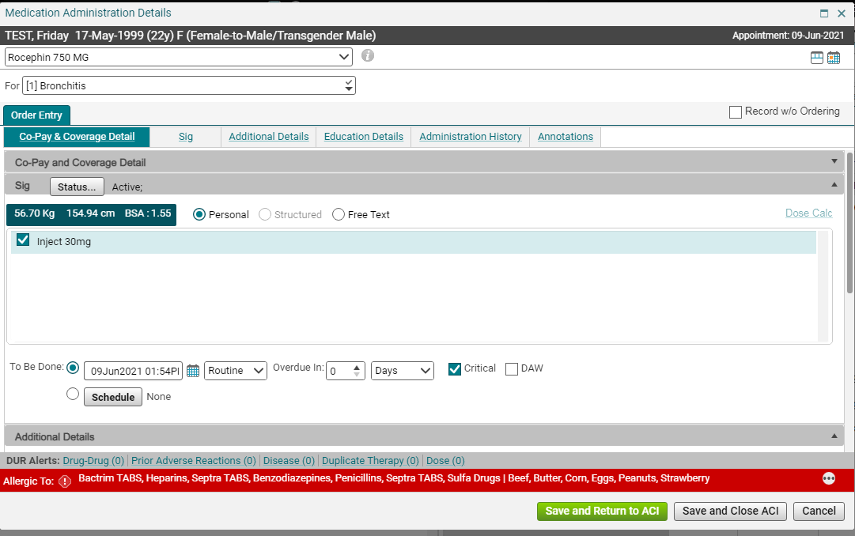
The aci screen – Med Admin
On the medication Details screen, fill in the Link to field and the sig information. Click Save and Return to ACI if you have more items to order. Click Save and Close ACI if you are finished ordering.

Slide 7
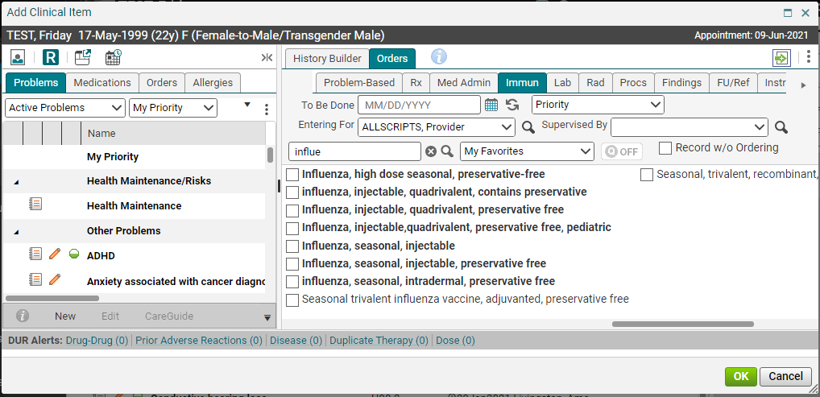
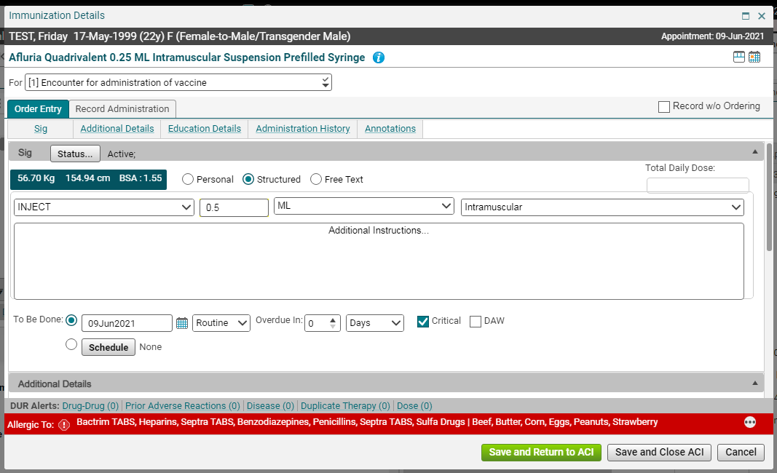
The aci screen – immunization tab
You know what to do here. Search for your immunization and check the box to order it!
On the Immunization tab, search for the immunization you want to order. Click the box next to the item you want to order. The Immunization Details screen will open up. Link the immunization and enter the sig information. This order will also generate a task to your nurse so she/he can document the administration details.

Slide 8
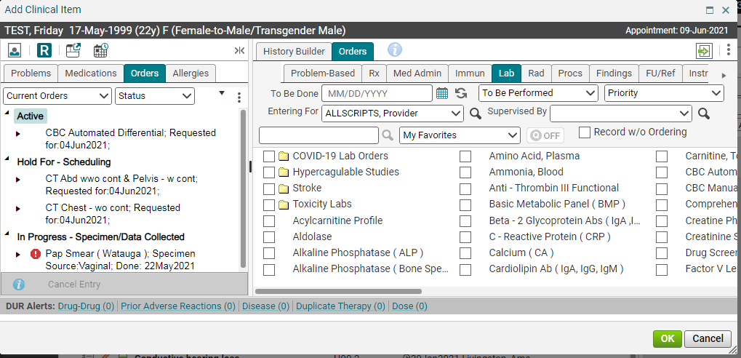
The aci screen – lab tab
To order a lab, search for the lab and check the box.
Tip: The folders that you see in the screenshot will not be covered in these modules. Instructions for setting up folders can be found on our website.

Slide 9
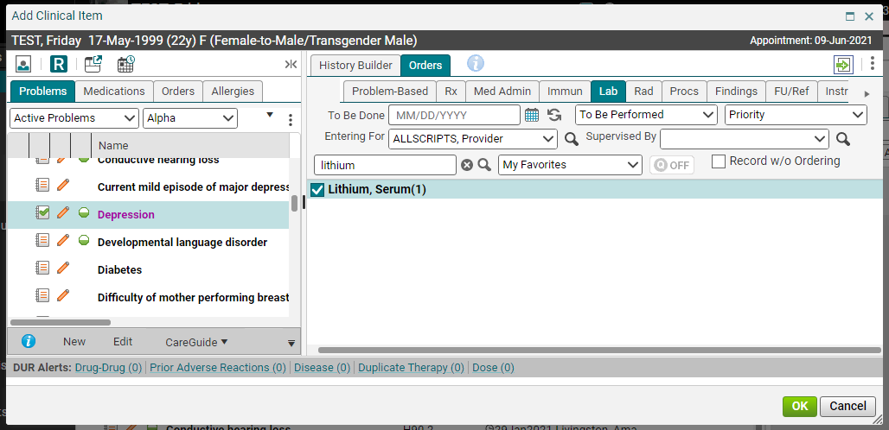
The aci screen – lab tab
Remember that Entering For field should be the precepting provider!
If you have selected a dx and filled in the “Entering for” field, when you check the box next to the lab(s) that you want to order, you should only get a small (1) after it. A secondary screen will NOT open.
A word of warning about this, however: All of our labs are set to default to our lab. If your patient wants this lab to be drawn at a different facility, you will need to right click this order and choose Edit.

Slide 10
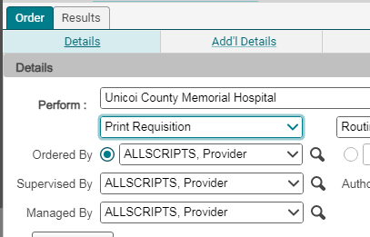
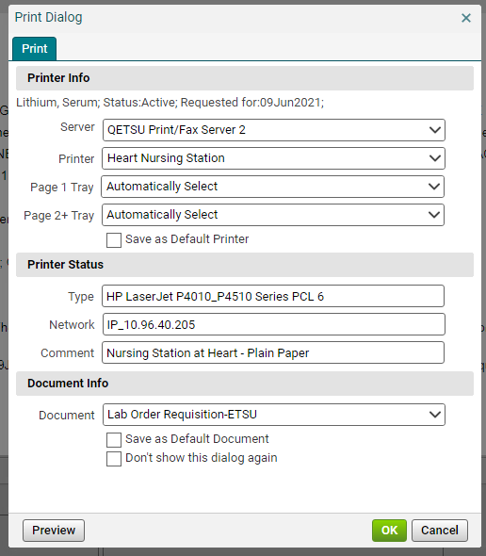
The aci screen – performing location
On the Order Details screen, available, you can choose “Other.” If you choose any location other than Orchard Lab, you will al go to the Perform: field, and change the location from Orchard Lab to the appropriate location. If the location isn’t so have to change the Send to Performing Location field to Print Requisition. Once you commit your changes, you will get a print dialog box so the requisition can be printed and given to the patient. Select the correct printer and the Lab Order Requisition- ETSU as the Document Info.

Slide 11
Linking tips for labs
There are some very strict requirements to linking a lab to a patient diagnosis, as insurance will not pay for the lab if it is linked incorrectly. If you fail to link the lab appropriately, your patient will have to pay out-of-pocket for their labs. Please review the following tips carefully, and when in doubt, ask your preceptor or nurse.
1. NEVER link the lab to the Health Maintenance Z00.00 code. This is available on every patient’s chart, but insurance will NOT pay for the majority of items linked to the Z00.00 code.
2. ALWAYS link labs to an Active Problem (i.e., never link to a PMH, SocHx or FH item.)
To get insurance to pay for a lab that you are ordering to screen for a particular diagnosis, search for the word “SCREENING” on the Active tab. There are multiple options to choose from.
If you aren’t sure what to link to, ask your preceptor or nurse. They can help you choose an appropriate diagnosis.

Slide 12
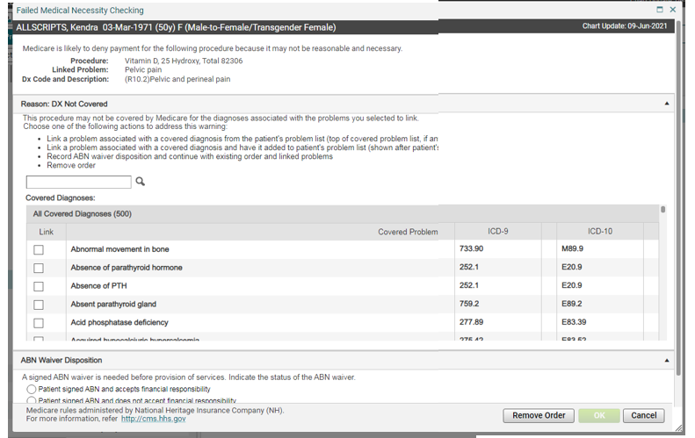
Failed Medical Necessity Checking
Some labs require a medical necessity diagnosis according to payer guidelines. The system will check for these. And if a covered diagnosis is not chosen, a Failed Medical Necessity Checking screen will open. It suggests covered diagnoses from the patient’s problem’s list. It also shows All Covered Diagnoses that are available. Choose the correct diagnosis based on clinical presentation. The lab will have the patient sign the ABN Waiver, if needed.

Slide 13
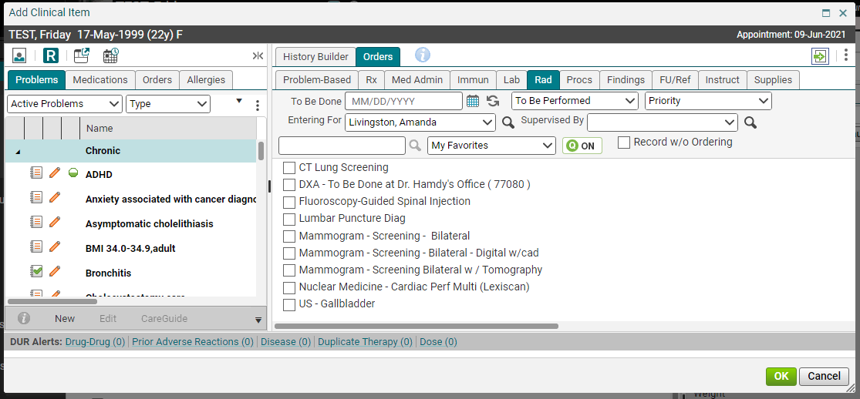
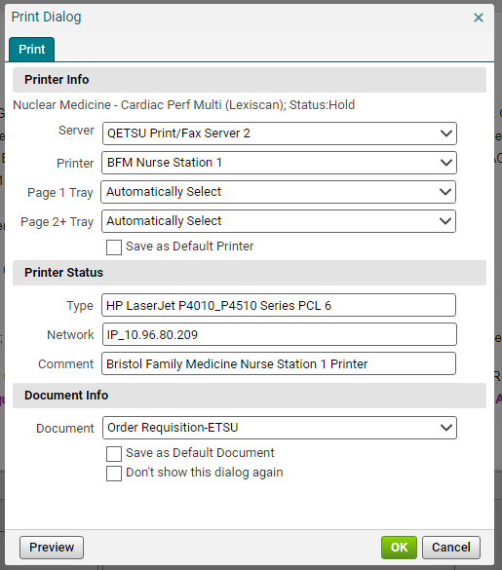
The aci screen - radiology
Searching tips for Radiology items:
Xrays – search for xray (one word, no hyphen)
Ultrasounds – search for US(space)
MRIs – search for MRI
*Allscripts requires 3 characters to search.
All radiology orders will be printed once the order is committed. Radiology orders are not currently transmitted electronically.

Slide 14
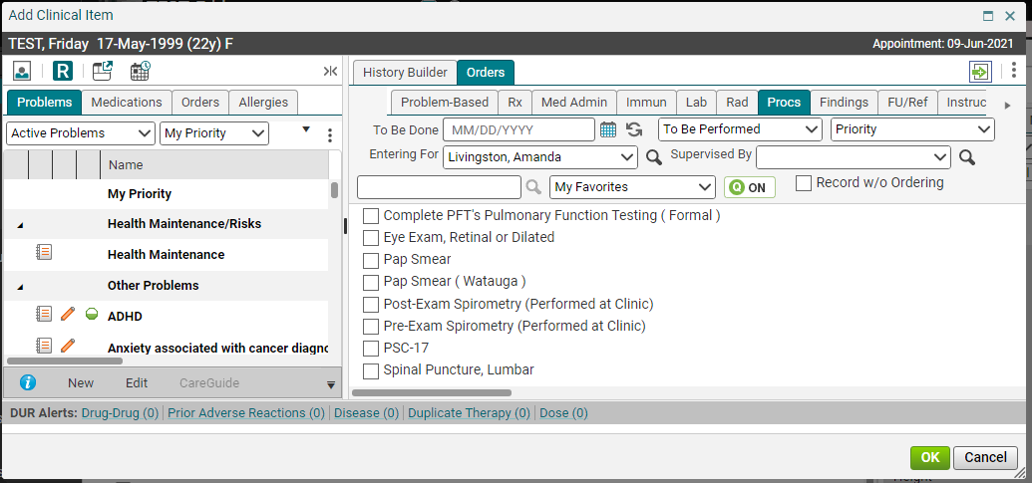
The aci screen - procedures
The Procedures tab is where you will order procedures that are performed in the clinic, as well as procedures that will be done elsewhere. If the procedure has (Performed At Clinic) in parentheses after it, it will not print a requisition. Instead, a task will be generated to either your nurse or a scheduler in your office so the procedure can be set up.

Slide 15
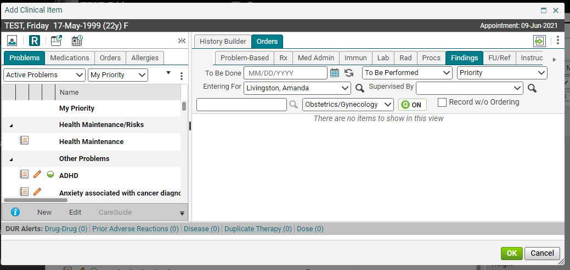
The aci screen - findings
It currently is not in use in the clinic.

Slide 16
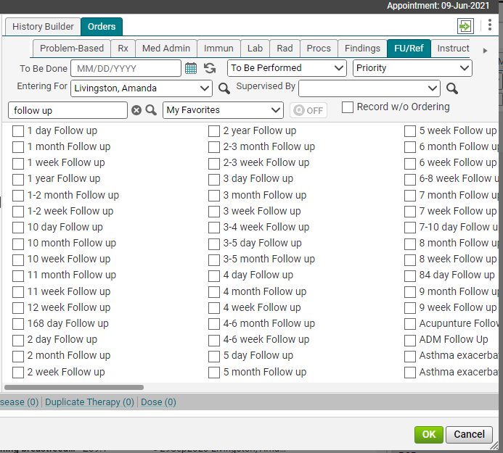
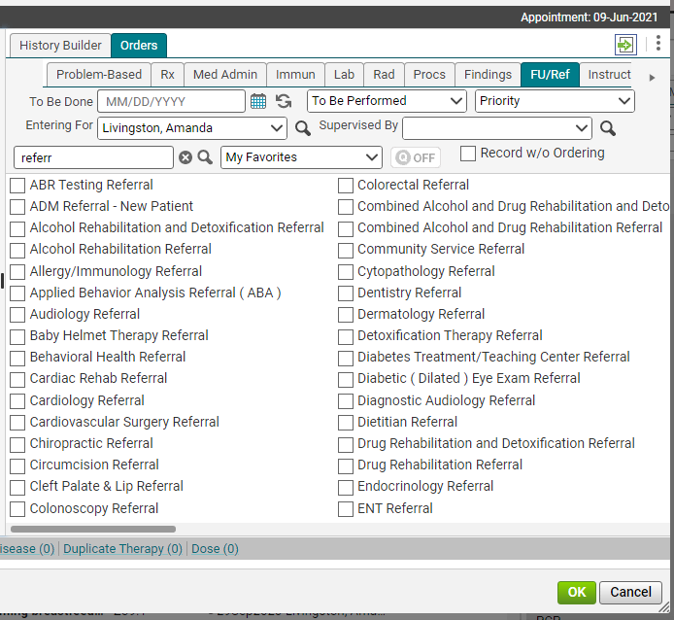
The aci screen – followup/referral
The FU/Ref tab is where you will order all of your followup and referral orders. Ordering the followup here will send a task to the front desk, so when the patient checks out, they can make the appointment. Referrals will send a task to either your nurse or your referral clerk so the referral can be set up.
Tip: To find all of the available follow ups, type “follow” in the search field.
To find referrals, type “referral” in the search field.

Slide 17
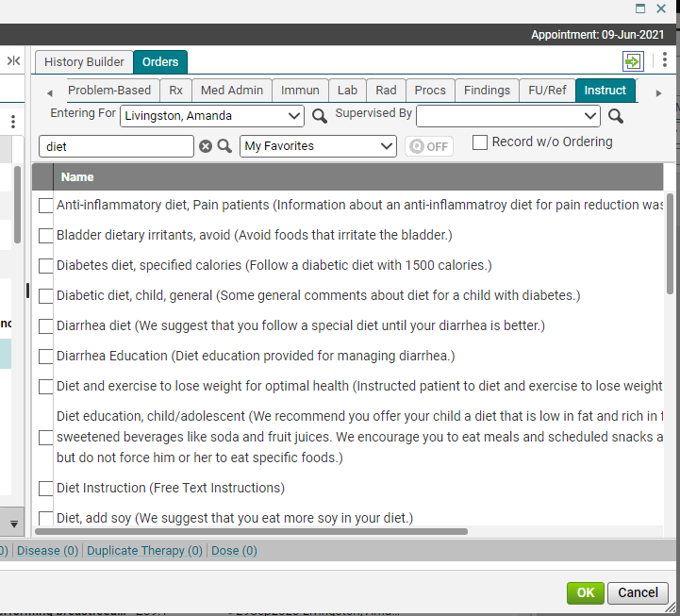
The aci screen - instructions
The Instructions tab is where you will document all of your patient education. These instructions will show up in your note, and will appear on the patient’s Clinical Summary. If you can’t find a specific education item, you may use the generic “Verbal Education Provided” or “Education Provided.”

Slide 18
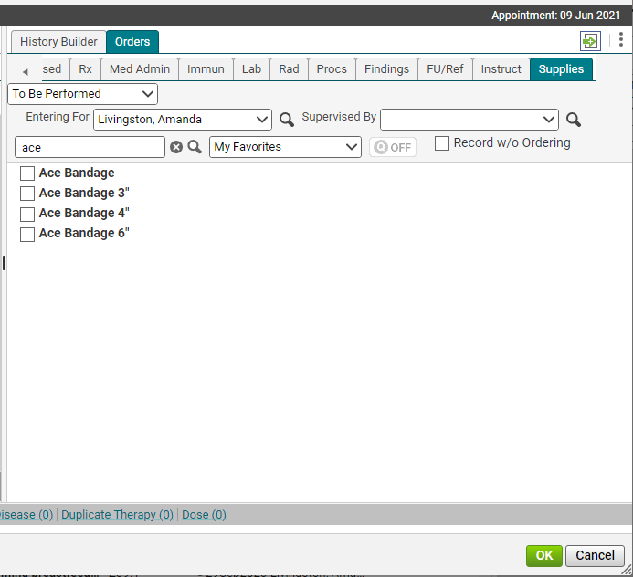
The aci screen - Supplies
The Supplies tab is for in-house supplies only. These orders do not go to the pharmacy. So, for example, if you have provided the patient with an Ace bandage, you can order it in the system so it will appear in your note.

Slide 19
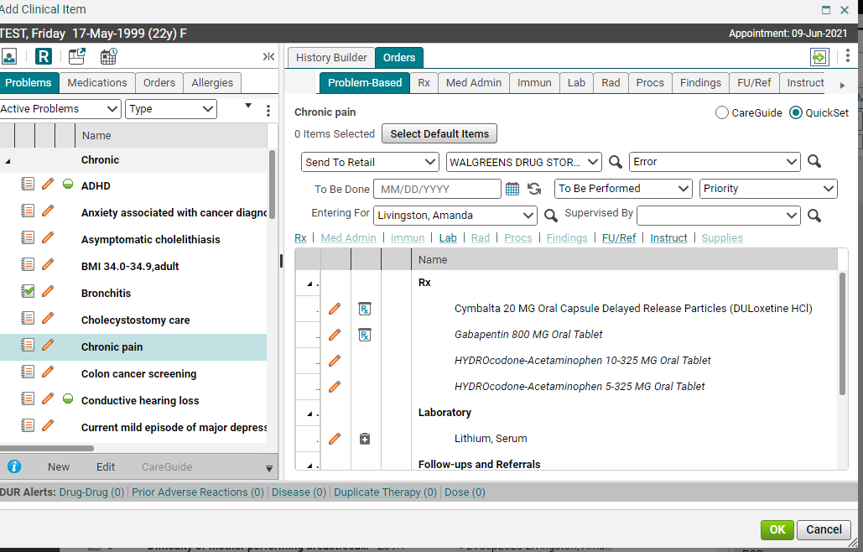
The aci screen – Problem-Based
There is a shortcut for ordering, which is on the Problem-Based tab. As you begin to use the system, it will remember the items that you ordered for particular diagnoses. So, if you have a patient with dermatitis, and you have ordered items and linked them to that dx in the past, you can go to the Problem-Based tab, assess dermatitis (by clicking on the paper icon), and all of your orders will appear on the right. Once you have highlighted a diagnosis, if you want to order one of the items, simply click in the first field next to that item. Then click OK and commit.
The majority of our providers don’t like this tab because it contains too much info.

Slide 20
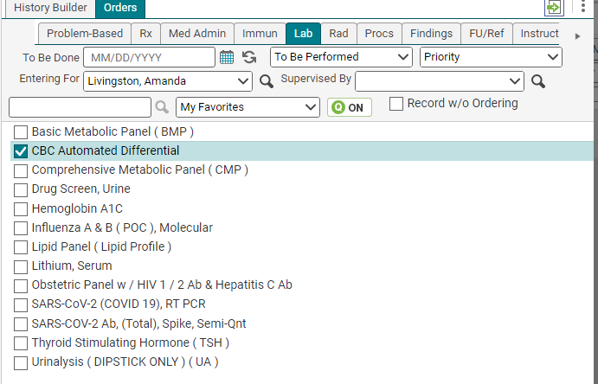
Future orders
Sometimes, you’ll want to create an order to be done in the future. To do this, simply click on the calendar next to the To Be Done: field and put in the future date.
When choosing a future date, you MUST pick an actual date. You can NOT use the “Before next appt,” or “Approximately” options. These orders will NOT cross the interface to the lab.
The orders will drop into the lab’s computer system 2 weeks before the To Be Done date, and will remain for 3 months. So, that gives you a wide window from which to choose.

Slide 21
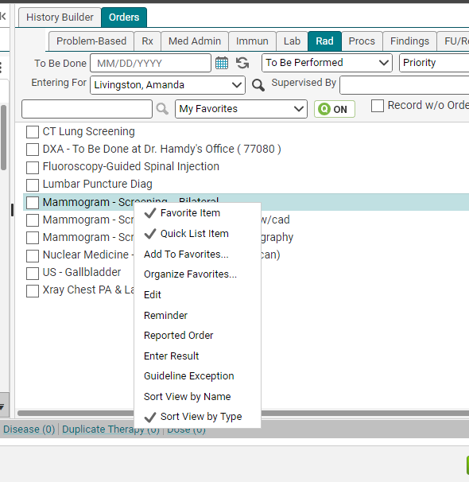
reminders
You can also set reminders for orders. Say, for example, the patient will be due for her mammogram at her next visit, in approximately 6 months. A reminder can be set which will do two things: appear in the next note that is opened, and send your nurse a task when the order comes due. To set a reminder, right click on the item and choose Edit.

Slide 22
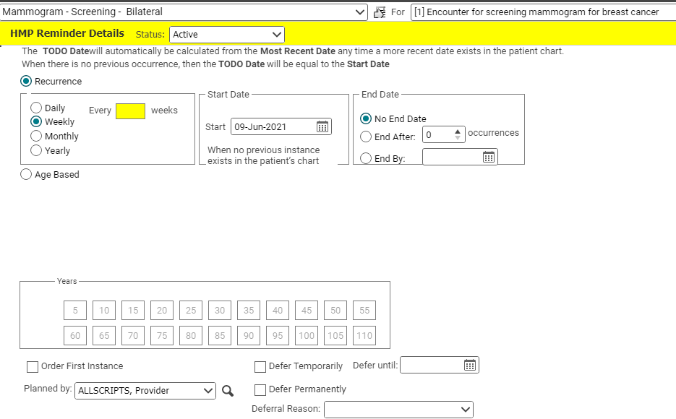
reminders
Once you choose Reminder from the menu, the details screen will pop up. To set the reminder, simply link it to a problem (the Health Maintenance code will work fine here, although a more specific diagnosis is preferable), then choose a rate of recurrence (# of days, weeks, months, or years), a start date (if different than the current date), and an end date, if you only want a certain number of reminders. Click Save and Return.
When the reminder comes due, the task will be sent to the person whose name is in the Planned by: field. If you are a nurse, put the provider’s name in this field, so the task will come back to your Clinical Staff task list, and not directly to your “My Active” tasks.

Slide 23
Population health
​As more of our payer contracts move toward value-based programs, the Population Health team was created in order to meet the growing needs, focusing on meeting the demands of our value-based programs.
Manage 20+ value-based programs, including the UPL, ACO, CPC+, MIPS, TennCare PCMH, and all of the payer-specific programs.
Meet monthly with payers.
Obtain and maintain PCMH certification for our primary care clinics.
Works with the EHR team, clinics, staff, residents and faculty to implement new workflows and track progress throughout the year.
Check out the population health measures we strive to meet on our website at https://www.quillenphysiciansehr.com/populationhealth.html

Slide 24
Please proceed to the next module – notes

