Slide 1
Quillen ETSU Physicians
Module 5: Notes
Provider Training Module
Allscripts Touchworks EHR
Quillen EHR Team
Phone: (423) 282-6122, Option 1
June 2021

Slide 2
Module instructions
There are a total of 5 modules that need to be completed prior to the on-site training. It is REQUIRED that you complete all of the modules PRIOR to training.
These modules are intended to serve two purposes: as an introduction to the system, and as a reference. The modules are very detailed. As such, we don’t expect you to retain all of the information in the slides before training; however, we encourage you to print the PDFs, as you will be able to refer back to them as you begin to use the system.
Training will consist mainly of mock practice sessions, so a basic knowledge of the system prior to training is essential. If you have any problems completing these modules, please contact the EHR team. (Contact info is on Slide 1 of each module).

Slide 3
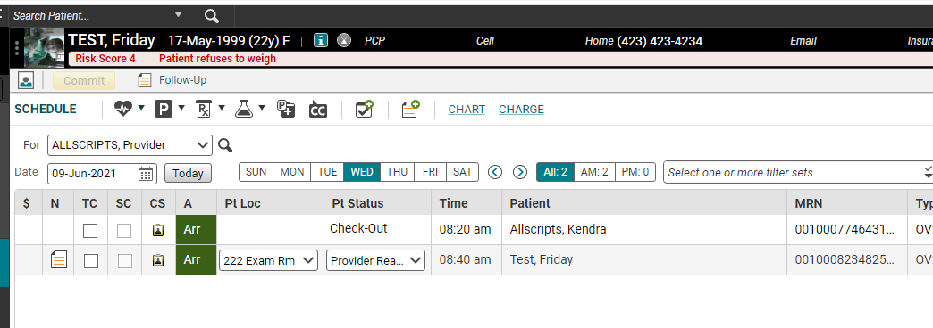
Opening a note started by nurse
In most of the clinics, your nurse will start your note for you. She/he will open the note, put in the chief complaint and possibly a reason for visit, and then save and close the note. Once the note has been started, it will appear on your Daily Schedule with a “note” icon in the “N” field. To begin documentation on your patient, make sure that the Pt Status is set to Provider Ready, and then double click the note icon to open your note in “edit” mode. (Slide 7 shows you the “edit” mode)

Slide 4
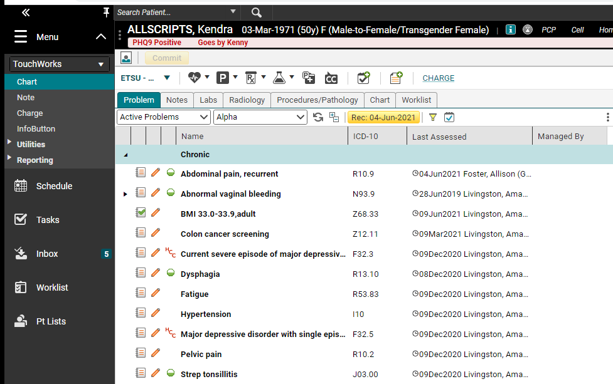
Starting your own note
If your nurse does not start your note for you, once he/she changes the status to Provider Ready, double click on the patient’s name. This takes you to the Chart.
Click the paper with the plus sign on the Chart or the Note section in the Action Bar.

Slide 5
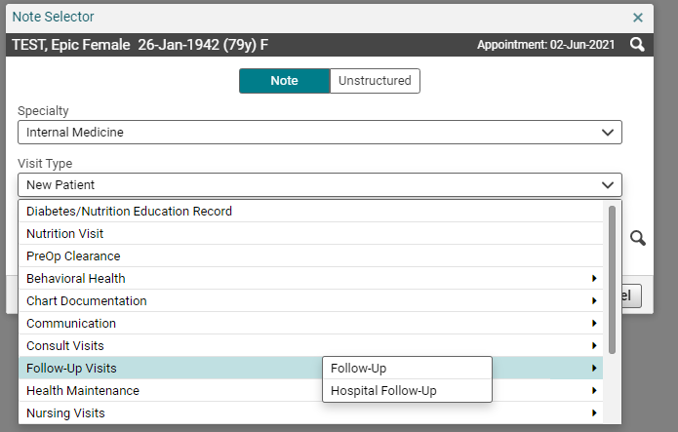
Note Selector
The Note Selector screen allows you to choose the type of note you are going to create. Click the drop down next to Visit Type and choose the note type. We suggest you talk to your preceptor about what note type to choose.
Ensure that correct appointment date in upper right.

Slide 6
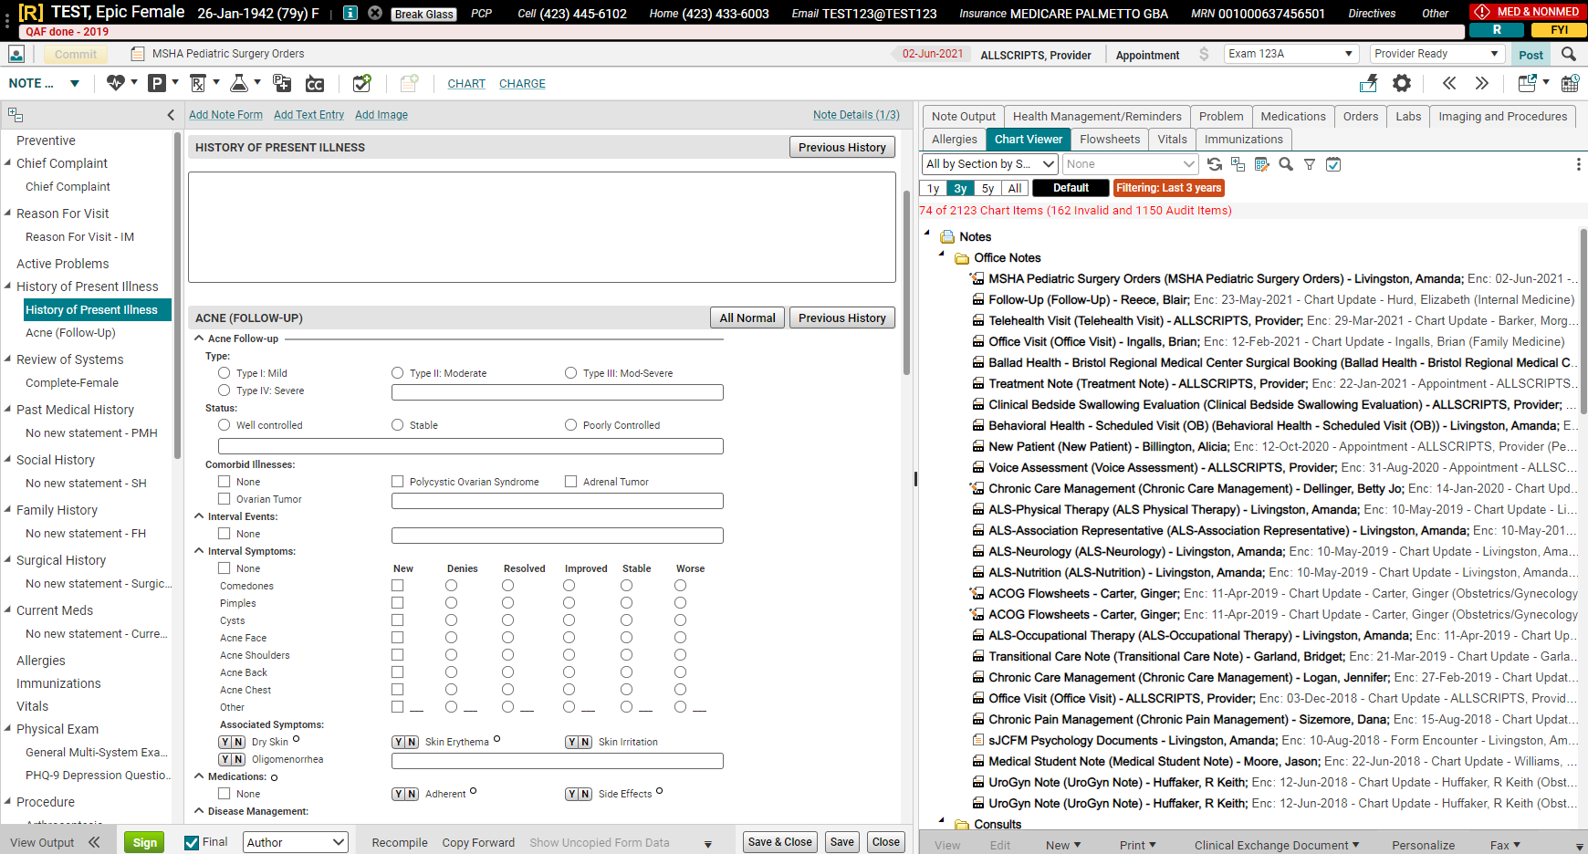
NOTE IN “EDIT” MODE
Patient Name, age and DOB
Appointment date/visit type
Clinical Toolbar
Chart
Table of Contents

Slide 7
TABLE OF CONTENTS
Table of Contents
Section Heading
The Table of Contents contains all the sections of the note, and any associated forms. The forms will always be indented beneath the section heading. It is suggested that you use the Table of Contents to scroll through your note. To navigate, simply scroll down until you reach the desired section.
Form

Slide 8
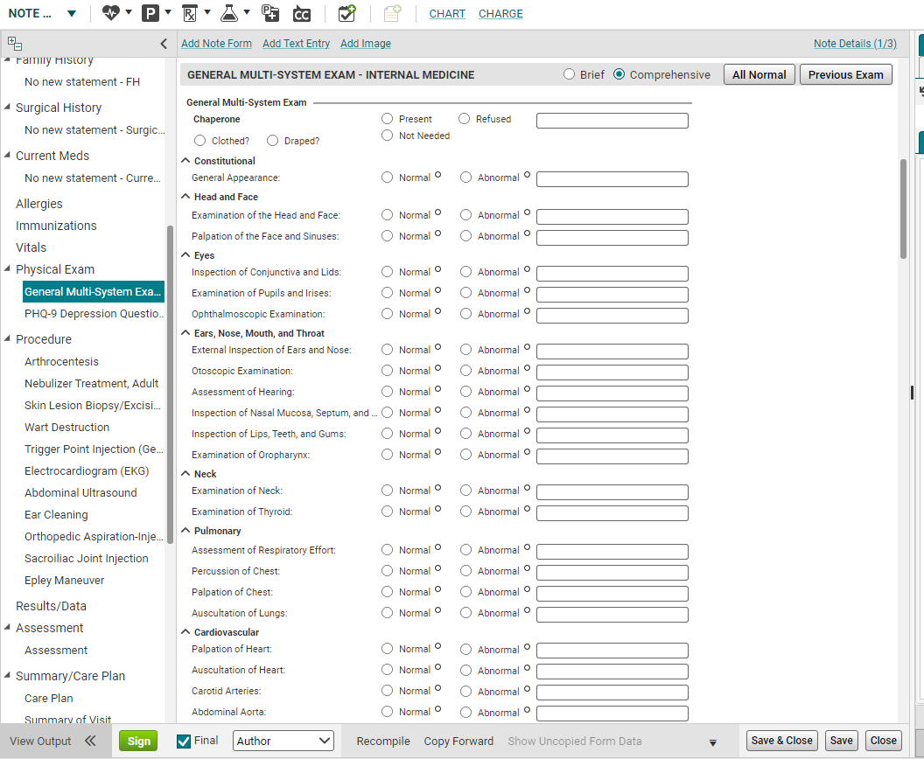
TABLE OF CONTENTS
As you click on each section header in the Table of Contents…
…that section will open up so that you can document your information.

Slide 9
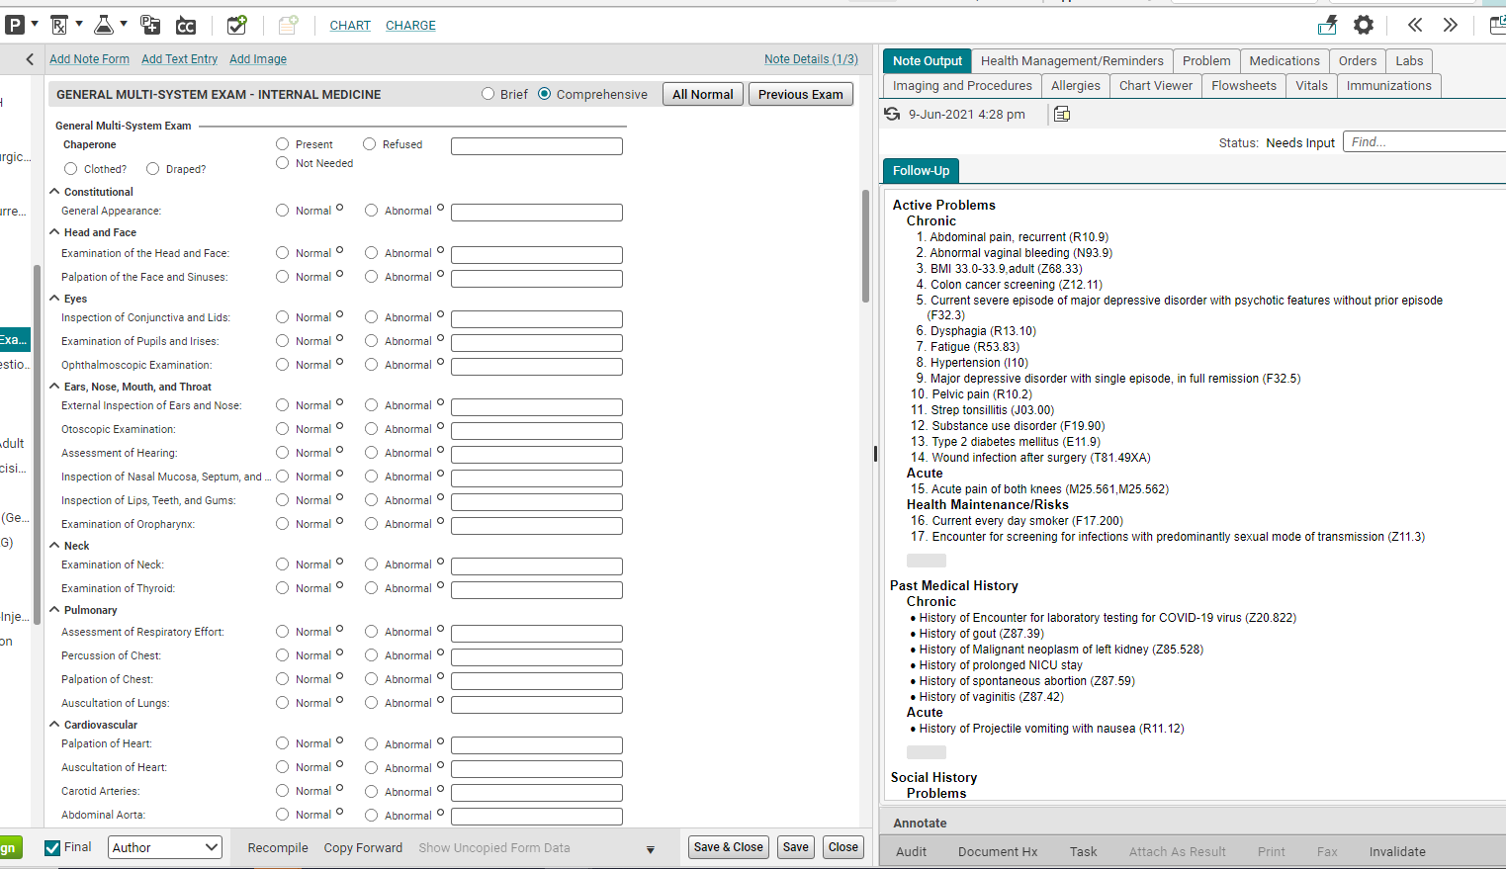
Right side –chart view
The pane on the right-hand side of the page contains all the components of the Chart. So, from within the note, you can view the patient’s Problem list, the Meds/Orders, Labs, Imaging, Allergies, and all of the notes (on the Chart Viewer tab), as well as the Flowsheets, Vitals and Immunizations. Just click the appropriate tab to view the patient’s information.

Slide 10
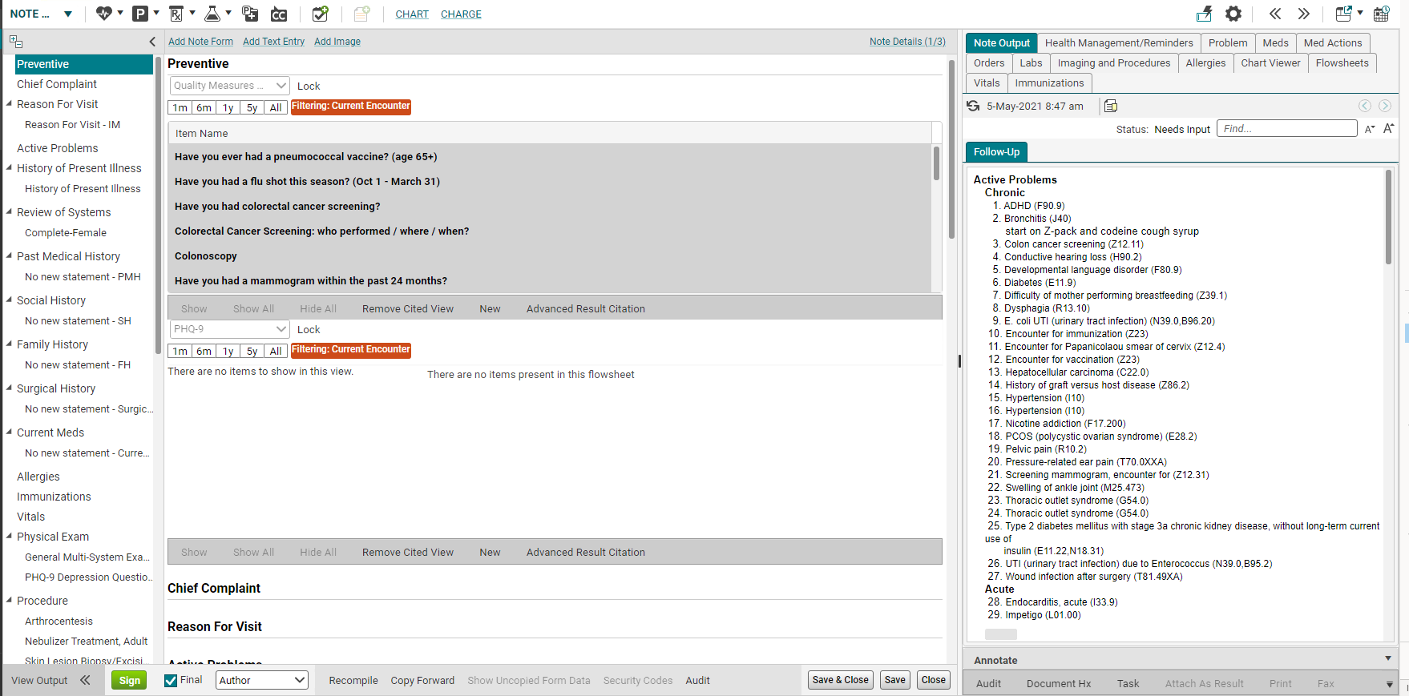
Note Output tab
The Note Output is how you see what your note looks like.

Slide 11
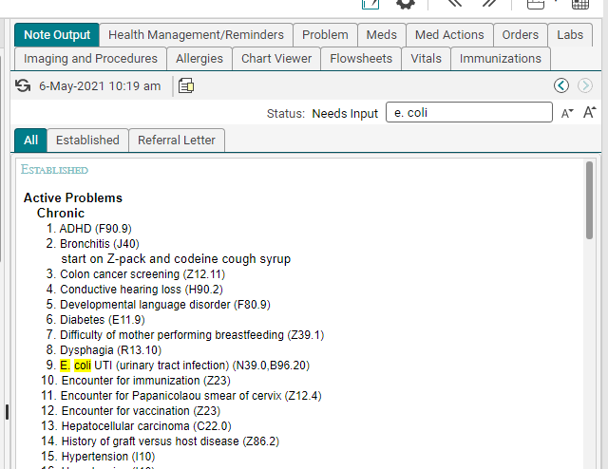
Search In note output

Slide 12
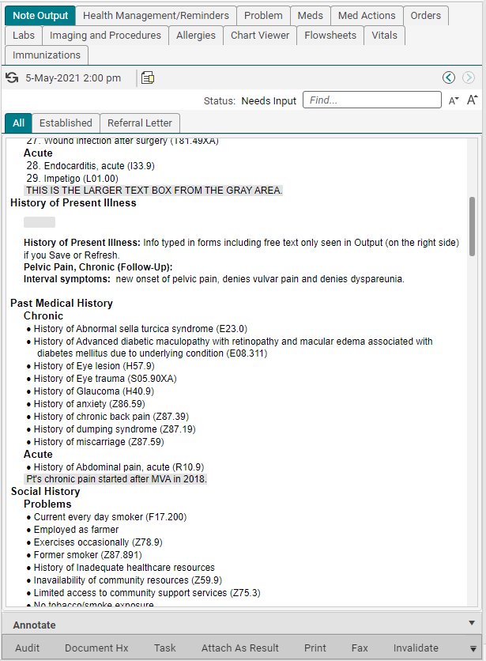
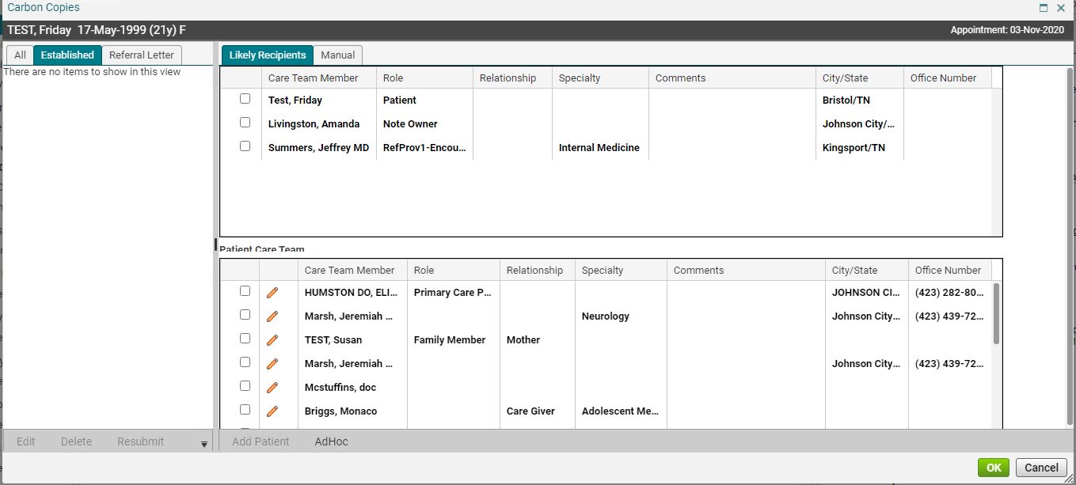
Note output
Carbon Copies.
Previous Versions.
Increase/decrease font size in Note Output.
You can create a task.
Precepting providers can Invalidate notes from here.
12

Slide 13
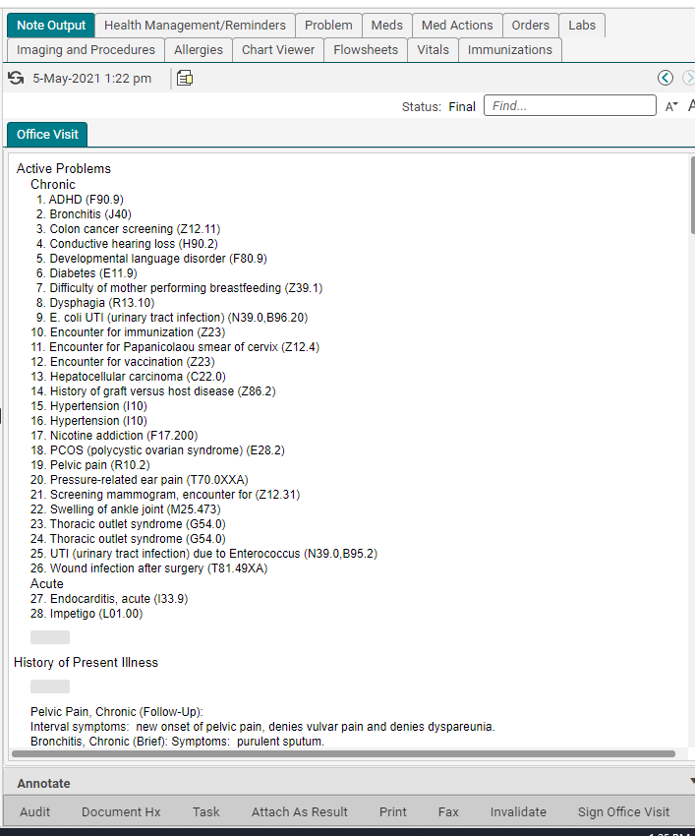
Note output
Must refresh by using refresh circle or Save to view info typed in forms.
Click on gray space to free text. A larger text box pops open. Apply changes.
Section headers only show up if you enter something in that section.
Gray space free text works but not recommended workflow.
ETSU EHR recommends using Note Output for viewing, not typing.
ETSU EHR recommends free text boxes for typing free text.
The Note Output view doesn't scroll with you.

Slide 14
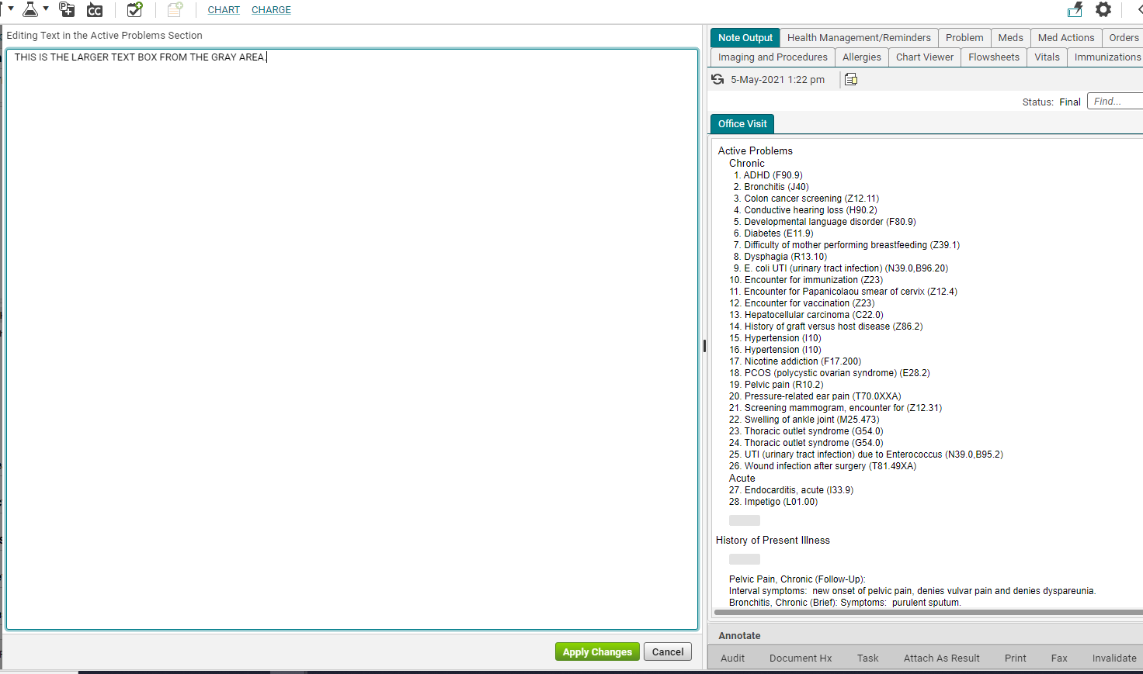
Editing text using gray area
This is what it looks like when you click in the gray space in Note Output.
Don’t forget to Apply Changes.

Slide 15
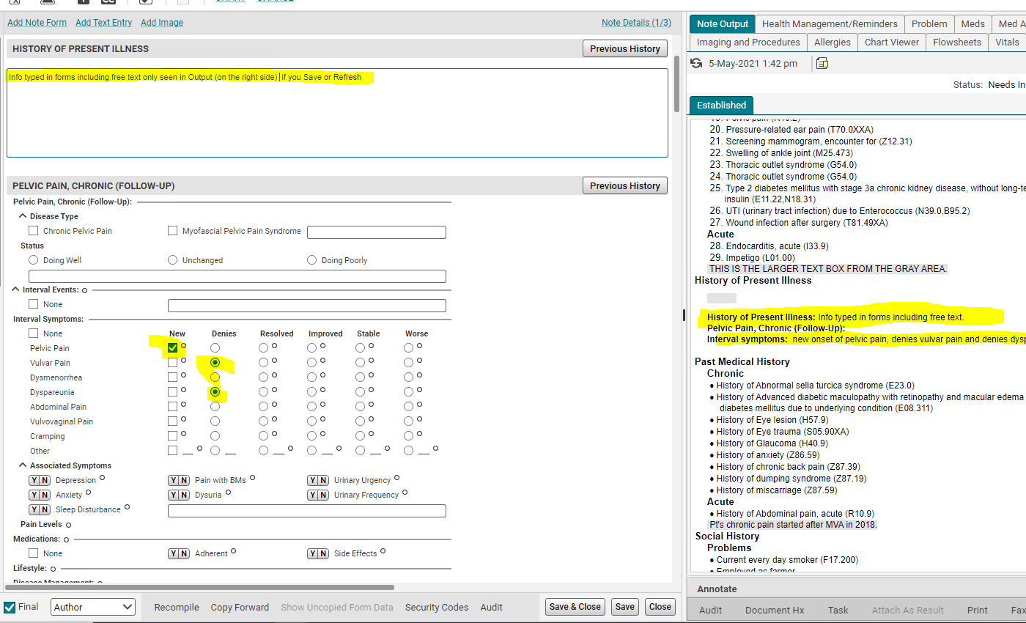
Data entered in forms
Info entered into forms is only seen in Note Output if you Save or Refresh.

Slide 16
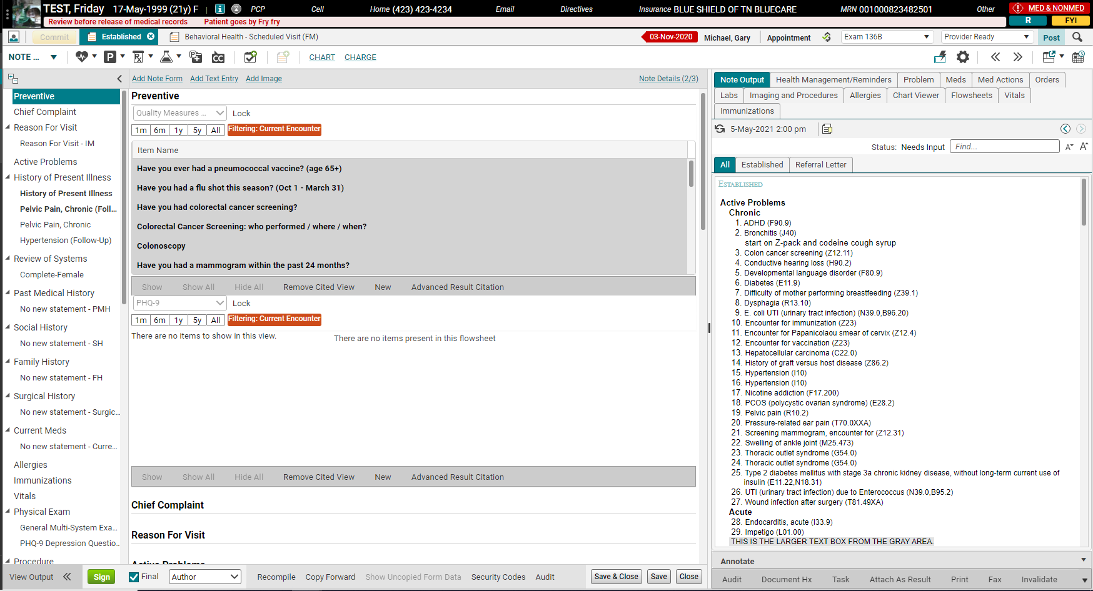
Note input (entering data)
Note Inputs created for this encounter.
<< >> arrows are a quick way to expand or shrink the right column.
16

Slide 17
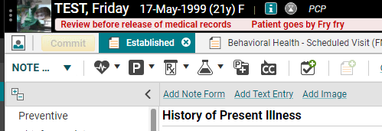
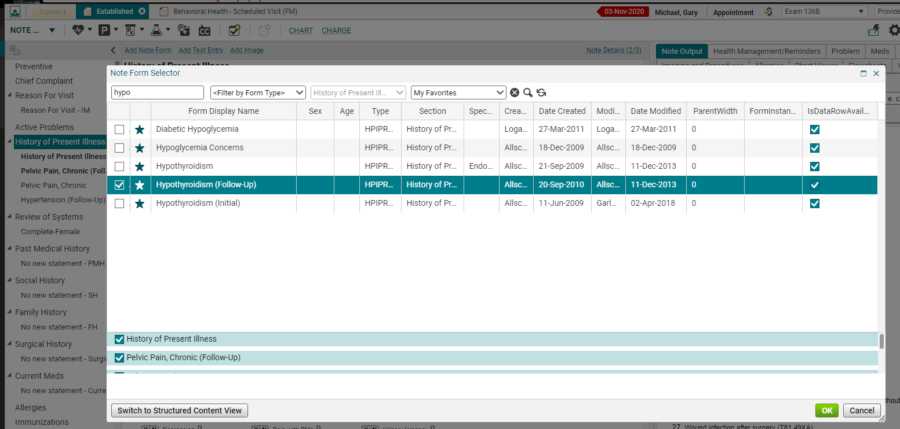
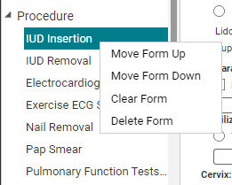
Add note form
Most popular note forms are in HPI and procedure section.
Be sure you have the right section selected.
To move or delete form, you would still need to right click on it.

Slide 18
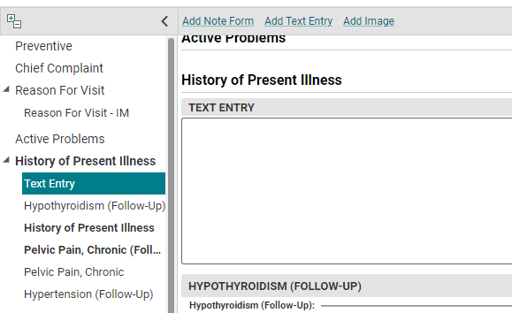
Add text entry
You can add your own Free text box wherever you want!
The department chair or medical director can contact the EHR team to update note templates too.

Slide 19
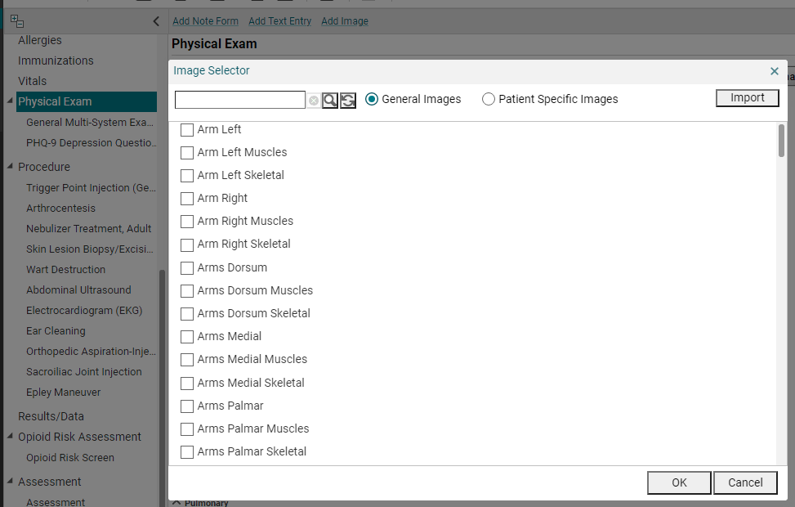
Add image
Be sure to use a HIPAA compliant way of uploading images.
Use the Table of Contents (the right-side column) to determine which section you want your image.

Slide 20
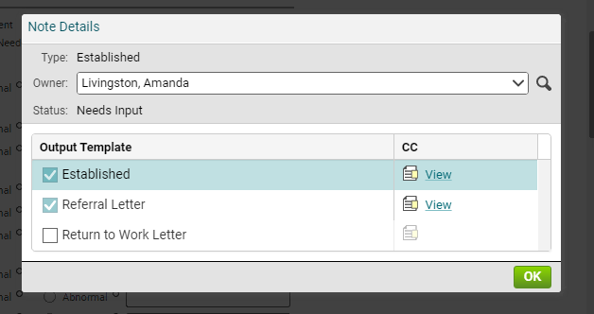
Note details
Note Details show you the different output templates.
This is where you change the Owner!!
You can Carbon Copy from here too.

Slide 21
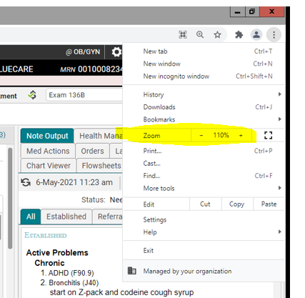
Increase note input font size
You can make the font bigger inside the window that you use to type up the note.
1. In very top right corner, click the 3 dots.
2. Increase your font size.
Only increases in increments of 10%.

Slide 22
Note sections – patient care team
The Patient Care Team is a section where clinical staff can enter members of the patient’s care team – other physicians, home health companies, and even family members/caregivers.
Patient Care Team entered in under i (Patient Profile Dialog) in Patient Banner.

Slide 23
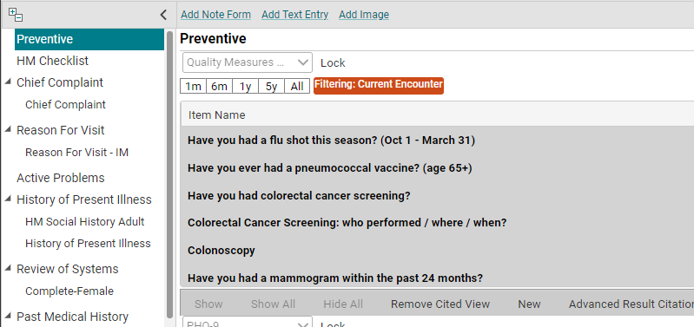
Quality measures
Many notes have a Quality Measures section at the top. In adult medicine this captures the information around quality programs or preventive screens such as mammogram, colonoscopy, and vaccines.

Slide 24
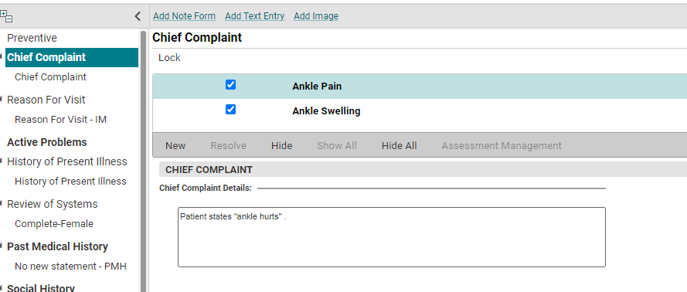
Note sections – chief complaint
Tip: Allscripts considers Chief Complaints to be symptoms, rather than diagnoses. For this reason, the system-generated CC selection is limited and includes items such as wheezing, shortness of breath, and swelling, rather than asthma, COPD, and edema.
The next section is the Chief Complaint. These system-generated cc are entered on the ACI.
This is for a free text chief compliant.
You can add a new CC by simply clicking on New on the toolbar under the Chief Complaint section. Most note types also have a free-text form for more detailed documentation.

Slide 25
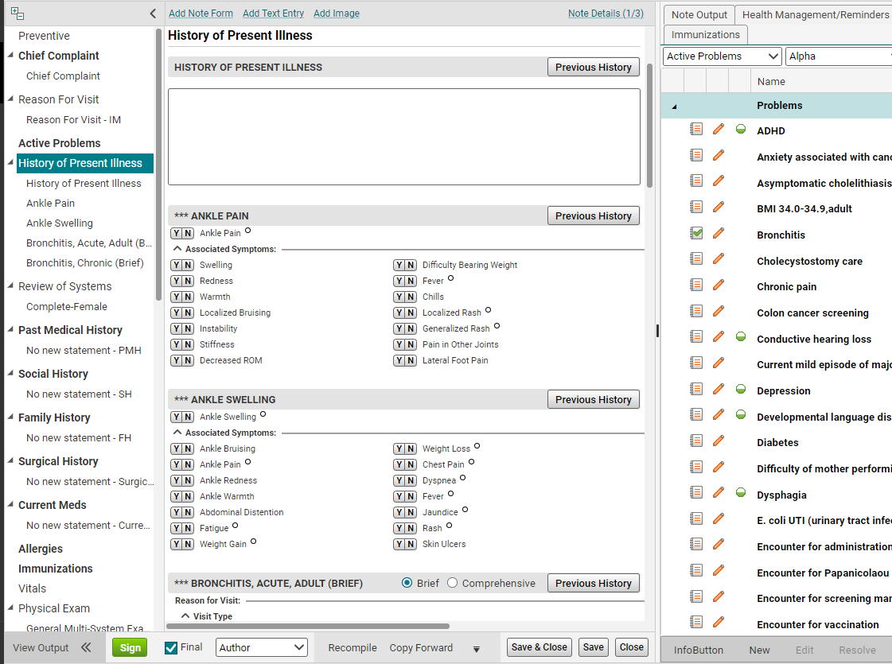
Hpi note forms
Both the Chief Complaint and the Active Problem sections are designed to pull forms into the HPI section of the note. The HPI forms are added when the problem is Assessed or the Chief Compliant is added in the ACI.
To get the form(s) to pull into the note, add a Chief Complaint or assess an Active problem, and then click the Recompile button.

Slide 26
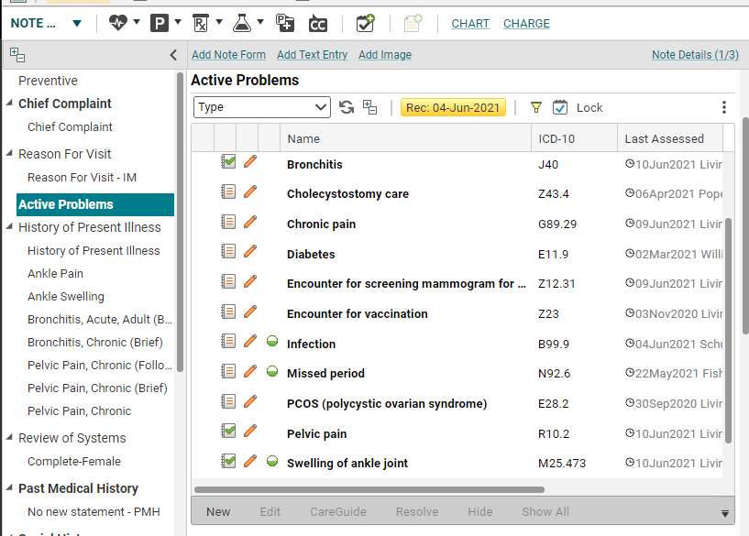
forms
To add a new problem, click “P” on the Clinical Toolbar (or New on the gray toolbar).
Assessed problems are billable dx codes. Items that are added and assessed here, or checked on the Chart, will appear in the Assessment section of the note.
If the Active Problem was added at a previous visit, and you want the form to pull into the note, click the paper icon in the Active Problem section (which assesses the problem for today’s visit), and then click Recompile. The form will pull into the HPI section.

Slide 27
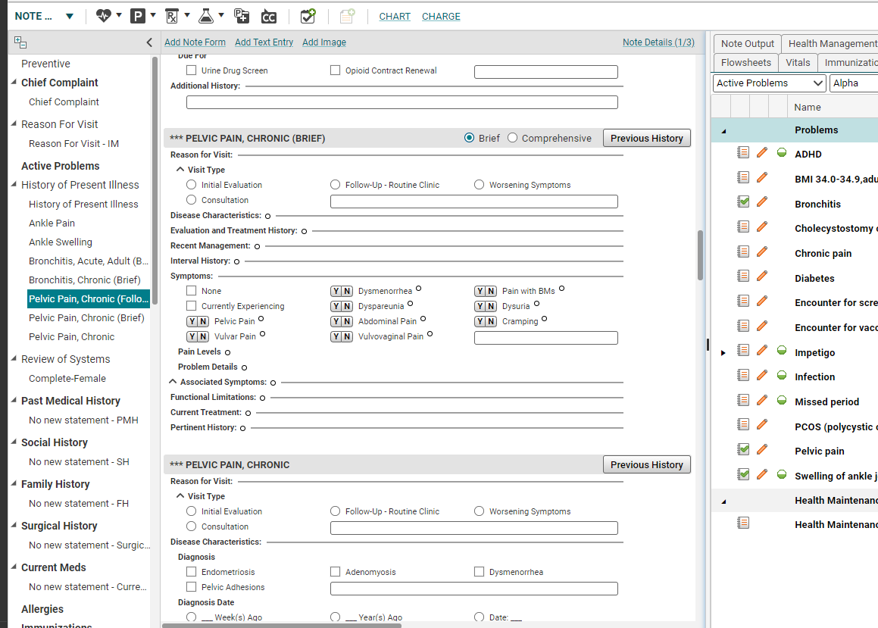
forms
The forms are used to document specific information related to the patient’s complaints. Keep in mind, if you do not click on any items on the form, it will not appear in your note. Also, the forms have a LOT of choices—but you only need to document relevant items. Feel free to ignore the rest.

Slide 28
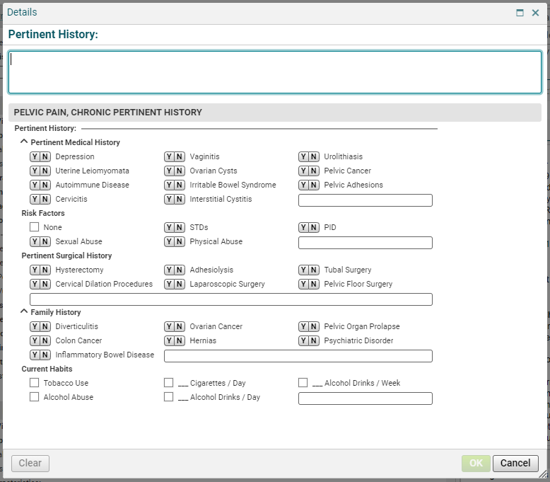
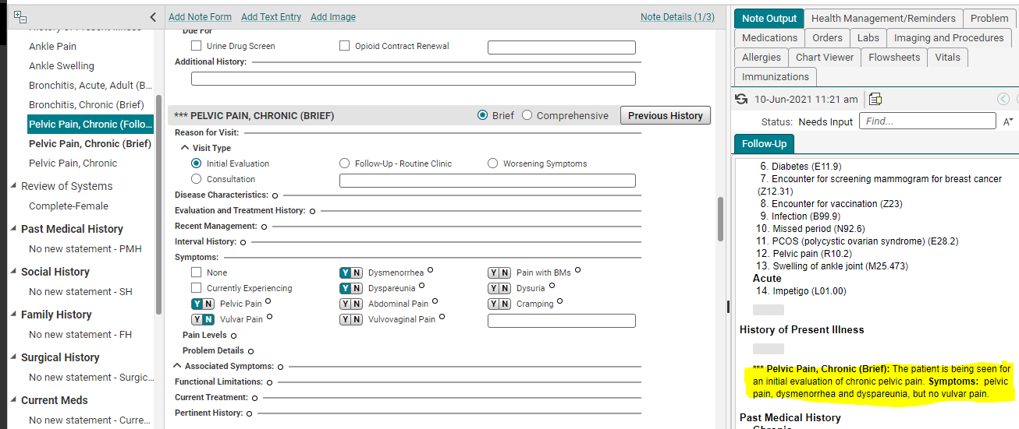
forms
Clicking the boxes on the forms will populate the text in the Note Output. But you must Save first!
Clicking on the small radio button (looks like a degree symbol) next to a checkbox will open up a details form which provides more options for charting.
Remember refresh saves.

Slide 29
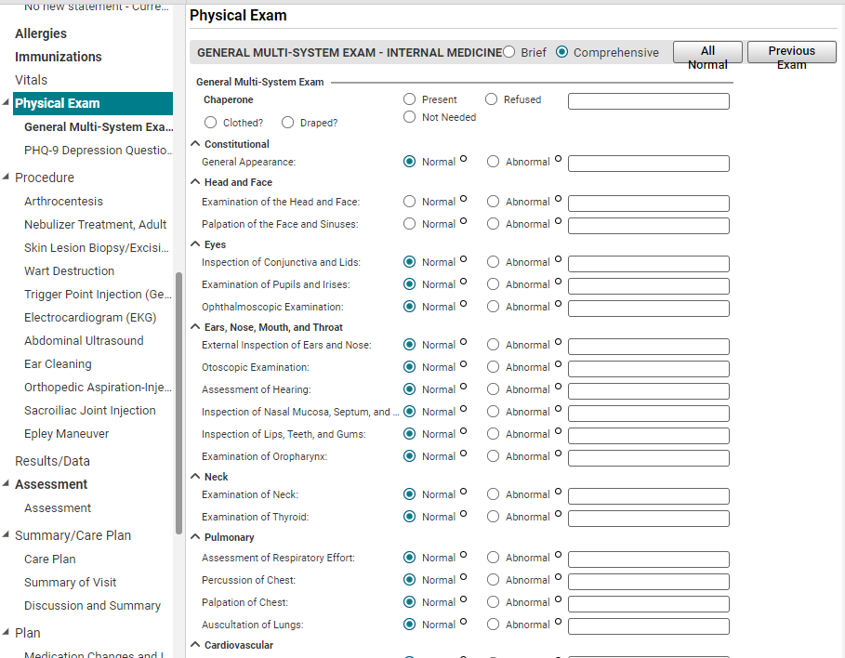
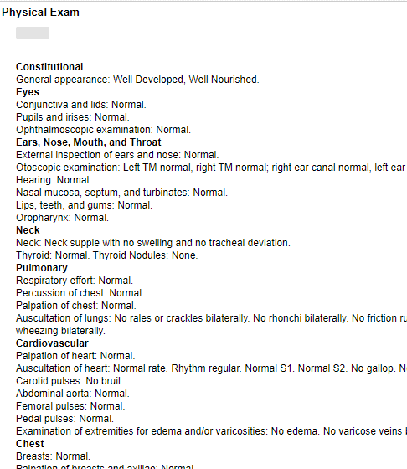
forms
Some of the forms will have an All Normal and/or Previous Exam option. Clicking the All Normal button will populate negative/normal text for ALL of the systems. The Previous Exam button will pull in all items from the last exam.
Be VERY careful using the All Normal button. Using this option frequently is a HUGE red flag to our auditors. Of note, you can click the All Normal button, and then go back and uncheck the systems that are abnormal, and document the specific information as needed for those sections.

Slide 30
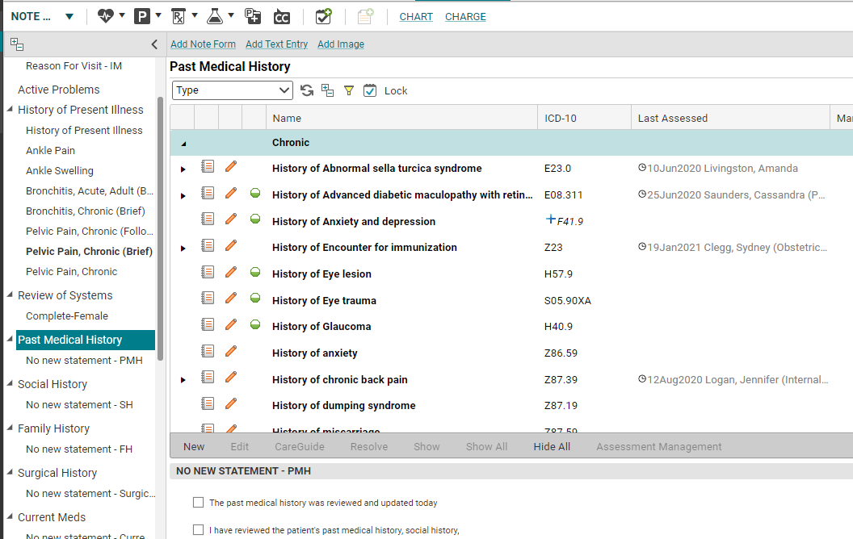
History sections
The “historical” sections of the chart are designed to auto-populate from previous notes. So, for example, the history items that you entered on your patient during their first visit will automatically pull into the note on subsequent visits. These sections include: Active Problems, Past Medical History, Social History, Family History, Surgical History, Current Meds, Allergies, and Immunizations. All or some of the items in these sections can be hidden if you do not want them in your note.

Slide 31
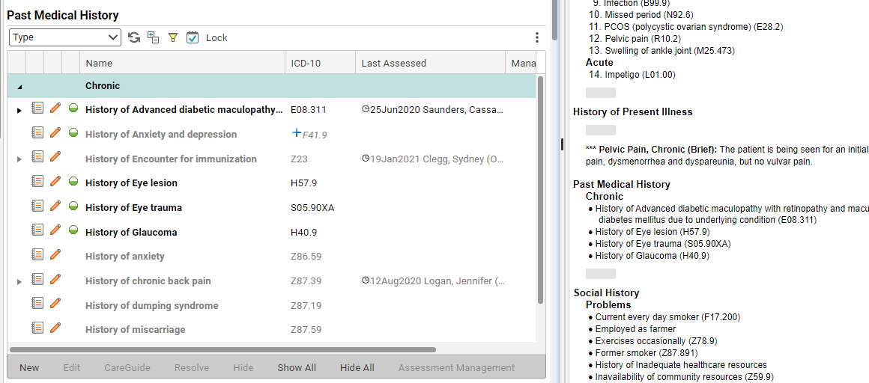
Hiding items
Use the “Show,” “Show All,” “Hide,” and “Hide All” options to pull only relevant items into your note. If the items are grayed out, they are hidden. If they are black, they will appear in your note. In this example, I’ve clicked on 4 items, and then clicked “show.” Only those items will appear in my finished note. It does not erase them from the patient’s chart, however. The next time you open a note, all items will pull in.
Edit Mode of Note
Note Output

Slide 32
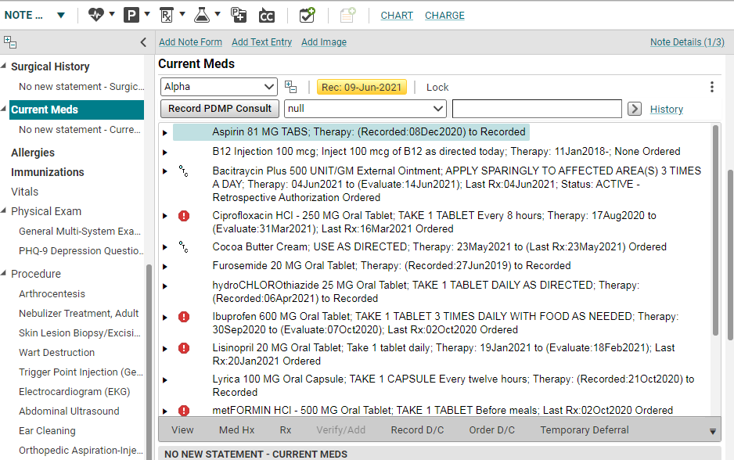
Note sections – current meds
The “Current Meds” are the medications that the patient was on when the note was started. Any new meds that you prescribe during the visit will appear in the Plan section.

Slide 33
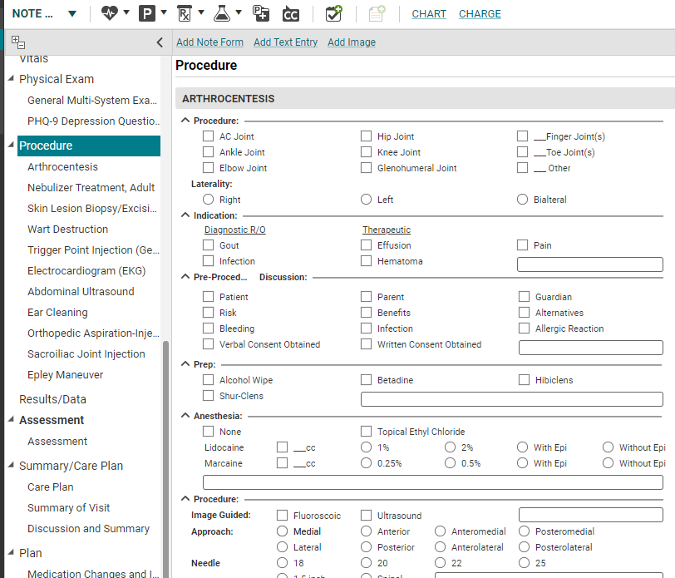
Note sections – procedures
The notes are set to pull in approximately the top 10 Procedures. If you need a form that isn’t in the note, you can click Add Note Form.
*If you need a Procedure section added to a note, please contact the helpdesk.

Slide 34
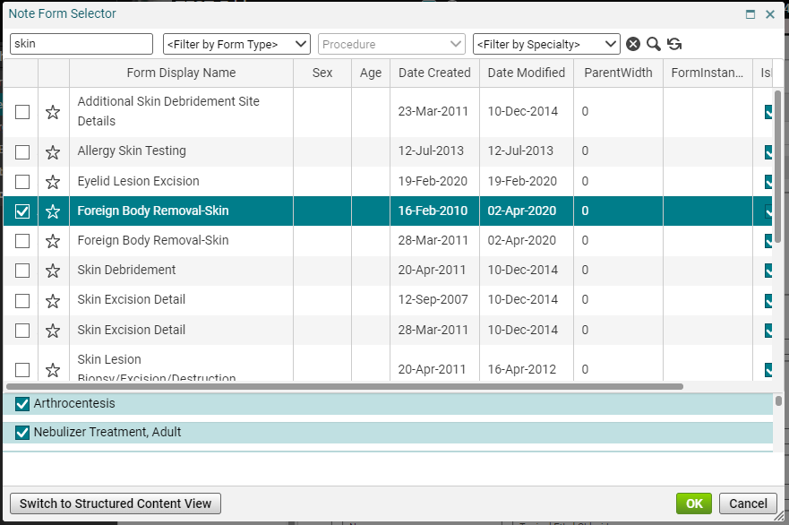
Note sections – procedures
Once you click Add Note Form, the Form Selector box pulls up. Search for the form you wnt, then check the box next to the desired form and click OK.

Slide 35
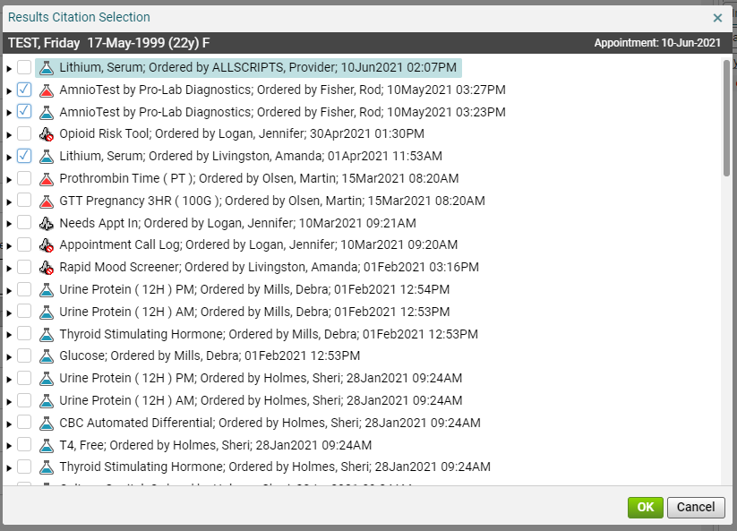
Note sections – Results/Data
The Results/Data section will pull in the patient’s labs for the previous month for MEAC clinics. Family Medicine doesn’t automatically pull in any labs.
To pull in a lab that is outside of the 1-month parameter, simply choose Advanced Result Citation then check the box for the lab you want pulled into the note. This is only available for labs completed by ETSU laboratory.

Slide 36
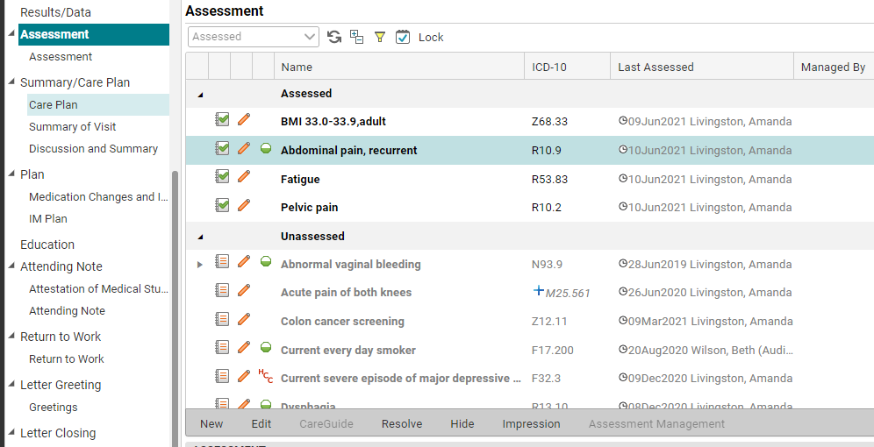
Note sections – Assessment
The Assessment section shows the patient’s Active Problems. Make sure that you check the boxes of any diagnoses that you assessed at the visit and uncheck any items that were not assessed. You can also add a diagnosis at this point, by clicking on the “New” on the toolbar.
It’s really important for billing purposes that the items you assessed are placed in order of importance. To do this, right click and choose Make Primary, Make Secondary, Make Tertiary. Currently, we are still utilizing superbills, so the assessed problems in your note need to match the problems you list on the encounter form (superbill). The order also needs to match.

Slide 37
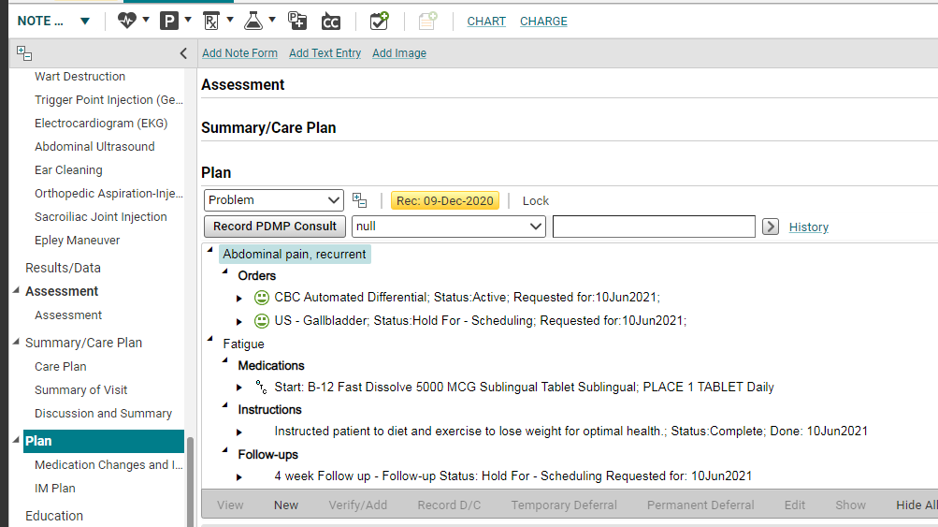
Note sections – plan
The Plan section is where you are going to order all the items for the patient; such as prescriptions, labs, radiology, follow-up visits, referrals and patient education.
To order the patient’s prescriptions or labs, etc., just click on the Rx or beaker button on the Clinical Toolbar or the New button on the gray toolbar. This will take you to the ACI screen, where you can order all of the items.

Slide 38
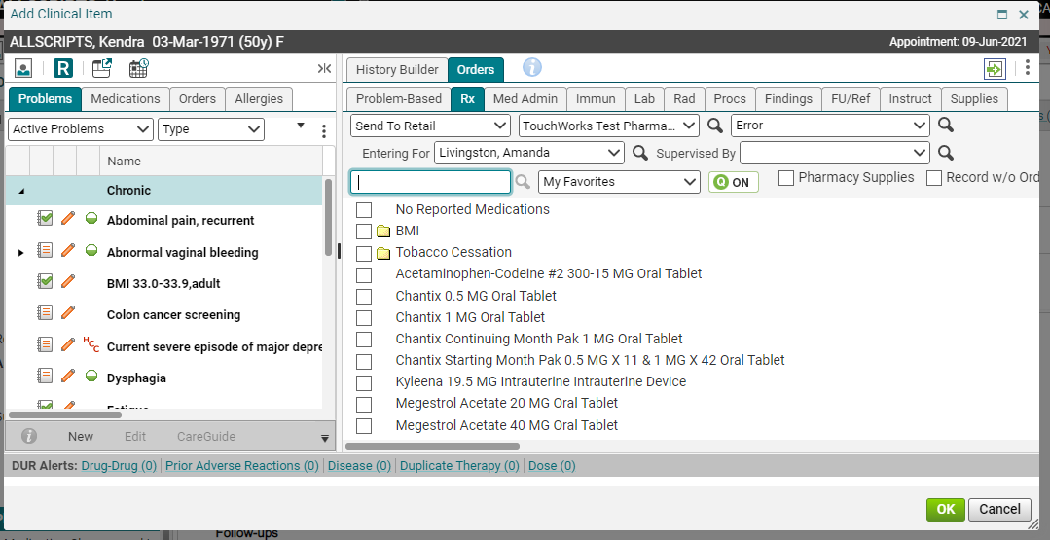
Note sections – ordering
Recognize this screen? This is where you will do all of your ordering. It’s important that you get all of the ordering completed before the patient leaves, as this information will show up on the Clinical Summary, which is given to the patient at check out.

Slide 39
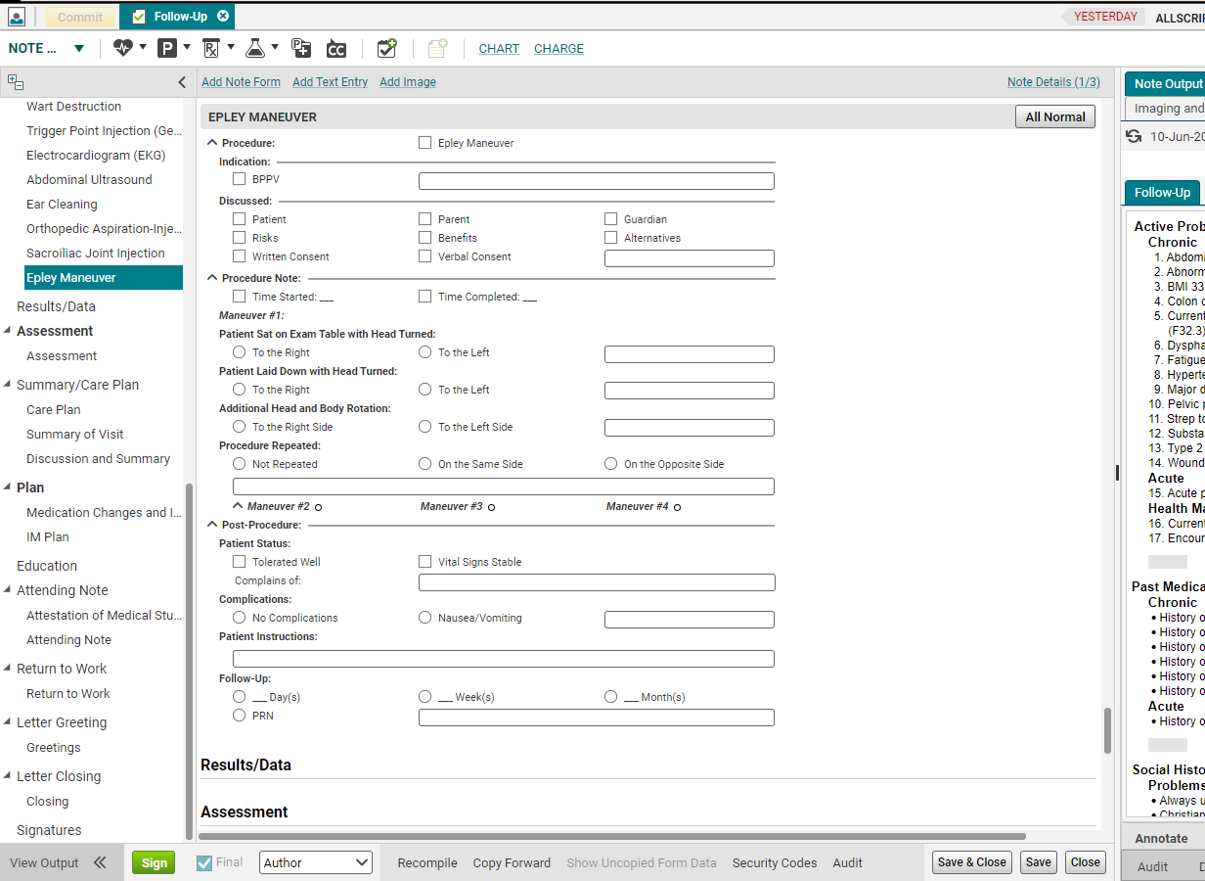
Save your note
It is important to save your note often when working. This will create iterations that can be retrieved by the EHR team in case the note crashes or you lose internet connectivity.

Slide 40
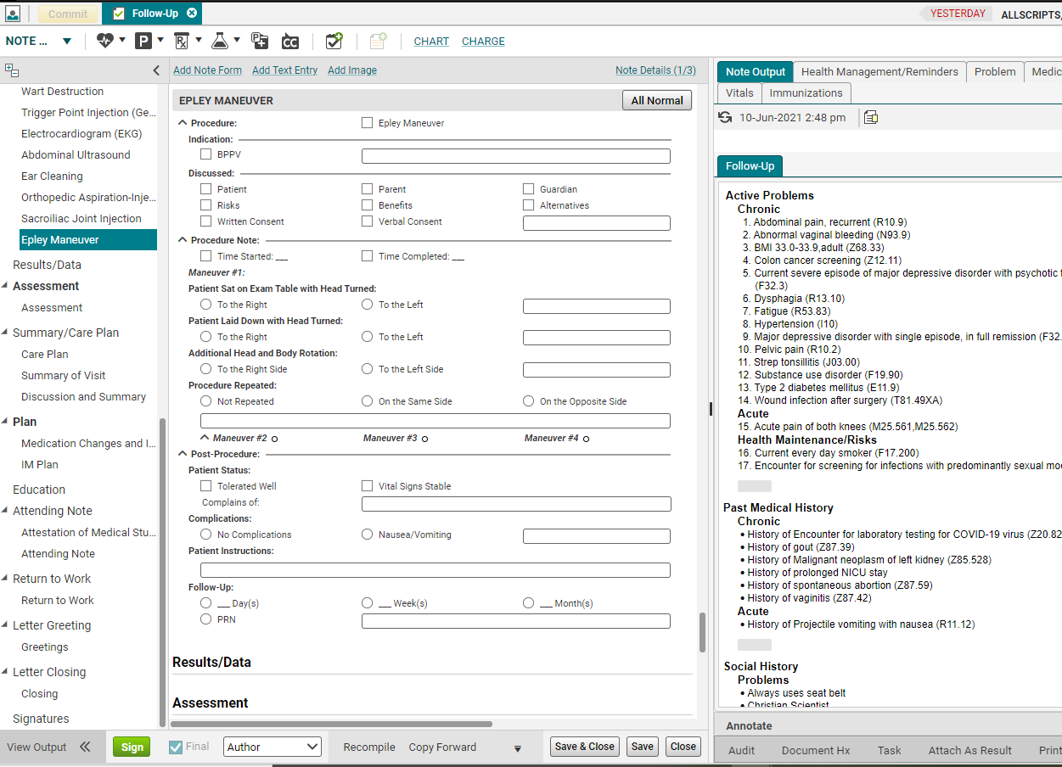
viewing your note- in the note output
Once you’ve finished inputting the sections of the note, you’re going to want to view it. (In fact, you can view it at any point during the process.) Simply look at the Note Output.

Slide 41
signing your note
Once you’ve finished reviewing your note, and it’s complete, you will want to sign it. Residents will need to send it to their preceptor for review and finalization. If you are NOT finished with the note but need to get out of it and go on to another patient, you will click “Save & Close,” instead of “Sign.”
When you’re ready to sign off on your note, click “Sign” on the toolbar.

Slide 42
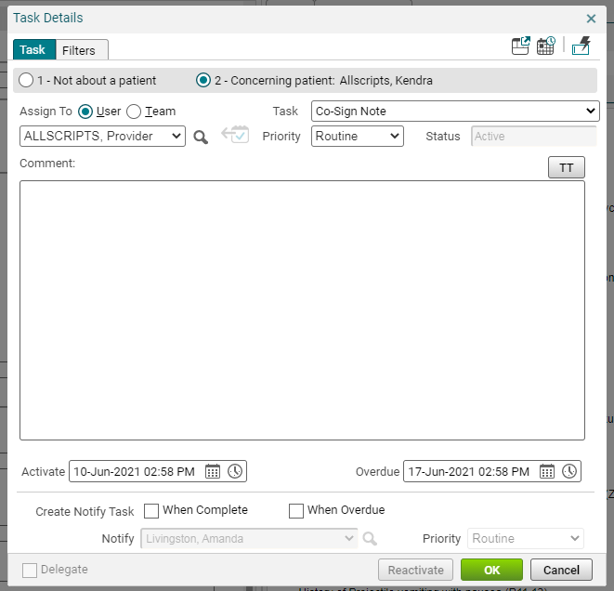
Co-sign note task
Once you click OK on the Signature Box, residents (and nurses, if they are creating a note that needs to be finalized by an attending MD) will get a Co-Sign Note task.
After you have put your attending physician’s name in the Assign To: field, click OK. There is no need to type anything in the Comment section. (When your attending double clicks on this task, it will take him/her directly into the note to be signed and finalized.)
1. Change the radio button to “User.”
2. Click the “magnifying glass” button and search by last name for your attending physician. (Once you have searched for their name once, they will be available in the drop-down list)

Slide 43
Return to schedule
If you aren’t automatically routed back to the Schedule after you have closed your note, go ahead and click on the Daily tab to return to your schedule. You are ready to move on to the next patient!

Slide 44
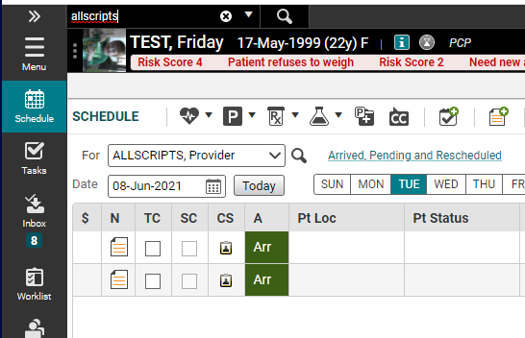
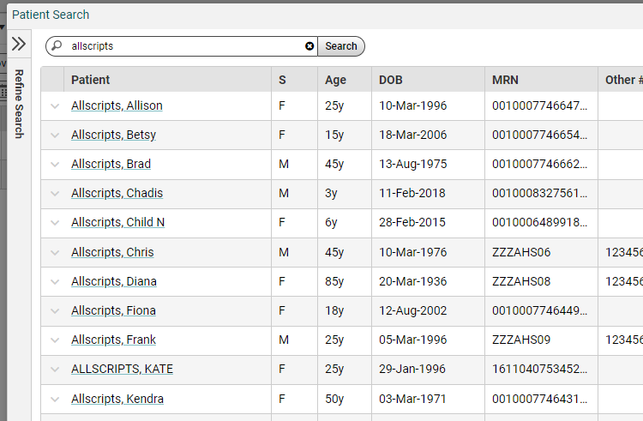
Starting a note
Most of the time, you will be doing notes on patients who are on your schedule. But, from time to time, you’ll want to create a telephone note on a patient who isn’t on your schedule. To document a note in this situation, type in the Search Patient… field in the upper left. Search for your patient by Last Name, First Name or DOB. Click Search. A “Select Patient” box will appear. Highlight the patient’s name and click OK.

Slide 45
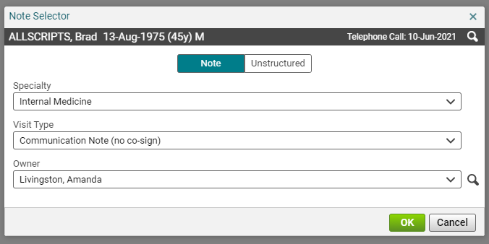
New Note tab
Once the patient is in the Banner, click on the New Note icon. Select New Encounter and Type, Ok. The choose your Note type using the Note Selector. Click OK.

Slide 46
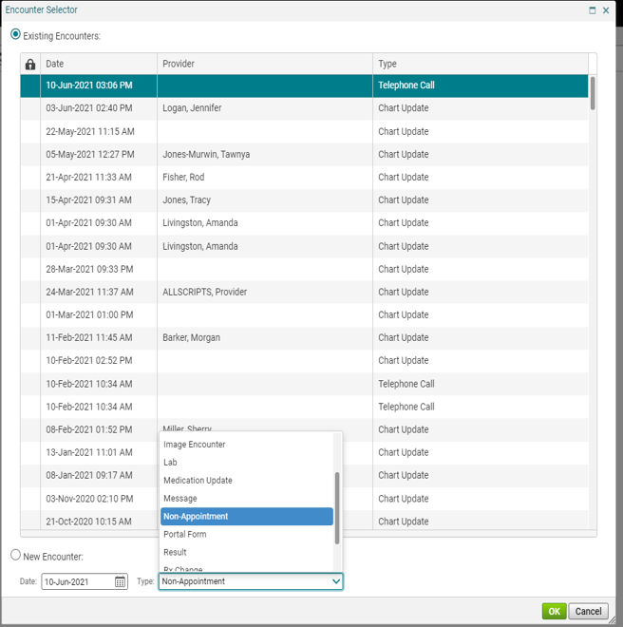
ENCOUNTER SELECTOR
The Encounter Selector opens when the note isn’t attached to an appointment, like a telephone call. Click New Encounter radio button and choose a Type.

Slide 47
macros
A macro is a shortcut that you create that when entered into the system will automatically expand into a larger phrase or series of phrases. A macro can be used to automatically enter simple, repetitive phrases including commonly used sentences and instructions in your documentation.
Macros that are inserted without editing may contain elements that were not asked or examined during the specific patient encounter. Physicians need to be certain that the medical record accurately reflects the patient encounter.
More documentation does not equal a higher E/M level. E/M levels are determined by the nature of the presenting complaint, History, Physical Exam and Medical Decision Making. Evaluation and treatment must be medically necessary and appropriate.
(from https://www.acep.org/Clinical---Practice-Management/EMR-EHR-FAQ/)

Slide 48
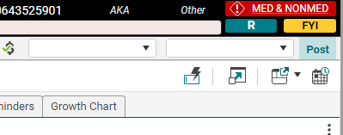
How to Create a Macro
A. Click the macro button.
or

Slide 49
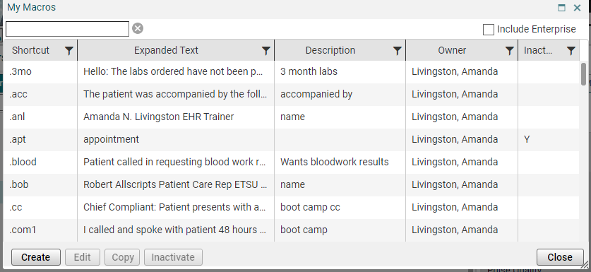
Macro creation
B. Macros Edit box will appear for you to begin creating.
C. Click Create.

Slide 50
macros

Slide 51
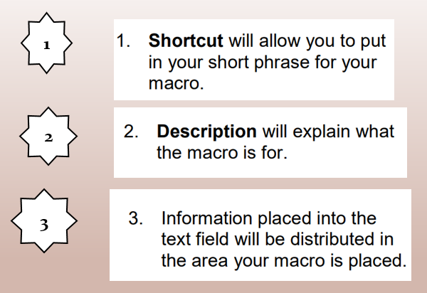
Macro components

Slide 52
Save your macro
E. Save your macro.
The new macro will be added to your Manage Macros list.
From this window, you can Create, Edit, and Inactivate.
They are not removed easily from the system.

Slide 53
To add macro in allscripts
To add, just type whatever your shortcut name is wherever you want your macro to populate. Be sure to begin with the period. Enter the macro shortcut. Then click the enter key on your keyboard.

Slide 54
You have now completed all of the required modules for Allscripts EHR 20.1 training. Please be sure to complete the quiz by following the link beneath the modules.

