Slide 1
TouchWorks EHR Upgrade Version 20
Basic Changes
Go-Live Date 05/24/2021

Slide 2
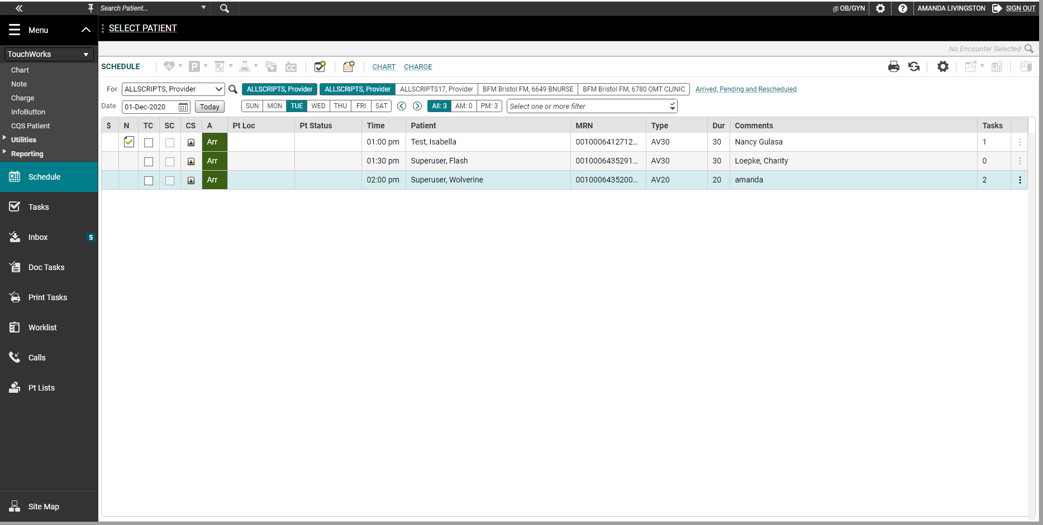
Action Bar
The action bar is a menu-based navigational tool you use to access workspaces in Allscripts TouchWorks® EHR that are available to you. It is located on the left.
You can minimize or maximize .
The push pin icon will “pin” a menu into place throughout Touchworks.
You can access all pages in the Site Map.

Slide 3
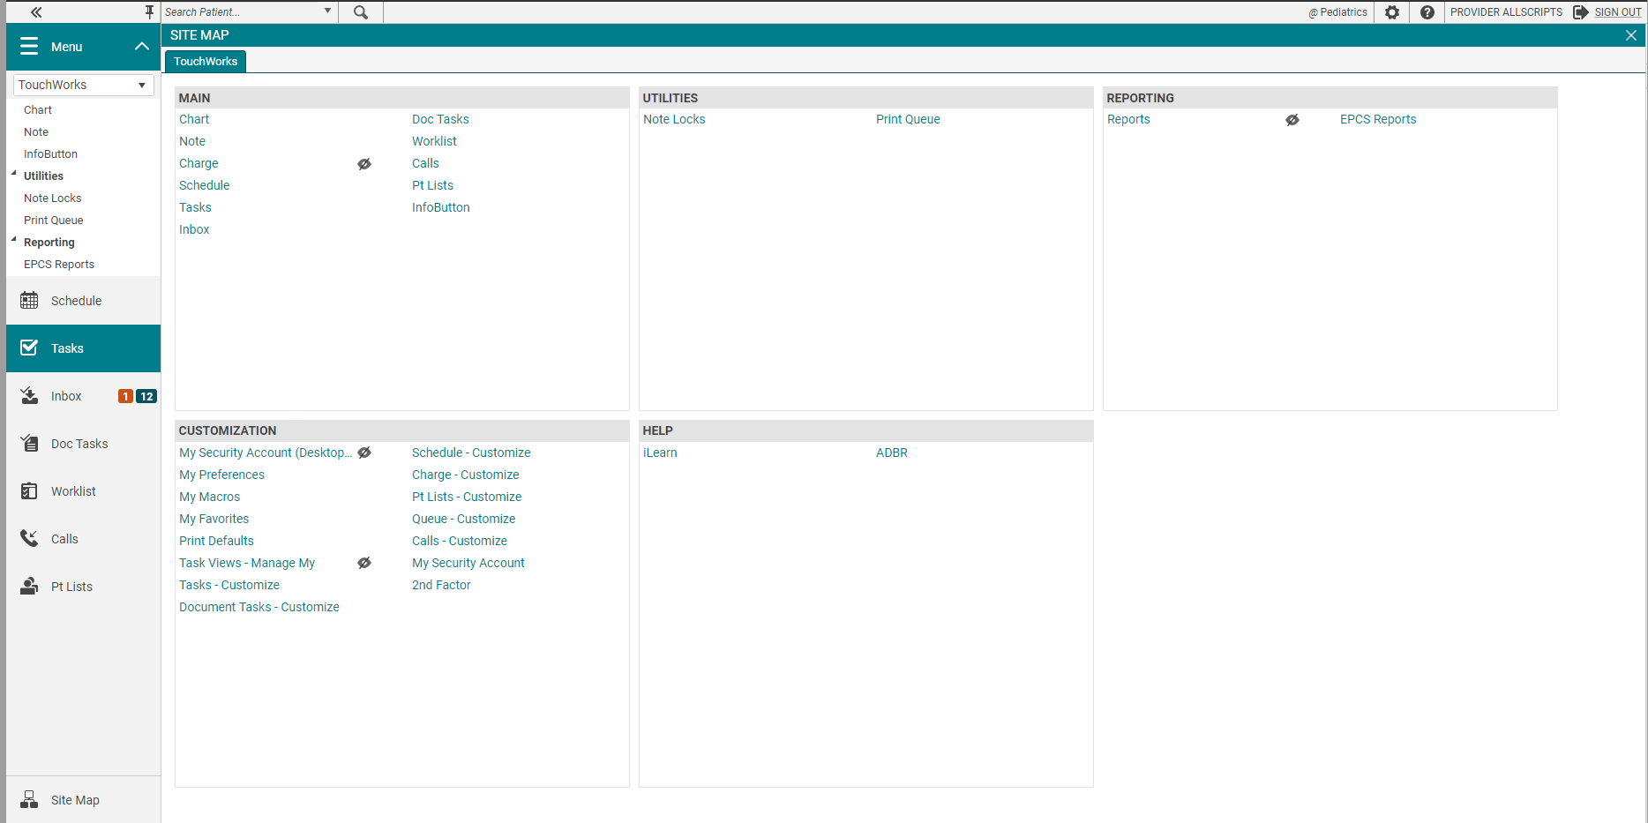
Site Map
The Site Map shows you the pages you have available. We recommend only showing the workspaces you use daily. You can also navigate to your pages from here.
External links like CSMD, EHR website, Opioid Documents will be located in the HELP section on the Site Map.
iLearn includes short training videos from Allscripts.
The HELP links can also be located on the

Slide 4
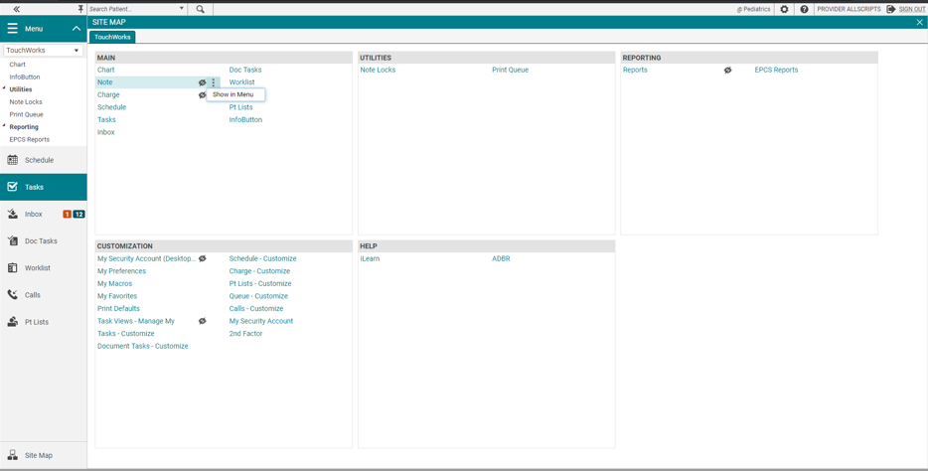
Hiding and Showing Pages
The hidden from menu icon is displayed next to hidden pages. These pages aren’t shown in the Action Bar.
To show a page in the Action Bar, Click the options icon and select Show in Menu.
You can hide pages too.

Slide 5
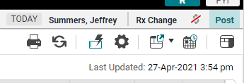
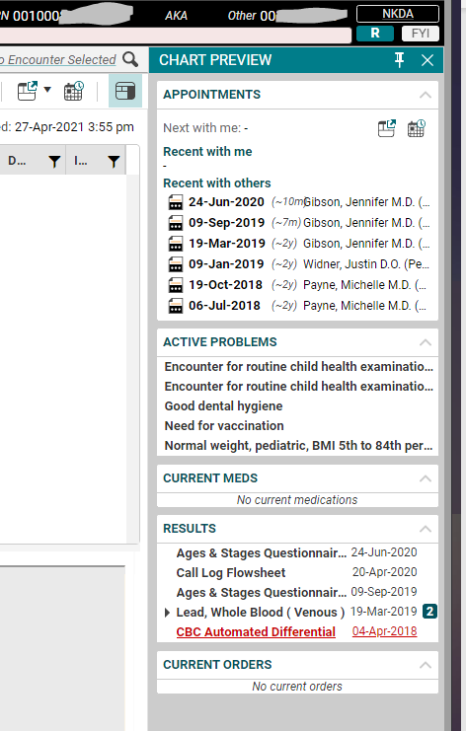
Chart Preview
Chart Preview is a new feature.
It can be pinned into place.
It shows appointments, active problems, current meds, some results.
Most useful on tasks, inbox, pt lists, and worklist.

Slide 6
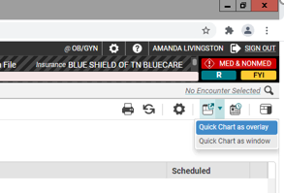
Quick Chart
New ways to use Quick Chart.
Quick Chart as Overlay can’t be moved off of EHR window.
Quick Chart as Overlay allows editing including assessing problems.
Quick Chart as Window can be moved around including to a second monitor.
Quick Chart as Window doesn't allow editing.

Slide 7
Clinical Toolbar/Patient Banner updates
The floating clinical toolbar has been eliminated.
Chart alerts are part of the patient banner.
The 3 dots indicate more alerts are available.
The clinical toolbar is available throughout the EHR.
Insurance has been added to the patient banner.
Allergy badge flyout shows allergies.

Slide 8
Long names

Slide 9
Patient Banner features
Clicking inside patient banner expands it.
If a lot of info, scroll available on right.

Slide 10
Encounter Toolbar
Can view the encounter or date of service selected from the Encounter Toolbar in top right.

Slide 11
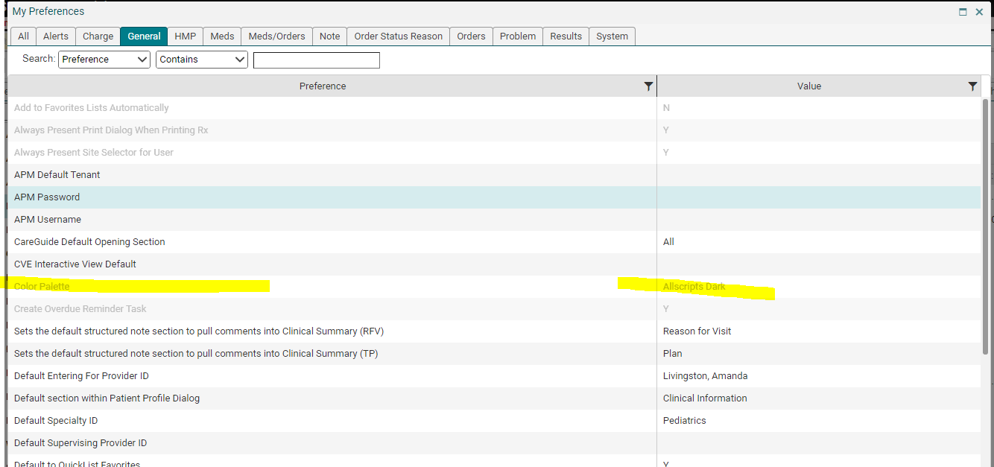
Color Palette
You can update your Color Palette. From the Site Map, chose My Preferences.
On the General tab, choose Color Palette.

Slide 12
Renamed workspaces

Slide 13
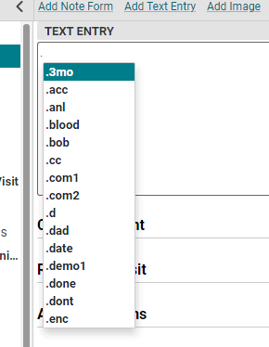
Macros
Your macros will come with you into the new version.
The EHR will now suggest macros for you when you type the “period”.

Slide 14
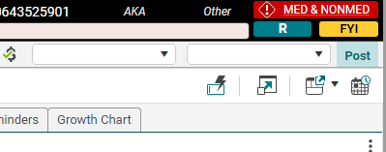
Macro refresher- in case you need it
A macro is a shortcut you create that when entered into the system will automatically expand into a larger phrase or series of phrases.
A macro can be used to automatically enter simple, repetitive phrases including commonly used sentences and education in your documentation.
A. Click the macro button.
or

Slide 15
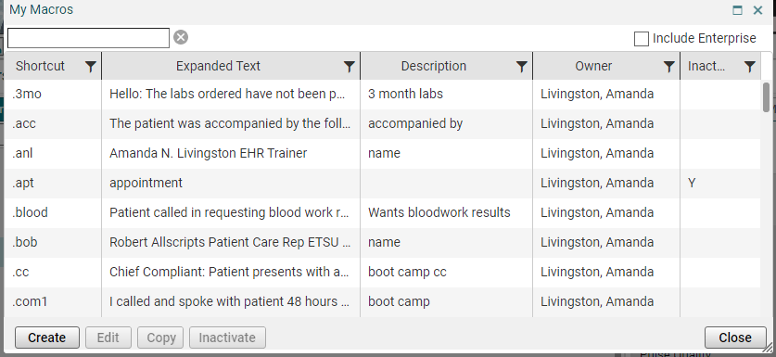
B. A macro edit box will appear for you to begin creating. C. Click Create.

Slide 16
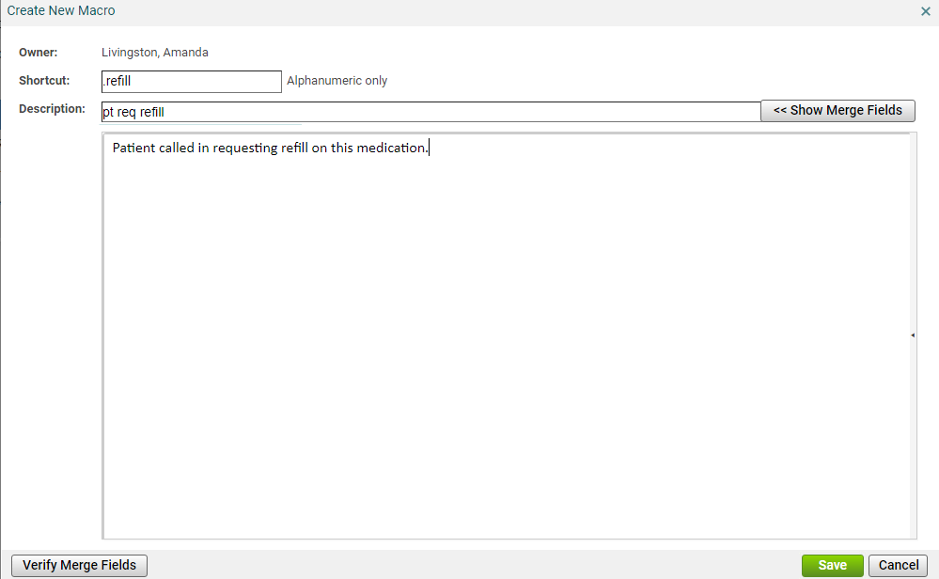
1
2
3
D. Create your macros.

Slide 18
E. Save your macro.
The new macro will be added to your My Macros list.
From this window, you can Create, Edit, Copy, and Inactivate.
They are not easily removed from the system.

