Slide 1
TouchWorks EHR Upgrade Version 20
Chart
Go-Live Date 05/24/2021

Slide 2
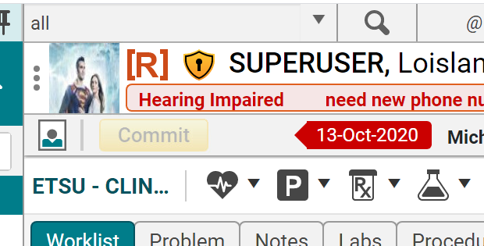
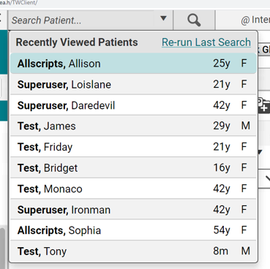
Search Patient
Search patient is still in the upper left corner but includes the magnifying glass and an inline search.
The search dropdown now remember the last 10 patients you opened even after you log out and log back in.

Slide 3
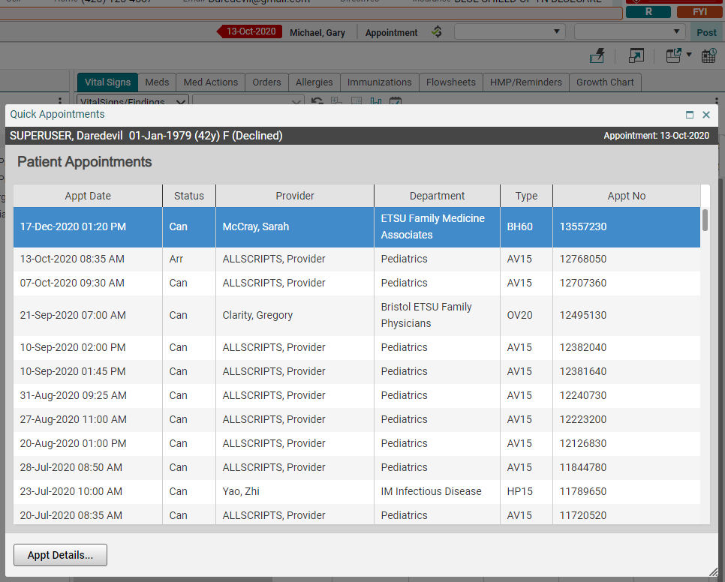
Quick Appointments
Quick Appointments icon is the only way to see the past, present, and future appointments for the patient in the patient banner.
Appointments tab is gone.

Slide 4
Chart Window
Current encounter/date of service
Current location

Slide 5
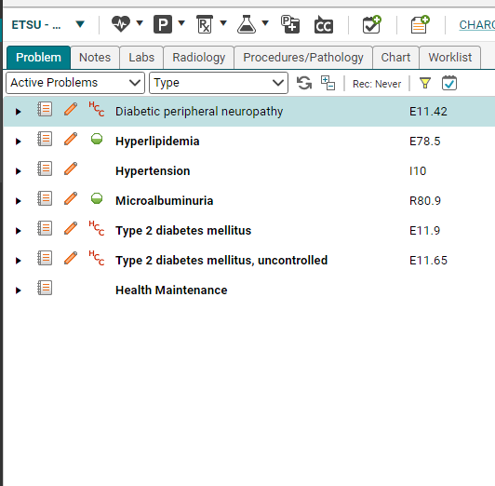
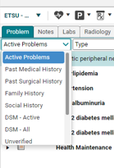
Active Problems
Problems tab will now default to only Active Problems.
Use the dropdown arrow to show All Problems or to select a Problem list.

Slide 6
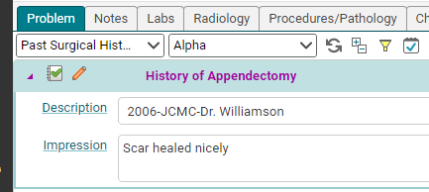
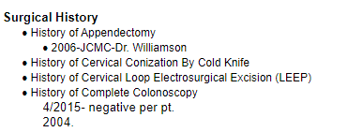
Problem Description and Impression
Now available at a click in the Problem list.
Depending on your note configuration, these description comments will appear in your note output.
If note output needs to be reconfigured, then have your Department Head contact the EHR team.

Slide 7
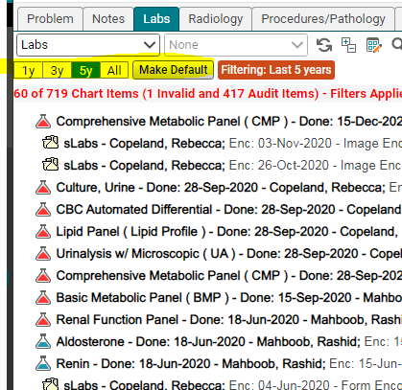
Chart View Filtering
Notes, Labs, Radiology, Procedures/Pathology, Chart tabs now have the ability to show 1 year, 3 years, 5 years, All.
1 year is system default and allows for fastest loading times.
You can toggle to alternate values and set your own default filter by clicking Make Default.

Slide 8
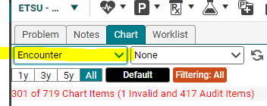
Chart tab sort by Encounter
Non-clinical staff now have the ability to sort by Encounter on the Chart tab.

Slide 9
Med Actions – NEW TAB
Med flowsheet has been updated to Med Actions.
Green check mark indicates patient is taking medication.
Red dash indicates patient is non-compliant, not taking medication.
Red dash does not remove med from Current Meds to Past Meds.
Dropdown box allows a not-taking reason.
R D/C allows to record discontinue from this tab and does move med from Current Meds to Past Meds.
3 dots opens additional menu.
Can also right click for an additional menu.
Changes must be Committed.
This can be used as part of the medication reconciliation.
Please work with nursing supervisors and medical directors for each specialty to determine best practices for your team.

Slide 10
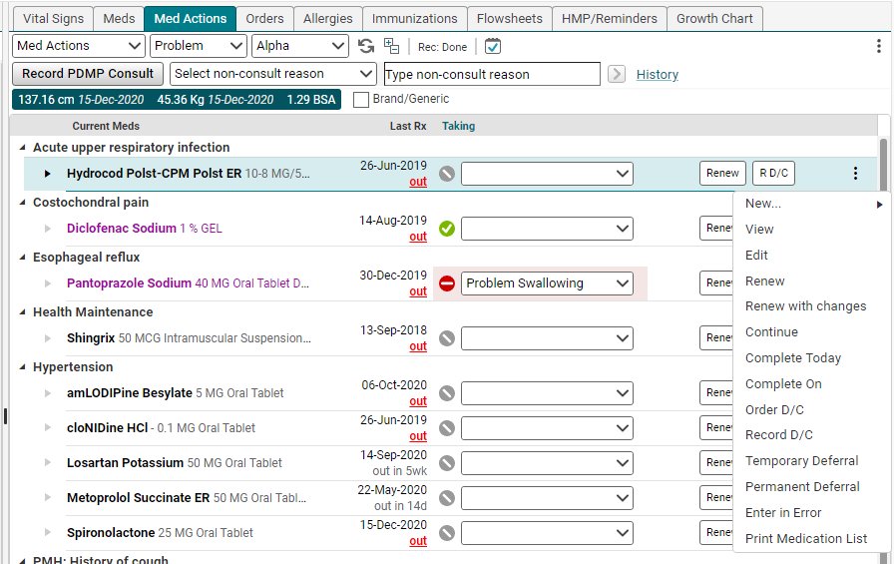
Med Actions Screenshot

Slide 11
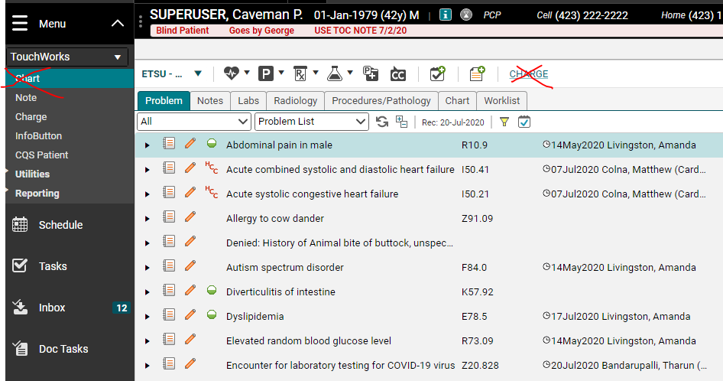
Charge is for billing from the system
Charge is for billing from the EHR- Charge Entry.
Only a small number of providers are currently billing from the system. (Thank you Dr. Smith and Dr. Michael!)
We hope to roll out Charge in 2021.
Until then, please ignore.

Slide 12
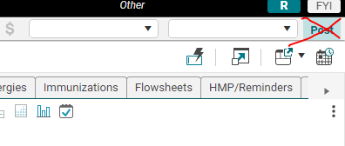
Post is for charge entry too.
Until we roll out charge entry, please don’t click Post in the upper right corner.

