Slide 1
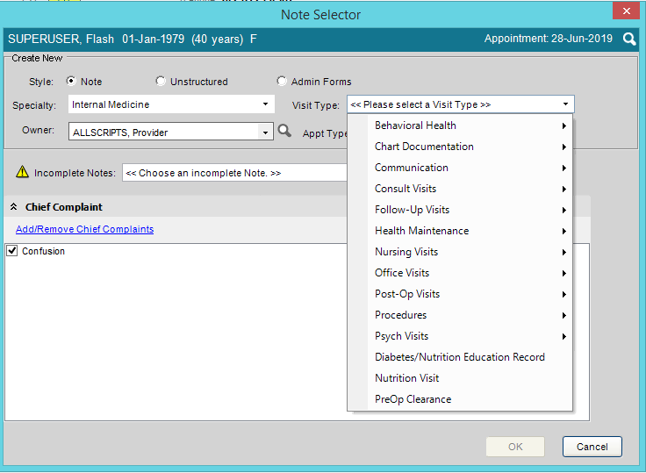
5 note types
Internal Medicine
Boot Camp July 7, 2020

Slide 2
Transition of Care
In general, Transition of Care when transferring from a different place of service or provider
Different types of TOC
New Patient
Hospital Follow up
Discharge from Hospital or Rehabilitation Facility or Nursing Home

Slide 3
TOC Case Manager
Hospital Follow up appointment scheduled from hospital at discharge
Case Managers call patient and starts TOC note at that time
Visit Type on the Note Selector box: Transition of Care
Transition of Care note-special note not finalized until post- 30 days from discharge
Comments section on Daily Schedule will indicate to use TOC note already created
Alert in red may tell you to use a TOC for a visit too

Slide 4
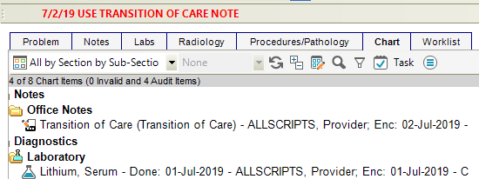
TOC NOTES
Look at the Alert
Open the already started Transition of Care note

Slide 5
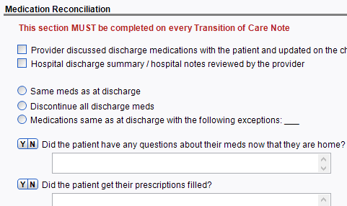
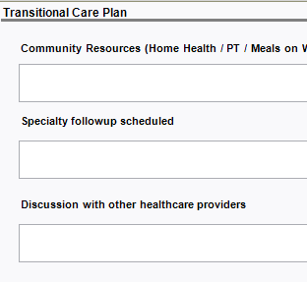
Toc tips
Complete all sections required included Medication Reconciliation and Transitional Care Plan.
Med Rec still must be clicked in chart.

Slide 6
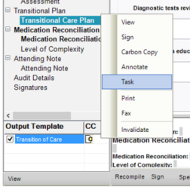
TOC Note task
These notes need to be manually sent to Attending as a Task.
Right click on the Output Template and Choose Task.

Slide 7
TOC CPT Codes
TOC CPT codes are documentation driven
TOC Note format created to meet guidelines
Payers decide if and when TOC CPT reimbursed
Pt to be seen within 7 days
99495 face-to-face within 14 calendar days of discharge, moderate complexity
99496 face-to-face within 7 calendar days of discharge, high complexity
If it isn’t a 99496 (7 days, high complexity), it is a 99495

Slide 8
Medicare Annual Wellness
Visit Type on the Note Selector box: Medicare Annual Wellness
Includes Quality Measure Assessment Form located under Vitals panel
Quality Measure Assessment Info entered in at Triage
Specific Medicare-driven documentation: AWV Pain Screening, AWV Self-Assessment of Health, AWV Screening and Management, AWV Assessment (Other)
Once in a lifetime option for a Welcome To Medicare Evaluation when patient first signs up for Medicare

Slide 9
Medicare Annual Wellness
Important to have Medicare Annual Wellness once a year
All HCC Codes should be assessed at every Medicare Annual Wellness

Slide 10
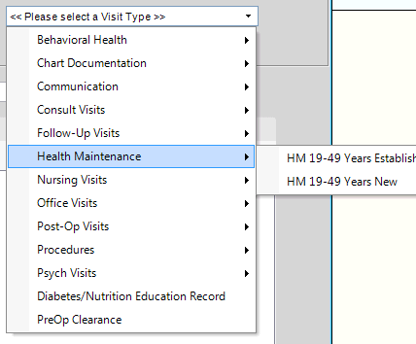
Annual Physical Exam
Can use the HMP reminders in EHR-see hand out from wwww.quillenphysiciansehr.com
Visit Type on the Note Selector box: Health Maintenance note determined by age and new or established
Pt may bring Biometric Screening documents mandated by commercial insurance companies
Not as many payer driven questions
Follow appropriate Preventative Health Care guidelines based on age and risk: cholesterol, breast cancer, cervical cancer, prostate cancer, colorectal cancer

Slide 11
New Patient
Visit Type on the Note Selector box: HM 19-49 Years New or under Office Visits: New Patient
This is a type of Transition of Care (but not a TOC note!)
The TC box will be marked on the Daily Schedule tab as well
CPT defines a new patient as “one who has not received any professional services from the physician, or another physician of the same specialty who belongs to the same group practice within the past three years.”
All 3 key components (history, exam, and medical decision making) must be satisfied when determining E/M level. So document accordingly.

Slide 12
Sick or Acute Visit
Visit Type on the Note Selector box: Acute or Established
Considered Problem focused Visits
HPI important to document well
Document Clinically Relevant information in ROS and Exam

Slide 13
Care Plans
Care Plans as part of Annual Wellness/HM
Can be addressed more often at discretion of the physician
Part of Patient-Centered Medical Home (PCMH)-not payer or age driven
From BCBS: “A care plan is a detailed approach to patient care that is customized to incorporate an individual patient’s needs, goals, and preferences. In order for care plans to be successful, the patient must be an engaged partner in the care planning process. Care Plans are called for when patients can benefit from personalized physician instruction and feedback regarding management of their condition(s).”

Slide 14
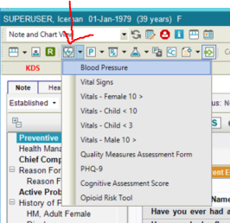
Tips and tricks
If bp is 140/90 at triage, it will need to be retaken in exam room
Document from within the note, by choosing arrow beside heart in Clinical Toolbar

Slide 15
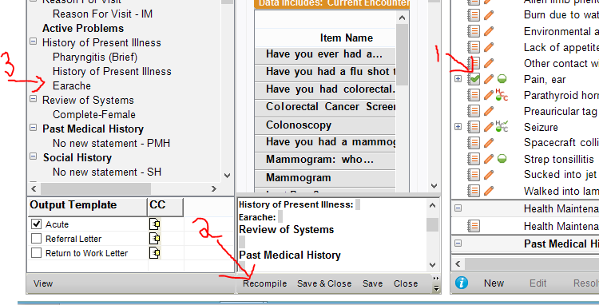
Adding forms
Some assessed dx codes will have HPI forms.
Assess the dx code and open the note.
Or assess the dx code from within the note, and then click Recompile at the bottom of the note.
____________
Assess/Commit problem
Click Recompile
Form appears in note

Slide 16
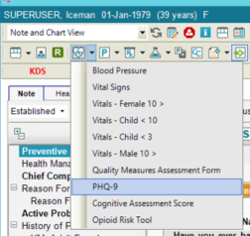
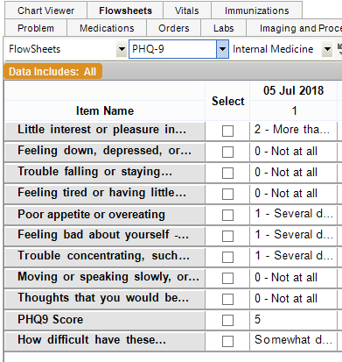
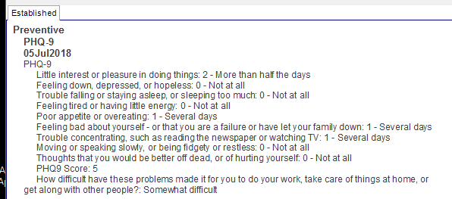
PHQ-9 Depression screen
The PHQ-9 depression screening questions can be added to any note
This is required for all patients annually
But it can be added if clinically needed at any time
These results will appear in encounter note and flowsheet

Slide 17
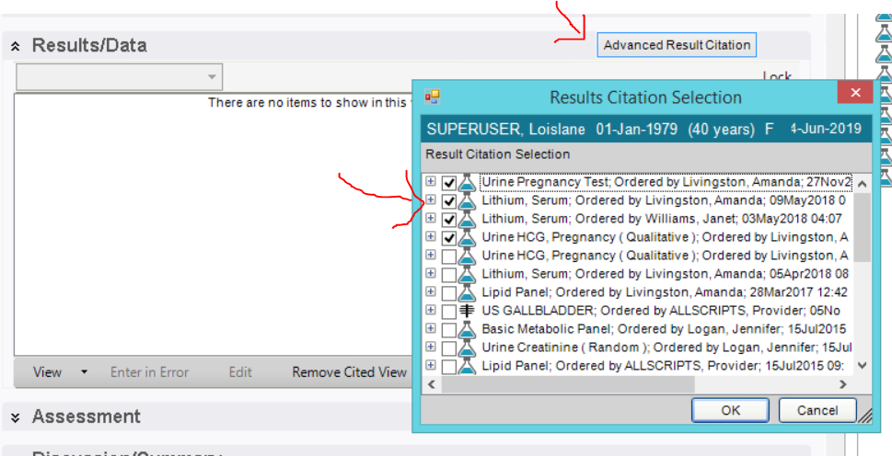
ADD ETSU Labs
Labs performed at ETSU in the last 30 days will automatically pull into the note.
To manually enter ETSU labs older than 30 days, use the Advanced Result Citation.

Slide 18
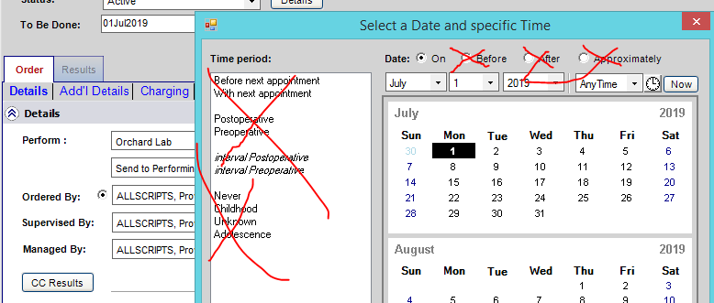
Labs for future date
You can order future labs
Don’t use Before, After, Approximately or With next appointment
Labs go to our lab system 2 weeks before To Be Done date and are valid for 3 months after To Be Done date

Slide 19
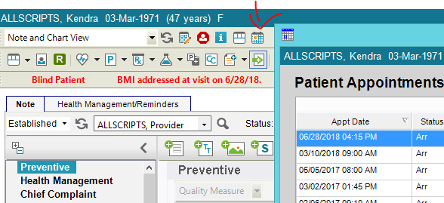
Already scheduled follow-up
You can view any future appointments by clicking the calendar at the top of the note
Enter information in Summary of Visit
Enter information in Plan

Slide 20
Today’s Test patients
Look at Allscripts Provider schedule
Your patient has your last name in the Comments
Ask questions-you have 3 notes to complete (Medicare Annual Wellness, already started TOC, Established)

Slide 21
Today’s Test patients
If you order, send to Allscripts Provider as attending in the ACI box
If you send for co-Sign, send to Allscripts Provider
Review the note forms in the TOC and work through the exam workflow

