Slide 1
TouchWorks EHR Upgrade Version 20
Notes
Go-Live Date 05/24/2021

Slide 2
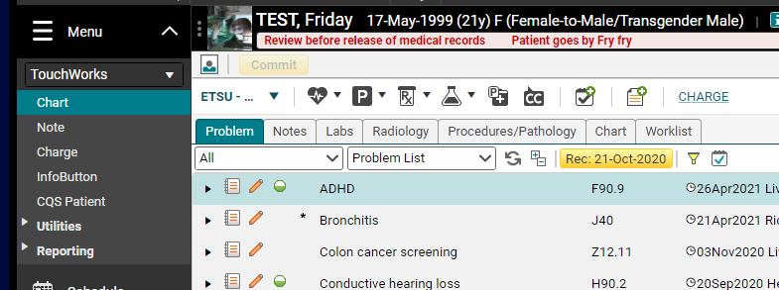
Starting a new note
The New Note tab is gone.
Note in the action bar will start a note too.
Start a note using the paper with a plus sign. In the clinical tool bar.

Slide 3
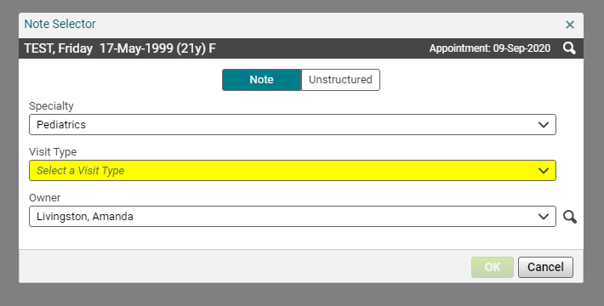
New Note Selector Screen
Always check the Encounter type and date.
Chief Compliant from this screen is gone.

Slide 4
Change Encounter Date
If you need to change the Encounter date, from inside the note click the magnifying glass in the top right.

Slide 5
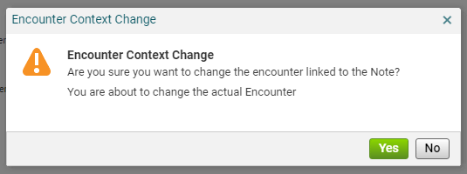
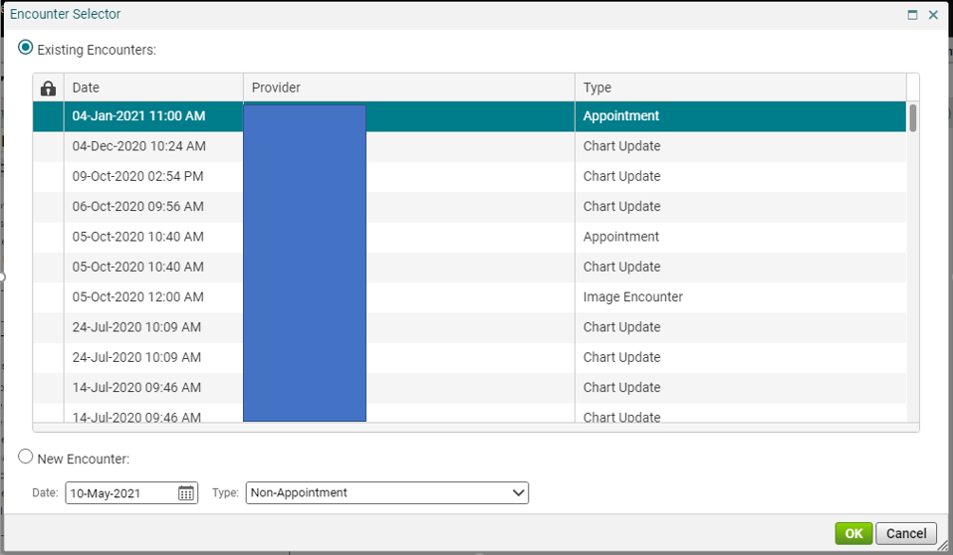
Encounter Context Change
Answer yes to the Encounter Context Change pop up window.
Select the correct Encounter and click Ok.

Slide 6
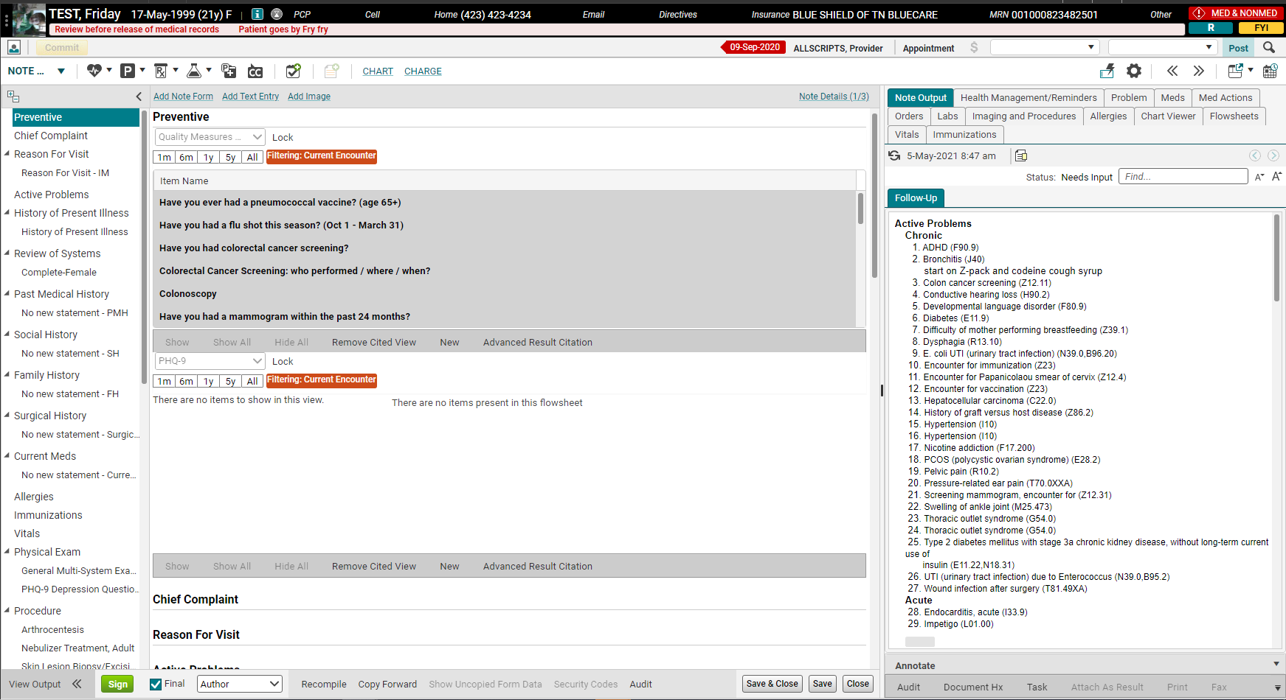
Note Editing View (Note Input)

Slide 7
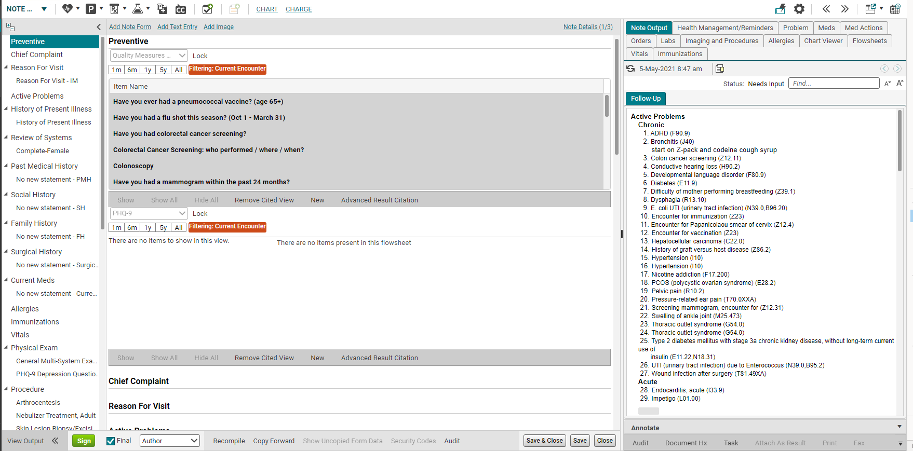
Note Authoring Workspace
The Note Accumulator is completely different.
It is no longer at the bottom of the note, but under the Note Output tab on the right.
The Note Output is how you see what your note looks like.
Can no longer see the note build down here.

Slide 8
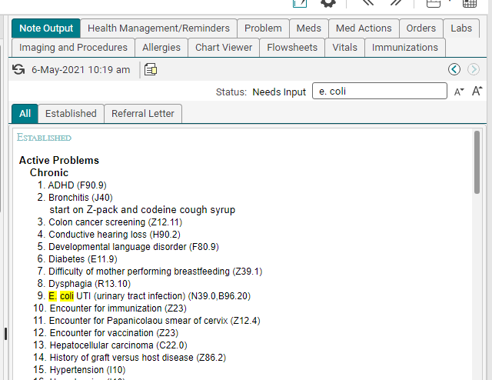
Search in Note Output
You can search for words in the Note Output section.

Slide 9
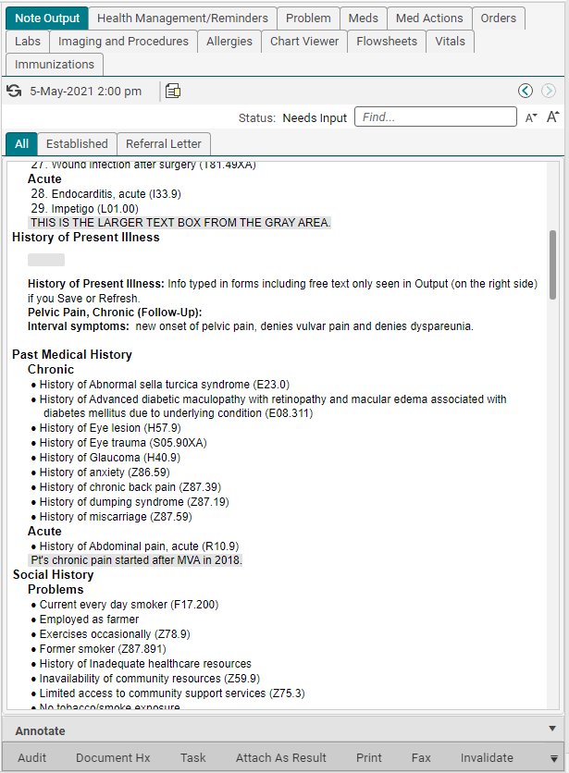
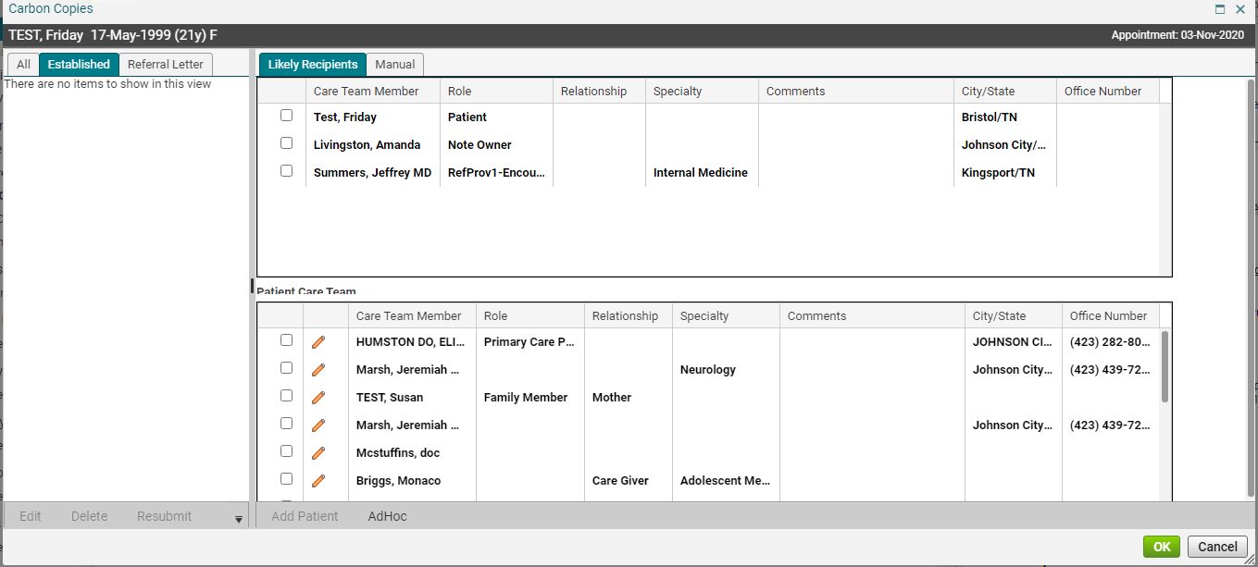
Note Output
Previous Versions.
Increase/decrease font size in Note Output.
Carbon Copies.
This location has moved.
You can create a task.
Precepting providers can Invalidate notes from here.
Carbon copy functionality stays the same.

Slide 10
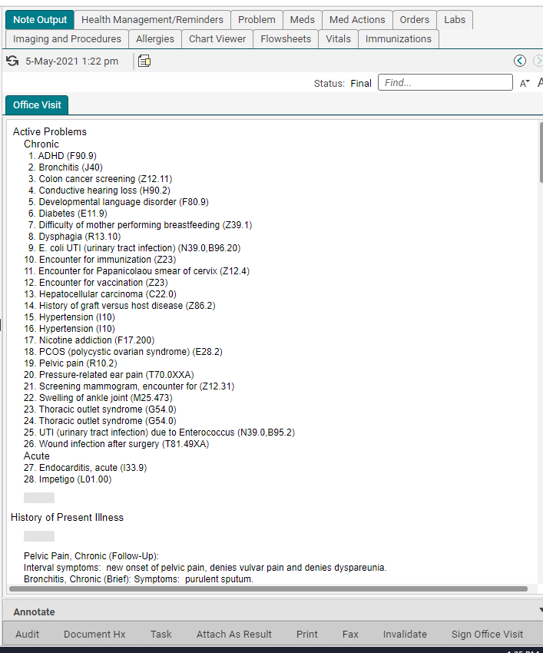
Note Output
Must refresh by using refresh circle or Save to view info typed in forms.
Click on gray space to free text. A larger text box pops open. Apply changes.
Section headers only show up if you enter something in that section.
Gray space free text works but not recommended workflow.
ETSU EHR recommends using Note Output for viewing, not typing.
ETSU EHR recommends free text boxes for typing free text.
The Note Output view doesn't scroll with you.

Slide 11
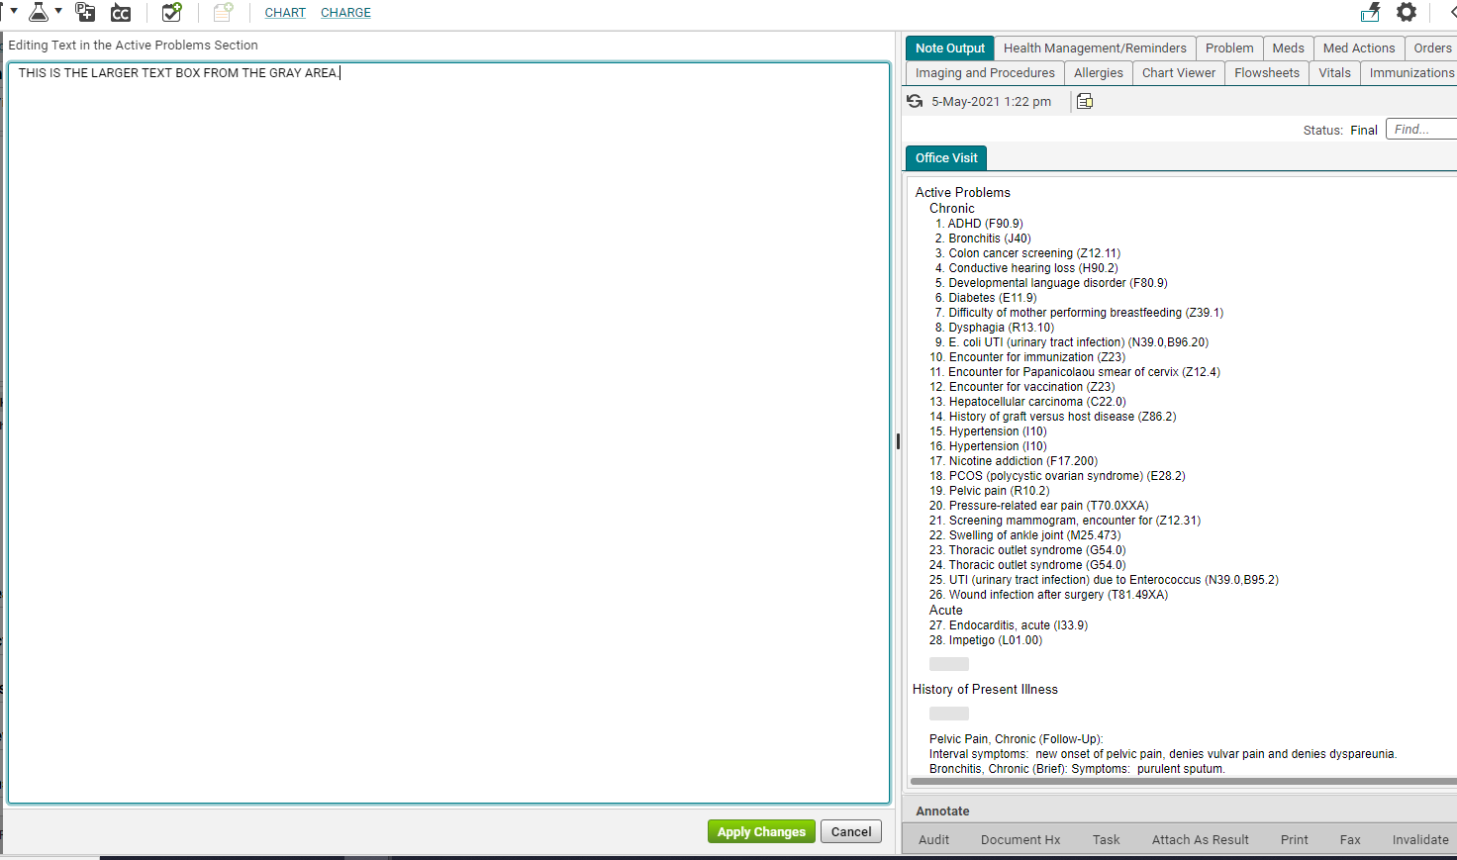
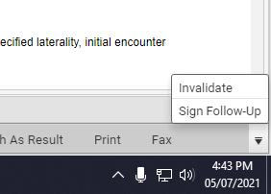
Editing text using gray area in Note Output
This is what it looks like when you click in the gray space in Note Output.
Don’t forget to Apply Changes.
If you can’t find Invalidate click the downward arrow to open to show it.

Slide 12
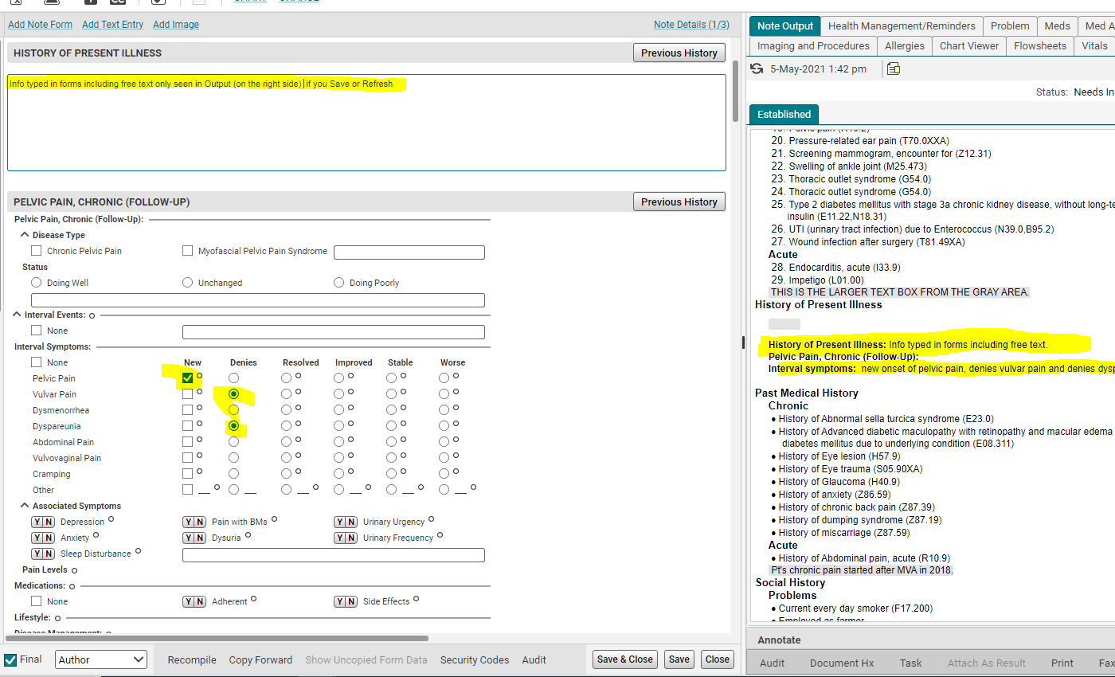
Data entered in forms
Info entered into forms is only seen in Note Output if you Save or Refresh.

Slide 13
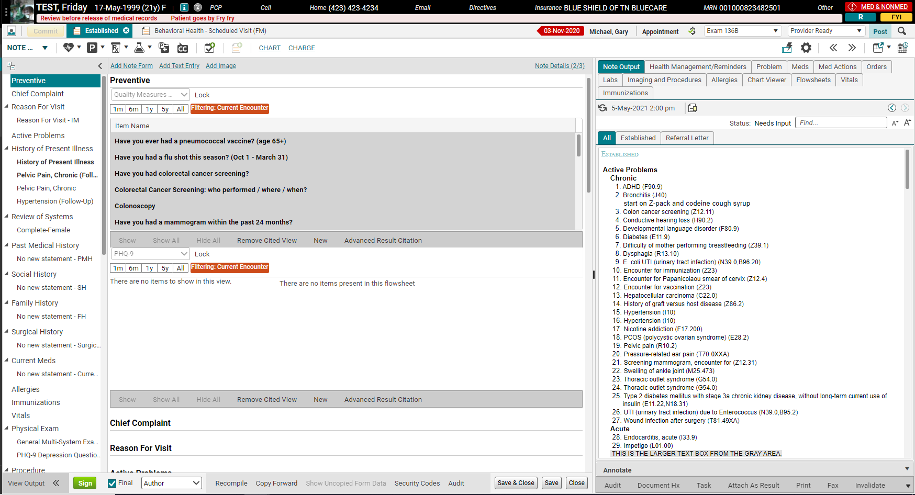
Note Input (entering data)
Encounter date, provider, type
Banner stays viewable.
Note Inputs created for this encounter.
<< >> arrows are a quick way to expand or shrink the right column.

Slide 14
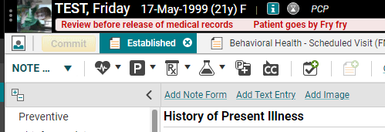
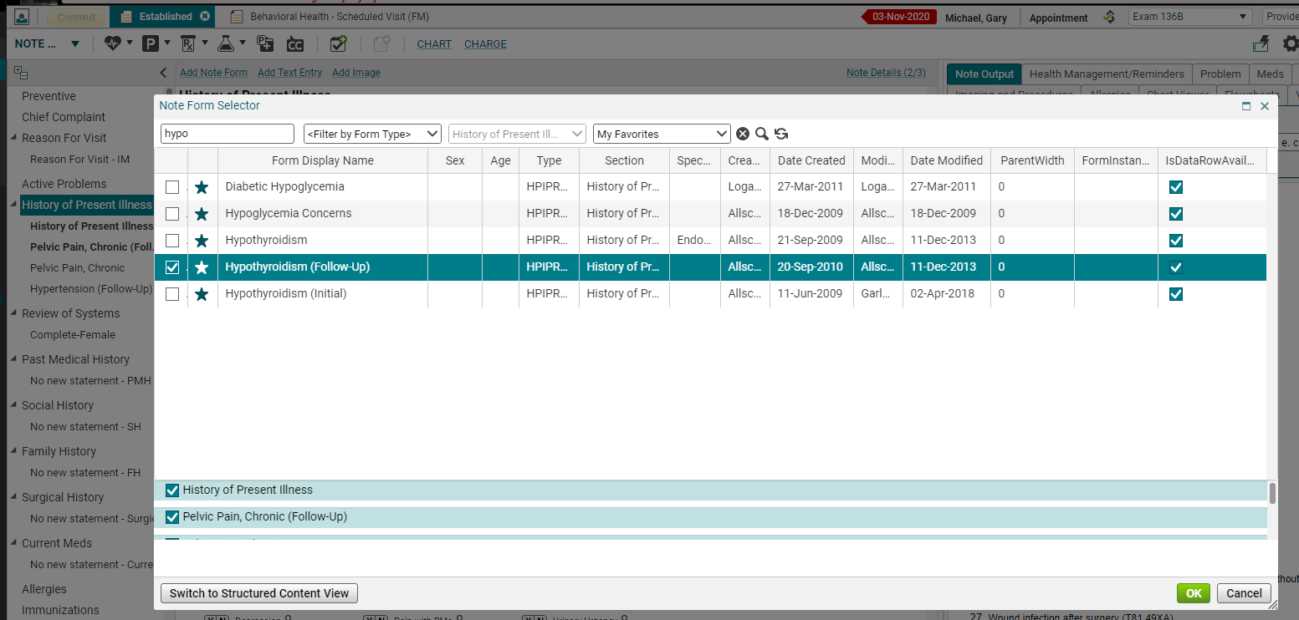
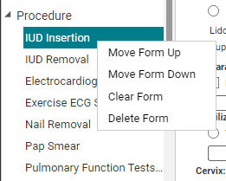
Add Note Form
No longer need to right click to Add Note Form.
Most popular note forms are in HPI and procedure section.
Be sure you have the right section selected.
To move or delete form, you would still need to right click on it.

Slide 15
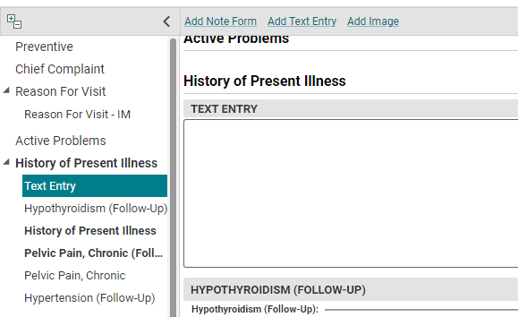
Add Text Entry
Text Template box is replaced by Text Entry.
It is easier most of the time.
You can add your own Free text box wherever you want!
The department chair or medical directors can contact the EHR team to update note templates too.

Slide 16
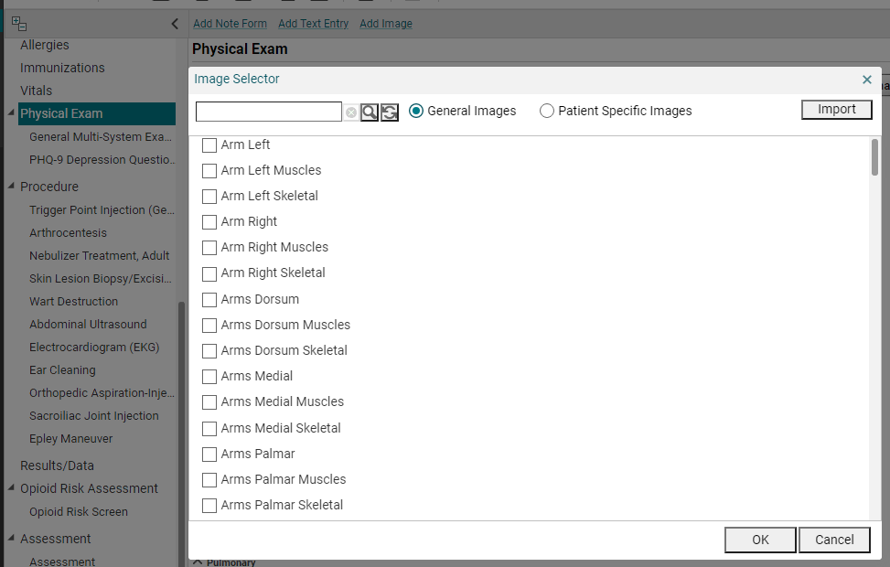
Add Image
No longer need to right click to Add Image.
It is easier most of the time.
Use the Table of Contents (the right-side column) to determine which section you want your image.

Slide 17
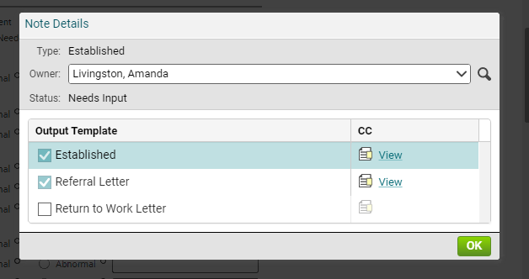
Note Details
Note Details show you the different output templates now.
This is where you change the Owner!!
You can Carbon Copy from here too.

Slide 18
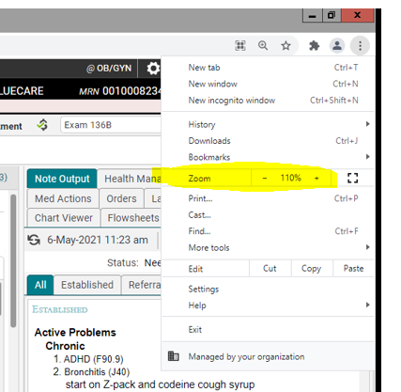
Increase note input font size
You can now make the font bigger inside the window that you use to type up the note.
This didn’t work in version 17 on note input.
1. In very top right corner, click the 3 dots.
2. Increase your font size.
Only increases in increments of 10%.

Slide 19
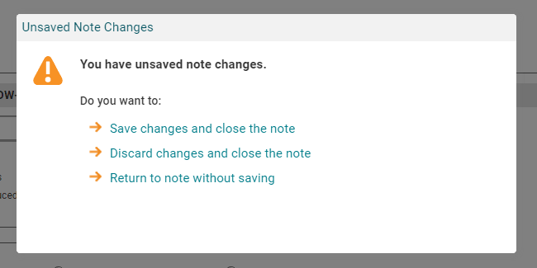
Unsaved notes
Note workspace will auto-save when user navigates away, switches patients, or logs off.
If note is closed with unsaved data, new window is displayed.

Slide 20
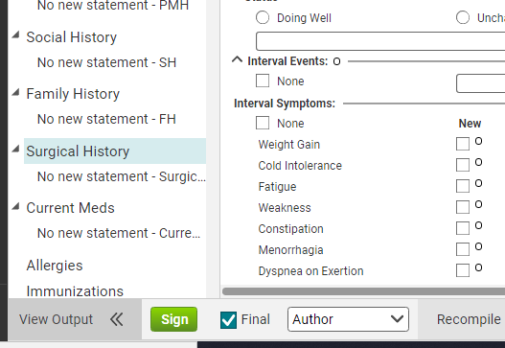
Sign notes
You no longer enter your password when you sign notes.
Just click Sign.

