Slide 1
TouchWorks EHR Upgrade Version 20
Rx Changes
Go-Live Date 05/24/2021

Slide 2
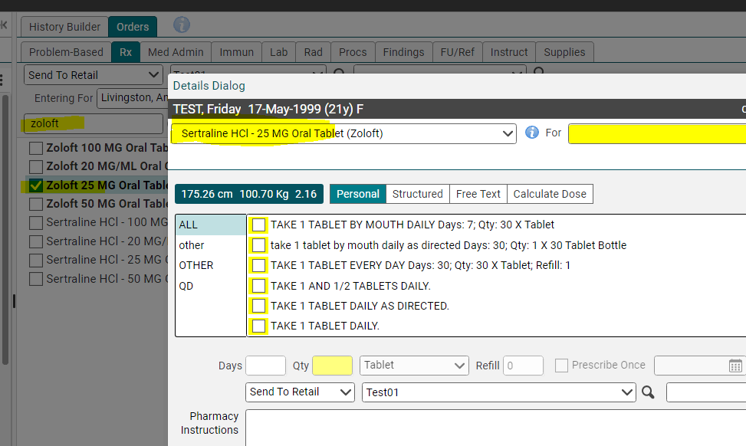
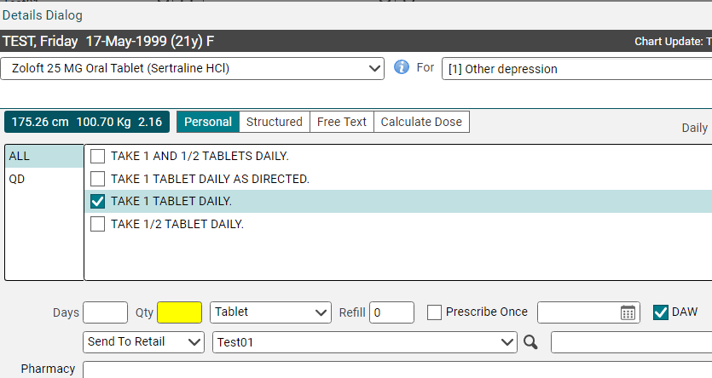
Generic over brand
TouchWorks will automatically switch brand name drugs to generic drugs.
In this example, Zoloft (brand) was selected, but Sertraline (generic) was placed in order.
To order brand name, use the dropdown arrow to select the brand name and click the DAW button on the order after the Sig is entered.

Slide 3
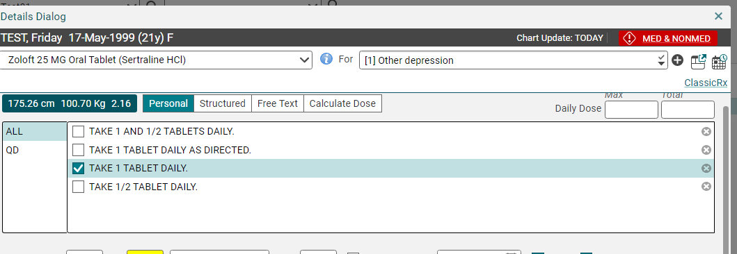
Easier to delete unwanted Sigs
If you have a Sig that you don’t want to keep as a default choice, click the X to remove it.

Slide 4
Classic Rx vs. Quick Rx
Quick Rx should be fine for most prescription orders.
Automatically opens for non-controlled meds.
To dispense a sample, must use Classic Rx.
Edit and Record w/o ordering is done with Classic Rx.
Some specialty meds, pharmacies, or ePA’s will route to Classic Rx.
If you need to add Education Details, Annotations, or to view Order and Renewal History, use Classic Rx.
Click Classic Rx in blue on the top right to switch.
Some details may need to revalidated when switching to Classic Rx if they are already entered on Quick Rx.

Slide 5
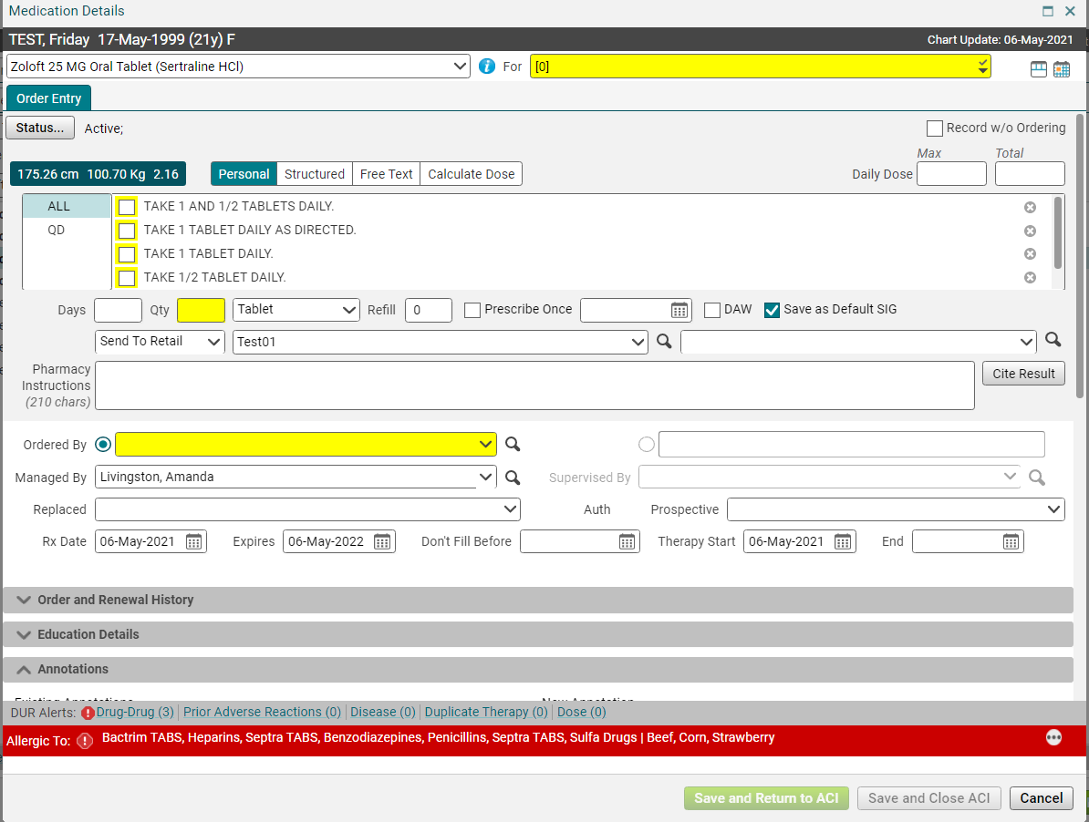
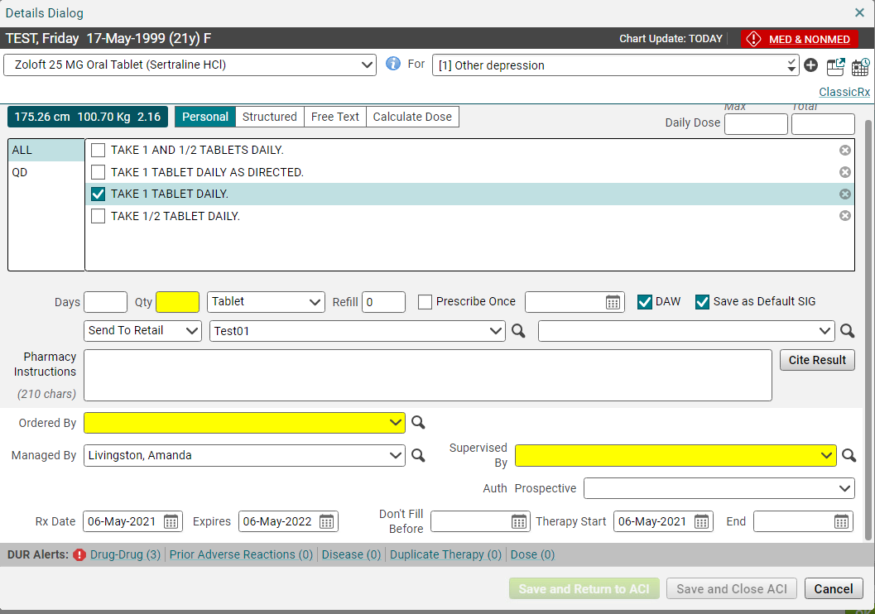
Classic Rx vs. Quick Rx
Classic Rx is the window that is in previous versions of Touchworks.
Quick Rx is new to version 20.

Slide 6
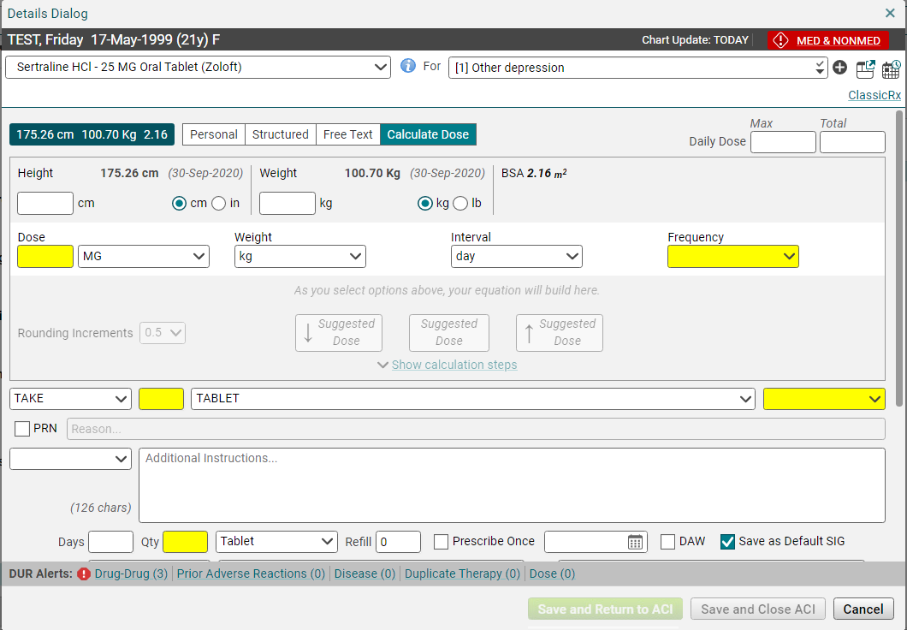
Dosage Calculator improvements
Ability to select a Rounding button to default dose and frequency into sig.
Calculation Steps Available.
To add a new problem, click the + plus sign in a circle.

Slide 7
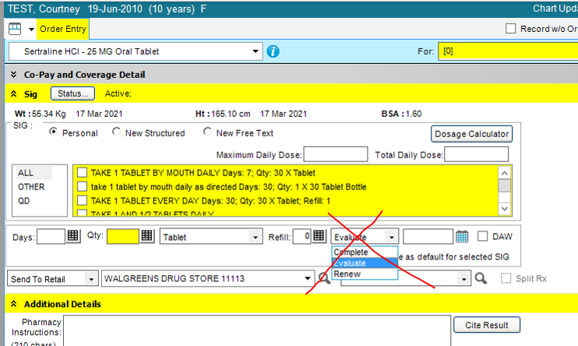
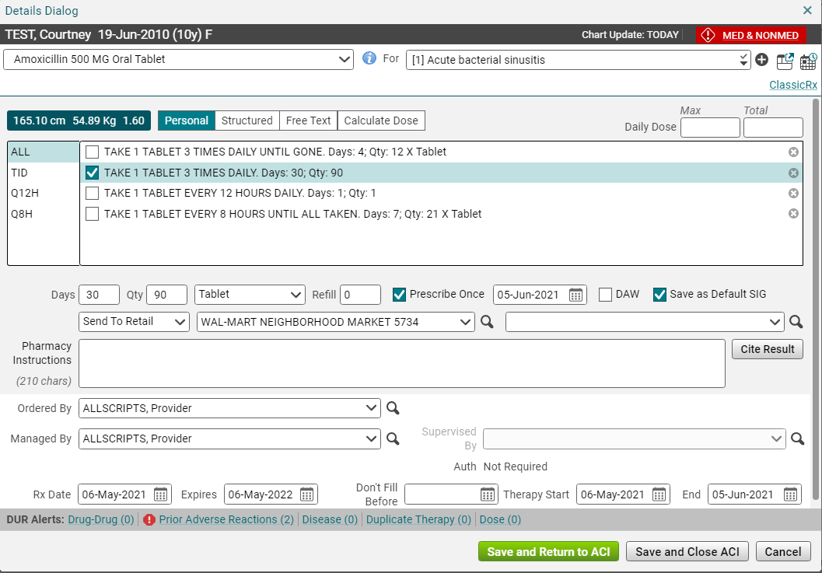
Prescribe Once
Complete, Evaluate, Renew dropdown no longer an option.
Replaced with Prescribe Once click box.
Prescribe Once acts like Complete and automatically updates meds list by moving medication from Current Meds list to Past Meds list on date patient should be out of meds.
Prescribe Once can be used for short term meds like antibiotics, steroids.
Not checked is default and works like previous Evaluate, keeps medication on Current Meds list even when patient is due to be out of medication and possibly needs refill.

Slide 8
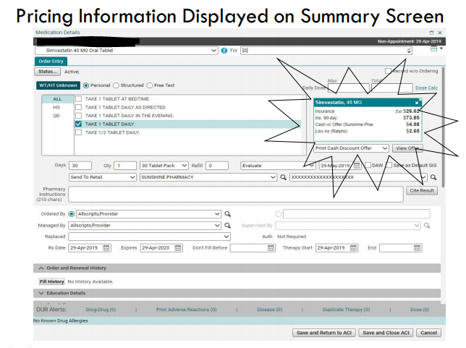
Rx True Price
Rx True Price is a new feature in Touchworks.
The EHR team is currently testing the functionality.

Slide 9
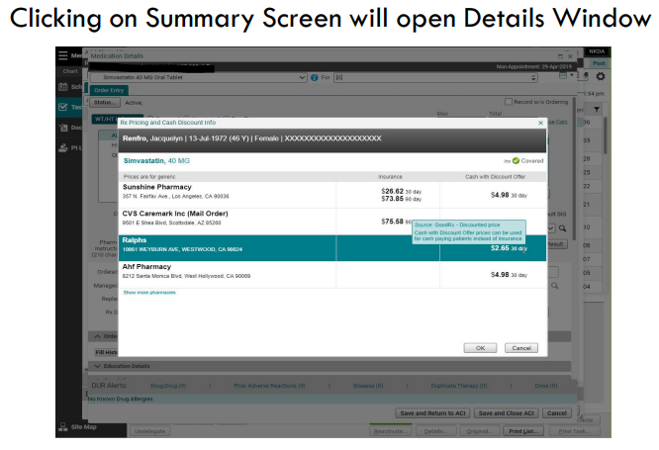
Rx True Price
The idea is that you would be able to see the actual price for the Rx at local pharmacies.
This will help you help the patient make the right decision regarding drugs and cost.
Sometimes you are even offered a cash price.

Slide 10
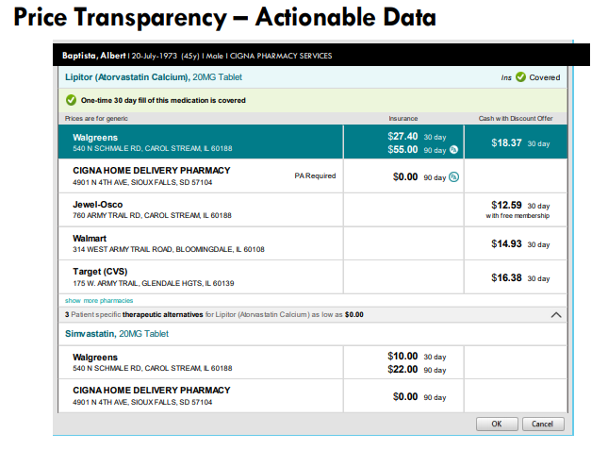
Rx True Price

Slide 11
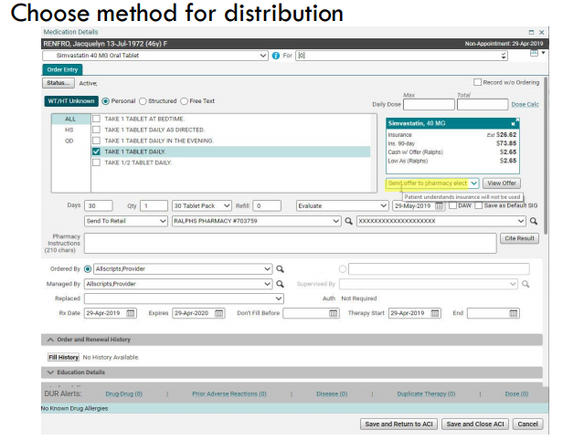
Rx True Price

Slide 12
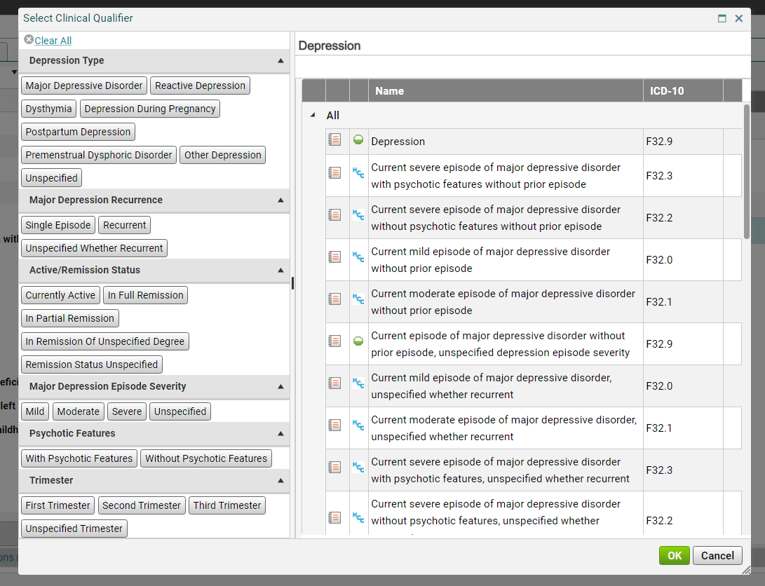
When entering problems- the Select Clinical Qualifier tool
The Select Clinical Qualifier tool (used to help narrow down to a more specific diagnosis code) is now on the right side and not the top.

