Slide 1
TouchWorks EHR Upgrade Version 20
Tasks
Go-Live Date 05/24/2021

Slide 2
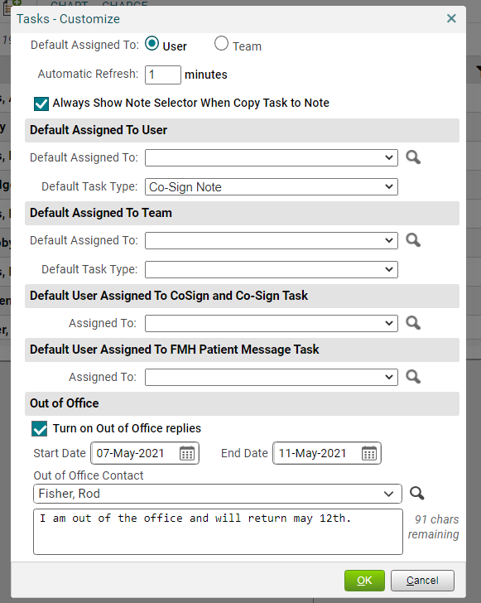
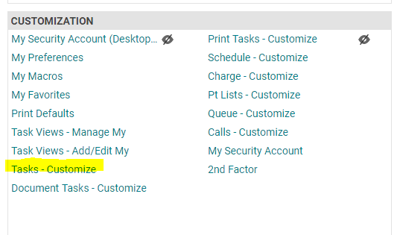
Tasks- Out of Office
To open, click the gear box on the upper right side on the task window.
Tasks now have an Out of Office option.
Accessible from the Tasks page, at the top right, click the gear box.
Out of Office is also accessible from the Site Map, under the Customization header, choose Tasks – Customize.

Slide 3
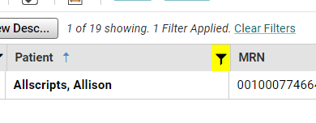
Tasks Filters
On the Tasks window, you can now sort and filter.
Selecting the funnel icon allows for filtering.
Clicking on the header sorts the column.
When a filter is applied, it turns yellow and says “Filter Applied.”
Click Clear Filters to remove filter.

Slide 4
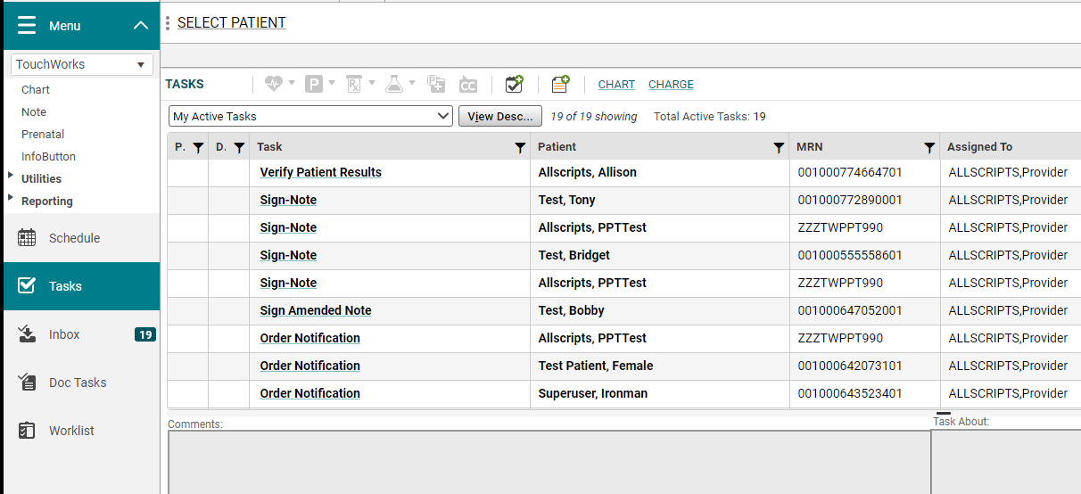
Tasks
Tasks functionality hasn’t changed.

Slide 5
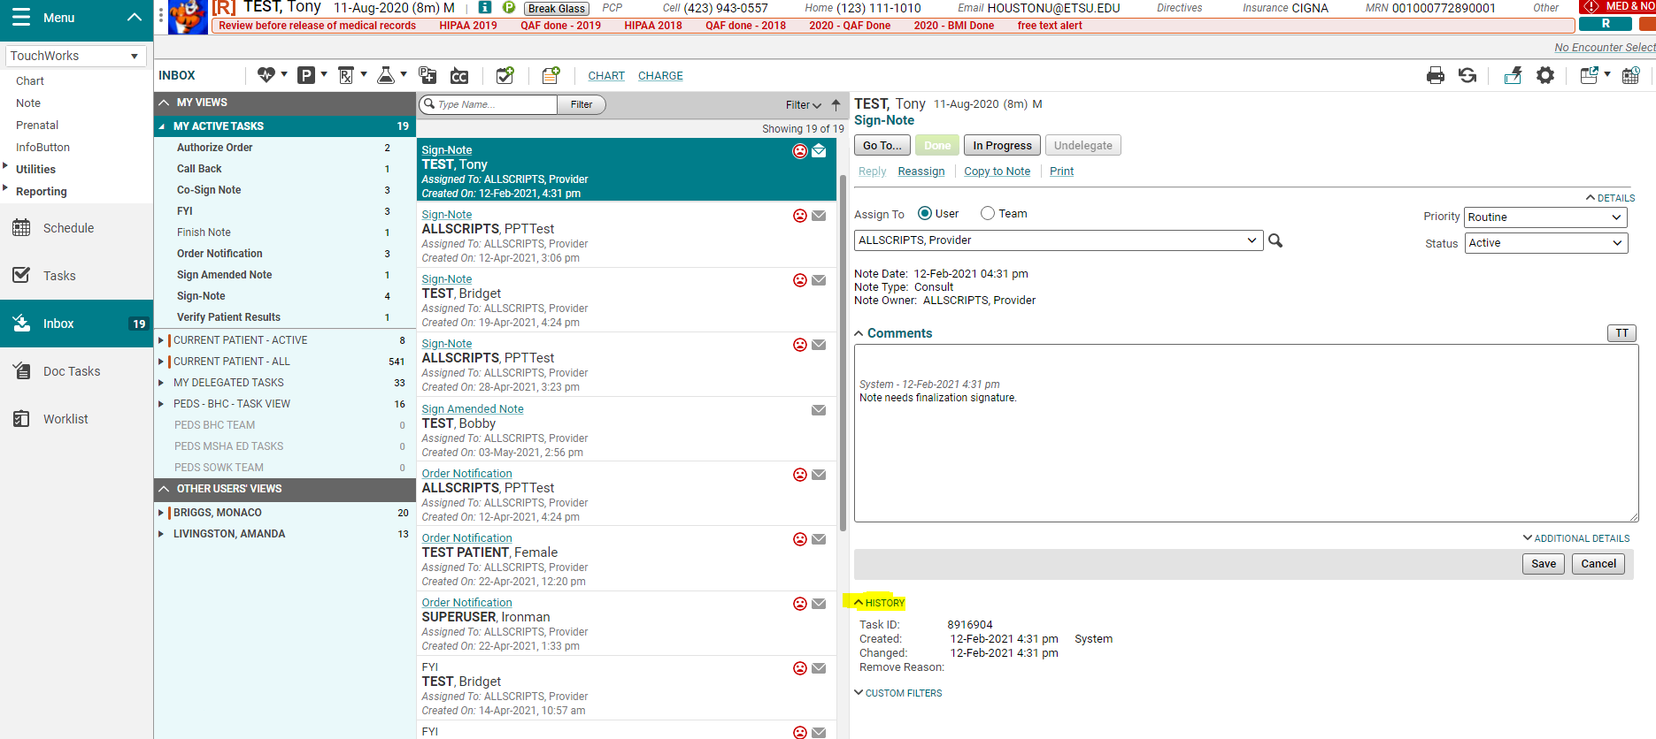
Inbox
Inbox is a new way to look at tasks as well.
The functionality remains the same: Go To…, Done, In Progress, Undelegate, Assign To.
It has a more “email-like” look.
You can see the History of the task.

Slide 6
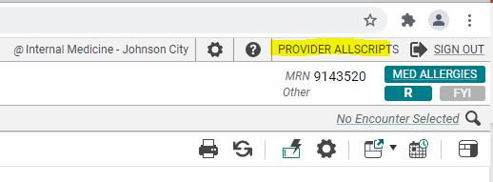
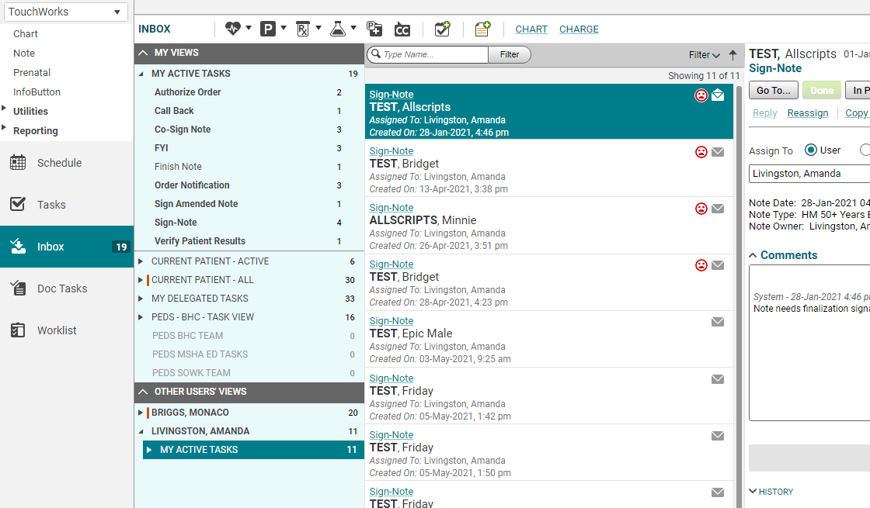
Other Users’ Views
Logged in as Provider Allscripts.
Ability to see other user’s “My Active Tasks.”
You can set these up. You will no longer need to contact the Helpdesk to get a view of your nurse’s tasks, your out-of-town colleagues, or your residents.
In the example on the right, Dr. Provider Allscripts can also see and work the “My Active Tasks” of Monaco Briggs, and Amanda Livingston.
These are only visible on the Inbox page.

Slide 7
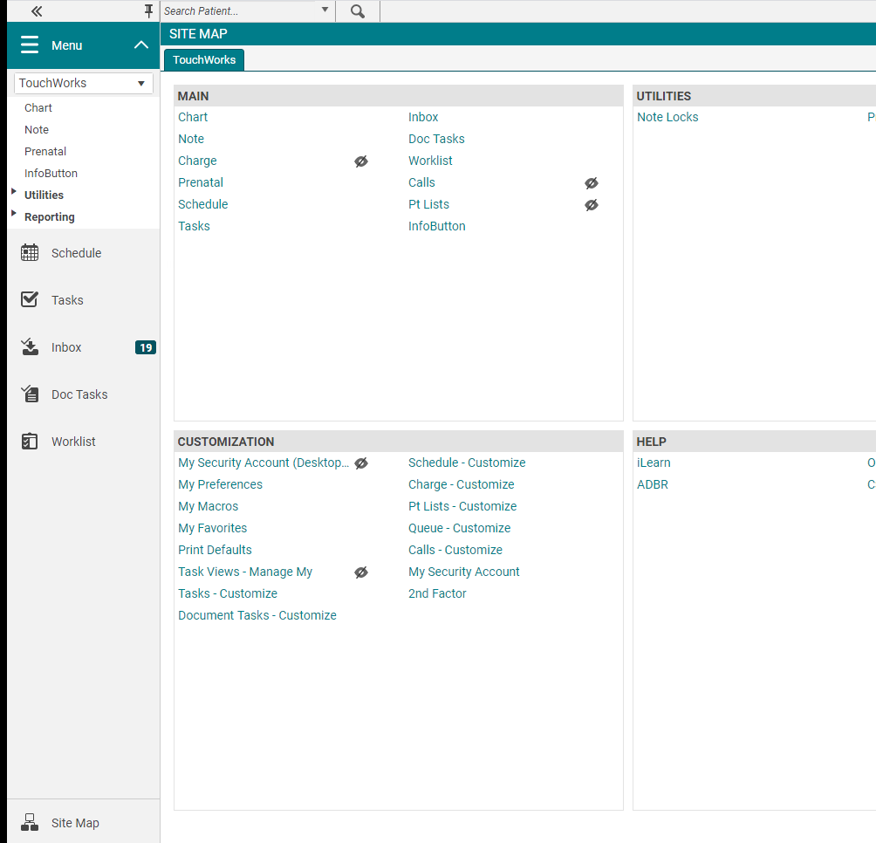
Setting up Other Users’ Views
From the Site Map under Customization, you will choose Tasks Views-Manage My.

Slide 8
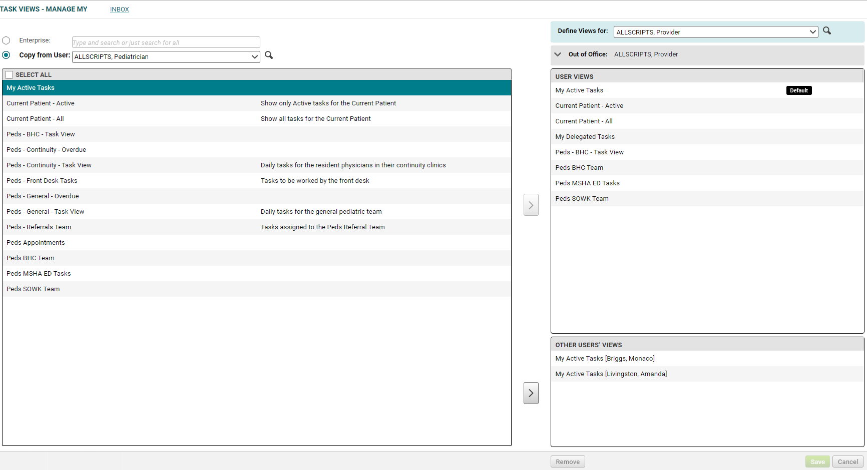
Tasks Views-Manage My
You can Copy (add) an individual’s “My Active Tasks.”
This is probably the most beneficial.
You can also copy Team views.
Nursing most likely to want to copy Team Views.
Select the user you want to copy from. (Remember to search using magnifying glass.)
Select which box you want to Copy.
Select the > arrow to add to your view.
Teams go on the top section and “My Active Tasks” are assigned on the bottom section.
Save
1
2
3
4
5

Slide 9
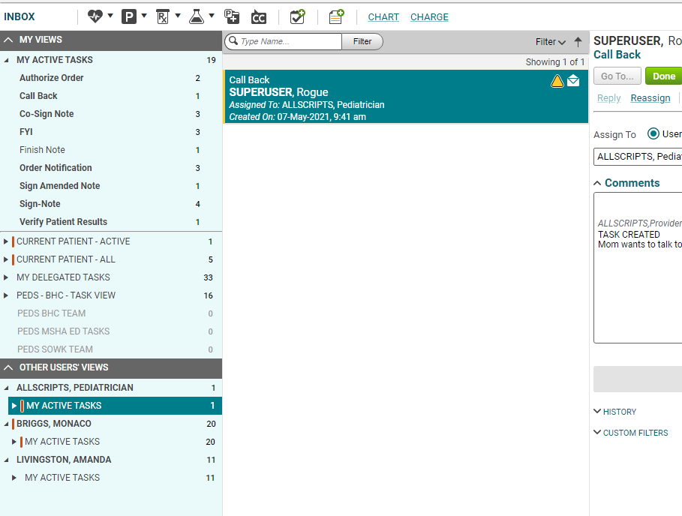
Inbox updated
From my example, Dr. Provider Allscripts can now see the “My Active Tasks” of Dr. Pediatrician Allscripts.
Use the checkmark-plus sign icon to start a new task from the Inbox page.
Start new task

Slide 10
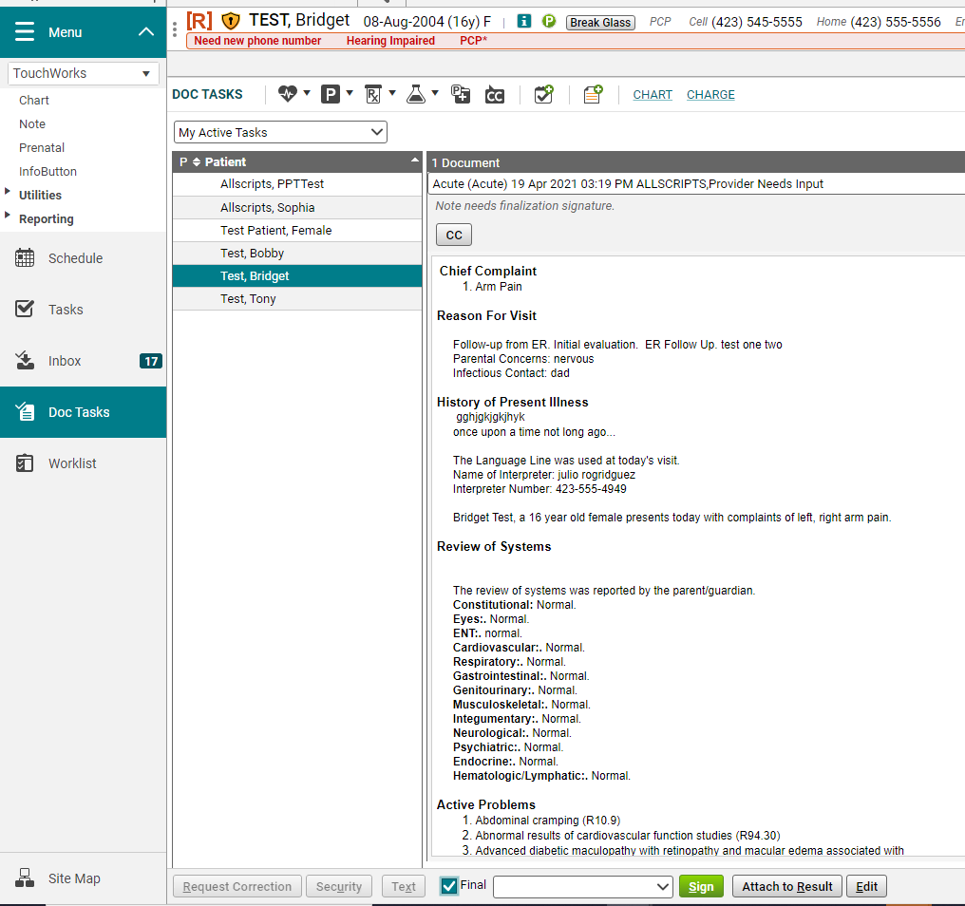
Doc Tasks
Doc tasks replace Batch Sign tab.
Shows you just the notes you need to sign.

Slide 11
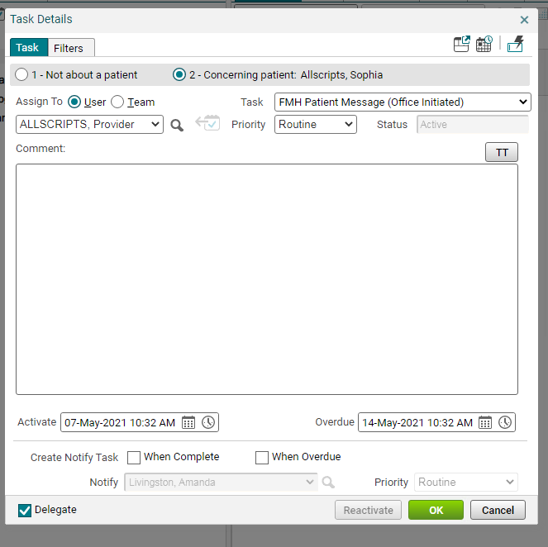
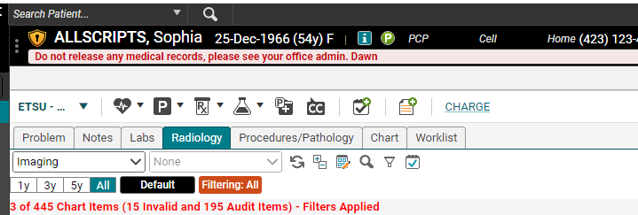
Send a patient Follow My Health message
You can easily send a patient a FMH message by clicking the green P in the patient banner.
The Assign to User field needs to be a Provider’s name.
It essentially acts like “From the office of Provider Allscripts”

Slide 12
FMH Not Read Receipt- New task type
If the patient hasn’t read a FMH message by the overdue date, a FMH Not Read Receipt task is created.
Task is delivered as Delegated (to the clinical staff).
This task type is still being tested.
You can change the overdue date when you create the FMH message by using the calendar.

Slide 13
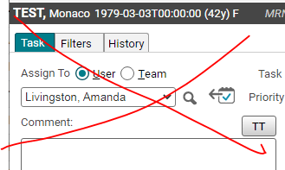
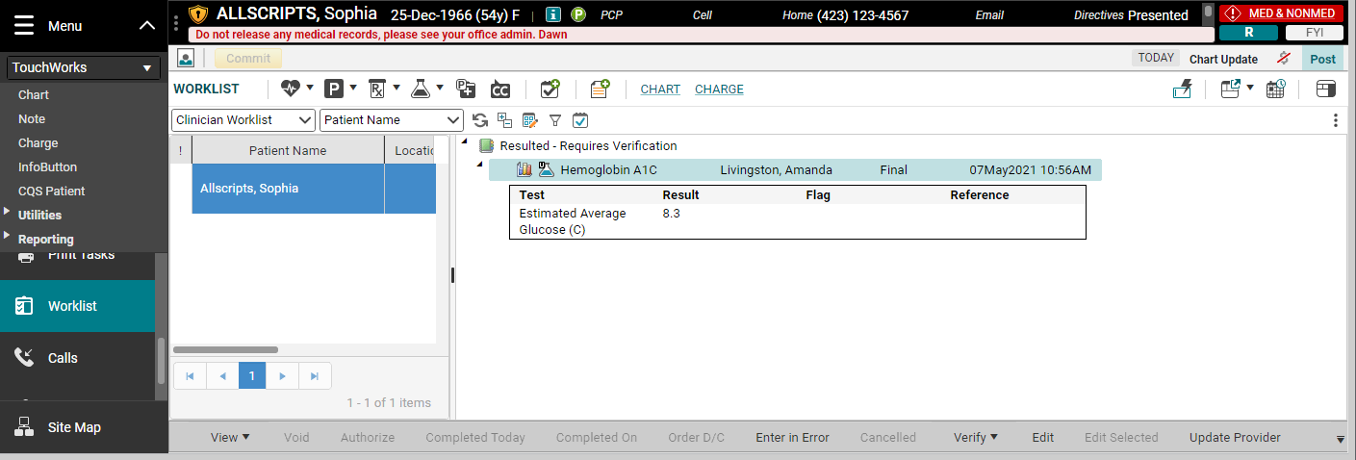
Can no longer Reassign Verify Patient Results tasks
You can no longer forward a “Verify Patient Results” task to another provider.
It doesn’t work from the Task List.
It does work from the Worklist!
You will need to Update Provider from the Worklist page.

Slide 14
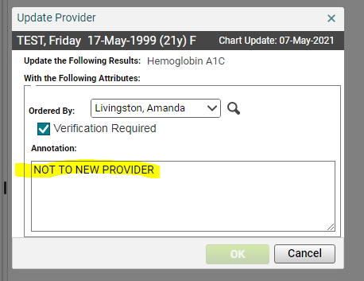
Update Provider
Use magnifying glass to search for provider if not in dropdown.
These Annotations are on the RESULTS not a message to the new Provider.

