Slide 1
TouchWorks EHR Upgrade Version 20
Logging In and Schedule
Go-Live Date 05/24/2021

Slide 2
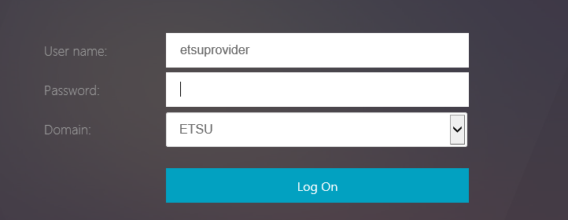
Logging In
If you are an on-boarding provider that needs EPCS-enrollment for controlled substances, a member of the EHR team will help you enroll, set up your security account, and log in.
If you are already enrolled in EPCS prior to May 24, 2021, please see the EHR website https://www.quillenphysiciansehr.com/v20-training-logging-on.html
After your first log in, the logging into the EHR process has simplified.
Log into ETSU Health Citrix icon from inside the clinic or https://mea.allscriptscloud.com for outside of the clinic.
Enter your username and ETSU email password.

Slide 3
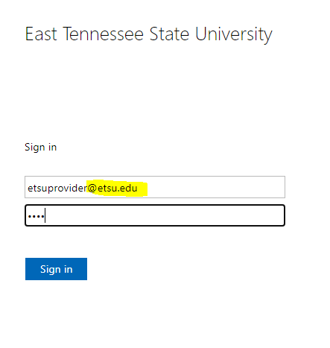
Logging in
3. Click the TouchWorks EHR LIVE icon.
4. Log into ETSU domain again using your full email address and password.

Slide 4
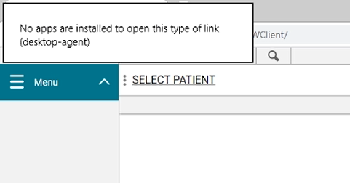
No apps installed error message
The no apps installed error message is a known issue.
This issue may be resolved by Go-Live date.
It has been reported to Allscripts.
Click back on the EHR and it will go away.

Slide 5
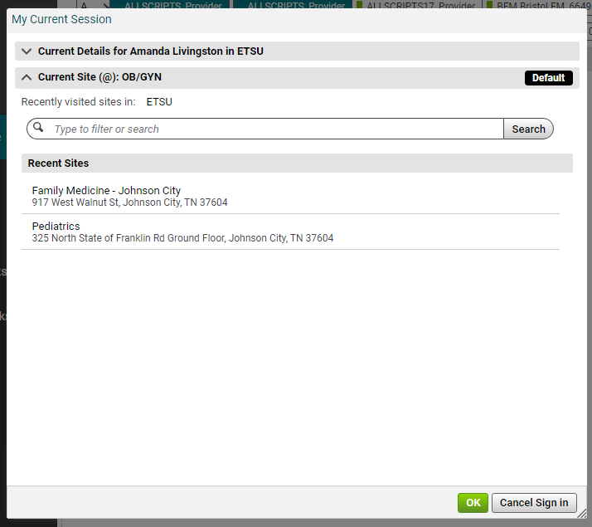
My Current Session
Always, always, always log into the correct site or location.
This is how the orders flow to the nurse or check out staff.
Current Site shows site currently selected.
You can make a site your Default.
Use your Search box to look for a new site or location.

Slide 6
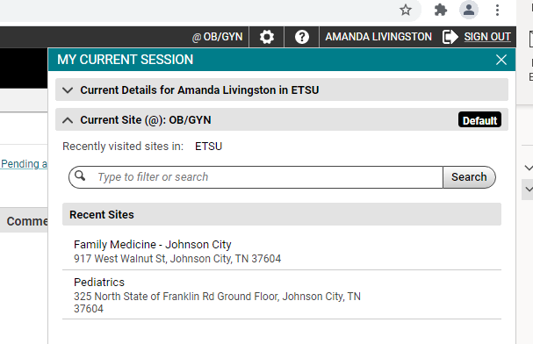
Current Site
Your current site is visible in the upper right corner now.
By clicking on the name of your site, the My Current Session opens back up.
You can change your site from here as well.

Slide 7
Now opens in Chrome
Touchworks should now run in Chrome as recommended by Allscripts.
Touchworks EHR will no longer open in Internet Explorer.

Slide 8
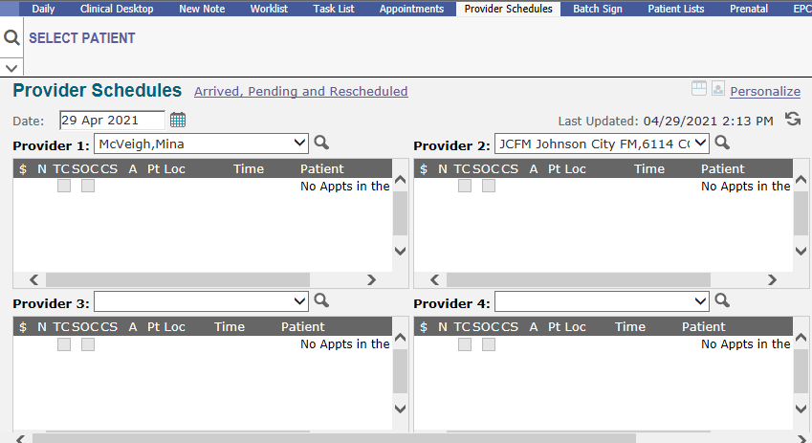
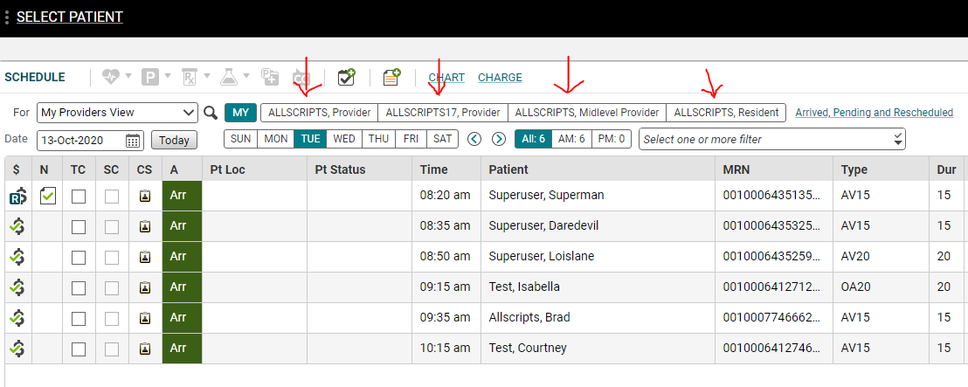
Schedule
The four panel-Provider Schedules is no longer available.
The four different providers are available on the Schedule page as tabs.

Slide 9
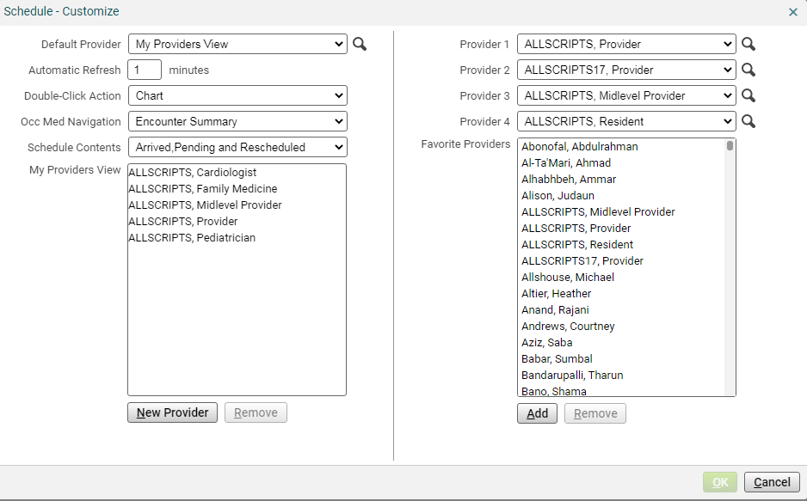
Schedule-Customize
The Schedule-Customize option is accessible from the gear box in the top right.
From within this window, you can create your My Providers View and add Provider 1, Provider 2, Provider 3, and Provider 4 to be shown on the previously mentioned tabs.
The My Providers View did not increase the number of providers that we can load.

Slide 10
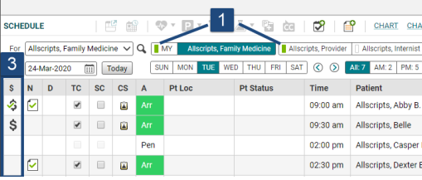
Schedule changes
Green indicator shows new pt arrival behavior since provider’s schedule was last viewed.
The underlined words are jump links to section.
This functionality works throughout Touchworks.

